Slide 1
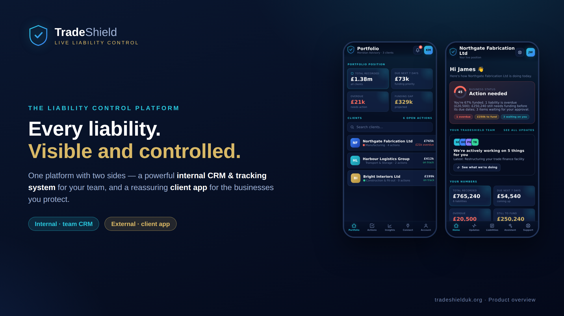
Notes:
TradeShield — the liability control platform. One system, two sides: an internal CRM & tracking tool for your team, and a client app for the businesses you protect. This deck covers the problem, the platform, how it works, and the path to a commercial app.

Slide 2
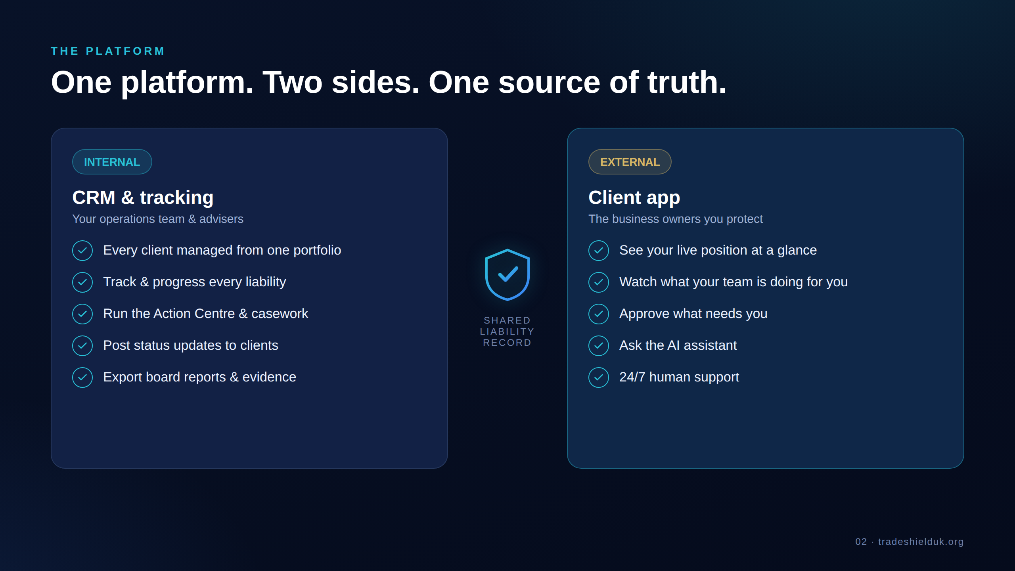
Notes:
The platform has two front doors over one shared liability record. Internally your team runs the CRM & tracking; externally clients get a focused view of their own business. One source of truth feeds both.

Slide 3
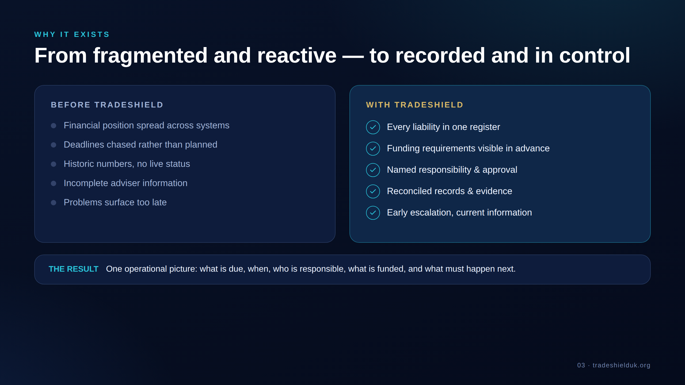
Notes:
Today liability information is fragmented and reactive — spread across systems, deadlines chased. TradeShield makes it recorded and in control: one register, funding visible in advance, clear ownership, early escalation.

Slide 4
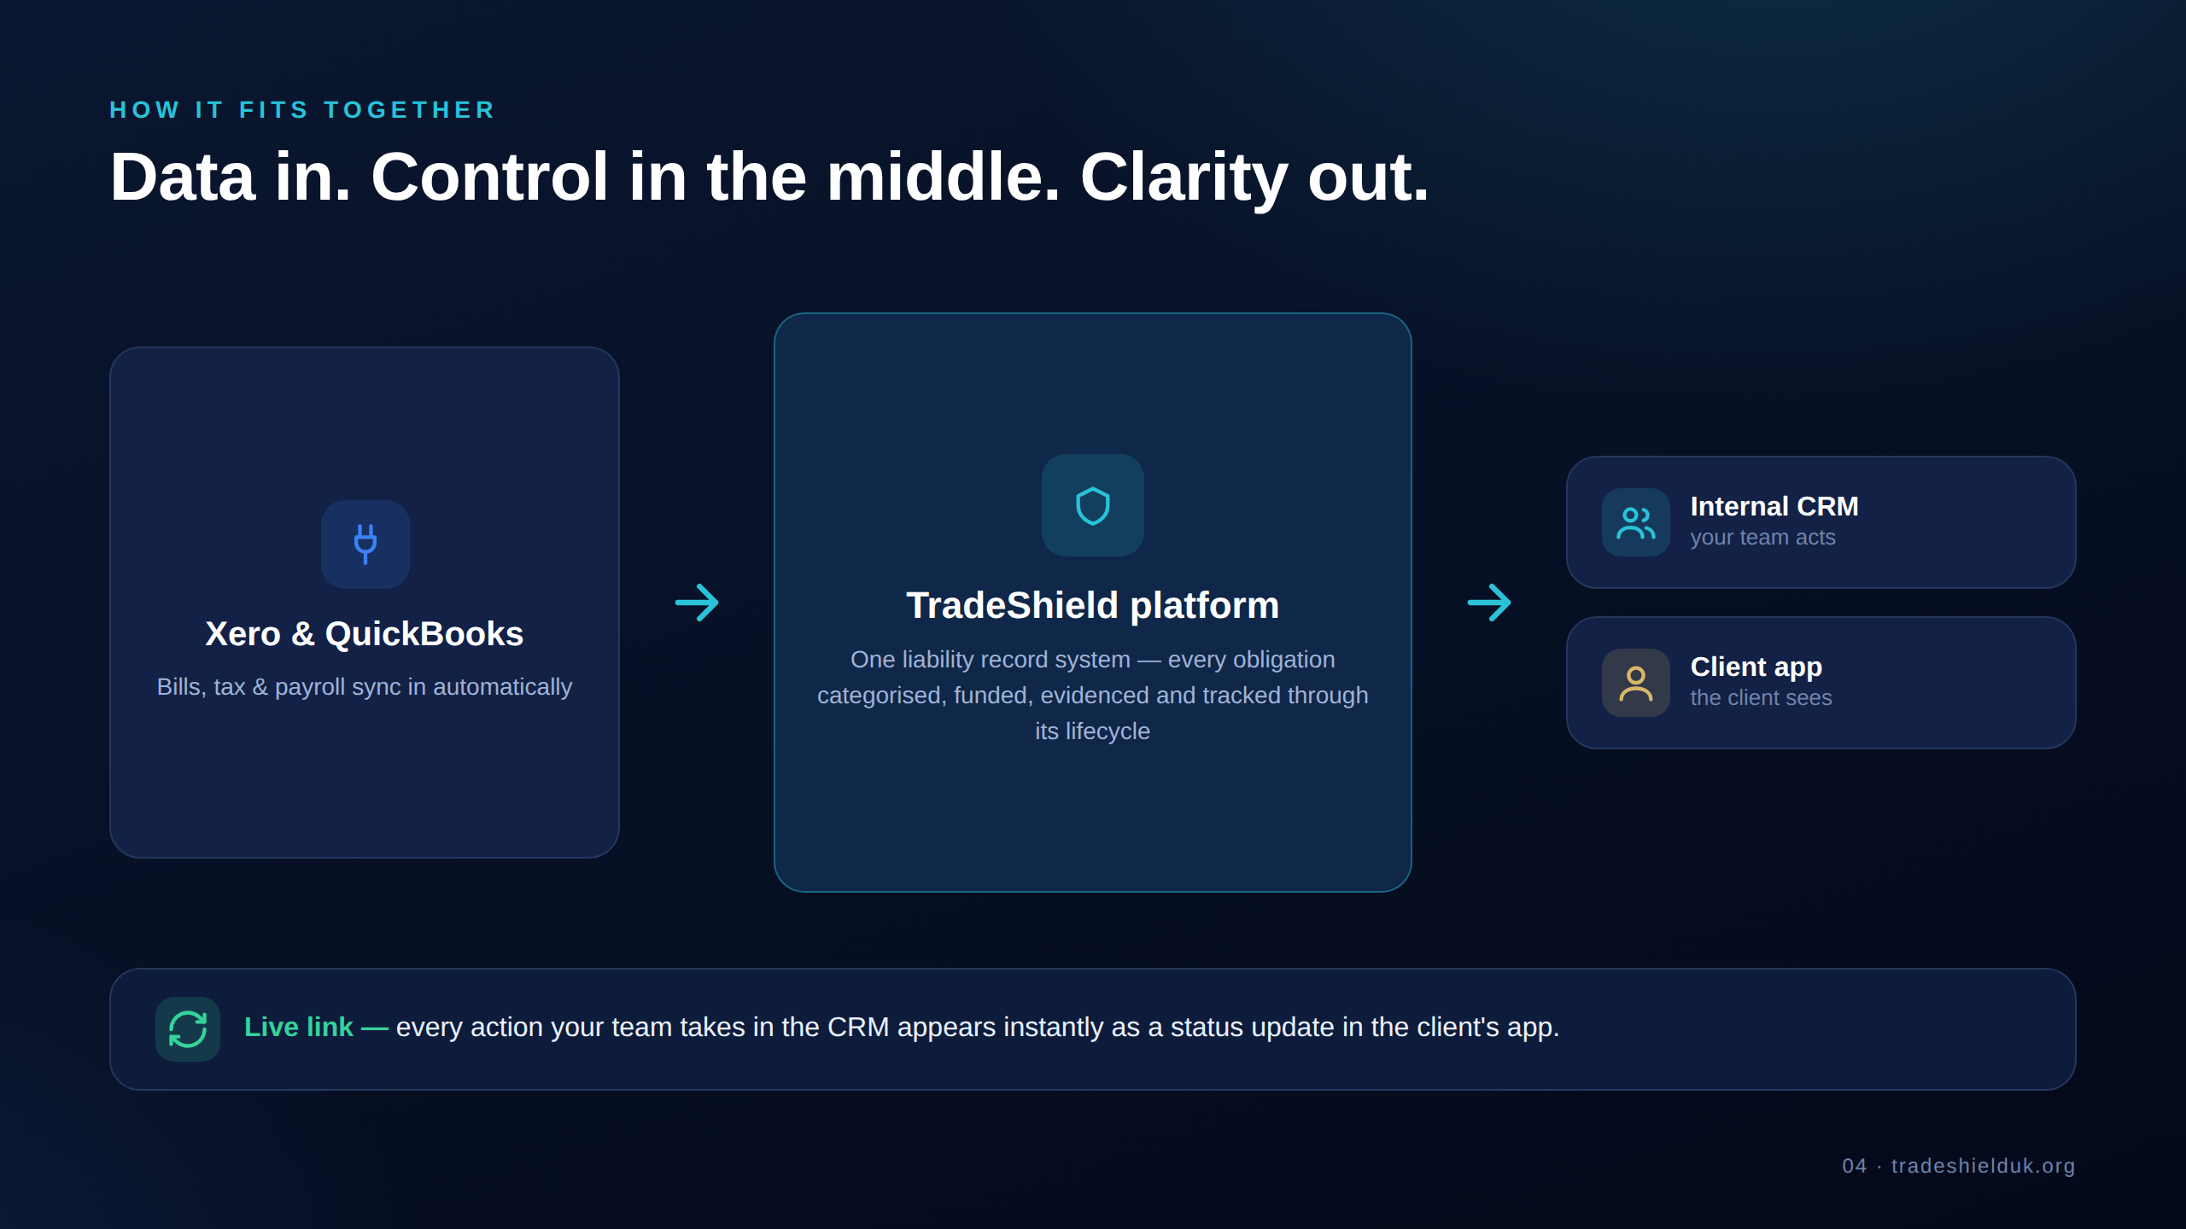
Notes:
How it fits together: accounting data flows in from Xero/QuickBooks, the TradeShield platform is the control layer that records and tracks every liability, and it outputs to two apps. Crucially, every internal action appears live in the client's app.

Slide 5
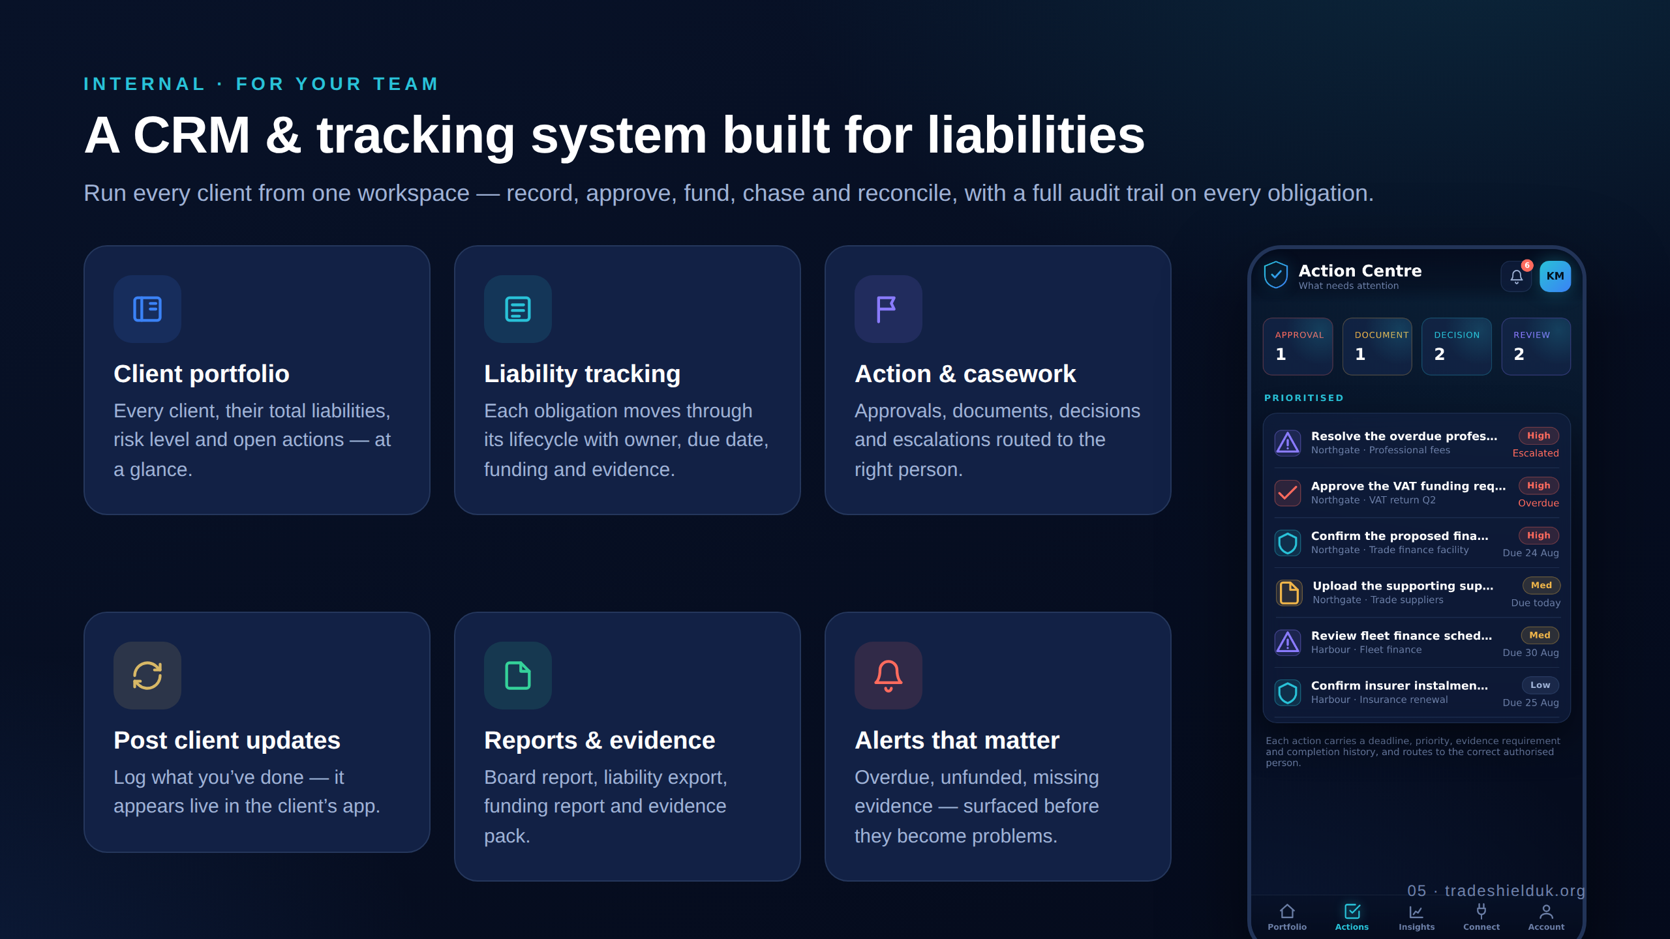
Notes:
Internally, this is a CRM & tracking system built for liabilities: client portfolio, liability tracking through its lifecycle, action & casework, posting client updates, reports & evidence, and alerts that matter.

Slide 6
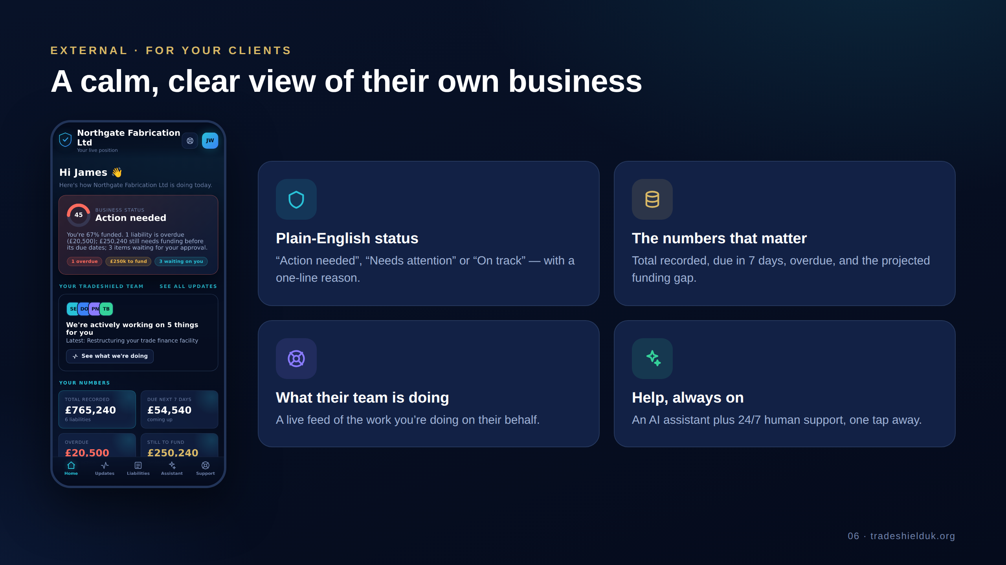
Notes:
Externally, the client app gives a calm, clear view of their own business — a plain-English status, the numbers that matter, what their team is doing, and always-on help.

Slide 7
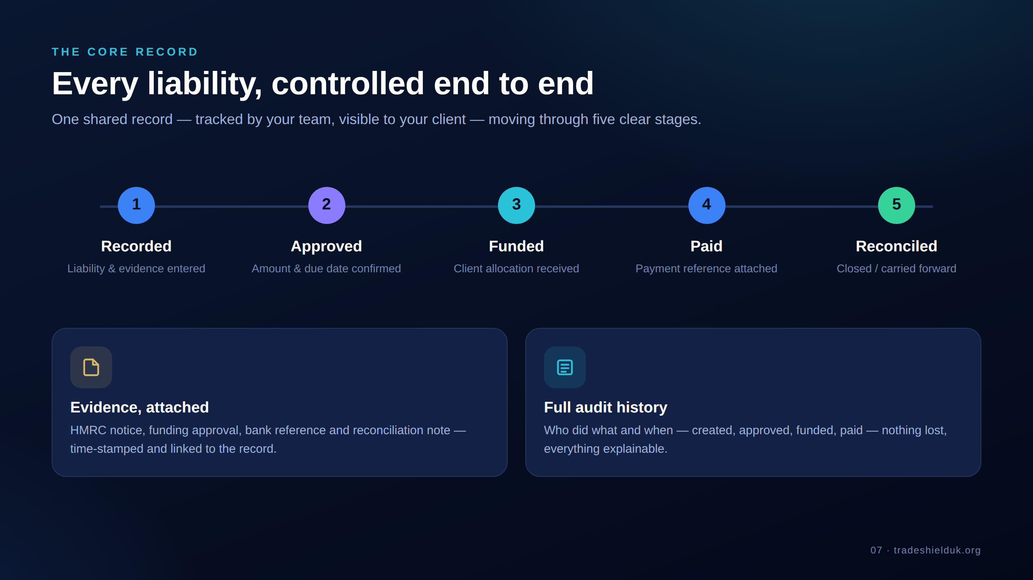
Notes:
The core record: every liability moves through five clear stages — Recorded, Approved, Funded, Paid, Reconciled — carrying its own evidence and full audit history. It's one shared record: your team tracks it, the client sees it.

Slide 8
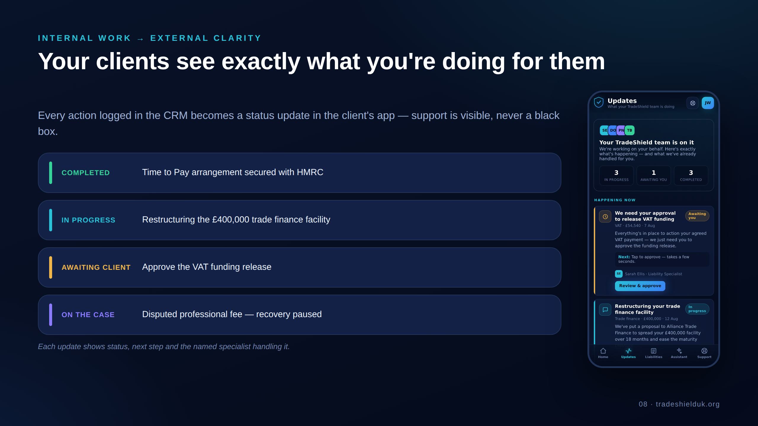
Notes:
Internal work becomes external clarity: every action logged in the CRM becomes a status update in the client's app. Support is visible, never a black box — with status, next step and the named specialist on each.

Slide 9
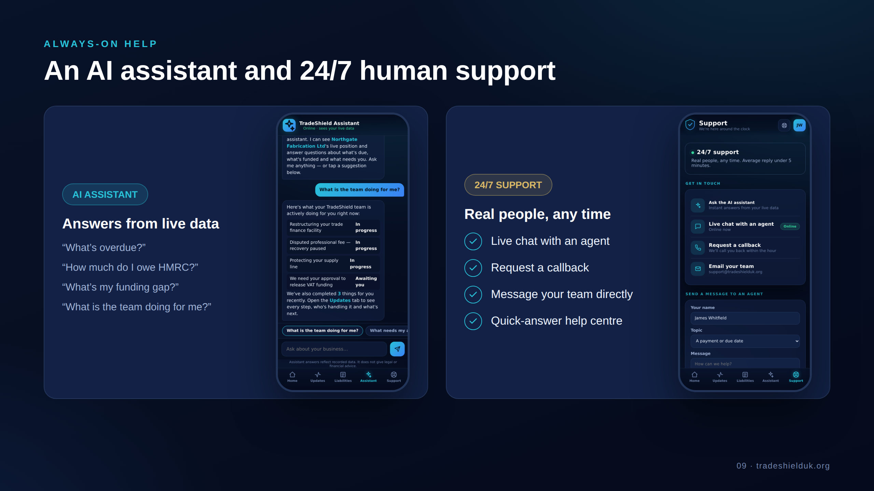
Notes:
Two layers of help: an AI assistant answering instantly from the client's live data, and 24/7 human support — live chat, callback, or a direct message to their team.

Slide 10
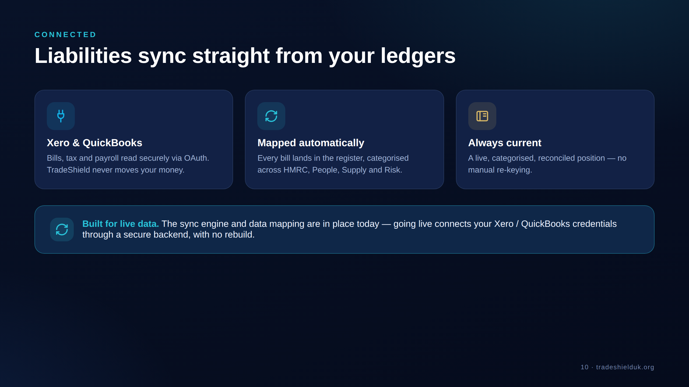
Notes:
Liabilities sync straight from Xero & QuickBooks via secure OAuth — read only, never moving money — mapped automatically into the register and kept current. The sync engine is built; going live connects credentials via a backend.

Slide 11
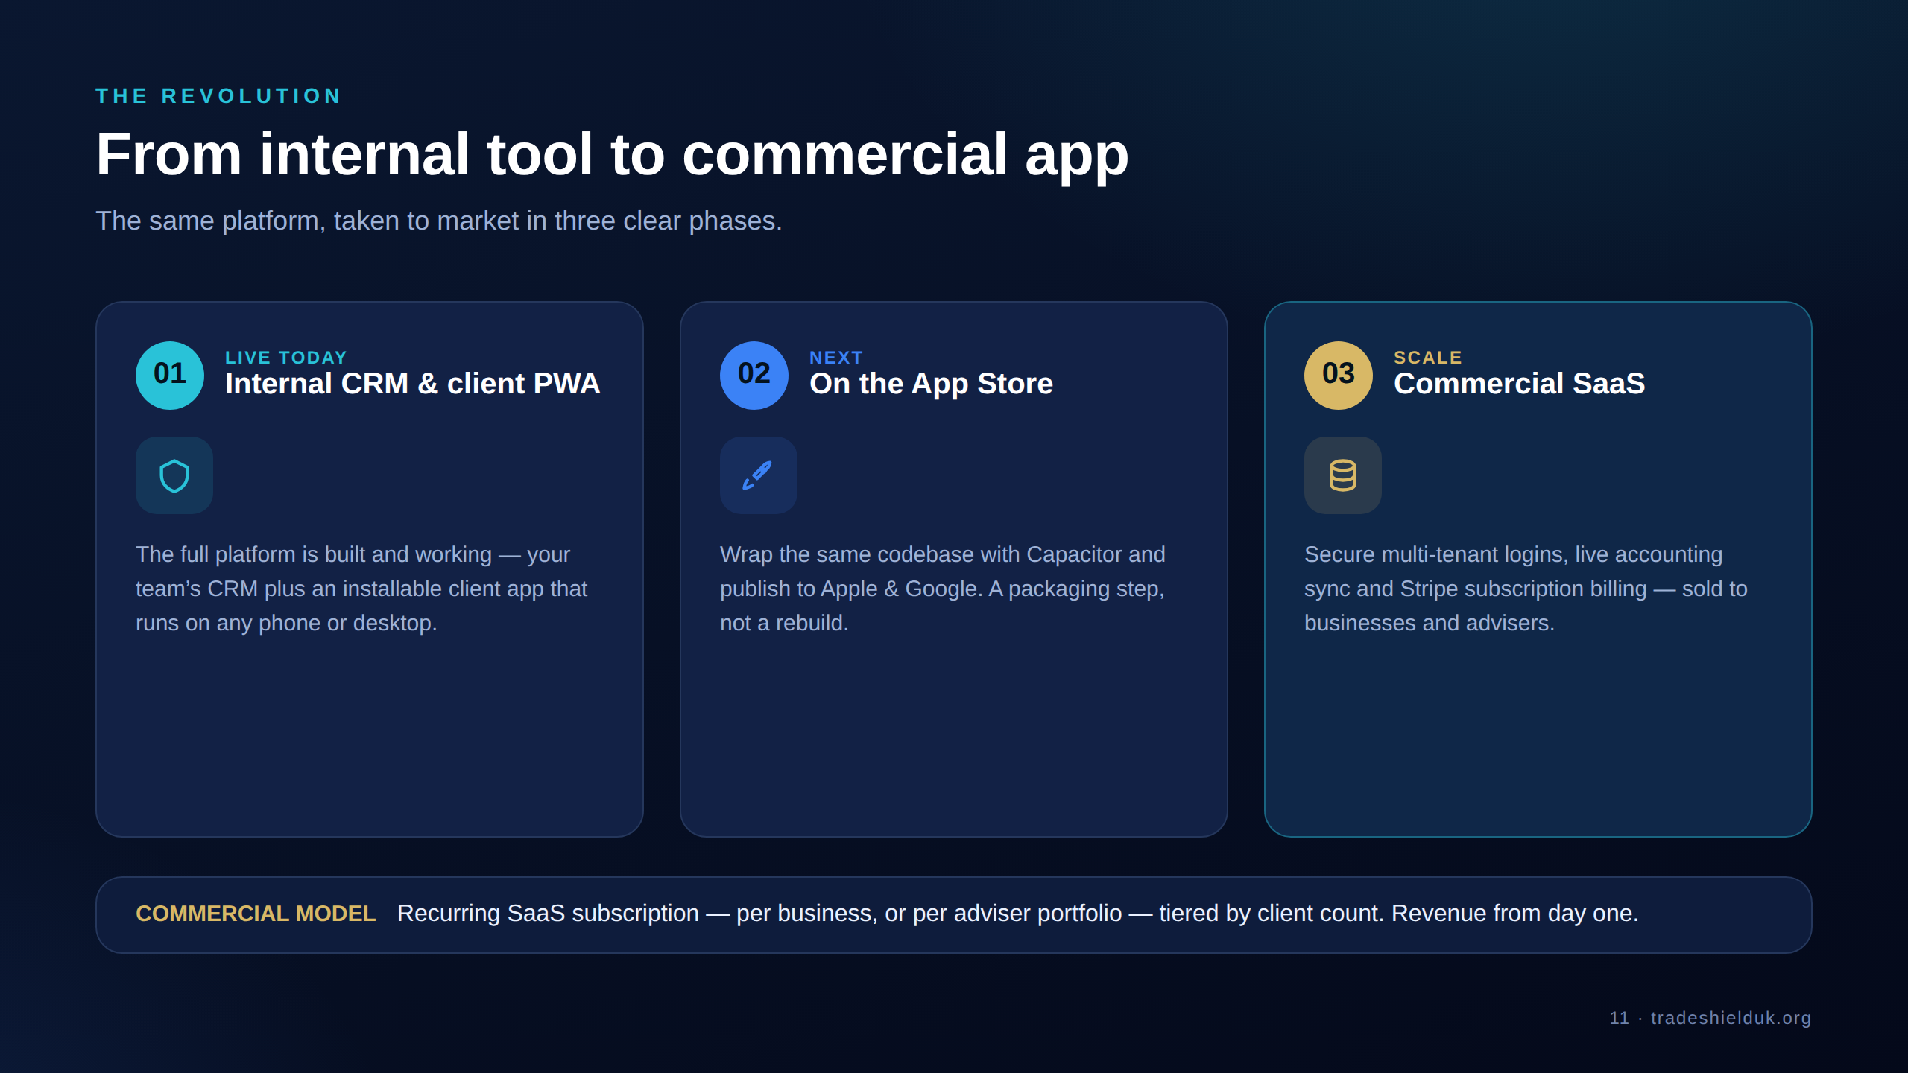
Notes:
The revolution: from internal tool to commercial app, in three phases. Phase 1 is live today (internal CRM + client PWA). Phase 2 wraps the same code for the App Store. Phase 3 adds multi-tenant logins, live sync and Stripe billing. Recurring SaaS revenue, tiered by client count.

Slide 12
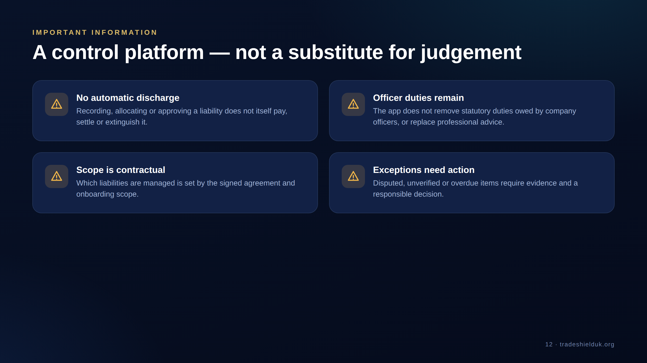
Notes:
An honest, trust-building slide: TradeShield is a control platform, not a substitute for judgement. Recording a liability doesn't pay it, officer duties remain, scope is contractual, and exceptions still need real decisions.

Slide 13
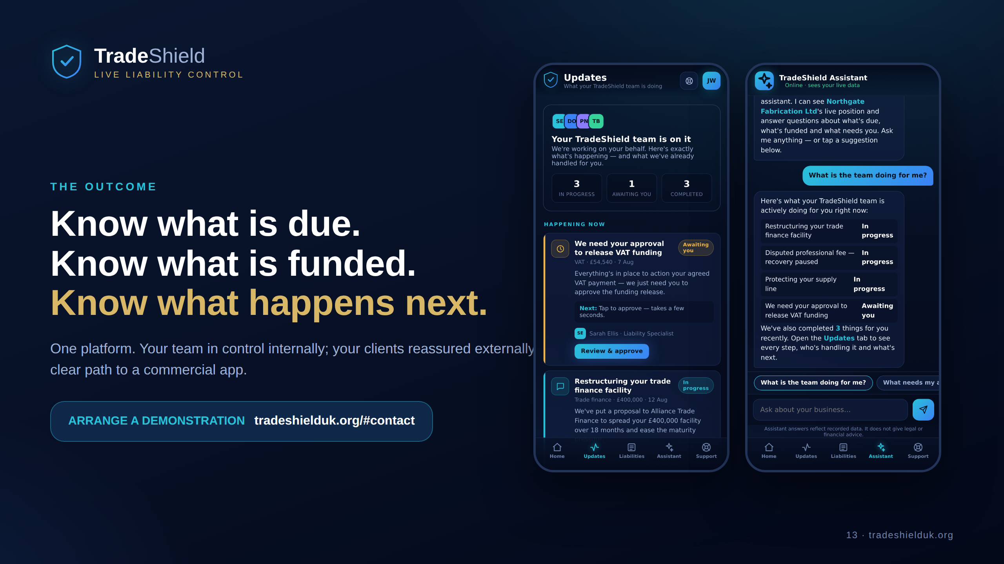
Notes:
Close on the outcome: know what is due, what is funded, and what happens next. One platform — your team in control internally, your clients reassured externally, and a clear path to a commercial app. Arrange a demonstration at tradeshielduk.org/#contact.

