Slide 1
Quantum Computing
&
Quantum Annealing

Slide 2
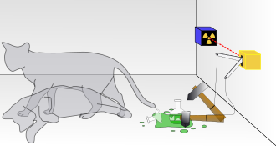
Quantum Computing
exponentially faster than classic computers (in some areas)
in contrast to a classic computer it mimics the way particles work at an atomic level
Notes:
https://en.wikipedia.org/wiki/Shor%27s_algorithm
https://en.wikipedia.org/wiki/Schr%C3%B6dinger%27s_cat

Slide 3



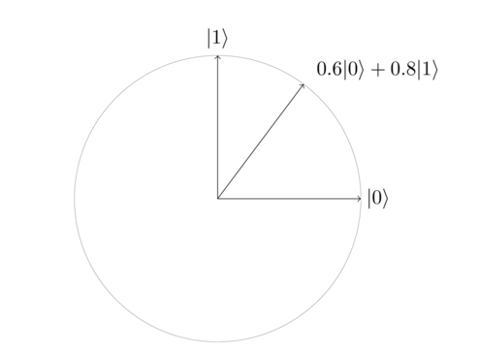
Bit
Qubit
Qubit State
0
1
Notes:
https://www.youtube.com/watch?v=JhHMJCUmq28

Slide 4
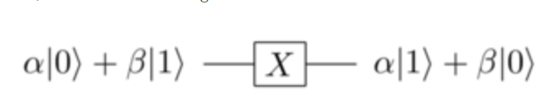
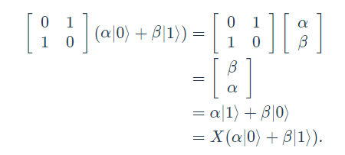

Quantum Logic Gates
Not Gate
Notes:
https://quantum.country/qcvc#part-I

Slide 5





Other Gates
Restrictions
only gates that preserves the “length” can be used:

Slide 6
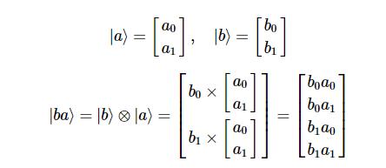
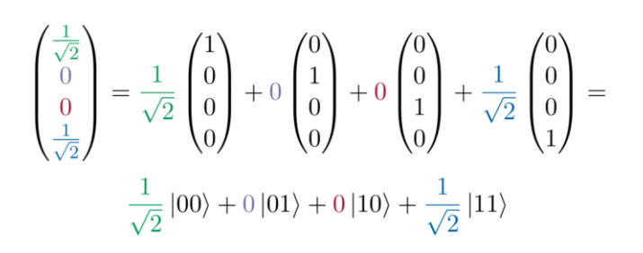

Multiple Qubits

Slide 7
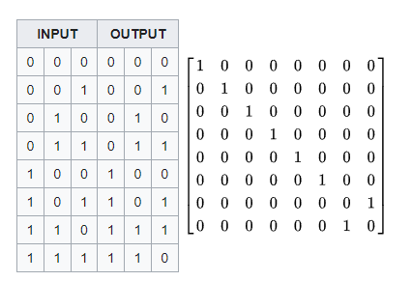
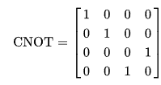

Controlled Not Gate
CCNOT Gate

Slide 8
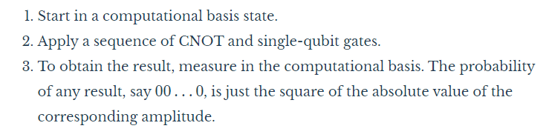
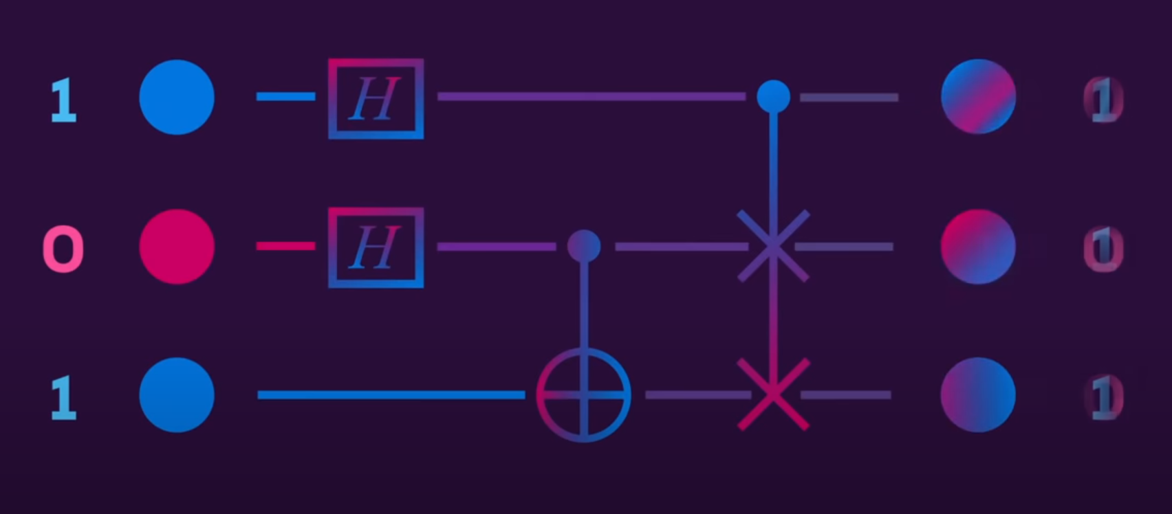
Process of a quantum computer:

Slide 9
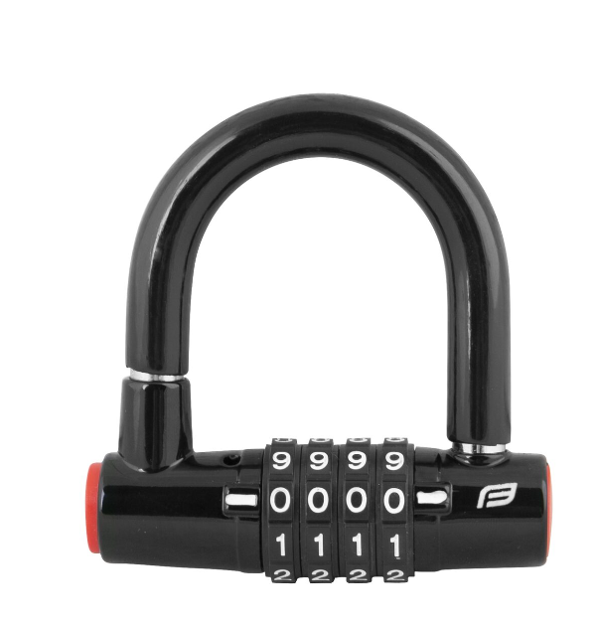
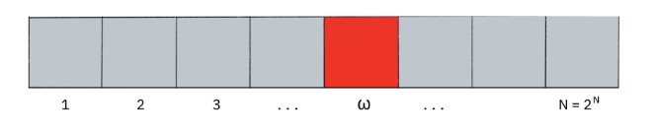
Grover's algorithm
given a large list of items, we wish to locate a particular item
in classical computation this is done in O(N)

Slide 10
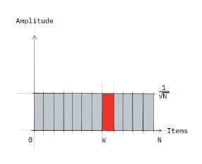
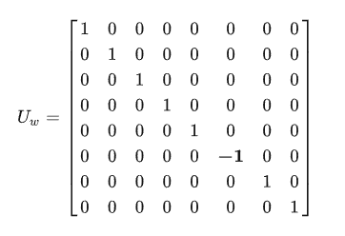
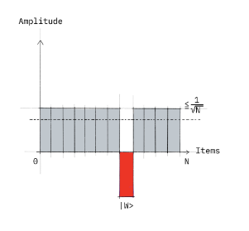
Quantum search
Example of a quantum oracle for w=101

Slide 11
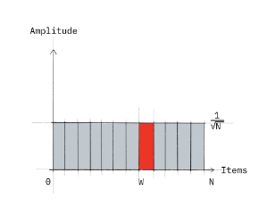
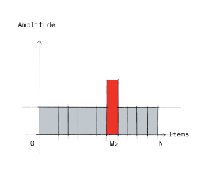
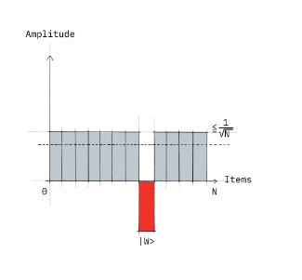
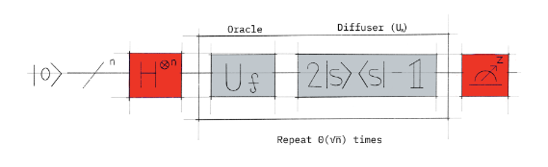
Quantum search
Notes:
https://www.quantamagazine.org/how-pi-connects-colliding-blocks-to-a-quantum-search-algorithm-20200121/
https://quantum-computing.ibm.com/composer/docs/iqx/guide/grovers-algorithm

Slide 12
Genetic Programming
an automated method for creating a working computer program from a high-level problem statement of a problem
it starts from a high-level statement of “what needs to be done” and automatically creates a computer program to solve the problem
especially used for symbolic regression
for Quantum Computing Linear Genetic Programming can be used
Notes:
https://drive.google.com/drive/folders/0B2V3iLlOUk15fnpIZzJnc2tZYUJwTmdoUWJDOEIzR29LZ29mbTVKUVMySVViWTh6WHl0ZTg?resourcekey=0-xJEuENAMguR4fEzY9LM6kA
https://docs.google.com/presentation/d/1_vt8IEZ_Qllz2OFYOem4HkKxS0wAd12o/edit

Slide 13
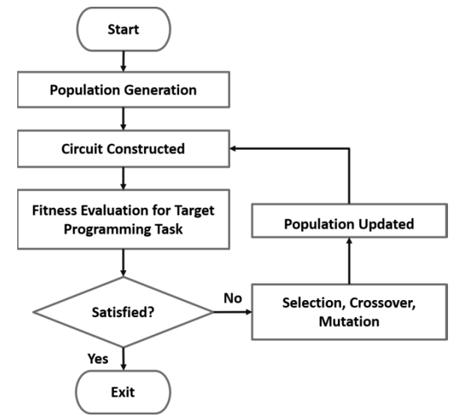

Linear Genetic Programming for Quantum Computing

Slide 14
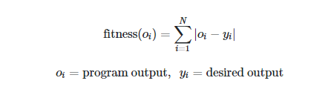
Target
generate a quantum program that performs quantum search for N items
this program should work for any input function (e.g. for any oracle)
Fitness function
Mutation(s)
index + gate mutation
index mutation
gate mutation
permutation

Slide 15
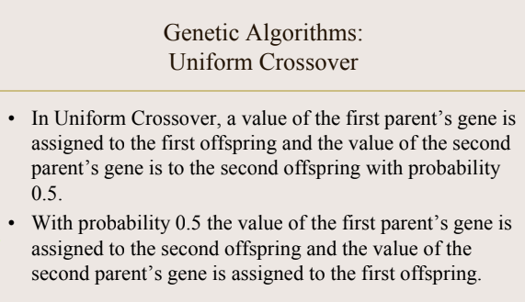
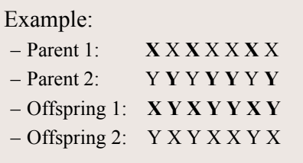
Crossover

Slide 16
Example of generated programs for 2-qubits
:(H(2))
:(H(1))
:(oracle(w))
:(H(1))
:(H(1))
:(H(1))
:(Z(1))
:(CZ(2, 2))
:(H(2))
:(X(1))
:(CZ(2, 1))
:(H(1))
:(H(2))
:(H(2))
:(H(1))
:(oracle(w))
:(H(1))
:(X(1))
:(H(2))
:(H(1))
:(CNOT(2, 1))
:(CNOT(1, 1))
:(X(1))
:(CZ(1, 1))
:(H(2))
:(Z(1))
:(X(1))
:(H(1))
:(H(2))
:(Z(1))
:(Z(2))
:(oracle(w))
:(H(2))
:(H(2))
:(Z(1))
:(H(1))
:(CNOT(1, 2))
:(Z(2))
:(H(1))
Notes:
https://quantum-computing.ibm.com/
https://quantum-computing.ibm.com/composer/files/74d5734269a79c820a6e8262e53cbda00cc247175a2a3c5cd756b930e1539b4d

Slide 17
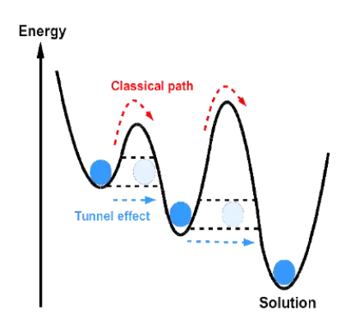
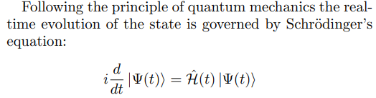
Quantum Annealing
physical systems tend to be in the lowest energy state, called the ground state
we encode the information of our optimization problem into a physical system in a way that its ground state is the solution of our problem
the program evolves to the ground state naturally, without using quantum gates
Notes:
https://www.youtube.com/watch?v=zvfkXjzzYOo

Slide 18
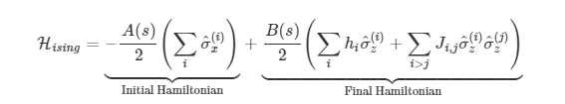
In D-WAVE
initial Hamiltonian: equal superposition for all qubits so that is easy to prepare
final Hamiltonian: represents the optimization problem that is desired to be solved

Slide 19
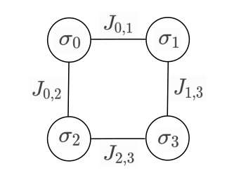

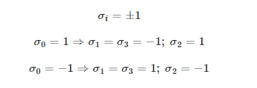
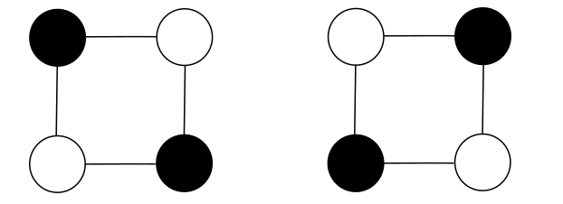

Slide 20
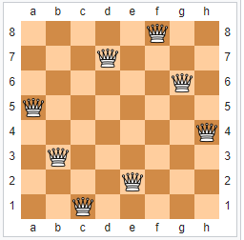
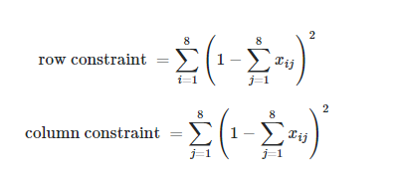

Slide 21
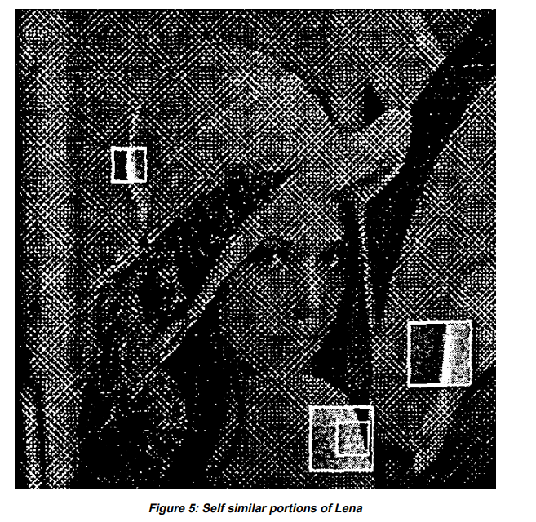
Fractal Image Compression

