Slide 1
MARVEL FIT STUDIOS
Operational & Financial Management Operating System
System Valuation & Architecture Overview Document
Full-Stack Next.js 16
Supabase PostgreSQL
Role-Based Access
Automated Financial Ledger
Clinical Injury Tracking
Confidential — Prepared for System Pricing & Valuation Assessment

Slide 2
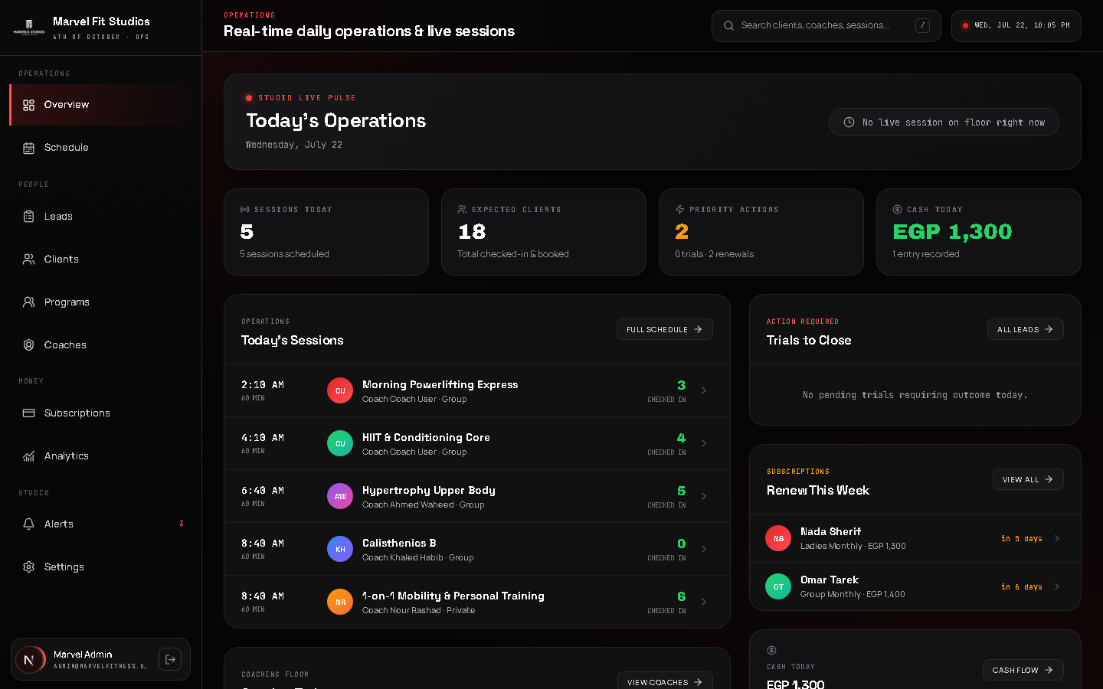
EXECUTIVE SUMMARY
1. Unified Operating System Replacing Disconnected Tools
Fragmented Tools vs. One Workspace
Replaces scattered spreadsheets, WhatsApp groups, manual receipts, and notebook tracking with a single central platform.
Complete Operational Visibility
Provides live studio pulse, roster check-ins, automated renewal alerts, and audited daily cash movement.
Role-Tailored Security & Workspaces
Separate high-security Admin Command Center and Coach Workspaces ensuring data privacy and operational focus.
Turn-Key Production Readiness
Engineered with zero technical debt, complete test coverage, automated migrations, and enterprise-grade resilience.

Slide 3

OPERATIONAL WORKSPACES
2. Role-Based Workspaces: Admin & Coach Control Centers
Admin Command Center
Real-time studio stats, live floor pulse, pending trial actions, upcoming renewals, and cash ledger controls.
Coach Floor Workspace
Focused mobile & desktop view for coaches with assigned clients, roster check-in, and injury flags.
Strict Permission Boundaries
Coaches access only floor attendance and client medical context — administrative revenue data remains locked.
Instant Action Triggers
One-click attendance check-in, quick lead follow-ups, and direct WhatsApp client messaging.

Slide 4
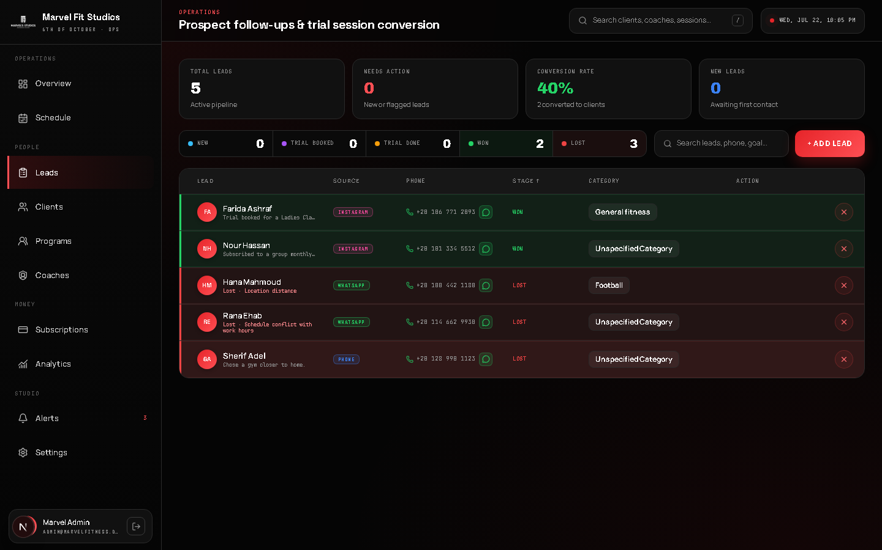
LEAD MANAGEMENT
3. Prospect Acquisition & Lead Conversion Pipeline
Structured Acquisition Stages
Tracks leads through New → Trial Booked → Trial Done → Won / Lost conversion funnel.
Trial Session Integration
Links prospective members directly to group trial sessions with automated outcome tracking.
Loss Reason Analytics
Captures detailed reasons for lost leads (location, timing, pricing) for business intelligence.
One-Click Lead Conversion
Converts successful trials into active client profiles and subscriptions seamlessly.

Slide 5
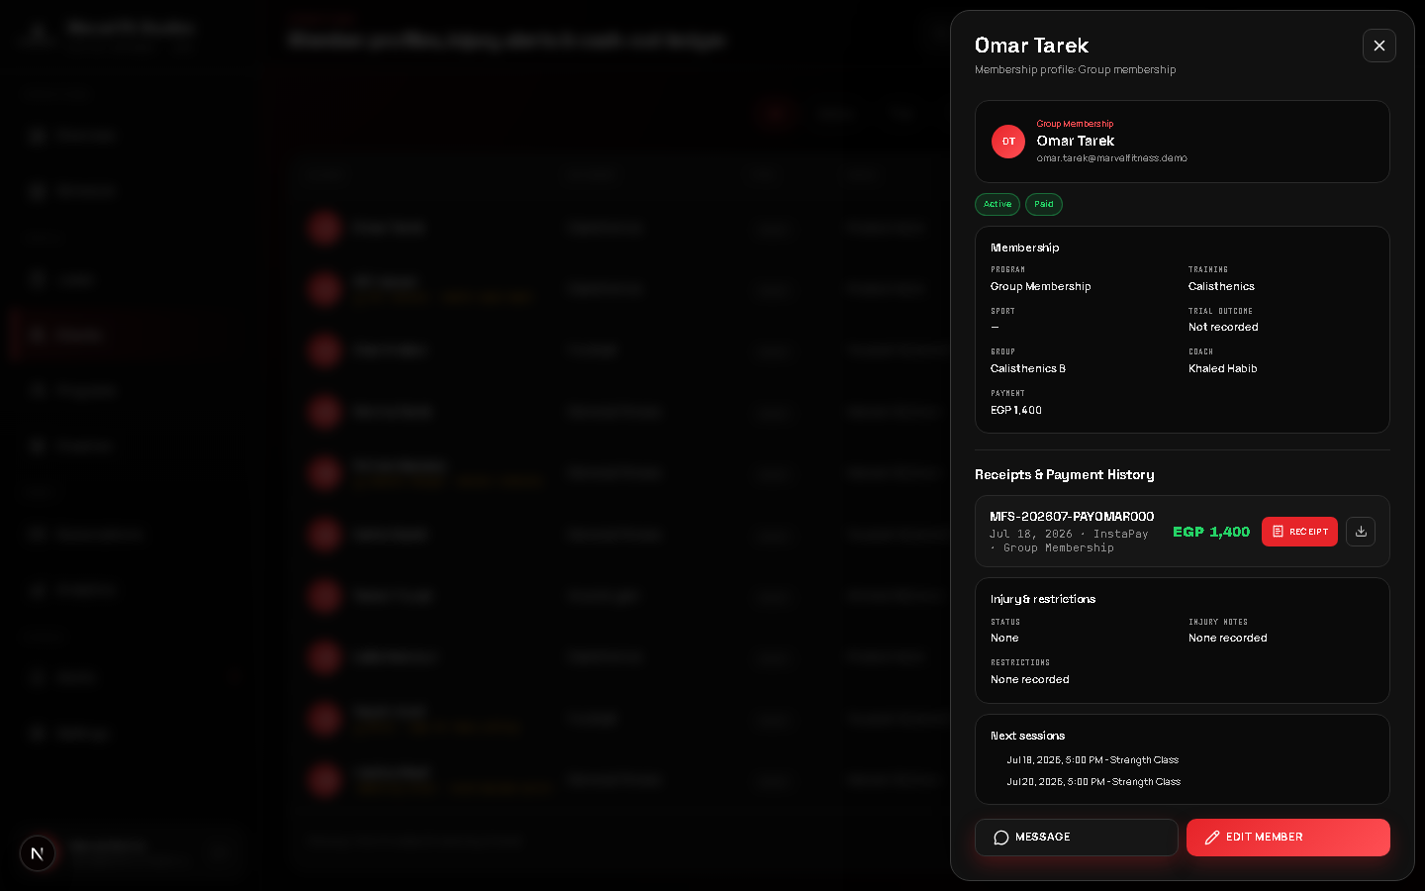
CLIENT DOSSIERS
4. Member Intelligence & Clinical Injury Prevention
360-Degree Client Dossiers
Centralized member profiles containing membership history, assigned coach, category, and receipts.
Clinical Injury Flags
Real-time warning badges for ACL, meniscus, lumbar strains, and movement restrictions across all views.
Floor-Level Safety Rules
Ensures coaches and admins see injury notes directly on class rosters to prevent aggravated injury.
Direct Communication
Integrated WhatsApp link for instant client messaging directly from their dossier.

Slide 6
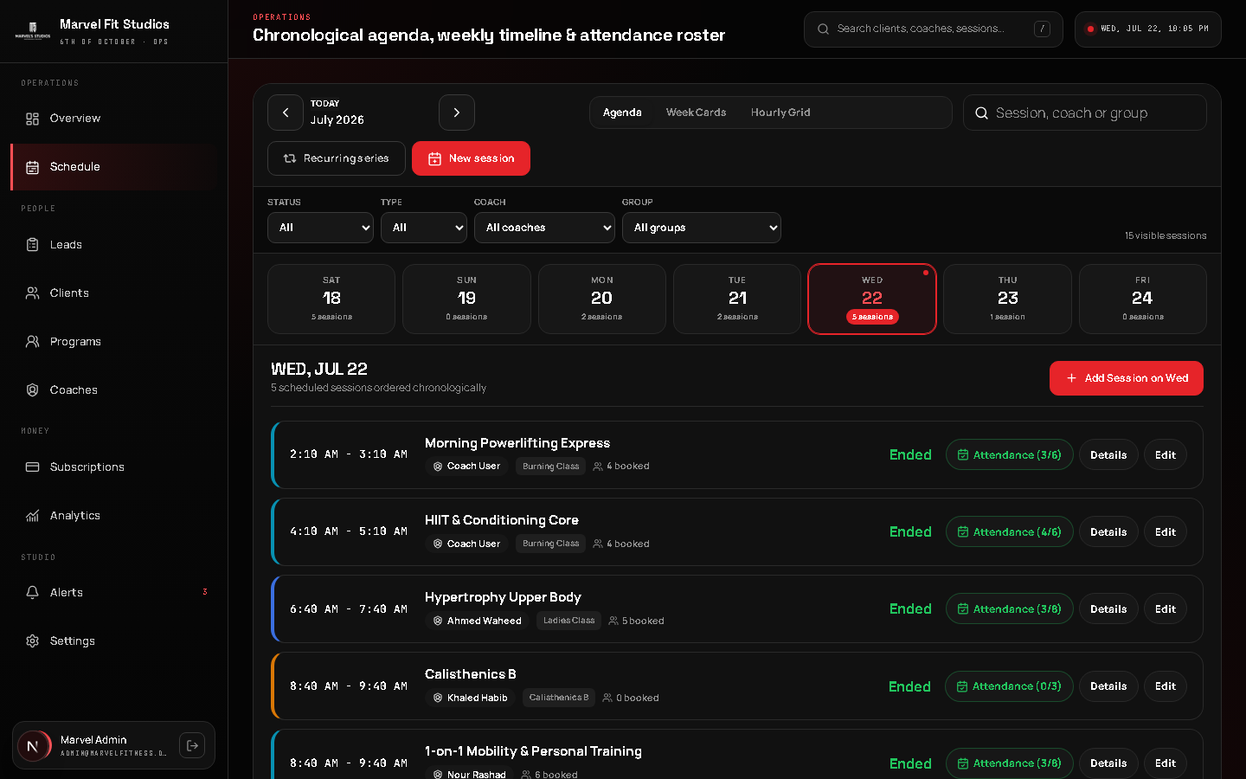
SCHEDULING & ATTENDANCE
5. Dynamic Weekly Scheduling & Roster Attendance
Multiple Schedule Views
Chronological Agenda, Week Cards, and Hourly Grid views tailored for high-volume studio scheduling.
Real-Time Live Status
Automated status badges indicating 🔴 Live Now, Upcoming, or Ended sessions based on Cairo time.
Granular Attendance States
Track Attended, Late, Missed, and Excused attendance with mandatory excuse notes.
Recurring Session Automation
Manage weekly group templates and generate recurring occurrences with exception handling.

Slide 7
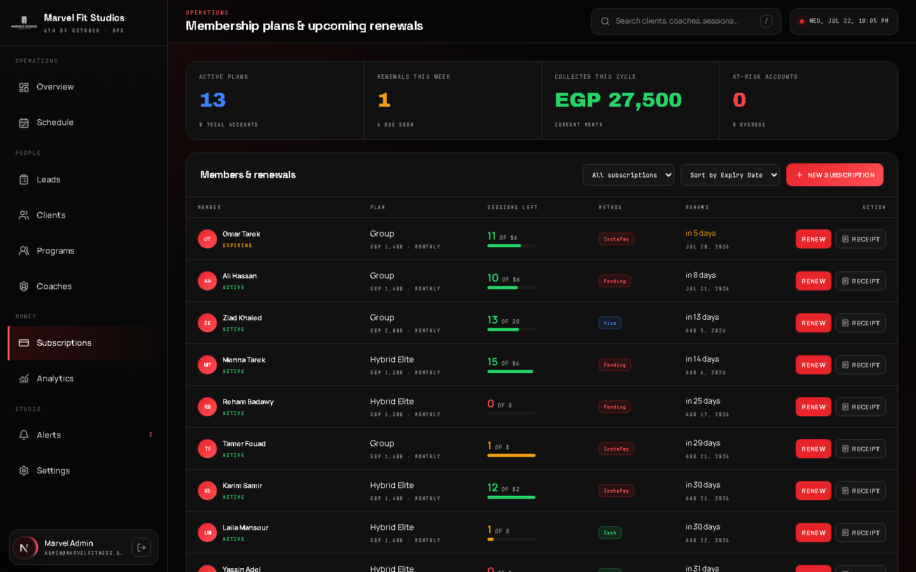
SUBSCRIPTION MANAGEMENT
6. Subscription Lifecycle & Automated Payment Ledger
Flexible Membership Plans
Supports Group, Private, and Hybrid subscription plans with session count limits.
Session Balance Tracking
Automatically decrements remaining sessions upon attendance check-in with low-balance alerts.
Subscription Controls
Full lifecycle actions: Pause, Resume, Cancel, and Renew subscriptions with date precision.
Auditable Digital Receipts
Generates branded digital receipts with unique receipt numbers and instant PDF export.

Slide 8
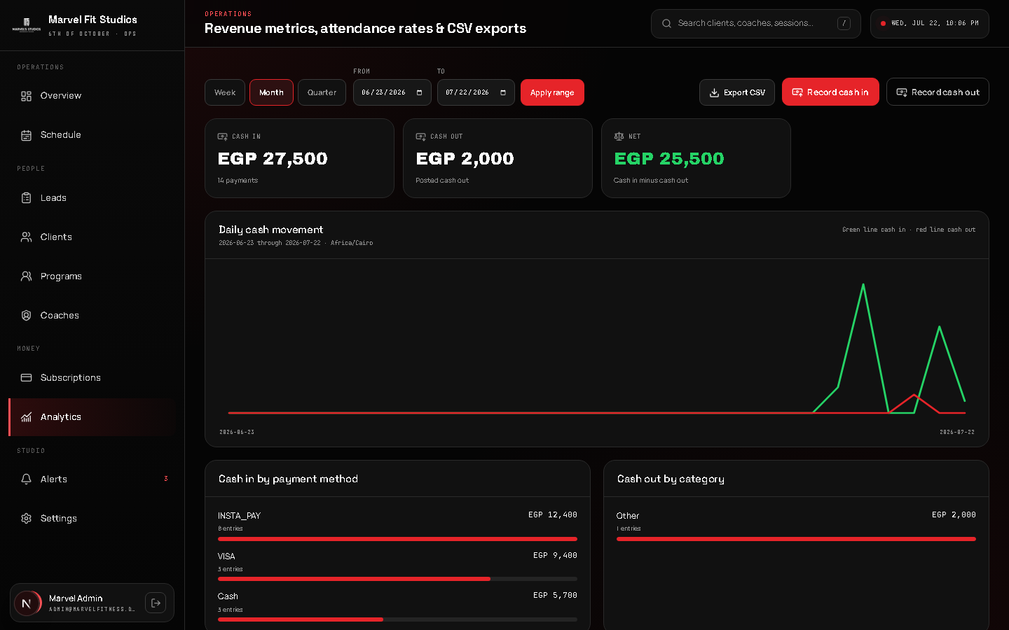
FINANCIAL ANALYTICS
7. Financial Operations & Cash Movement Audit
Real-Time Cash Flow Ledger
Tracks cash-in receipts and categorised cash-out expenditures with net movement calculations.
Payment Method Breakdown
Monitors revenue distribution across InstaPay, Visa, Cash, and Bank Transfers.
Date Range Filtering
Filter financial reports by custom date ranges, weekly, monthly, or quarterly periods.
CSV Data Export
One-click export of complete financial ledgers for external accounting and tax compliance.

Slide 9
TECHNICAL ARCHITECTURE & SECURITY
8. Full-Stack Next.js 16 App Router & Enterprise Security Stack
Frontend & UI Framework
Database & Security Boundary
Next.js 16.2 App Router, React 18, TypeScript 5, Radix UI primitives, Lucide Icons, and 100% custom CSS token design system.
Supabase PostgreSQL database with Row Level Security (RLS), transactional RPC functions, and server-only service role boundary.
Auth & Access Control
Testing & Production Verification
Auth.js v5 JWT credentials authentication, bcrypt password hashing, forced password change flow, and strict role permissions.
Vitest unit & contract suites, Playwright E2E browser tests, ESLint, TypeScript checks, and automated Vercel deployment pipeline.

Slide 10
COMMERCIAL ASSET EVALUATION
9. System Commercial Assets & Valuation Highlights
Turn-Key Operational Product
Proprietary IP & Custom Code
Fully functional, production-ready fitness studio operating system ready for immediate commercial deployment.
100% bespoke codebase (no generic templates), custom design system, and studio domain logic.
Scalable SaaS Architecture
High Market Demand Domain
Structured data model easily adaptable for multi-branch studio chains or SaaS multi-tenant licensing.
Solves high-friction daily operational challenges for fitness studios, gyms, and sports academies.

