Slide 1
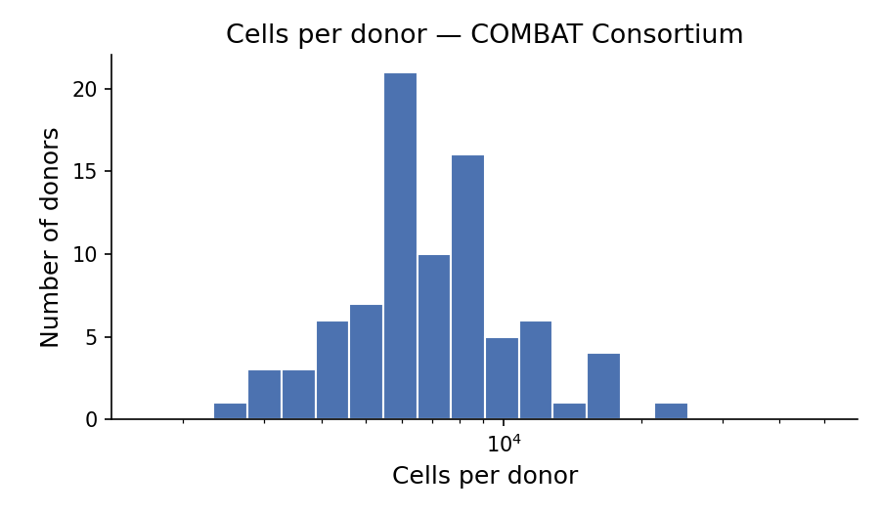
COMBAT Consortium
COMBAT Consortium, Cell (2022)
Tissue | Whole blood (PBMCs)
scRNA-seq technology | 10x 5' v1
Total cells (post-QC) | 637,266
Total donors | 85
Control | 10
Mild | 29
Severe | 46

Slide 2
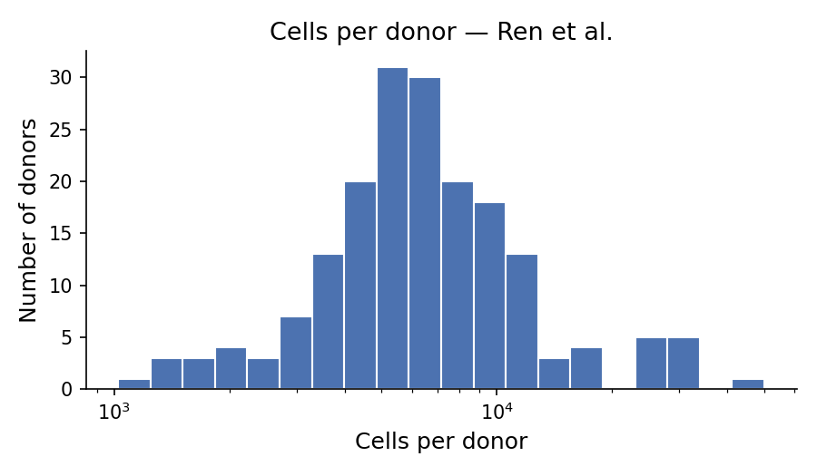
Ren et al.
Ren et al., Cell (2021)
Tissue | PBMCs + airway samples
scRNA-seq technology | 10x 3' v3, 10x 5' v2
Total cells (post-QC) | 1,456,806
Total donors | 185
Control | 25
Mild | 77
Severe | 83

Slide 3
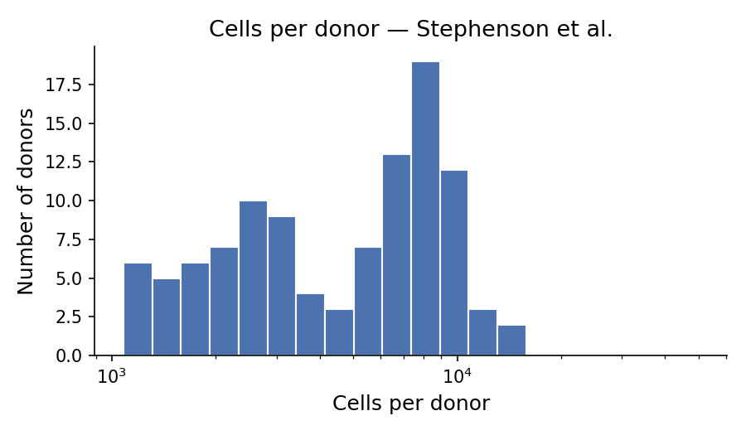
Stephenson et al.
Stephenson et al., Nature Medicine (2021)
Tissue | Whole blood (PBMCs)
scRNA-seq technology | 10x 3' transcription profiling
Total cells (post-QC) | 585,153
Total donors | 106
Control | 23
Mild | 55
Severe | 28

