Slide 1
“Maze Solver Using BFS”
By
Shahir Anzal
Zaeem Baig

Slide 2
Aim:
The Aim of this is Project is to implement BFS algorithm learned in our course “Data Structure and Algorithm”
We are implementing BFS algorithm to solve a maze using shortest path using python Data structures

Slide 3
Introduction:
What is BFS algorithm?
Breadth-first search (BFS) is an algorithm for traversing or searching tree or graph data structures. It starts at the tree root (or some arbitrary node of a graph, sometimes referred to as a 'search key'), and explores all of the neighbor nodes at the present depth prior to moving on to the nodes at the next depth level

Slide 4
Advantages:
BFS is simple to implement.
BFS can be applied to any search problem.
BFS does not suffer from any potential infinite loop problem compared to DFS. The infinite loop problem may cause the computer to crash, whereas DFS goes deep down searching.
BFS will always find the shortest path if the weight on the links are uniform. So BFS is complete and optimal.

Slide 5
Disadvantages:
As discussed, memory utilization is poor in BFS, so we can say that BFS needs more memory than DFS.
BFS is a ‘blind’ search; that is, the search space is enormous. The search performance will be weak compared to other heuristic searches.

Slide 6
Implementation of “BFS” to solve maze
Algorithm:
1) first we find the starting point.
2) Find empty spaces around starting point.(“True path”)
3) append the possible path found, in a queue.(“it will be a string in list” )
4)Repeat the steps 1,2,3 for every child paths
5)If child path equals to end path pop the total path from queue

Slide 7
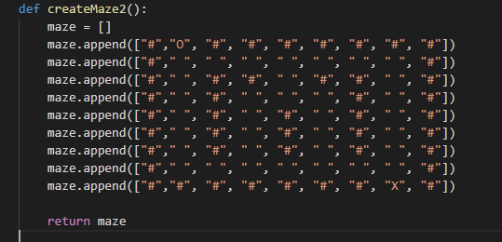
Input 1

Slide 8
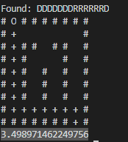
Output 1 :

Slide 9
Run time analysis
Running Time | Size of input
3.498971462249756 | 9x9
0.0009992122650146484 | 3x3

Slide 10
Libraries used:
Time
Queue
Turtle

Slide 11
Time complexities
The Time complexity of BFS is O(V + E) when Adjacency List is used and O(V^2) when Adjacency Matrix is used,

Slide 12
Project Outcome:
We learned how to solve maze using shortest path using algorithms learned in DSA like BFS algorithms and also learned some pros and cons of using BFS algorithm to solve maze like time complexity and real world challenges faced while implementing Data structure and algorithms which seems quite simple while learning

