Slide 1
ClimbOn Rock Climbing Database
Devon Cash
Dakota Zaengle

Slide 2
Problem Statement
We aim to provide a website anyone can access to find and share new and interesting rock climbing locations.
Functionality
Anyone can view most of the website content
Locations are divided into: outdoor climbing sites, gyms, and stores. All three can be reviewed by logged in users.
Outdoor sites and gyms also display the climbing routes they have available.
Users can create new outdoor sites and suggest new gyms/stores.
Users can add routes to gyms and outdoor sites.
Admins can approve suggested gyms/stores.

Slide 3
Website Layout
About
Home
Login
New Account
Profile
Gym
Outdoors
Store
Climbing Route
Review

Slide 4
Website Design
Simplicity
Bootstrap Sidebar
Some AJAX
Modal Login/Reviews/Routes

Slide 5
Implementation: Programming
HTML/CSS/JAVASCRIPT/PHP
Used Javascript to display Modals and update content. Also used for sidebar.

Slide 6
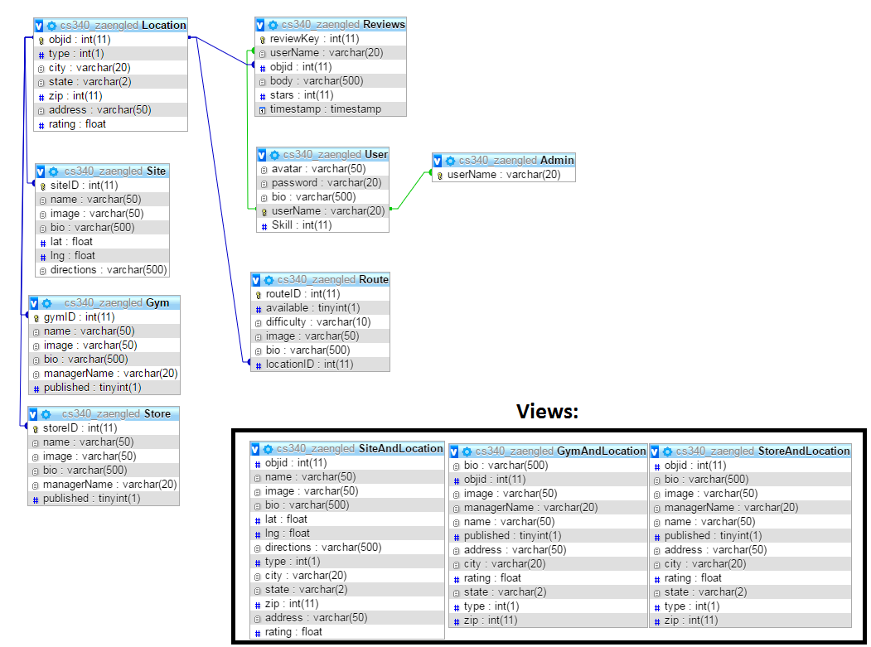
Implementation: Database

Slide 7
Implementation: SQL
CREATE TABLE `Gym` (
`gymID` int(11) NOT NULL,
`name` varchar(50) NOT NULL,
`image` varchar(50) DEFAULT NULL,
`bio` varchar(500) NOT NULL,
`managerName` varchar(20) DEFAULT NULL, `published` tinyint(1) NOT NULL
) ENGINE=InnoDB DEFAULT CHARSET=utf8;
CREATE TABLE `Reviews` (
`reviewKey` int(11) NOT NULL,
`userName` varchar(20) NOT NULL,
`objid` int(11) NOT NULL,
`body` varchar(500) NOT NULL,
`stars` int(11) NOT NULL,
`timestamp` timestamp NOT NULL DEFAULT CURRENT_TIMESTAMP
) ENGINE=InnoDB DEFAULT CHARSET=utf8;
CREATE TABLE `Location` (
`objid` int(11) NOT NULL,
`type` int(1) NOT NULL DEFAULT '0’,
`city` varchar(20) NOT NULL,
`state` varchar(2) NOT NULL,
`zip` int(11) NOT NULL, `address` varchar(50) NOT NULL, `rating` float DEFAULT NULL
) ENGINE=InnoDB DEFAULT CHARSET=utf8;
CREATE TABLE `Route` (
`routeID` int(11) NOT NULL,
`available` tinyint(1) NOT NULL,
`difficulty` varchar(10) NOT NULL,
`image` varchar(50) DEFAULT NULL,
`bio` varchar(500) NOT NULL,
`locationID` int(11) NOT NULL
) ENGINE=InnoDB DEFAULT CHARSET=utf8;
CREATE TABLE `Site` (
`siteID` int(11) NOT NULL,
`name` varchar(50) NOT NULL,
`image` varchar(50) DEFAULT NULL,
`bio` varchar(500) NOT NULL,
`lat` float DEFAULT NULL,
`lng` float DEFAULT NULL,
`directions` varchar(500) DEFAULT NULL
) ENGINE=InnoDB DEFAULT CHARSET=utf8;
CREATE TABLE `Store` (
`storeID` int(11) NOT NULL,
`name` varchar(50) NOT NULL,
`image` varchar(50) DEFAULT NULL,
`bio` varchar(500) NOT NULL,
`managerName` varchar(20) DEFAULT NULL, `published` tinyint(1) NOT NULL
) ENGINE=InnoDB DEFAULT CHARSET=utf8;
CREATE TABLE `User` (
`avatar` varchar(50) DEFAULT NULL,
`password` varchar(20) NOT NULL,
`bio` varchar(500) DEFAULT NULL,
`userName` varchar(20) NOT NULL,
`Skill` int(11) DEFAULT NULL
) ENGINE=InnoDB DEFAULT CHARSET=utf8;
CREATE TABLE `Admin` (
`userName` varchar(20) NOT NULL
) ENGINE=InnoDB DEFAULT CHARSET=utf8;
NOT INCLUDING FOREIGN KEYS.
Foreign key relations on previous page.

Slide 8
Procedures/Triggers:
PROCEDURE: Allows admins to publish Gyms and Stores
DELIMITER $$
CREATE DEFINER=`cs340_zaengled`@`%` PROCEDURE `publishGymOrStore`(IN `object` INT(10))
NO SQL
BEGIN
IF(SELECT gymID FROM Gym WHERE object = gymID) is true THEN
UPDATE Gym SET published = 1;
END IF;
IF(SELECT storeID FROM Store WHERE object = storeID) is true THEN
UPDATE Store SET published = 1;
END IF;
END$$
DELIMITER ;
TRIGGER: Recounts rating when a new review is added
CREATE TRIGGER `updateRating` AFTER INSERT ON `Reviews`
FOR EACH ROW UPDATE Location SET rating = (SELECT ROUND(AVG(stars),2) FROM Reviews WHERE Reviews.objid = new.objid) WHERE Location.objid = new.objid

Slide 9
Website Demo
http://web.engr.oregonstate.edu/~zaengled/ClimbOn/

Slide 10
Questions?

