Slide 1
MaaHifazat AI
AI-Powered Maternal Health & Multi-Agent Orchestration
Group Name: Algo Titans
1. Zafar Ullah (Leader)
2. Muhammad Ali
3. Muhammad Younus Khan

Slide 2
The Problem: Why MaaHifazat?
In rural areas, mothers and babies face critical risks due to 'The Three Delays':
  1. Delay in Decision: Unrecognized symptoms leading to late action.
  2. Delay in Reaching Help: Unknown hospital capabilities and distances.
  3. Delay in Care: Overcrowded facilities and slow triage.
Our Goal: Eliminate these delays using advanced Machine Learning and AI Agents.

Slide 3
System Architecture & Tech Stack
A full-stack, scalable application built for clinical environments:
  Backend: FastAPI (Python) for asynchronous, high-performance REST APIs.
  Frontend: React 19 + TypeScript + Vite + Tailwind CSS for a highly responsive UI.
  Database: SQLite with SQLAlchemy (asyncio) for persistent clinical records.
  AI Infrastructure: 5 custom ML models (XGBoost, Random Forest) loaded into a Model Registry.
  Orchestration: LangGraph StateGraph connecting 9 AI sub-agents.

Slide 4
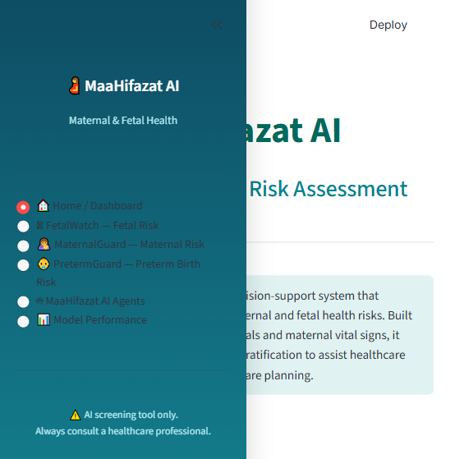
The MaaHifazat Dashboard
A clean, clinical UI designed for Lady Health Workers (LHWs) and Doctors to manage patient records and alerts easily.

Slide 5
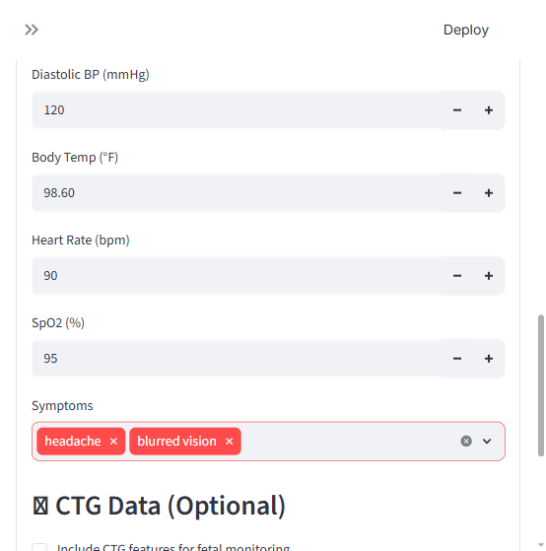
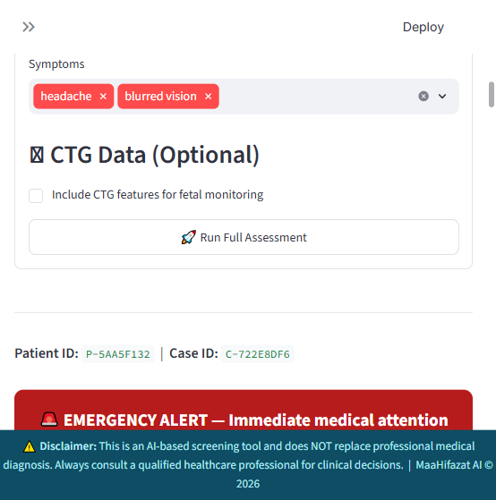
5 Specialized ML Models in Action
1. MaternalGuard (Maternal Risk) | 2. FetalWatch (Fetal Distress)
3. PretermGuard (Preterm Risk) | 4. GestationInsight | 5. CareReach (ANC Dropout)
Patient vitals and CTG features are processed simultaneously to provide a unified diagnostic view.

Slide 6
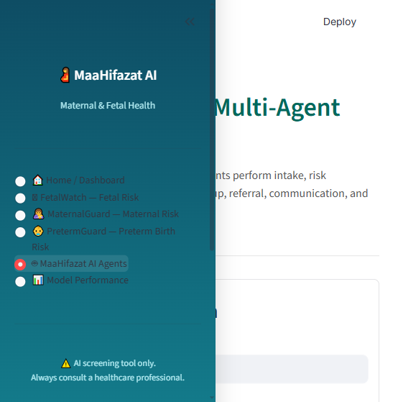
9-Agent LangGraph Orchestration
When an emergency is detected, a state graph of 9 autonomous AI agents kicks in. They handle Data Quality, WHO Triage, Smart Referrals, and automated SMS Communications.

Slide 7
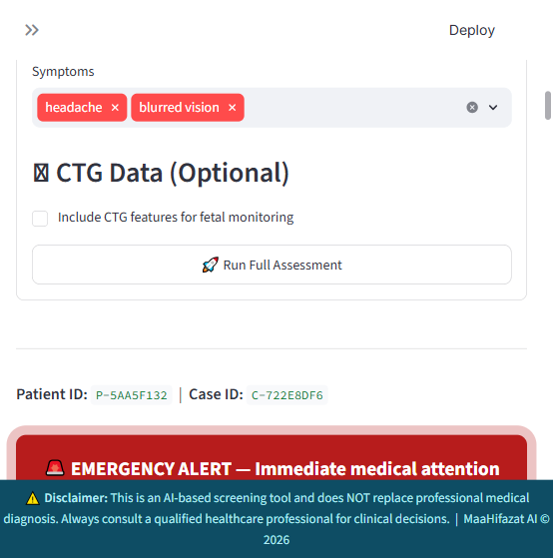
Live Workflow & Clinical Reporting
The 'Reporting Agent' generates a complete clinical summary for the doctor. The 'Smart Referral Agent' calculates optimal facility routes, and the 'Communication Agent' dispatches SMS alerts.

Slide 8
Strict WHO Safety Guardrails
AI must be reliable. We implemented deterministic safety rules:
  Rule-Based Overrides: If vitals show severe hypertension (BP > 160/110) or eclampsia symptoms, the system IGNORES the ML prediction.
  High-Risk Emergency: It instantly triggers an emergency triage level, forcing the orchestration agents to route the patient to an ICU.
  This hybrid approach (ML + Deterministic Rules) guarantees 100% safety.

Slide 9
Conclusion & Impact
MaaHifazat AI is not just a prediction tool; it is a full clinical workflow:
  It identifies the problem early using 5 distinct ML models.
  It coordinates the solution using a 9-Agent architecture.
  It connects the patient to the right facility instantly.
  By eliminating the 'Three Delays', Algo Titans aims to drastically reduce maternal mortality.

