Slide 1
DOST / KP · TECHNOLOGY-TRANSFER R&D PROPOSAL
MaaHifazat AI
AI-Powered Maternal Health & Multi-Agent Orchestration
GROUP · ALGO TITANS
Zafar Ullah — Team Leader
Muhammad Ali
Muhammad Younus Khan

Slide 2




The Problem: Why MaaHifazat?
In rural areas, mothers and babies face critical risks due to ‘The Three Delays’:
1
2
3
Delay in Decision
Delay in Reaching Help
Delay in Care
Unrecognized symptoms leading to late action.
Unknown hospital capabilities and distances.
Overcrowded facilities and slow triage.
Our Goal: Eliminate these delays using advanced Machine Learning and AI Agents.
MaaHifazat AI | Algo Titans
02

Slide 3




System Architecture & Tech Stack
A full-stack, scalable application built for clinical environments.
Backend
FastAPI (Python) for asynchronous, high-performance REST APIs.
Frontend
React 19 + TypeScript + Vite + Tailwind CSS for a highly responsive UI.
Database
SQLite with SQLAlchemy (asyncio) for persistent clinical records.
AI Infrastructure
5 custom ML models (XGBoost, Random Forest) loaded into a Model Registry.
Orchestration
LangGraph StateGraph connecting 9 AI sub-agents.
MaaHifazat AI | Algo Titans
03

Slide 4
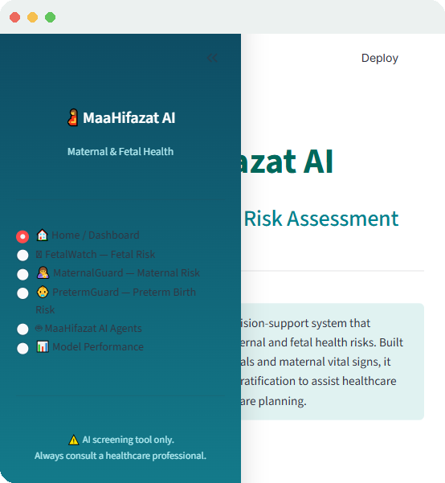

The MaaHifazat Dashboard
A clean, clinical interface for frontline maternal care teams.
Built for Lady Health Workers & Doctors
A clean, clinical UI designed for Lady Health Workers (LHWs) and Doctors to manage patient records and alerts easily.
Unified patient record management
Real-time maternal & fetal risk alerts
Purpose-built navigation for clinical workflows
MaaHifazat AI | Algo Titans
04

Slide 5
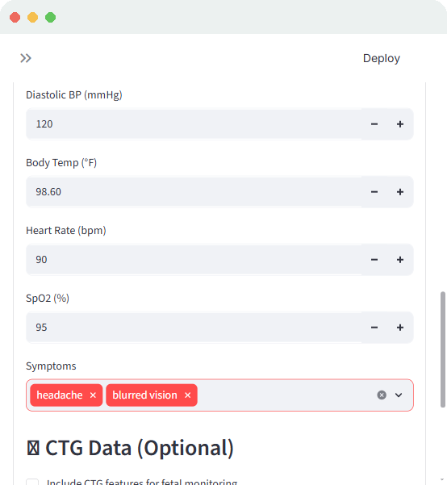





5 Specialized ML Models in Action
Patient vitals and CTG features are processed simultaneously for a unified diagnostic view.
MaternalGuard — Maternal Risk
FetalWatch — Fetal Distress
PretermGuard — Preterm Risk
GestationInsight
CareReach — ANC Dropout
MaaHifazat AI | Algo Titans
05

Slide 6
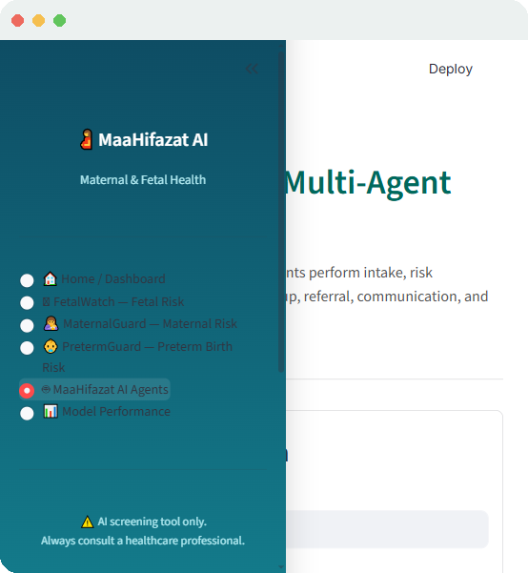




9-Agent LangGraph Orchestration
When an emergency is detected, a state graph of 9 autonomous AI agents kicks in.
The agents handle data quality, WHO triage, smart referrals, and automated SMS communications.
Data Quality
WHO Triage
Smart Referrals
SMS Communications
MaaHifazat AI | Algo Titans
06

Slide 7
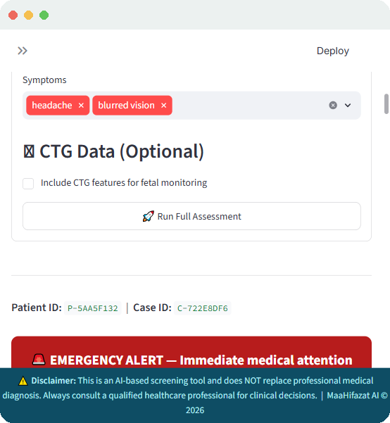

Live Workflow & Clinical Reporting
From emergency detection to a complete, actionable clinical response.
Reporting Agent
Generates a complete clinical summary for the doctor.
Smart Referral Agent
Calculates optimal facility routes.
Communication Agent
Dispatches SMS alerts.
MaaHifazat AI | Algo Titans
07

Slide 8


Strict WHO Safety Guardrails
AI must be reliable. We implemented deterministic safety rules:
Rule-Based Overrides
If vitals show severe hypertension (BP > 160/110) or eclampsia symptoms, the system ignores the ML prediction.
100%
High-Risk Emergency Routing
Safety guaranteed by a hybrid approach — Machine Learning plus Deterministic Rules.
Instantly triggers an emergency triage level, forcing the orchestration agents to route the patient to an ICU.
MaaHifazat AI | Algo Titans
08

Slide 9

Conclusion & Impact
MaaHifazat AI is not just a prediction tool — it is a full clinical workflow.
Identify
Coordinate
Connect
Identifies the problem early using 5 distinct ML models.
Coordinates the solution using a 9-Agent architecture.
Connects the patient to the right facility instantly.
By eliminating the ‘Three Delays,’ Algo Titans aims to drastically reduce maternal mortality.
Algo Titans — Zafar Ullah (Leader) · Muhammad Ali · Muhammad Younus Khan

