Slide 1
Make your own interactive ble-controlled display and joystick interface system with stm32
By: Zafeer

Slide 2
1. Brief intro to the project
Hardware:
This is the hardware I used, and I would recommend that if you guys want to re-create the project then you should also buy the same products. Links in description.
Main MCU board: STM32 NUCLEO-F411RE MCU
NUCLEO-F411RE STMicroelectronics | Development Boards, Kits, Programmers | DigiKey
BLE Extension Board: STM32 X-NUCLEO-BNRG2A1 BLE Extension Board
X-NUCLEO-BNRG2A1 STMicroelectronics | Development Boards, Kits, Programmers | DigiKey
LCD: LCD 1602 Module with pre-soldered I2C Bus Expander
KEYESTUDIO IIC 12C 1602 LCD 16x2 Display Blue Backlight Module for Arduino Mega R3 2560 Raspberry Pi : Amazon.ca: Electronics
JoyStick Module
5Pcs Game Joystick Breakout Module, Dual-axis Joystick Module for PS2 Game Controller,Game Controller Replacement Joystick Analog Thumb Stick for Arduino PS2 Switch Joy-Con Controller : Amazon.ca: Video Games
Breadboard and lots of wires

Slide 3
1. Brief intro to the project
Software and Platforms:
We’ll be making this project using PlatformIO on VSCode, and I’ll also be showing how to download, set up and use it as well.
We’ll also use STM32CUBEMX to auto-generate some code used in the lower-level drivers ( GPIO, I2C, USART etc ) and we’ll be needing STM32CUBEMX to generate the BLE Stack that we’ll use.
By using the BlueNRG BLE Stack provided by ST, we won't be writing manual code for the lower-level stuff, we’ll be using the stack to create the higher-level objects and use that API to Send/Transmit and Configure the higher-level objects.

Slide 4
1. How does the project work?
The Main Microcontroller on the NUCLEO-F411RE is acting as a BLE Server, and the phone is the BLE Client.
The ADC Peripheral of the MCU is converting Joystick Voltage Readings into digital readings, then uses BLE to send that data to the phone.
I2C is used to send Display data to the LCD, the display data will be received from the phone via BLE.

Slide 5
2. Intro to ble
Bluetooth Low Energy ( BLE ) is a wireless communication technology designed for short-range communication between devices.
The BLE Protocol is divided into several layers.
Think of BLE Layers like the different floors of a modern office building, where each floor has its own specific role, working together to maintain the business’s operations.
At the top, the CEO doesn’t usually deal with the tasks which the bottom layer deals with, rather the CEO oversees how the whole building works, and the lower floors oversee very specific details. The higher up, the more responsibility and less specific detailed tasks.
Orders from the CEO get broken down into multiple tasks, and things brought to the CEO are usually a large thing built up of small details and parts.

Slide 6
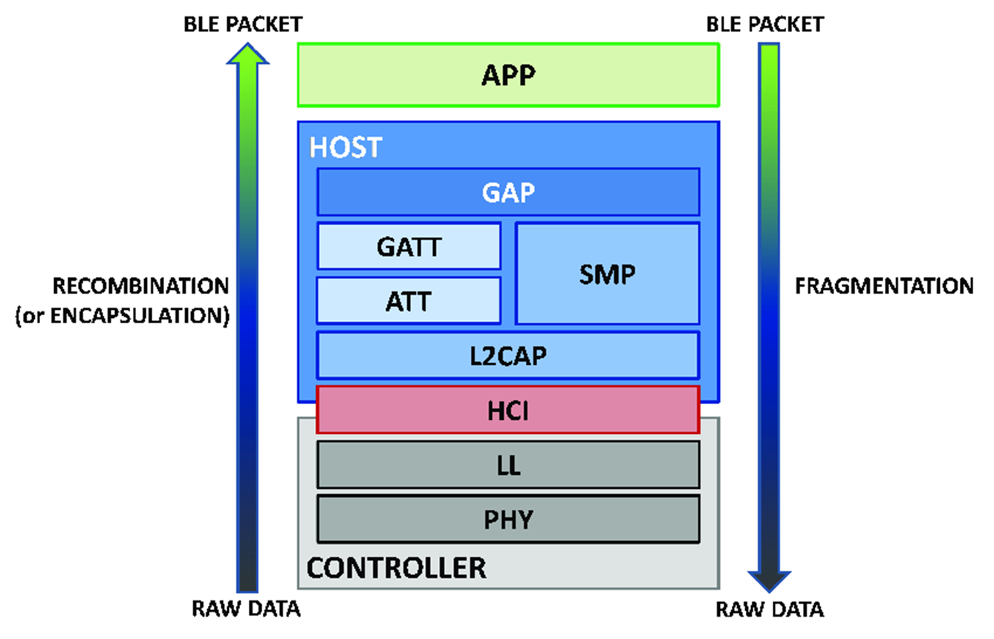
2.1 Ble layers

Slide 7
2.1.1 Application layer
Application Layer ( The Executive Floor )
This is where the big decisions are made, and where the purpose and goals of the entire operation are defined. Just as executives give direction and purpose to each department, the Application Layer dictates the specific user interaction, data processing, and the logic of the BLE application.

Slide 8
2.1.2 Generic access profile ( gap )
GAP Layer ( Main Entrance Reception Floor )
This building has the main entrance at the top and the lower-level workers way at the bottom.
Upon entering the building, the reception area is where visitors are greeted, identities are confirmed, and instructions on how to navigate the building are given.
Similarly, the GAP manages how devices are advertised and connected, much like the first point of contact for new visitors entering a building.
Just like how the CEO can order the receptionists to allow certain visitors, the application can order the GAP to only connect with certain devices using certain methods

Slide 9
2.1.3 Security manager protocol ( smp )
SMP Layer ( The security office )
The security office in a building oversees the safety protocols, hands out badges, and monitors the surveillance.
Similarly, the Security Manager in BLE ensures that communication between devices is secure, managing encryption and authentication.

Slide 10
2.1.4 Generic attribute profile ( gatt )
GATT Layer ( Customer Service Department )
The Customer service Department is where customer inquiries are processed, and information is organized and presented.
Likewise, the GATT handles how data is structured and exchanged between devices, like how customer representatives manage and convey information to clients.

Slide 11
2.1.5 Attribute Protocol ( att )
ATT Layer ( The Records Room )
The Records Room stores files and records, where clerks fetch or file information upon request from customers or the CEO.
In BLE, the ATT holds the data in a structured format, ready to be retrieved or stored as services and characteristics. ( We’ll learn what services and characteristics are later )

Slide 12
2.1.6 logical link control and adaptation protocol ( l2cap )
L2CAP Layer ( The Mail Sorting Room )
The Mail Sorting Room in a building is where all the incoming mail ( From outside source e.g. Customer to the Building ) and the outgoing mail ( From Building to Customer ) is sorted and ensures the mail packets have the correct addresses.
The L2CAP is responsible for organizing and fragmenting data from higher levels into smaller, manageable packets, and directing those packets to their appropriate communication channels.

Slide 13
2.1.7 Host controller interface ( hci )
HCI Layer ( Internal Communications )
The Internal Communications department has email or mailroom, this room takes the sorted mail from the L2CAP and controls the mail going to and from the building, weather the mail is going from the building to a customer, or the mail is coming from a customer, directed to a specific department.
Likewise, the HCI serves as the command-and-control communication center within the BLE Stack, facilitating information exchange between the host ( like a CPU ) and the controller ( like a BLE Radio connected to the CPU )
In our case the Host is the STM32 Nucleo board, and the controller is the X-NUCLEO-BNRG2A1 Expansion board.

Slide 14
2.1.8 Link layer ( ll )
LL Layer ( The Couriers )
The couriers of the building are the messengers who actually deliver the mail or packages from the mailroom ( HCI ) to their destinations.
The LL for BLE controls the radio and manages packet transmission and reception, like couriers efficiently navigating the city’s streets.

Slide 15
2.1.9 Physical layer ( phy )
PHY Layer ( The Mail Trucks and Roads )
In order for the couriers to deliver the mail, they need a means of transportation, Roads and Trucks. Without Roads or Trucks the couriers would never be able to deliver the mail.
The PHY consists of the actual hardware which produces radio waves that BLE uses to transmit data, the radio waves are like the roads.

Slide 16
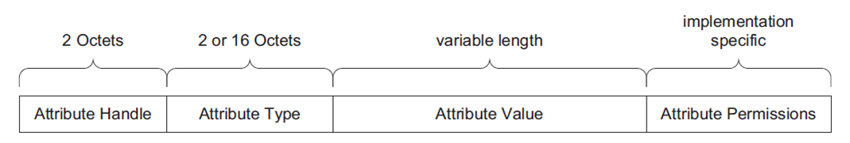
2.1.10 Attributes
Lets refer back to the ATT Layer ( The records room ). Let’s say that in the records room we have an entire mail system. A mail is an envelope with a letter inside.
Each mail has 4 types of information in it:
A) A Mail Tracking Number, Unique to every single Mail
B) A type of mail ( First-Class, Express … etc. )
C) Delivery Instructions
D) The actual letter inside the mail envelope
In BLE, Attributes are just like mail, they have 4 types of information in them:
Attribute Handle
Attribute UUID
Attribute Permission
Attribute Value

Slide 17
2.1.11Handle
Last slide we said Attributes are like Mail.
Now let's say a Service is a type of mail, so it’s a envelop with a letter, but this letter represents a group of mails.

