Slide 1
Denialism
denialism is a person's choice to deny something scientifically proven

Slide 2



Famous cases of denialism
Holocaust denialism
Antivax
Climate change denialism
Flat earth society
Evolution theory denialism

Slide 3



Causes of denialism
Greed
Ideology
Faith

Slide 4
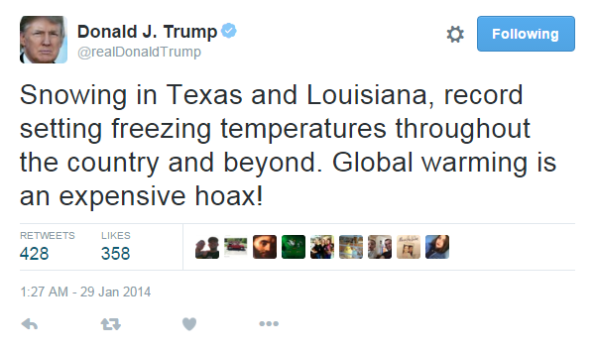

Climate change denialism

Slide 5

How to defy it
People should debate with the denialists

Slide 6
An example
An example of denialism was an article published by a canadian (that affected Michael E. Mann) in which the writer suggests that Mann's study on climate change was a fraud, but after being sued, the writer apologized

Slide 7
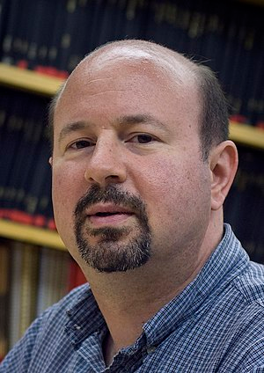
Michael E. Mann
Michael E. Mann is an American climatologist and geophysicist

Slide 8
About his life
Born in 1965 in Massachusetts
He studied in the University of California, Berkeley
He worked as a professor at the university of Virginia
He is currently the director of “Earth System Science Centre”

Slide 9


Why he is famous
Michael E. Mann is famous because he got the 2007 Nobel Peace Prize, he published a lot of articles and some books about climate changes

Slide 10
References
Denialism
Wikipedia
Theguardian.com
Michael E. Mann
Curriculum vitae
Wikipedia
Mann’s website

