Slide 1



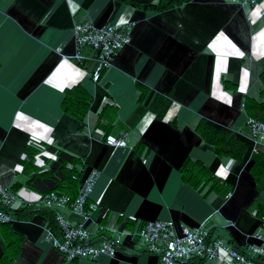
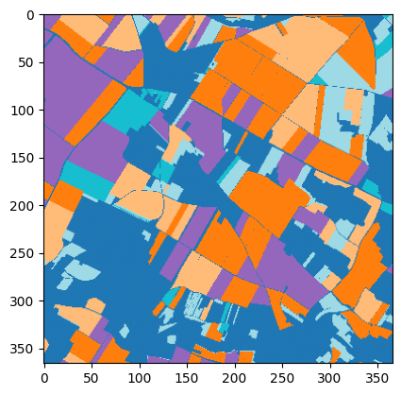
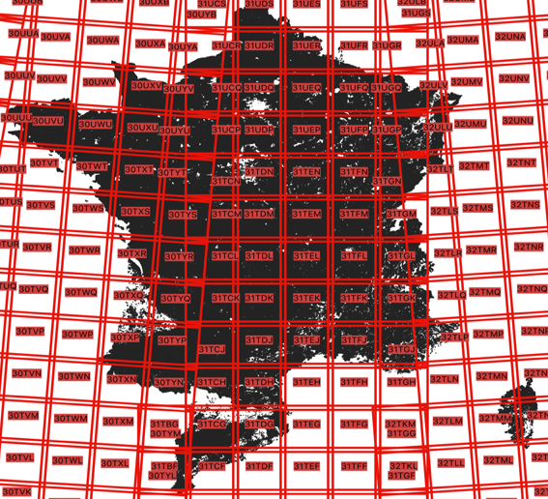
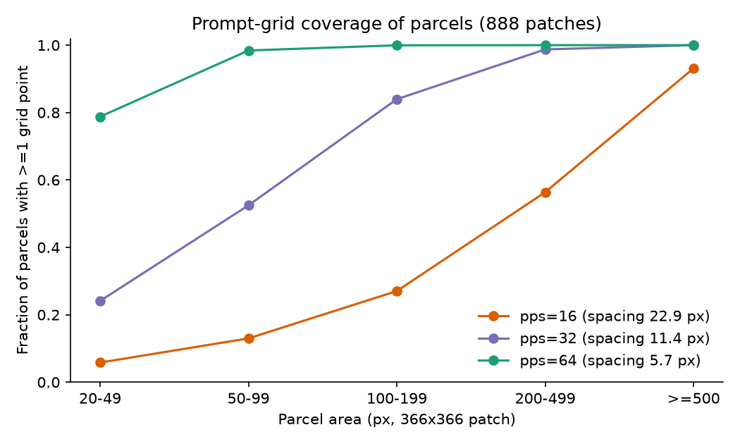
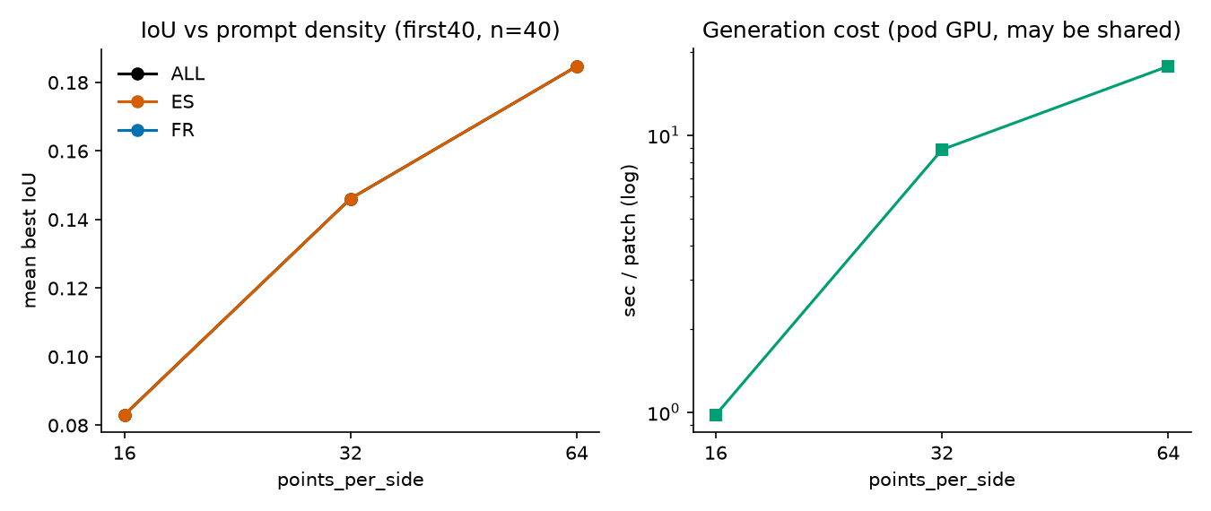

Workshop on Artificial Intelligence and Machine Learning Applications
The Cost of the Prompt: Prompt-Free SAM 2 on Sentinel-2 Fields
André Rubio • Johanna Zagon • Pierre Lavergne
Pontificia Universidad Católica del Perú (PUCP), Lima, Peru
MOTIVATION & RESEARCH PROBLEM
RESULTS & DISCUSSION
SAM 2 [1] segments anything from one human click. Mapping thousands of fields needs it prompt-free: the automatic generator clicks a regular point grid instead.
A. The prompt dominates compute. The encoder costs 134 GMAC per image, the decoder 1.4 GMAC per prompt: a 16 × 16 grid (256 prompts) already costs 2.6 × the encoder, 32 × 32 ≈ 10 ×.
Frozen baseline: mean best IoU 0.161; 15% of parcels with IoU > 0.5; Spain 0.085 ≪ France 0.220. Masks often merge neighbouring parcels.
Sentinel-2 parcels are far from SA-1B [2] objects: 10 m pixels, a median parcel of 113 px (≈ 11 × 11 px).
Question: how well does frozen, prompt-free SAM 2 find agricultural parcels, and what limits it: the model or the prompt?
B. Fine-tuning helped the proxy, hurt the pipeline. Validation with centroid prompts rose 0.312 → 0.530; the automatic generator on test fell 0.156 → 0.064 (paired Δ -0.092, 95 % CI [-0.103, -0.083]; masks per patch 78.7 → 41.1). Training prompt ≠ inference prompt.
OBJECTIVES / CONTRIBUTION
Teardown of frozen SAM 2.1: parameters, compute per block, latency.
Baseline of the automatic generator against parcel ground truth.
Adapt the mask decoder (encoder frozen) and test it with the deployment pipeline.
Diagnose the gap: domain shift (Spain vs. France) and prompt-grid density.
Fig. 2. Mean best IoU before / after decoder fine-tuning (v1), on the proxy and on the real pipeline.
METHODOLOGY
C. The grid misses the fields. At pps = 16 (a point every 22.9 px) only 32% of parcels get a grid point (Spain 24%, France 40%; 20–49 px parcels 6%); pps = 32: 68%, pps = 64: 95%. Patch IoU tracks parcel size (Spearman ρ = 0.87; confounded with country). Coverage is an upper bound, not IoU.
Fig. 1. A test patch (RGB) and its parcel map; the 6 Sentinel-2 tiles lie in Catalonia and France.
Data: Sen4AgriNet [3], 211,375 parcels (≥ 20 px) in 888 Sentinel-2 patches (366 × 366 px, RGB, 10 m, May), 6 tiles, Spain and France. Split 70/15/15 by patch, stratified by tile, seed 42; test = 132 patches.
Model: SAM 2.1 Hiera-Small; automatic generator, 16 × 16 grid (pps = 16), predicted-IoU ≥ 0.5, stability ≥ 0.8.
Metric: for each true parcel, best IoU over all generated masks; mean over parcels.
Adaptation (v1): train decoder transformer layer 2 + IoU head (1.71 M params, 3.7 %), Dice loss, one centroid prompt per parcel.
Ablation (v2): prompt (centroid / random / grid) × output tokens (0 / 1–3), checkpoint chosen by generator IoU; grid sweep pps 16 / 32 / 64.
Fig. 3. Fraction of true parcels hit by ≥ 1 grid point, by parcel size (all 888 patches).
D. Denser grid, better masks (v2). On 40 test patches (Spain), IoU rises 0.083 → 0.146 → 0.185 for pps 16 / 32 / 64, at 0.98 → 8.86 → 17.72 s per patch. Filters off (pps = 16): [FILTERS_OFF_IOU].
Decoder ablation: with checkpoints chosen by generator IoU, no trained variant beat the frozen model (best = epoch 0, 0.156); choosing by validation loss gives 0.092.
CONCLUSIONS
The bottleneck is prompt density, not the decoder: a 16 × 16 grid reaches only 32% of parcels; a 64 × 64 grid raises IoU 0.083 → 0.185, while no decoder fine-tune beat the frozen model.
Validate with the deployment pipeline: tuning on centroid prompts improved validation (0.312 → 0.530) and broke the automatic generator (0.156 → 0.064).
Removing the human prompt has a price: every grid point is a decoder pass, so the better grid costs 0.98 → 17.72 s per patch.
Limits: one seed; per-patch aggregates; grid sweep on 40 Spanish test patches; the Spain–France gap mixes parcel size with crop and radiometric shift.
Fig. 4. Mean best IoU (left) and seconds per patch (right, log scale; shared pod GPU) vs. grid density, first 40 test patches.
ACKNOWLEDGMENTS
Course Deep Learning (1INF52), PUCP. • Compute: rented GPUs on RunPod. • Model: Meta AI SAM 2.1; data: Sen4AgriNet.
Code written with AI assistance (Claude Code); every result checked by the authors.
KEY REFERENCES
[1] N. Ravi et al., “SAM 2: Segment Anything in Images and Videos,” arXiv:2408.00714, 2024.
[2] A. Kirillov et al., “Segment Anything,” in Proc. IEEE/CVF ICCV, pp. 4015–4026, 2023.
[3] D. Sykas et al., “A Sentinel-2 Multiyear, Multicountry Benchmark Dataset for Crop Classification and Segmentation With Deep Learning,” IEEE JSTARS, vol. 15, pp. 2937–2953, 2022.
CONTINUE THE CONVERSATION
Contact: andre.rubio@pucp.edu.pe
Code, splits and results:
github.com/ZagonTM/Sen4Sam
BRING YOUR RESEARCH. SHARE YOUR IDEAS. JOIN THE CONVERSATION.
WAIMLAp 2026 • November 18–20, 2026 • Lima, Peru • waimlap.org

