Slide 1


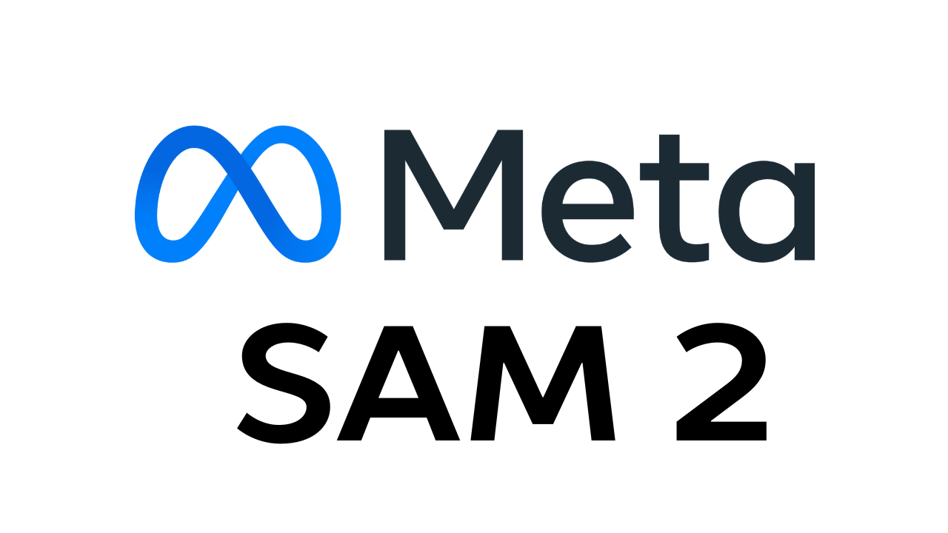
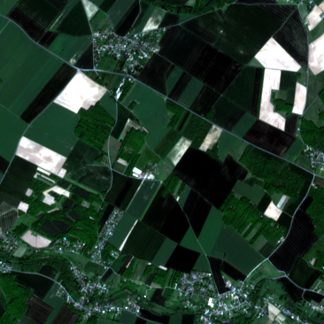
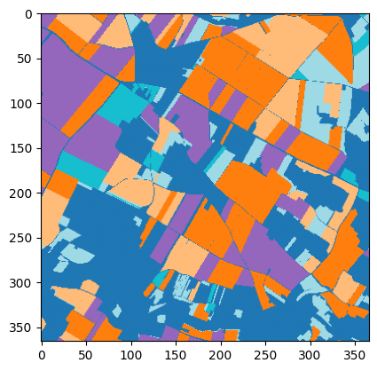

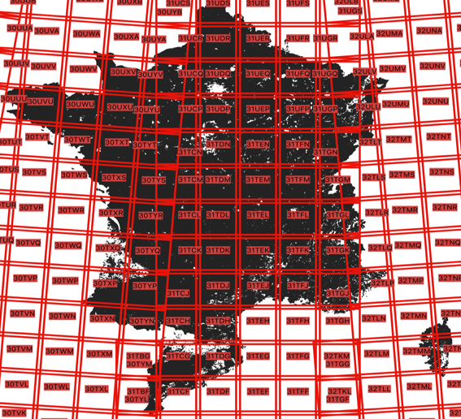
Workshop on Artificial Intelligence and Machine Learning Applications
From Natural Images to Satellite Imagery: Evaluating SAM 2 for Prompt-Free Agricultural Segmentation
André Rubio • Johanna Zagon • Pierre Lavergne
Pontificia Universidad Católica de Perù, Perù
MOTIVATION & RESEARCH PROBLEM
OBJECTIVES / CONTRIBUTION
• Problem: Foundation models like SAM 2 offer excellent performance on natural images, but their behavior when facing major domain shifts (such as agricultural remote sensing) remains poorly understood.
Satellite imagery fundamentally differs from the distribution of web-like images (original SA-1B dataset) used to train SAM 2.
Main objective: Evaluate the applicability and performance of the SAM 2 model in automatic (prompt-free) segmentation mode on agricultural satellite images.
Specific objectives:
Characterize the model's internal behavior, computational cost, and memory usage when transferred to remote sensing.
Evaluate the impact of the absence of a prompt and prepare targeted interventions on the Mask Decoder.
Contribution: Propose an analysis of the model beyond the "black box" to identify its architectural limitations in the face of a domain shift.
• Challenge: The challenge consists of applying a model designed for objects with well-defined boundaries to a complex new domain requiring automatic (prompt-free) segmentation of millions of parcels
METHODOLOGY
RESULTS & DISCUSSION
Data (Sen4AgriNet): PAD subset comprising 888 cloud-free Sentinel-2 image patches (May 2019, France and Spain) with a 10 m spatial resolution (366x366 pixels) and parcel-level ground truth data.
Base model: Frozen SAM 2.1 Hiera-Small, evaluated via its automatic mask generator using a dense 32x32 point grid instead of manual interactions.
Preliminary results: Automatic segmentation fundamentally alters the computational profile of SAM 2; the repeated execution of the mask decoder becomes more costly than image encoding.
Identified limitations: SAM 2 captures relevant agricultural boundaries but frequently merges neighboring parcels, resulting in a low IoU score despite visually plausible results.
Project phases:
Phase A: Hardware and software characterization (parameter allocation, latency, receptive fields) and evaluation of prompt-free segmentation via the IoU (Intersection over Union) metric.
Phase B: Partial and controlled fine-tuning of the mask decoder while keeping the image encoder frozen.
Phase C: Evaluation of the model's robustness against geographical variations.
CONCLUSIONS
KEY REFERENCES
SOON !
[1] N. Ravi et al., "SAM 2: Segment Anything in Images and Videos," arXiv preprint arXiv:2408.00714, 2024.
[2] A. Kirillov et al., "Segment Anything," Proceedings of the IEEE/CVF International Conference on Computer Vision (ICCV), pp. 4015-4026, 2023.
[3] D. Sykas et al., "A Sentinel-2 Multiyear, Multicountry Benchmark Dataset for Crop Classification and Segmentation With Deep Learning," IEEE Journal of Selected Topics in Applied Earth Observations and Remote Sensing, vol. 15, pp. 2937-2953, 2022.
ACKNOWLEDGMENTS / FUNDING
CONTINUE THE CONVERSATION
Contact: andre.rubio@pucp.edu.pe
GitHub Repository:
BRING YOUR RESEARCH. SHARE YOUR IDEAS. JOIN THE CONVERSATION.
WAIMLAp 2026 • November 18–20, 2026 • Lima, Peru • waimlap.org

