Slide 1
Our First Meetup!
Zagreb Cassandra Users
12.06.2014
Mario Lukica

Slide 2
Elevator Pitch
Cassandra is Java based, open source, distributed, decentralized, horizontally scalable, highly available and fault tolerant column-oriented database.
Notes:
Distributed – capable of running on multiple machines, while appearing to users as unified whole.
Decentralized – no single point of failure, no master/slave, all nodes equal, writes and reads can be performed on any node. Peer-to-peer mode.
Elastic scalability – form of horizontal scalability. Cluster can seamlessly scale up and back down again.
High availability/fault tolerance – failed nodes can be replaced with no downtime. Possible to replicate to multiple data centers.
Tuneable consistency – consistency level can be defined per read or write operation.
Column-oriented – not relational; sparse hashtable; column is minimum of information, organized in rows; comparison to row orientation of excel (there can be lot of empty columns, and those columns take up some space – not the case in column oriented DBs).
Time-to-live – can be set on each column. Time in seconds. Automatic cleanup after that time. Nice to have with Big Data.
Data compression – save up on disk storage, less IO. Should not downgrade performance.
Built-in caches – built-in row caches, column caches. No need for external caches (e.g. memcached).

Slide 3
History
2007 | Facebook
2008 | Google Code
2009 | Apache
2010 | v0.6
2011 | v0.7, v0.8, v1.0
2012 | v1.1, v1.2
2013 | v2.0
2014 | v2.1

Slide 4
Use Cases
Lots of writes
Storing user/device activity
Application statistics, monitoring, logging
Social network usage
Geographical distribution
Replication between multiple datacenters and availability zones, geo-redundancy
Move data close to customers – reduce networking latency

Slide 5











Installations
Notes:
Netflix – cluster 900-1000 nodes, 4 people maintain it; datastax enterprise.

Slide 6
CAP Theorem
Brewer
Pick any 2 of:
Consistency
Availability
Partition tolerance
Cassandra focuses on availability and partition tolerance
Availability
Consistency
Partition tolerance
Notes:
Formally proved by Seth Gilbert and Nancy Lynch of MIT in 2002. http://lpd.epfl.ch/sgilbert/pubs/BrewersConjecture-SigAct.pdf

Slide 7
Cluster
Murmur3Partitioner
RandomPartitioner
ByteOrderedPartitioner
Gossip
Partitioners, consistent hashing
Replicas, RF, replica placement strategy
Snitches
RF = 3
0
>76
SimpleStrategy
NetworkTopologyStrategy
Dynamic snitching
SimpleSnitch
RackInferringSnitch
PropertyFileSnitch
GossipingPropertyFileSnitch
EC2Snitch
EC2MultiRegionSnitch
75
51 - 75
1 - 25
25
26 - 50
50
Row 1
Row 2

Slide 8
vnodes
Multiple token ranges per node
Since C* v1.2
Token ranges on node are randomly selected and non-contiguous
Simplified operations
Default 256 ranges per node

Slide 9
Reads, Writes, Deletes
Coordinator
Consistency level defined per operation
Consistency level is relative to replication factor – NOT to the number of nodes in cluster
Newest value returned on read
Read repair
Hinted handoff
Anti-entropy node repair
Delete inserts tombstone
RF = 3
Client

Slide 10
Consistency Levels
ANY (write)
ONE
TWO
THREE
QUORUM
LOCAL_QUORUM
EACH_QUORUM
ALL
SERIAL
LOCAL_SERIAL

Slide 11
Strong and Eventual Consistency
Strong consistency:
W + R > RF
Eventual consistency:
W + R <= RF
W – write consistency level R – read consistency level RF – replication factor
Notes:
Strong consistency – all client reads will see the most recent write in this scenario.

Slide 12
Data Model
Column
Keyspace
Column Family
rowId1
name1
name2
name3
value1
value2
value3
Row
rowId2
name1
name4
value1
value4
Composite columns
Expiring columns
Counter columns
Data Types – Comparators & Validators

Slide 13
Thrift vs CQL
Thrift is original interface provided by C*, low level, matches physical storage, will not go away
CQL3 is SQL like language for C*, high level, but also a binary transport, since v1.1
Thrift | CQL
column family | table
row | partition
column | cell
cell name or value | column
group of cells with shared component prefix | row

Slide 14
cassandra-cli
CREATE COLUMN FAMILY users WITH comparator = UTF8Type AND key_validation_class=UTF8Type AND column_metadata = [ {column_name: full_name, validation_class: UTF8Type} {column_name: email, validation_class: UTF8Type} ];
SET users['ID1']['full_name']='Robert Jones'; SET users['ID1']['email']='bobjones@gmail.com';
LIST users; GET users[utf8('ID1')][utf8('full_name')];
DEL users ['ID1']['email'];

Slide 15
CQL 3
CREATE TABLE tweets ( tweet_id bigint PRIMARY KEY, author varchar, body varchar );
CREATE INDEX tweets_author_idx ON tweets (author);
INSERT INTO tweets (tweet_id, author, body) VALUES (123, 'john', 'Checking up on Cassandra');
SELECT * FROM tweets WHERE author = 'john' ORDER BY tweet_id DESC LIMIT 50;
UPDATE tweets USING TTL 86400 SET body = 'Was checking up on Cassandra' WHERE author = 'john';
DELETE body FROM tweets WHERE author = 'john';

Slide 16
CQL Type | Description
ascii | US-ASCII string
bigint | 64-bit signed long
blob | Arbitrary bytes, expressed as hex
boolean | true or false
counter | Distributed counter (64-bit long)
decimal | Variable precision decimal
double | 64-bit IEEE-754 floating point
float | 32-bit IEEE-754 floating point
inet | IP address string
int | 32-bit signed integer
list
map
set
text | UTF-8 string
timestamp | Date and time, 8 bytes since epoch
uuid | UUID in standard UUID format
timeuuid | Type 1 UUID
varchar | UTF-8 string
varint | Arbitrary precision integer

Slide 17
Example: cassandra-cli – list
list data;
RowKey: 1 => (cell=2013-06-05 15:11:00-0500, value=3.1, timestamp=1370463146717000) => (cell=2013-06-05 15:11:10-0500, value=4.3, timestamp=1370463282090000) => (cell=2013-06-05 15:11:20-0500, value=5.7, timestamp=1370463282093000) ------------------- RowKey: 2 => (cell=2013-06-05 15:11:00-0500, value=3.2, timestamp=1370463332361000) ------------------- RowKey: 3 => (cell=2013-06-05 15:11:00-0500, value=3.3, timestamp=1370463332365000) => (cell=2013-06-05 15:11:10-0500, value=4.3, timestamp=1370463332368000)

Slide 18
Example: cqlsh – select
sensor_id | collected_at | volts -----------+--------------------------+------- 1 | 2013-06-05 15:11:00-0500 | 3.1 1 | 2013-06-05 15:11:10-0500 | 4.3 1 | 2013-06-05 15:11:20-0500 | 5.7 2 | 2013-06-05 15:11:00-0500 | 3.2 3 | 2013-06-05 15:11:00-0500 | 3.3 3 | 2013-06-05 15:11:10-0500 | 4.3

Slide 19
Cassandra Limitations
CQL
No joins, no foreign keys, no subqueries, limited aggregation
Ordering per partition, specified at creation time
Limitations on select queries when using compound primary keys
Storage
All data for single partition must fit on disk on single machine in cluster
Single column value <= 2GB, in practice < 10MB
Collections <= 64kB
Max number of cells in single partition: 2 billion

Slide 20
High-Level Clients
Java | CQL | DataStax Java Driver
 | Thrift | Hector, Astyanax, Pelops, Firebrand, PlayOrm, Kundera
Scala | CQL | Scqla
 | Thrift | Cascal, Cassie, Polidoro
Python | CQL | DataStax Python Driver
 | Thrift | Pycassa, Telephus
Other |  | Node.js, Clojure, .NET, Ruby, PHP, Perl, C++, Haskell, Erlang, Go

Slide 21
Commit Logs, Memtables, SSTables
Client
2.
Memtable CF1
1 active per CF
Memtable CF2
1.
No overwrites-in-place!
No random seeks!
async
memory
disk
CommitLog
SSTable-CF1-1
multiple SSTables per CF
multiple files per SSTable:
data
index
bloom filter
compression info
statistical metadata
mutations only
shared for all CFs
Notes:
Fast writes (writes are sequential).
Commit log – for all mutations (insert, delete), crash recovery log for data,
Commit log periodically synced to disk (2 modes – periodical and batch).
Commit log rolls over to new file on size threshold (standard rollover procedure).
Commit logs have preallocated size (32MB).
Memtable – in memory cache, data sorted by key, each CF has separate memtable. When number of objects in memtable reaches threshold, flushed to disk to SSTable (flushing is nonblocking).
Multiple memtables can be in memory for single CF – 1 active, and others waiting to be flushed (if overloaded).
Commit log has bit flags for each CF. When memtable is flushed to disk, bit flag for this CF on commit log is set to 0. Bit flag indicates if there is anything for some CF that hasn’t been flushed to disk. When all bit flags are cleared, commit log can be cleared.
SSTable – once memtable is full, sorted data is written out sequentially to disk as SSTable (sorted string table; named like this for historical reasons – concept from Google BigTable).
Multiple SSTables created on disk for single CF.
Data is immutable (no seeks, only appends).
Row read requires reading all existing SSTables for CF to locate the latest value (bloom filters used as optimization – each SSTable has associated bloom filter). It's possible to get false positive via bloom filter, but it's not possible to get false negative (nondeterministic).
Compaction – multiple SSTables merged into one (although SSTable is immutable, new ones can be created based on old ones).
On reads, cassandra first checks memtables to find row.
Deletion – tombstones, executed on compaction after configured GC timeout.

Slide 22
NR | 1.000.000 | Number of Rows
NC (per row) | 10 | Number of Columns per Row
CNS | 8 | Column Name Size (in bytes)
CVS | 4 | Column Value Size (in bytes)
RKS | 50 | Row Key size (in bytes)
RF | 3 | Replication Factor
Number of Nodes | 9 | Number of Nodes in Cluster
IPS | 1.024 | From column_index_size_in_kb in YAML file
TNC (total) | 10.000.000 | Total Number of Columns (Calculated)
Column data | 40.000.000 | Amount of actual data in your cluster
Column overhead | 230.000.000
Column Subtotal | 270.000.000
Row header overhead | 73.000.000
Row bloom filter | 18.000.000
Row index | 4.000.000
Row Subtotal | 95.000.000
Data file subtotal | 365.000.000 | Column data/overhead + Row data/overhead
Per Node | 121.666.667 | Includes replication and should be comparable to summation of all SSTABLES on disk for a single node
SSTABLE index | 60.000.000
SSTABLE bloom filter | 1.875.003
Base Storage | 426.875.003
Additional Replicas | 853.750.005
Compaction Overhead | 1.280.625.008
Total Storage | 2.561.250.015
Per Node | 284.583.335
http://btoddb-cass-storage.blogspot.com/

Slide 23
Installation and Configuration
Configure yum datastax.repo (RedHat, very similar on Debian)
sudo yum install dse-full
Edit configuration.yaml
cluster_name num_tokens seeds listen_address
Start service
sudo service dse start
Check status
nodetool status

Slide 24
O&M
nodetool
sstableloader
sstable2json / json2sstable
sstableupgrade
JMX
Cassandra Cluster Admin
OpsCenter (CE, EE)

Slide 25
nodetool
Command line interface for managing C* cluster
status | snapshot
info | clearsnapshot
ring | compact
gossipinfo | compactionhistory
flush | tpstats
drain | cfstats
refresh | netstats
repair | enablebackup
rebuild | disablebackup
scrub | join
… ~60 commands total …

Slide 26
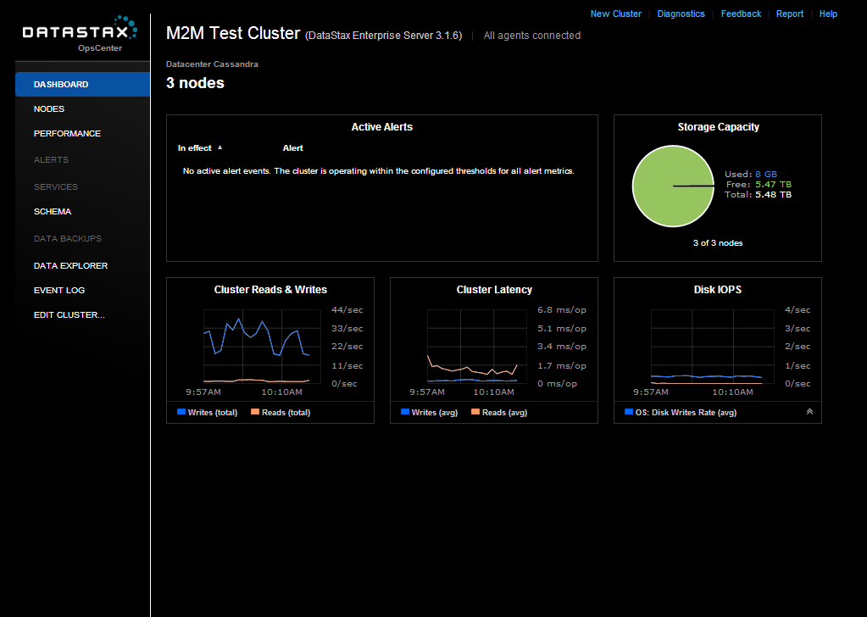
OpsCenter

Slide 27
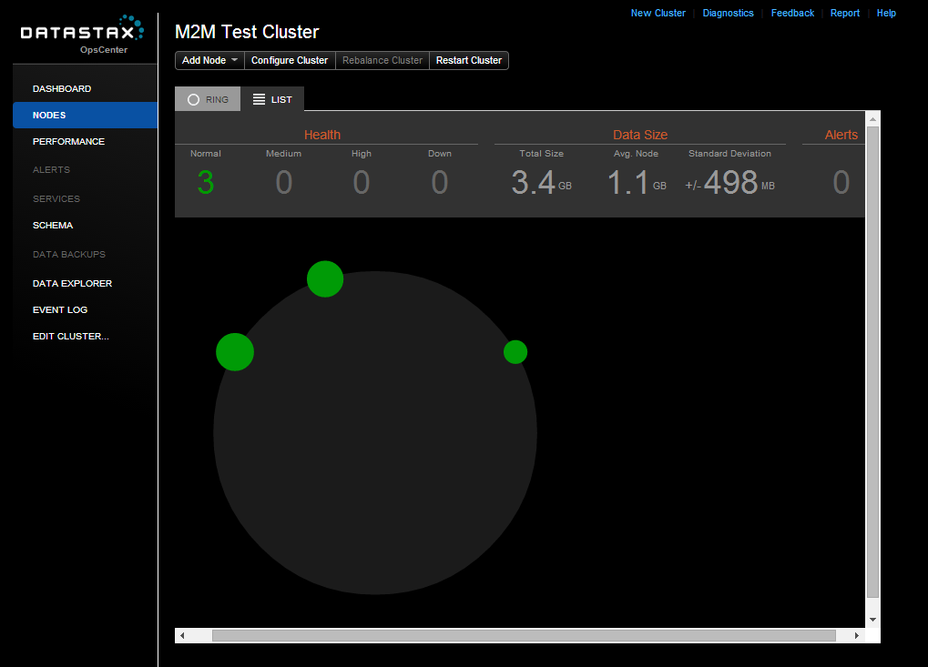
OpsCenter

Slide 28
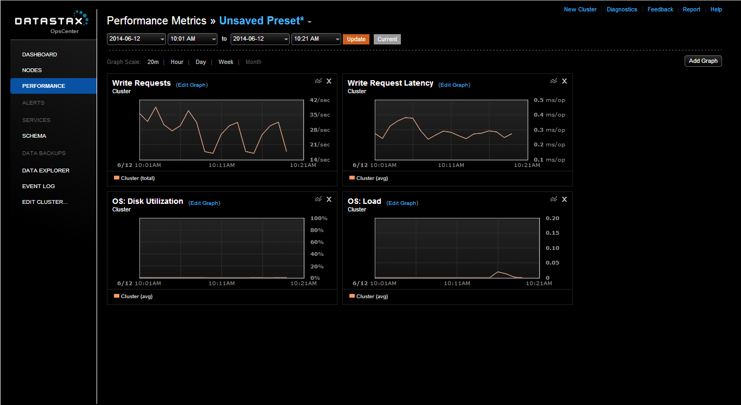
OpsCenter

Slide 29
DataStax
Community and Enterprise
Enterprise
Integrated real-time data (Cassandra), analytics (Hadoop) and search (Solr) – started with different command line switch
Support, training, consulting
OpsCenter
Jonathan Ellis – chair of Apache Cassandra is CTO
Employs 90% of Cassandra committers

Slide 30
Conclusion
No one size fits all DB
C* is excellent choice when you require:
High ingest rate
High availability
Linear scalability
Replication
Operations and maintenance are user friendly even on big clusters … with good tool support
Know how data is queried and build data model around this

Slide 31
References
Documentation : DataStax http://www.datastax.com/docs
Cassandra Wiki http://wiki.apache.org/cassandra/
git clone https://github.com/apache/cassandra.git
Dynamo: Amazon’s Highly Available Key-value Store http://www.allthingsdistributed.com/files/amazon-dynamo-sosp2007.pdf
Bigtable: A Distributed Storage System for Structured Data http://research.google.com/archive/bigtable.html
One Million Writes / Sec http://www.datastax.com/1-million-writes

