Slide 1
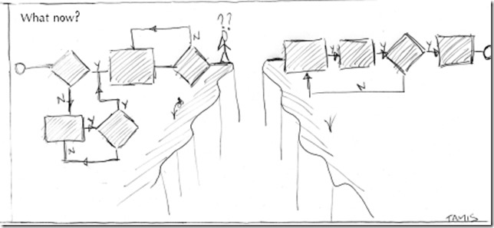


BPMN Plus: A modelling Language for Unstructured Business Processes
Zaharah Allah Bukhsh

Slide 2
Agenda
Research Problem
Research Question
Assessment of Process Support Paradigms
Assessment of Process Modelling Languages
BPMN Plus : An Extension to BPMN
Validation of BPMN Plus
Conclusion
Future Work

Slide 3
Problem
According to AIIM survey, 51% companies indicate that half of their processes are unstructured and unpredictable
Scattered nature of data (policies, records, etc)
Collaboration among knowledge workers is time-consuming (emails , phone calls)
In other words, process model doesn’t show the real business process

Slide 4
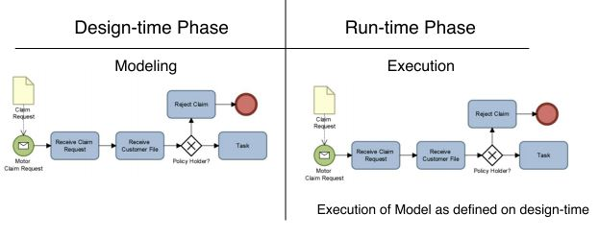
Structured Business Process

Slide 5
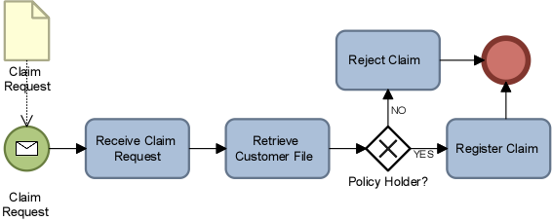
Problem Structured Business Process
Design-time
Run-time
Insurance Claim Registration

Slide 6
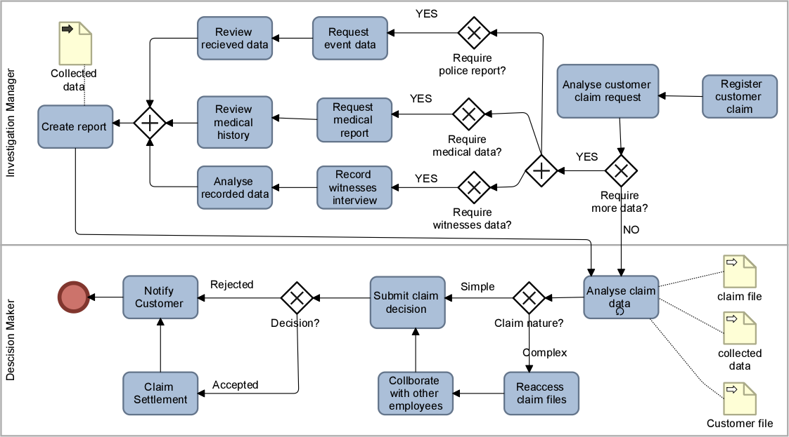



Problem Unpredictable Process instances
Notes:
Which means we cannot model the unstructured process in sturctured way

Slide 7
Research Question
How can unstructured business processes be modelled and managed in a flexible manner?

Slide 8




Background Business Process Spectrum
Structured
Structured with
Ad-hoc Exceptions
Unstructured with
Pre-defined fragments
Unstructured
What are the differences between structured and unstructured business processes?
RQ1

Slide 9

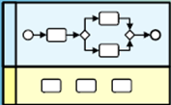
Background Business Process Spectrum
Structured
Structured with
Ad-hoc Exceptions
Unstructured with
Pre-defined fragments
Unstructured
Examples : Financial back-office transaction, order lost
Examples : Regulatory Processes e.g. customer registration, order processing, salary payments
RQ1

Slide 10

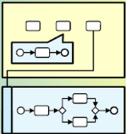
Background Business Process Spectrum
Structured
Structured with
Ad-hoc Exceptions
Unstructured with
Pre-defined fragments
Unstructured
Examples : Insurance Claim handling, Dispute Handling,
Mortgage Claim, Investigation
RQ1

Slide 11
Management of Business Process
Business Process Management
Design, model, execute, maintain and optimize the business process
Case Management
Facilitate in process related data management, decision making, and process task management
Which Process Support Paradigm is suitable for managing unstructured business process?
What are the differences between BPM and CM in dealing with unstructured business processes?
RQ2

Slide 12
Management of Business Process An Experiment
Object of Study: Insurance Claim Process
Two software tools
Bizagi
Cognoscenti
Implemented the Insurance claim process with both software tools
Process modelling
Data management
Business Roles definition
Setup Effort…
RQ2

Slide 13

Business Process Management Implementation process with Bizagi
Design-time
Process modelling
Data
modelling
Form Design
Business Rule Definition
Performer
Definition
Insurance
Claim Process
Run-time
Execution on work portal
RQ2

Slide 14
Case Management Implementation process with Congnoscenti
Congnoscenti
Design-time
Case modelling
Insurance
Claim Process
Run-time
Case Template
User Profiles
Task assignment
Case Folder
Document Management
RQ2

Slide 15
Management of Business Process Experiment Result
BPM highly rely on design-time defined process model
CM is too open ended which can lead to inefficient processing of business process
BPM automated the business operations while CM digitalize it
RQ2

Slide 16
Modelling of Business Process Assessment
Process Management Suites rely on process models for their business process automation and execution
Process Models are used as a communication tool among business people
Assess the capabilities of modelling languages with the help of unstructured business process
Business Process Model and Notation (BPMN)
Case Management Model and Notation (CMMN)
What are the capabilities of existing modelling notations to deal with
unstructured business processes?
RQ3

Slide 17
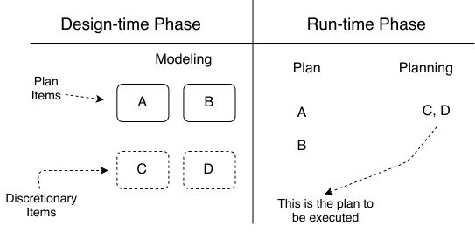
Modelling of Business Process Unstructured Process Modelling

Slide 18




Business Process Model and Notation Introduction
BPMN Basic
Data
Object
Sequence
Flow
Event
Activity
Gateway
Association
Lanes and Pool
BPMN Extended
Many complex modelling constructs
For example
RQ3
Notes:
Only six elements are used

Slide 19
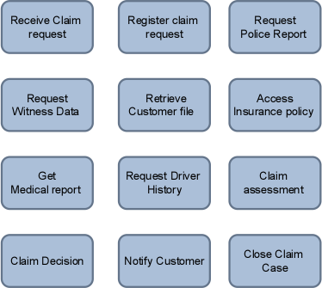
Unstructured Business Process Example
Insurance claim Process
Police reports
Medical reports
Witnesses
report
Insurance policy
Car damage report
Driver ‘s driving history
RQ3

Slide 20
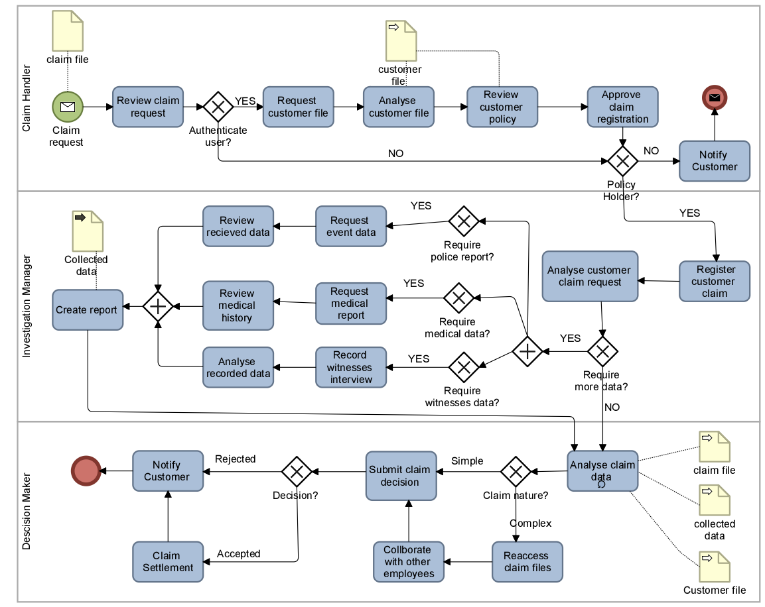
Modelling Unstructured Business process with BPMN Basic
Pre-define Resources
Limited Alternatives
Task Ordering
Task Dependency
Unavailable Optional Task
Limited View on Data
Notes:
These are not problem but they limit the flexibility of unstructured process model

Slide 21
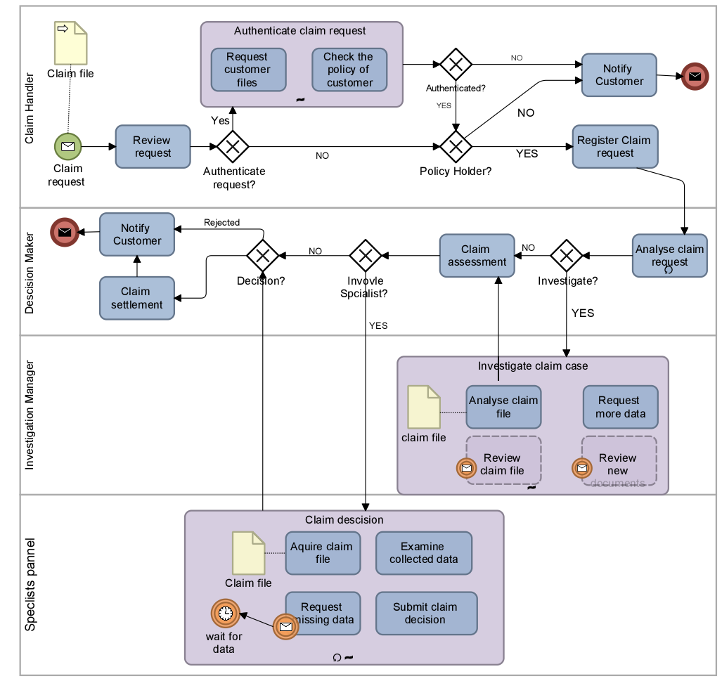
Modelling Unstructured Business process with BPMN Extended
Reduced Task ordering
Available Optional Task
Available Alternatives
Reduced Task Dependency
Complex process model with low expressibility

Slide 22
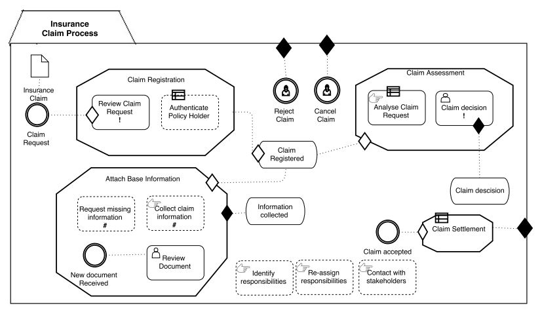
Modelling Unstructured Business process with CMMN
No Sequential Flow
Undefined Resource Role
Optional Task
Required Task

Slide 23
Modelling Unstructured Business Process Advantages
BPMN
CMMN
Sequential flow of BPMN make a model easy to read.
User roles are visible through Lanes.
With ad-hoc sub process, the unstructured process can be represented.
The notations of required and optional is very expressive in CMMN.
Milestones provide overall and quick overview of process
CMMN define case execution semantics.
RQ3
Notes:
Change this slide

Slide 24
Modelling Unstructured Business Process Disadvantages
BPMN
CMMN
Notation of ad-hoc process is not very expressive
Low (no) support for ad-hoc process execution
Unavailability of sequence flow hinders the process model readability
No notation to model user roles and data flow
RQ3
Notes:
Change this slide

Slide 25
Representational Requirement for Unstructured Business Process
Ordered and Unordered Activities
Capture Real-time Events
Process Specification
Data Specification
Business Rules Specification
Goal Specification
Knowledge Workers Specification
Activities Specification
Optional and Required Activities
Capture Conditions
Re-execute and Undo Activities
Varying Levels of Granularity
Collaboration Among Activities
Role Assignment
Process and Data Alignment
Capture Decisions
Capture Social Network
Process/Activity Call
Dynamic Task Assignment
Data Representation
Data Versioning
Goals Definition
Data Authorization
Business Rules Definition
RQ4
How to model an unstructured business process while providing run-time flexibility?

Slide 26
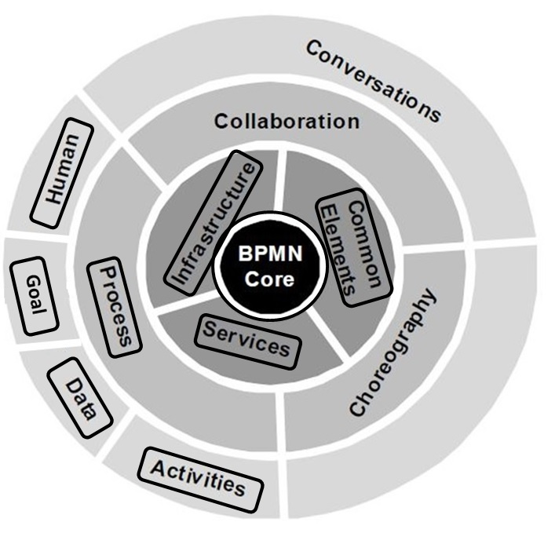
BPMN Plus
Extension to BPMN standard
Introduced new concepts and constructs
Aligned new concepts classes to existing classes
Modified the relationship among abstract-syntax
classes and inherited classes
RQ4

Slide 27
BPMN Plus Concepts
BPMN Plus
Process
Activity
Data
Performer
Goal
Event
Gateway
RQ4
Notes:
Optimum set of modelling notation that can represent structured and unstructured process parts.

Slide 28
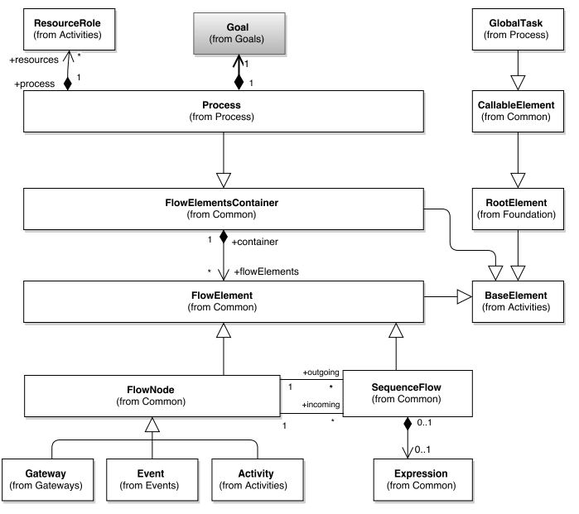
BPMN Plus Process
Each process has one associated goal
BPMN Plus
Process
Activity
Data
Performer
Goal
Event
Gateway

Slide 29
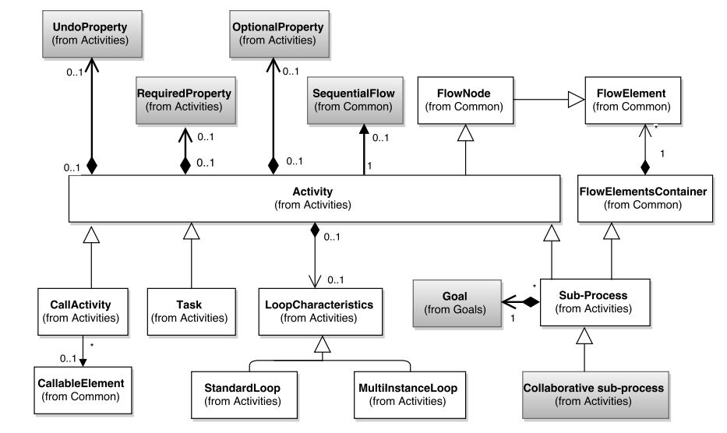
BPMN Plus Activity
New types of activities
Each subprocess can have one goal
BPMN Plus
Process
Activity
Data
Performer
Goal
Event
Gateway

Slide 30
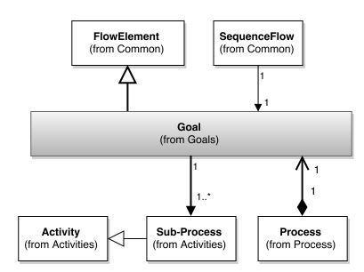
BPMN Plus Goal
Goal define the purpose of process
Each process has one goal
A single goal can be associated to number of sub-processes
BPMN Plus
Process
Activity
Data
Performer
Goal
Event
Gateway

Slide 31
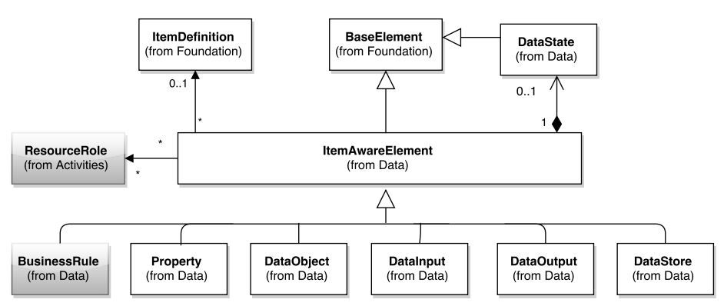
BPMN Plus Data
Business rule is introduced as data item
BPMN Plus
Process
Activity
Data
Performer
Goal
Event
Gateway

Slide 32
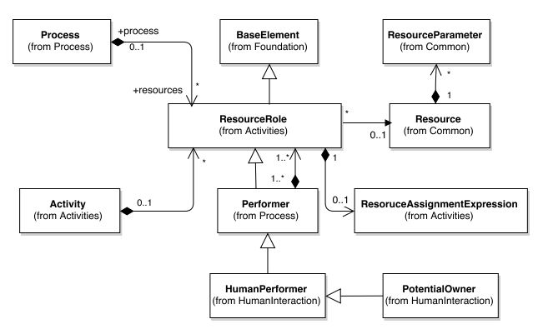
BPMN Plus Performer
Each performer can have one or more roles
BPMN Plus
Process
Activity
Data
Performer
Goal
Event
Gateway

Slide 33
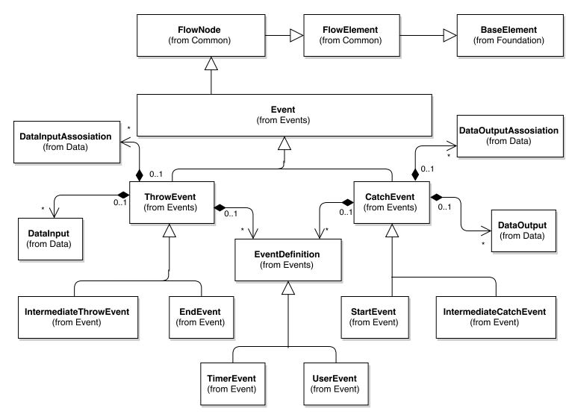
BPMN Plus Event
To avoid complexity, only two types of events are considered
BPMN Plus
Process
Activity
Data
Performer
Goal
Event
Gateway

Slide 34
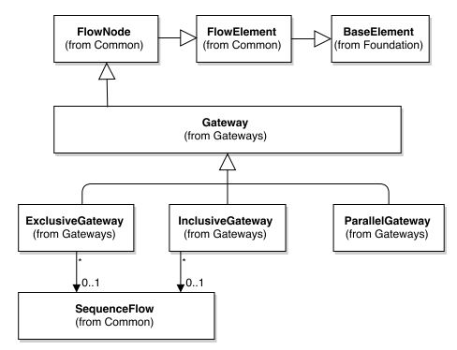
BPMN Plus Gateway
To avoid complexity, only three types of gateway are considered
BPMN Plus
Process
Activity
Data
Performer
Goal
Event
Gateway

Slide 35









BPMN Plus Notations
Proposed Notations
Collaborative
Subprocess
Optional
Activity
Required Activity
Undo Activity
Business Rule
Decision Activity
Performer
Role
Goal
RQ4

Slide 36







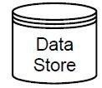






BPMN Plus Notations
Adopted from BPMN
Lane
Subprocess
Call Activity
User Activity
Data Object
Data Input
Data Output
Data Store
Event
Timer Event
User Event
Exclusive
Gateway
Parallel
Gateway
Inclusive
Gateway
RQ4

Slide 37
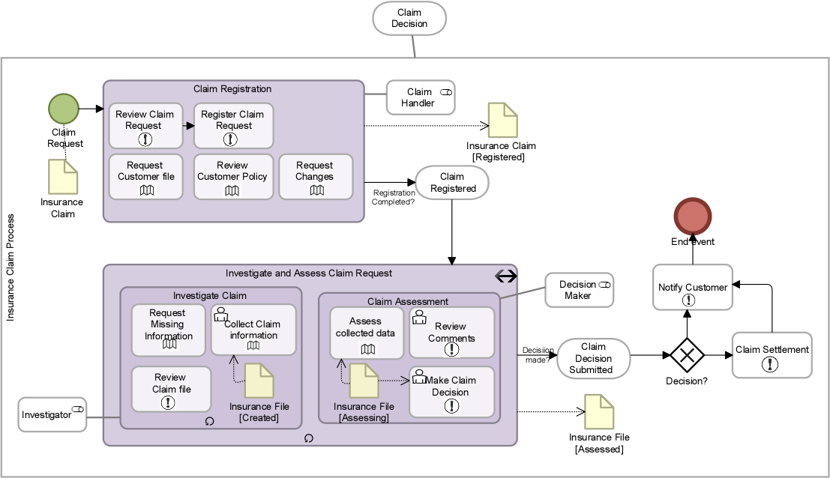
BPMN Plus Demonstration
Well define start and end event
Structured and Unstructured Parts
Expressive Activities
Data Access levels
Goal provide process overview
RQ4

Slide 38
Validation of BPMN Plus Comments
Conducted Interviews with three BPM consultants of BiZZdesign
The proposed notations are found to be very useful, especially collaborative subprocess, required, optional and reexecute activities.
Process model are easy to read and communicate as compared to CMMN model
Visualization of data access is very powerful

Slide 39
Validation of BPMN Plus Suggestion
Recommended changes in BPMN Plus
Eliminate Required or Optional task
Business rules representation might overcrowd the process model
Modify the notations to improve readibility
Assist on use of Concepts
Introduce BPMN Plus as a Modeling Level

Slide 40
Conclusions
Unstructured business process require optimum level of representation on design-time
BPMN and CMMN have certain modelling limitation with respect to unstructured business process
A BPMN Plus process model represent the optimum design-time definition as well as run-time flexibility
Notations of BPMN Plus can model structured and unstructured process parts

Slide 41
Future Work
Evaluate the BPMN Plus with real case study, and experiments
Reassess the capabilities of CMMN with the release of its newer version
Propose a new process modelling pattern to capture the interactions among knowledge workers

Slide 42
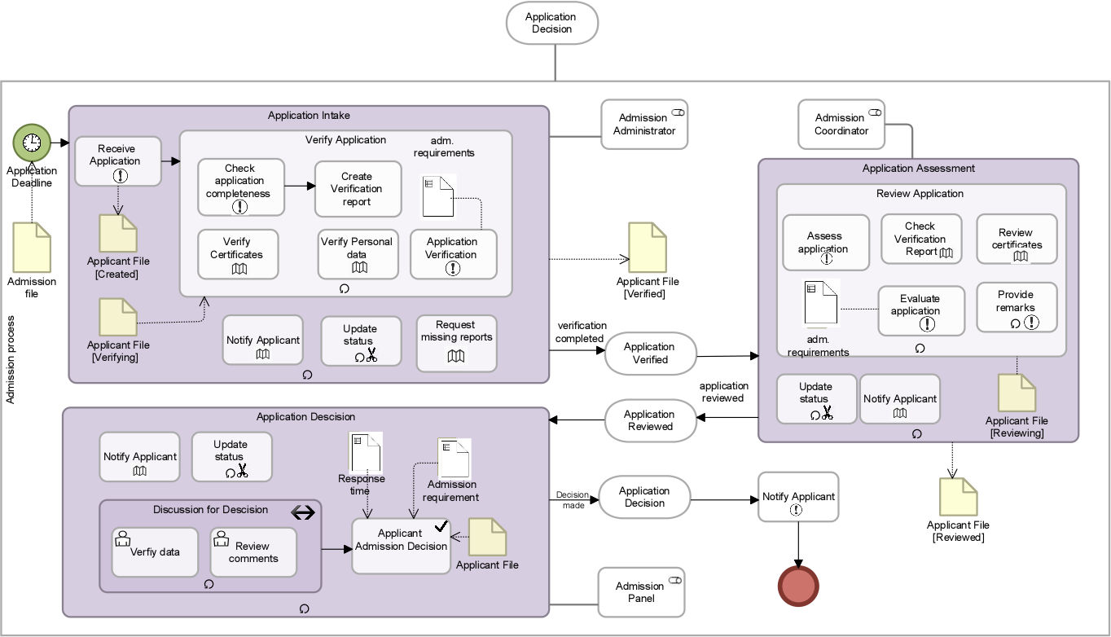
BPMN Plus Demonstration

Slide 43
Research Questions (1)
What are the differences between structured and unstructured business processes?
What are the differences between BPM and CM in dealing with unstructured business processes?
RQ1
RQ2

Slide 44
Research Questions (2)
What are the capabilities of existing modelling notations to deal with unstructured business processes?
How to model an unstructured business process while providing run-time flexibility?
RQ3
RQ4

Slide 45
Research Objective
To investigate the way through which the unstructured business processes can be modelled and managed without limiting their run-time flexibility

Slide 46
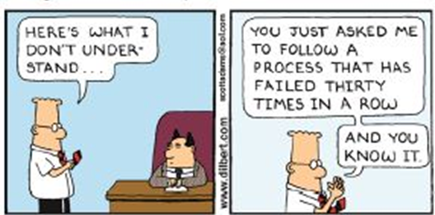
Problem Unpredictable Process instances

Slide 47


Problem Unpredictable Process instances
Run-time
Incomplete File
Incorrect policy number
Insurance Claim Registration

