Slide 1
Multi-criteria decision making: AHP method applied for network bridge prioritization
Zaharah Allah Bukhsh, Irina Stipanovic Oslakovic – University of Twente, Netherlands Giel Klanker – Rijkswaterstaat, Ministry of Infrastructure, Netherlands
Niels Peter Hoj – HOJ consulting, Brunmen, Switzerand
Boulent Imam – University of surrey, United kingdom
Yiannis Xenidis - Aristotle University of Thessaloniki , Greece

Slide 2
Introduction
Multi-criteria decision making: AHP method applied for network bridge prioritization – Zaharah et. al. 2017
Bridges are key structure of transport infrastructure networks
Length of bridge is just 2% or whole network but it represent 30% of value (PIARC, 1999)
Ratio of expenses per route km spent on bridge is 10 times more than the average expenses per route km (CEDR, 2010)
Bridge management is exposed with budget constrains and need of improved service quality
In last decade, number of bridge management system and life cycle tools have been developed to facilitate the reliable management of deteriorating assets

Slide 3
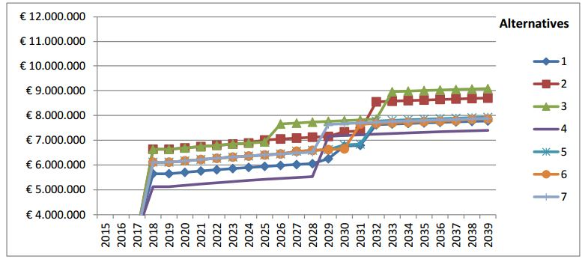
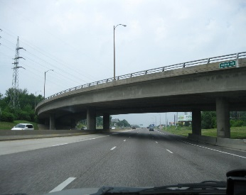
Bridge maintenance planning Object level
Multi-criteria decision making: AHP method applied for network bridge prioritization – Zaharah et. al. 2017
Consider only owner cost
Ignore environment impact, availability, importance on the transport and overall societal impacts
It is a process of deciding the scope, timing, costs, and benefits of future maintenance activities on a specific bridge.
Life cycle activity of each object
Selection, budgeting and planning on network level
Object level

Slide 4
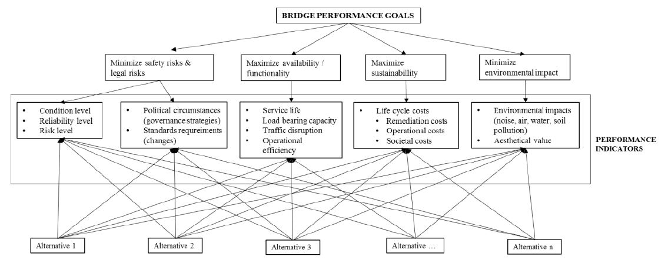
Bridge maintenance planning Network Level
Multi-criteria decision making: AHP method applied for network bridge prioritization – Zaharah et. al. 2017
Notes:
When we talk about network level, we zoom out a bit and consider the startgic decision making. Where we have wider scope of objectives and constrains.

Slide 5
Multi-criteria decision making: AHP method applied for network bridge prioritization – Zaharah et. al. 2017
Bridge maintenance planning Network Level
Notes:
Imagine having number of alternatives that are reaching to maximum state.

Slide 6
Multi-criteria decision making For maintenance planning
Multi-criteria decision making: AHP method applied for network bridge prioritization – Zaharah et. al. 2017
Systematic approach to evaluate multiple conflicting objectives in decision making
Limited budget vs. aging bridge
Demands of availability vs. need of maintenance
Risk of failure vs. criticality
Enable the decision maker to provide preferences when exposed with conflicting objectives
Weighting
Scaling
Amalgamation
Notes:
Weifhting: preference for a one creteria/attributr
Scaling: to convert
Amagaltion preference among multiple creteria

Slide 7
Multi-criteria decision making: AHP method applied for network bridge prioritization – Zaharah et. al. 2017
Multi-criteria decision making Analytical Hierarchy Process
Comparison of decision criteria (Experts’ judgment)
Matrix normalization into value function
Presentation
Define objective and identify criteria
Define the decision problems and the relative criteria
Pairwise comparison of decision criteria based on
fundamental scale (Saaty, 1999).
Normalization of each column into value function from 0 to 1
Calculate the eigenvector by Geomean
Present the final result
Notes:
Not all of the criteria of same importance. So a pairwise comparison to compare each of the objective with other one.

Slide 8
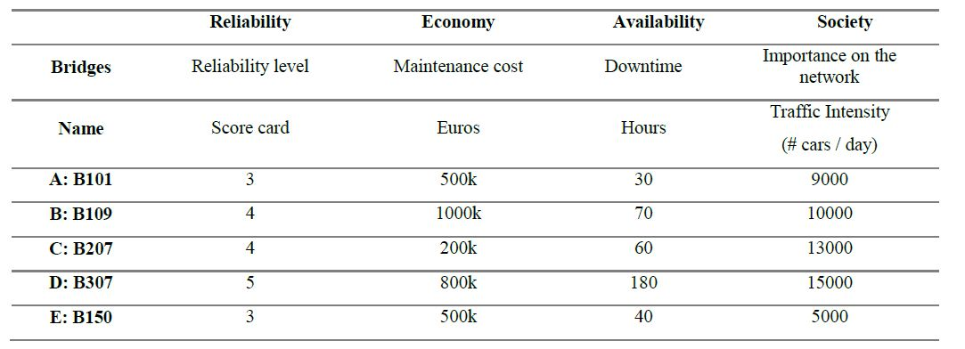
Analytical Hierarchy Process Illustrative example
Multi-criteria decision making: AHP method applied for network bridge prioritization – Zaharah et. al. 2017
Define objective and identify criteria
Objectives
Minimize the maintenance cost
Minimize the downtime
Performance indicator
Criteria
Scale
Alternatives

Slide 9
Analytical Hierarchy Process Preference structure
Multi-criteria decision making: AHP method applied for network bridge prioritization – Zaharah et. al. 2017
Comparison of decision criteria (Experts’ judgment)
Criteria |  | Important | Intensity
A | B
Maintenance cost | Downtime | A | 1: Equal importance
Maintenance cost | Reliability level | A | 3: Moderate
Maintenance cost | Traffic Intensity | A | 5: strong
Downtime | Reliability level | A | 3: strong
Downtime | Traffic Intensity | A | 3: Equal importance
Reliability level | Traffic Intensity | A | 7: Very strong
Fundamental Scale for Pairwise Comparisons
Intensity of Importance | Definition
1 | Equal Importance
3 | Moderate importance
5 | Strong importance
7 | Very Strong importance
9 | Extreme importance
Intensities of 2, 4, 6, and 8 can be used to express intermediate values.

Slide 10


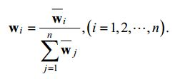
Analytical Hierarchy Process Matrix normalization
Multi-criteria decision making: AHP method applied for network bridge prioritization – Zaharah et. al. 2017
Comparison of decision criteria (Experts’ judgment)
Create the comparison matrix from the preference structure
Reduce the matrix from 0 to 1 by
Calculate the final Eigen vector from the preferences of each alternative by

Slide 11
Multi-criteria decision making: AHP method applied for network bridge prioritization – Zaharah et. al. 2017
Comparison Matrix
Comparison of decision criteria (Experts’ judgment)
Comparison among criteria | Maintenance cost | Downtime | Reliability level | Traffic Intensity
Maintenance cost | 1.00 | 1.00 | 3.00 | 5
Downtime | 1.00 | 1.00 | 3.00 | 3
Reliability level | 0.33 | 0.33 | 1.00 | 7
Traffic Intensity | 0.20 | 0.33 | 0.14 | 1
Matrix Normalization
Normalized matrix | Maintenance cost | Downtime | Reliability level | Traffic Intensity
Maintenance cost | 0.39 | 0.38 | 0.42 | 0.31
Downtime | 0.39 | 0.38 | 0.42 | 0.19
Reliability level | 0.13 | 0.13 | 0.14 | 0.44
Traffic Intensity | 0.08 | 0.13 | 0.02 | 0.06

Slide 12
Multi-criteria decision making: AHP method applied for network bridge prioritization – Zaharah et. al. 2017
Comparison of decision criteria (Experts’ judgment)
Calculate eigenvector
Normalized matrix | Maintenance cost | Downtime | Reliability level | Traffic Intensity
Maintenance cost | 0.39 | 0.38 | 0.42 | 0.31
Downtime | 0.39 | 0.38 | 0.42 | 0.19
Reliability level | 0.13 | 0.13 | 0.14 | 0.44
Traffic Intensity | 0.08 | 0.13 | 0.02 | 0.06
Scores
0.37
0.33
0.18
0.06

Slide 13
Multi-criteria decision making: AHP method applied for network bridge prioritization – Zaharah et. al. 2017
Comparison of decision criteria (Experts’ judgment)
Analytical Hierarchy Process Matrix normalization
 | Maintenance cost | Downtime | Reliability level | Traffic Intensity
A: B101 | 0.20 | 0.37 | 0.07 | 0.11
B: B109 | 0.04 | 0.12 | 0.19 | 0.11
C: B207 | 0.47 | 0.15 | 0.19 | 0.24
D: B307 | 0.08 | 0.03 | 0.46 | 0.49
E: B150 | 0.20 | 0.28 | 0.07 | 0.03
Overall score
0.21
0.09
0.27
0.15
0.18
Scores
0.37
0.33
0.18
0.06
Matrix Multiplication

Slide 14
Results
2
5
1
4
3

Slide 15
Results
4
3
2
1
5

Slide 16
Conclusion
Multi-criteria decision making: AHP method applied for network bridge prioritization – Zaharah et. al. 2017
The framework of multi-criteria decision making (MCDM) provides a guidance on how to implement multiple performance goals
The methods of MCDM incorporate decision makers preferences on multiple (conflicting) performance indicators
The pairwise comparison of AHP grows exponentially when presented with large number of performance indicators
For the maintenance optimization over the network, a link between the performance indicators at object level and the goal on network level needs to be established.
The quantification of performance goals, other than technical goals, is a challenge.

Slide 17


