Slide 1















Understanding Modeling Requirements of
Unstructured Business Processes
Zaharah Allah Bukhsh, Marten van Sinderen
Klaas Sikkel and Dick Quartel

Slide 2
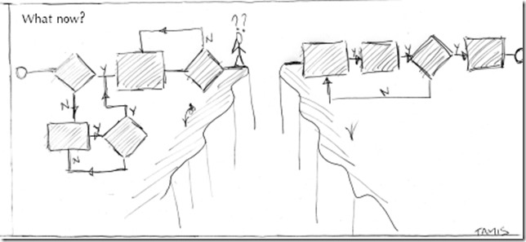

Agenda
Background and Problem
1.
Modeling capabilities of
BPMN and CMMN
2.
Modeling requirements of
Unstructured Business Process (UBP)
3.
4.
Validation
5.
Conclusions
5

Slide 3


Background and Motivation
1.

Slide 4
Modelling unstructured process in a flexible manner
Understanding Modeling Requirements of Unstructured Business Processes
But, the exact course of activities are undefined and unpredictable
Collection of activities that take one or more input and create output that is of value to customer/business
Notes:
Either we provide too much detsail or we moel them in structured way

Slide 5


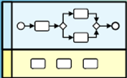

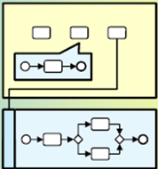



Business Process Spectrum
Structured
Structured with
Ad-hoc Exceptions
Unstructured with
Pre-defined fragments
Unstructured
Source: (Kemsley, 2011)
Notes:
Think of running example:
Buy a flight ticket online (session out!)
Printing a paper from printer
Admission process
Insurance process (outline the involved stakeholders and complexity)

Slide 6
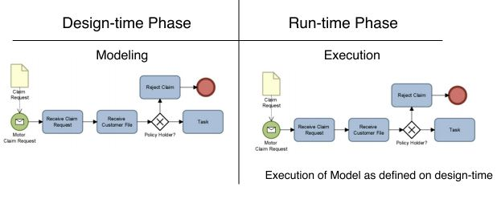
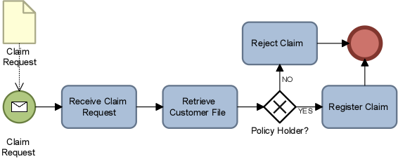
Structured Business Process
Problem
Design-time
Run-time
Insurance Claim Registration

Slide 7
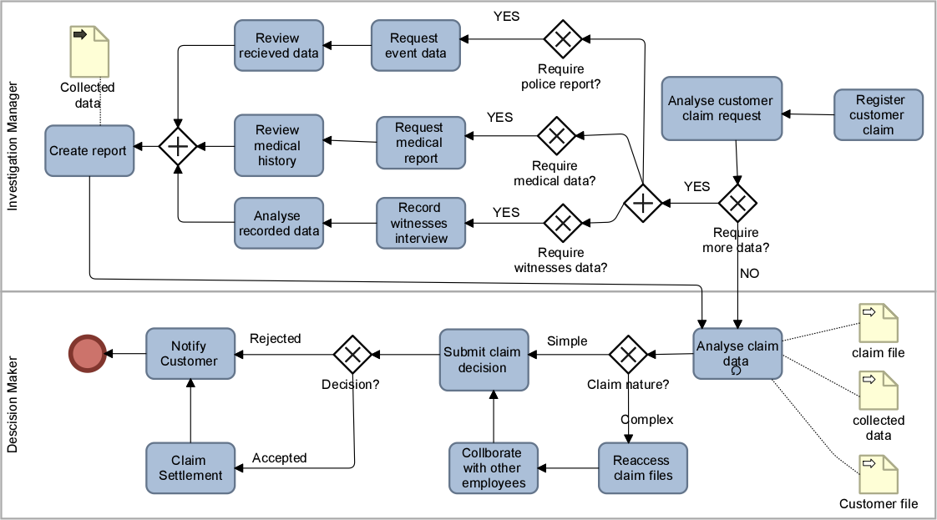



Unpredictable Process instances
Problem
Notes:
Which means we cannot model the unstructured process in sturctured wayb
It can take many unexpected paths based on available data and contextual triggers

Slide 8
Problem
According to AIIM survey, more than 50% of the processes are unstructured
Unstructured process are straight jacketed into structured processes flow
Process model doesn’t show the real business process
Drivers for modeling unstructured process: Documentation, Communicate, Redesign
How can unstructured business processes be modelled in a flexible manner?
Notes:
Association for Information and Image Management

Slide 9
Modeling capabilities of BPMN and CMMN
2.

Slide 10
Modelling of UBP
Assess the capabilities of modelling languages to model an unstructured business process
Business Process Model and Notation (BPMN)
Initially proposed by Business process management initiative and later adopted by OMG
BPMN version 2.0 realised in 2011
Case Management Model and Notation (CMMN)
Proposed by OMG specifically for unstructured business processes
CMMN specification realised in 2014
With a sample admission business process for a student in university

Slide 11
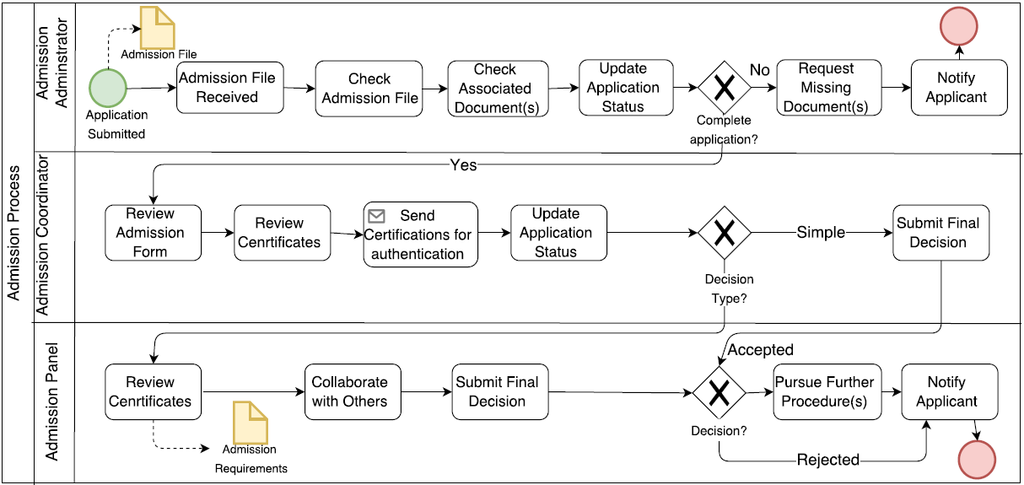
Modelling of UBP with BPMN
Task Ordering
Unavailable Optional Task
Limited Data View
Notes:
These are not problem but they limit the flexibility of unstructured process mode.. Nteresing observationl
Task ordering: Send certificate for authentication’ will be only performed after the task ‘Review admission form’ has been completed. While, in reality, the verification of certificates and review of admission form can be performed in parallel
For example, the activity ‘Send certificates for authentication’, in Figure 1, should be regarded as an optional activity if the authentication
is not needed.
Data view: there are no details if we provide more data or not!

Slide 12
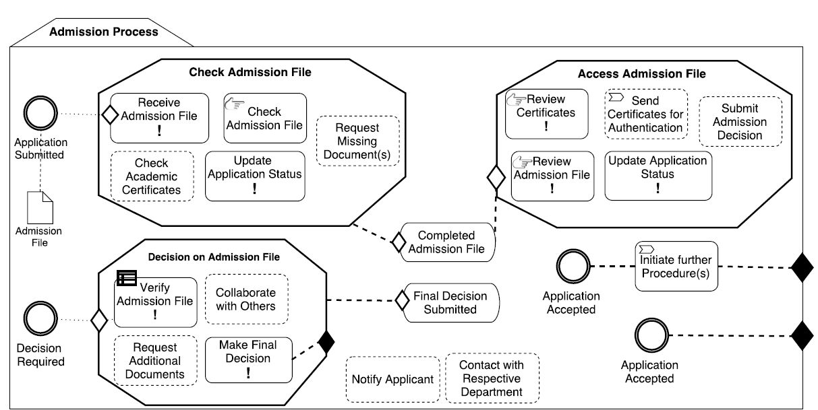
Modelling of UBP with CMMN
Case Folder
No Sequential Flow
Stages
Undefined User Role
Task Dependency
Milestones
Sentries
Notes:
Task dependency: the stage of Assess Admission File will only be executed if the milestone Application Check Completed
has been achieved.

Slide 13
Modelling of UBP
Limitations
BPMN
CMMN
Unnecessary task dependency
Notation of ad-hoc process is not very expressive
Low (no) support for ad-hoc process execution
Limited view on state of data
Unavailability of sequence flow hinders the process model readability
No notation to model user roles and data flow
Limited view on state of data

Slide 14
Modeling requirements of
Unstructured Business Process
3.

Slide 15
Representational Requirements of UBP
Capture Real-time Events
Ordered and Unordered Activities
Capture Conditions
Process Specification
Data Specification
Business Rules Specification
Goal Specification
Knowledge Workers Specification
Activities Specification
Optional and Required Activities
Re-execute and Undo Activities
Varying Levels of Granularity
Collaboration Among Activities
Role Assignment
Process and Data Alignment
Capture Decisions
Process/Activity Call
Data Representation
Data Versioning
Goals Definition
Data Authorization
Business Rules Definition

Slide 16
Demonstration of Representational Requirements of UBP
Extended BPMN
Process
Activity
Data
User role
Goal
Notes:
Optimum set of modelling notation that can represent structured and unstructured process parts.

Slide 17


Demonstration of Representational Requirements of UBP
Extended BPMN
Process
Activity
Data
User role
Goal
Process contains set of related activities
Each process has one associated goal
Notes:
Optimum set of modelling notation that can represent structured and unstructured process parts.

Slide 18





Demonstration of Representational Requirements of UBP
Extended BPMN
Process
Activity
Data
User role
Goal
Variety of process related activities and sub-process
?
Collaborative
Subprocess
Optional
Activity
Required Activity
Undo Activity
Decision Activity
Notes:
Optimum set of modelling notation that can represent structured and unstructured process parts.

Slide 19
Demonstration of Representational Requirements of UBP
Extended BPMN
Process
Activity
Data
User role
Goal
Goal define the purpose of process
Each process has one goal, while a single goal can be associated to number of sub-processes
Goal
Notes:
Optimum set of modelling notation that can represent structured and unstructured process parts.

Slide 20

Demonstration of Representational Requirements of UBP
Extended BPMN
Process
Activity
Data
User role
Goal
Business rule is introduced as data item
Business Rule
Notes:
Optimum set of modelling notation that can represent structured and unstructured process parts.

Slide 21

Demonstration of Representational Requirements of UBP
Extended BPMN
Process
Activity
Data
User role
Goal
User role represents a person or a class of people who are assigned to perform the process execution
Role
Notes:
Optimum set of modelling notation that can represent structured and unstructured process parts.

Slide 22
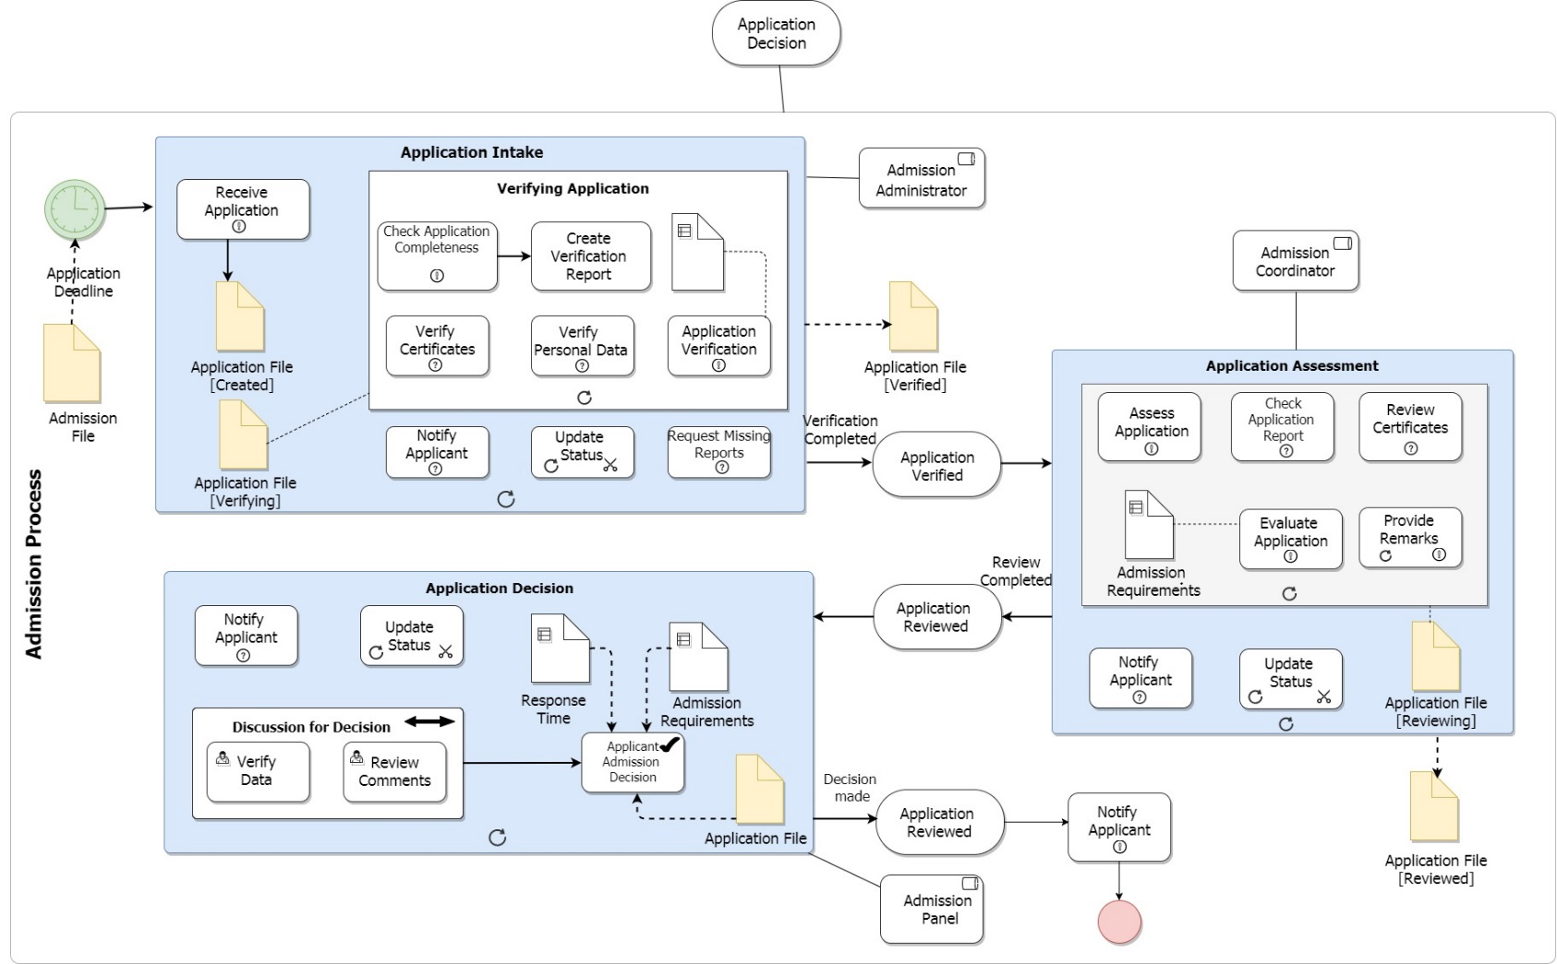
Process model of UBP with BPMN extended constructs
Goal
Sub-process
Well defined start & end event
Timer event
Structured and Unstructured Parts
Expressive Activities
User role
Goal condition
Data Access Levels
Process name
Collaboration activity
Decision activity
Data file with state
Goal provide process overview
End event

Slide 23
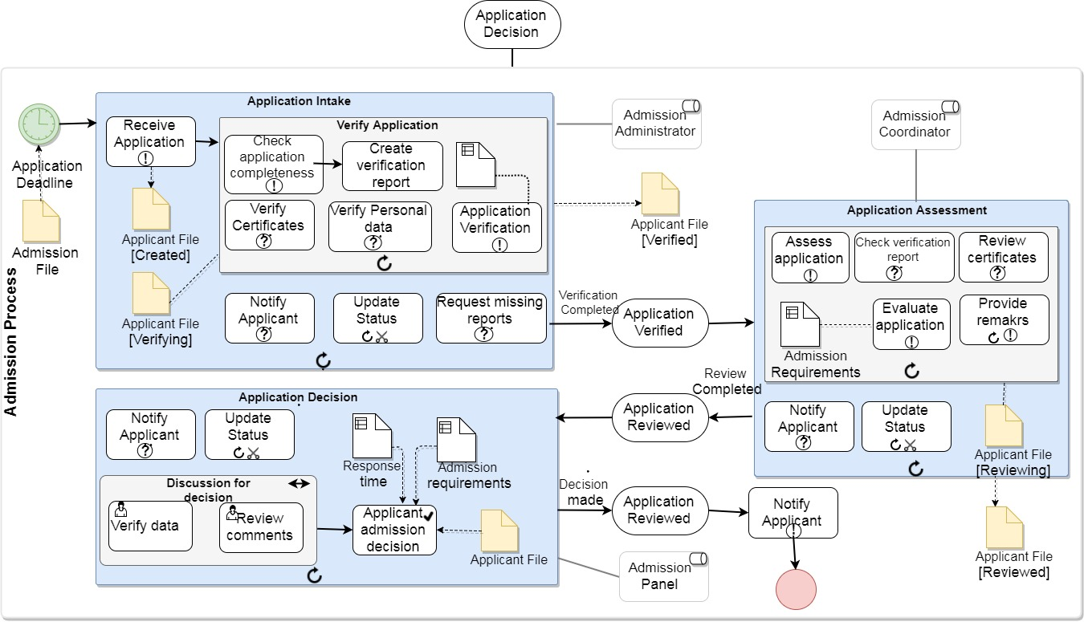
Process model of UBP with BPMN extended constructs
Goal
Sub-process
Well defined start & end event
Timer event
User role
Structured and Unstructured Parts
Expressive Activities
Goal condition
Data Access Levels
Process name
Data file with state
Goal provide process overview
Collaboration activity
Decision activity
End event

Slide 24
Validation
4.

Slide 25
Validation
Comments
Conducted Interviews with three BPM consultants of BiZZdesign
The proposed requirements represented by BPMN extended constructs are found to be very useful
Collaborative sub-process
Required activities
Optional activities
Re-execute activities
Process model are easy to read and communicate as compared to CMMN model
Visualization of data access is very powerful

Slide 26
Validation
Suggestions
Recommended changes in extended BPMN Construct
Eliminate Required or Optional task
Business rules representation might overcrowd the process model
Modify the notations to improve readability
Assist on use of Concepts
Introduce BPMN Extended construct as a Modeling Level
Notes:
Modeling level..description (for business people) .. Analytical (detailed with exception, rules )..

Slide 27
Conclusions
5.

Slide 28
Conclusions
Unstructured business process require optimum level of representation on design-time
BPMN and CMMN have certain modelling limitations with respect to unstructured business processes
In the future, a modelling language that fulfil the representation requirements can sufficiently model structured and unstructured process parts
A process model with extended BPMN construct provides the optimum design-time definition as well as run-time flexibility

Slide 29


Questions?
 | @BukhshZaharah
 | z.allahbukhsh@utwente.nl

