Slide 1
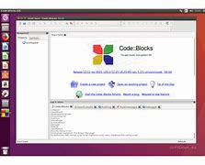
SD TEMA 1:
SORTARI
Zaharia Diana Cristiana

Slide 2
Sortarile Implementate
Bubble Sort
Quick Sort
Merge Sort
Count Sort

Slide 3

Complexitate
(Worst Case)
Bubble Sort: O (n^2)
Quick Sort: O (n^2)
Merge Sort: O (n log n)
Count Sort: O (n + r)

Slide 4
Tabel comparare vector random 10^4
bublesort | countsort | mergesort | quicksort
0,967 | 0,001 | 0,009 | -

