Slide 1
36th AGM and Conference of PSDE Charter of Economy Investment, Productivity & Employment

Slide 2
Assessing graduates’ readiness for jobs of today and tomorrow

Slide 3

Zahid Asghar School of Economics Quaid-i-Azam University, Islamabad

Slide 4
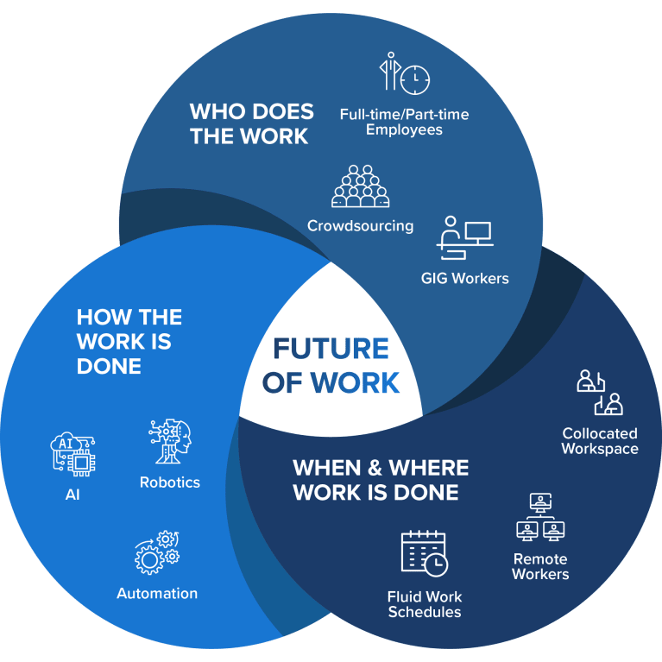
Research Questions
Whether our graduates are well equiped with skills for jobs of today and tomorrow?
What type of learning eco-system can enable higher education institutions to prepare graduates work ready and continuous learners
3rd decade of the 21st century is being characterized as the ‘Talent wars’ perhaps eclipsing the conflict for resources, ideology, territory etc. Talent flows to the highest bidder. Talent thrives in economic and competitive environments.
Outline
Huge youth bulge, unemployment, low economic growth
Lower productivity, stagnant output
Traditional skills
Universities : Business as usual
Shift from old paradigm to new paradigm
New learning ecosystem
Notes:
First, the advancing digitalization of work has made highly educated workers more productive and less-educated workers easier to replace with machinery.
The theory we are talking about states that a so-called “youth bulge”, which describes an excess in the young population of a country, is the real (and main) hidden force behind political instability. The term was first used by Gary Fuller in 1995, then adopted by the renowned political scientist Samuel Huntington, and later extended and popularized by German sociologist and economist Gunnar Heinsohn in his book “Söhne und Weltmacht” (2003, new ed. 2019). The basic idea is that resources are limited and are owned and managed by (older) adults. This is also true for (political) power. Young people want a piece of the action. The bigger the imbalance, i.e. the more young people there are, the bigger the conflicts because more young people fight for their place in the economy and society.

Slide 5
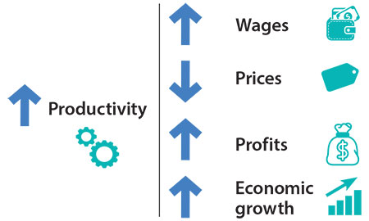

Slide 6
Challenges
Chasm between skills required and skill prevailing
Digital revolution, gig economy and Silicon Valley era
Employers placing higher values on work ready graduates
Firms : buying talent instead of investing in talent
Questions
What sort of skilling and reskilling may help our burgeoning young population and labor force to unlock its potential?
How , what types and where long-term investment be made by the institutions in skilling, reskilling and upskilling of youth and working population should be made?

Slide 7
Enabling workers to remain productive in a continuously evolving workplace requires empowering them with excellent skills programs at all stages of life—in primary and secondary schools, in vocational and college programs, and in ongoing adult training programs.
According to Robert Solow (2022 Prefeace The Work of the Future)
Maintaining a skilled and adaptable labor force : productivity.
Easy access to education can function as an equalizing factor, although it is pretty clear that it does not perform this function very well in the US.
Challenges and Opportunities
36% Pakistani Population under 14 years (WDI)
64% Pakistani Population under age 30 years
skill-biased technical change
Skill inequality gap
Opportunities to excel but requires skills
25 million aged 17-25, universities catering 2.5-3 million
Skill inequality gap based on degree and its quality is huge
Haque and Nayab (2022)
“Are we prepared for this new world? Our education system our governance system all need to be realigned if we are to meet this new world. Many new opportunities will open only if the economy and the policy are both seriously reimagined.”

Slide 8
Survey Results
Characteristic | N = 274¹
program
BS | 107 (40%)
MPhil | 112 (42%)
Other | 20 (7.5%)
PhD | 28 (10%)
Unknown | 7
¹ n (%)
Program of Study
Table 1. Program of study

Slide 9
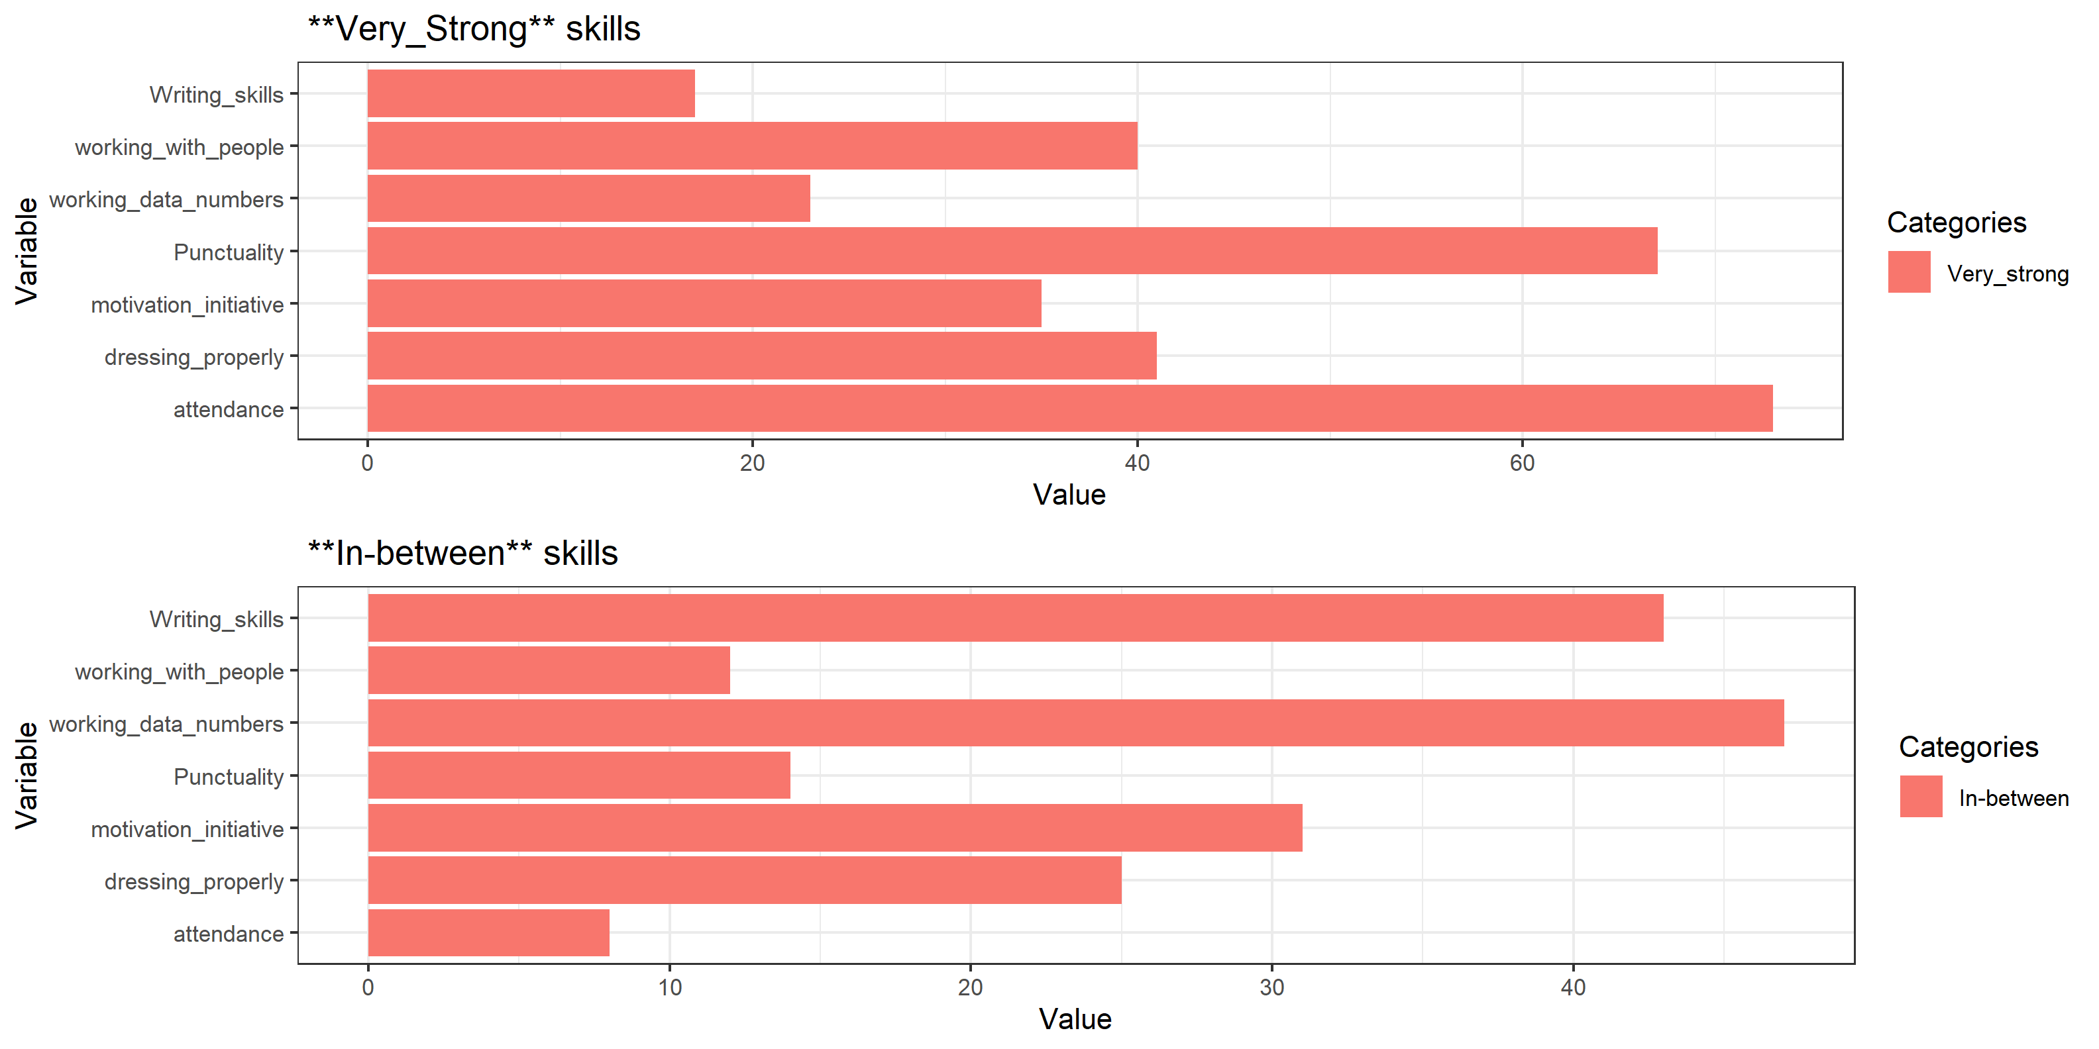
Awareness
Table 2: Awareness about AI, ML, Robotics and other disruption in future jobs
Preparedness
Table 3: How prepared one feels for job entry
Skills strengths

Slide 10
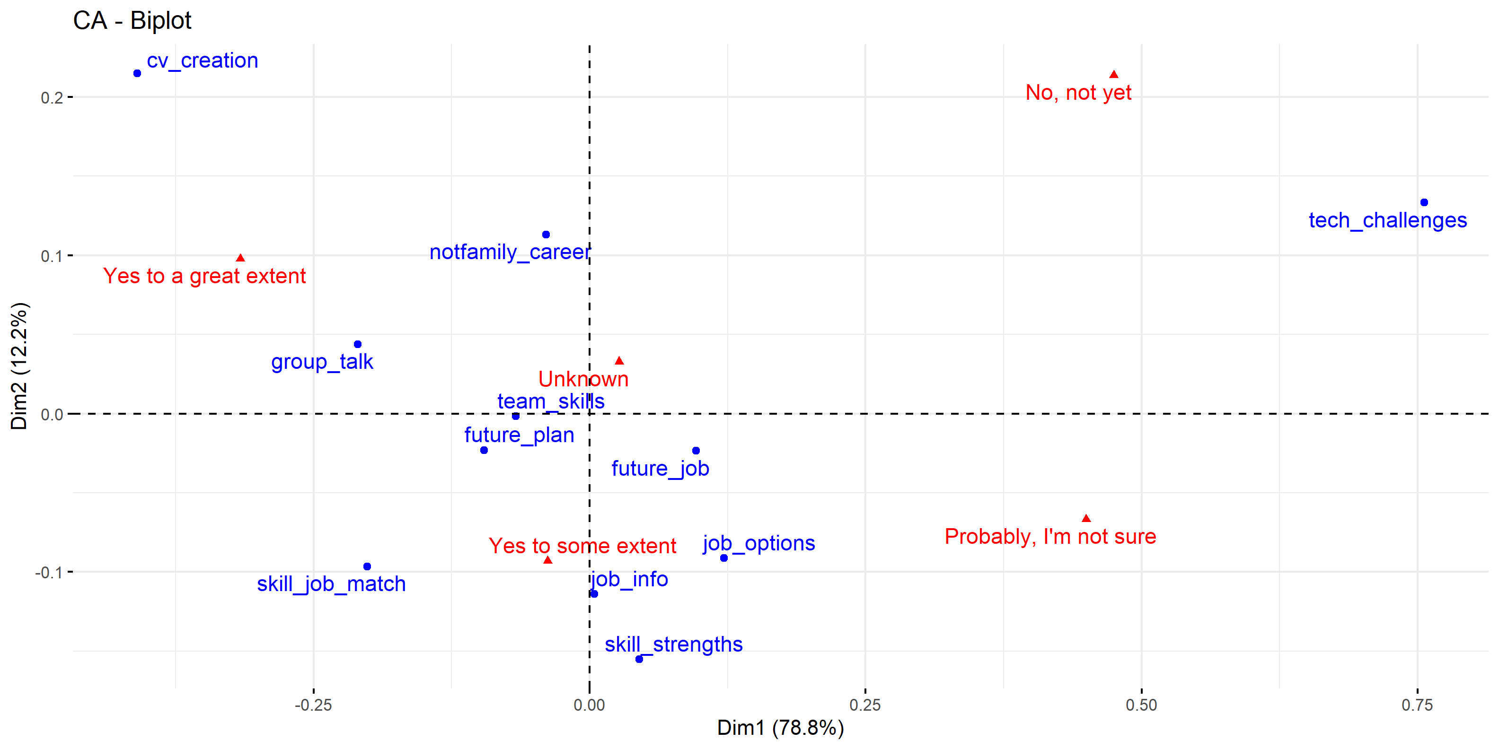
Correspondence Analysis

Slide 11
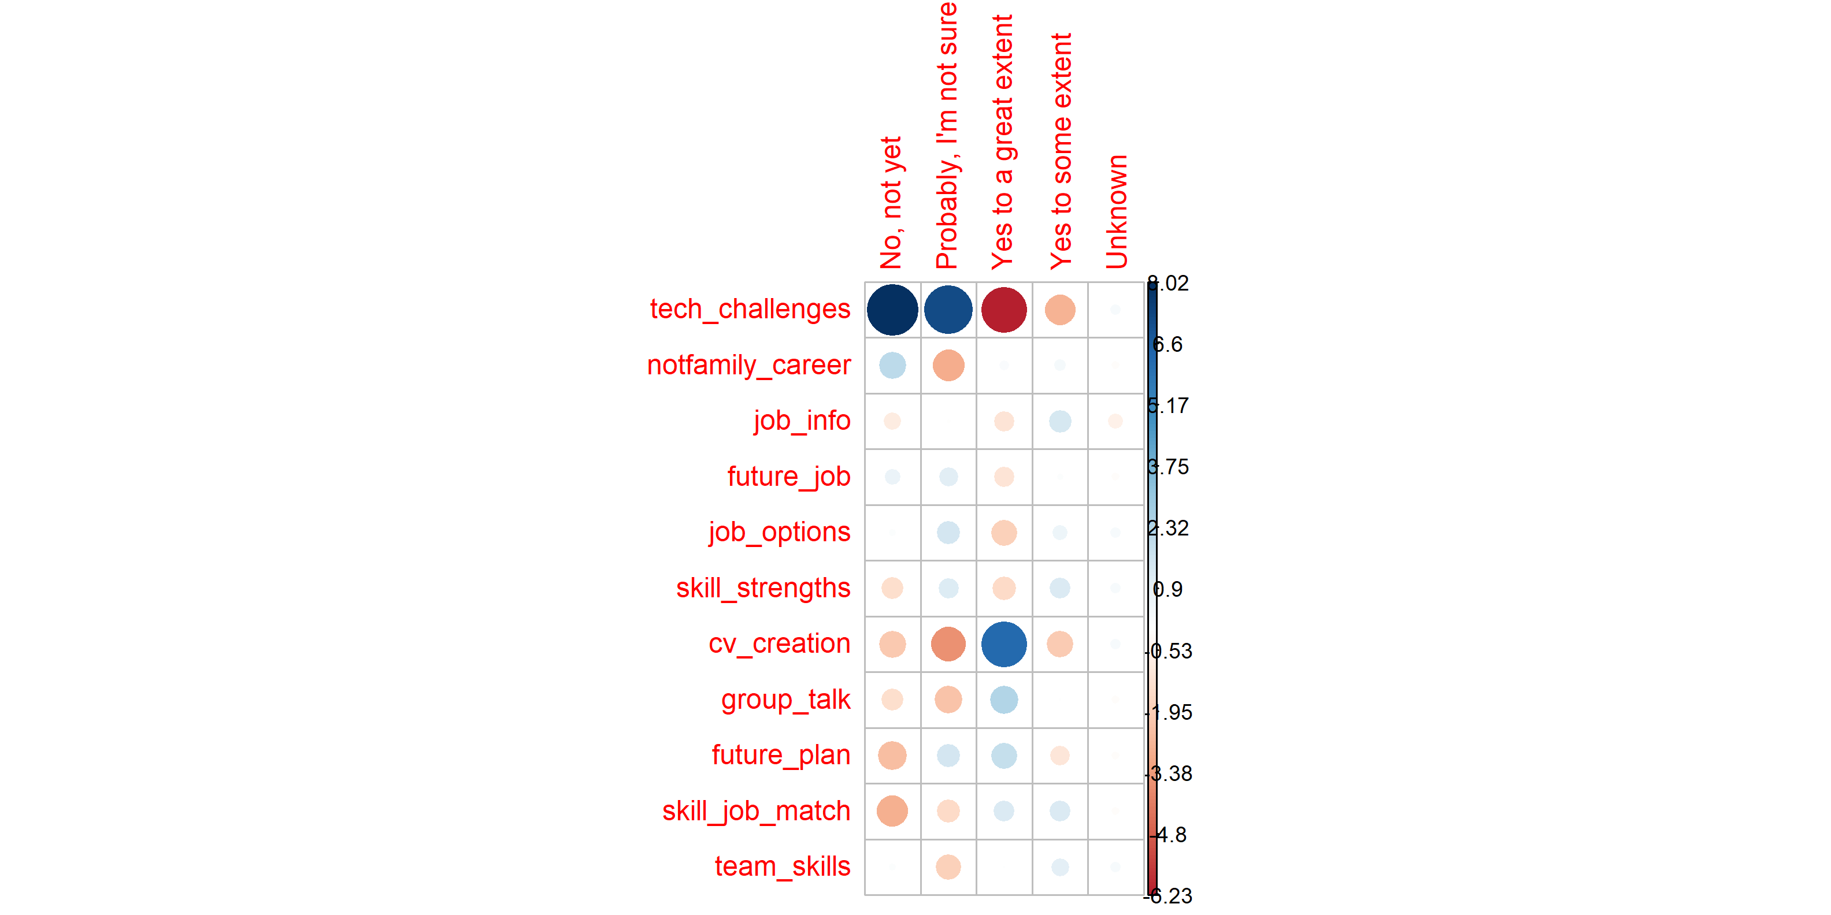
Chi-square

Slide 12
Response | %age
Yes | 68.8%
No | 13.4%
Maybe | 17.9%
Career counseling
Do you think choice of degree would have been better if you were provided career counseling before admission to a university?

Slide 13
Response | % response
Strongly agree | 67.5%
Agree | 26.3%
Nuetral | 5.5%
Disagree | 0.7%
Strongly Disagree | 0%
Do you think career counseling be mandatory?

Slide 14
Qualification | Earnings (USD)
Matric | 165.54
Intermediate | 156.76
Bachelor | 198.94
Masters | 117.54
PhDs | 350.00
Average earnings per month in USD by qualification

Slide 15
Universities’ Role
Learning Ecosystem

Slide 16
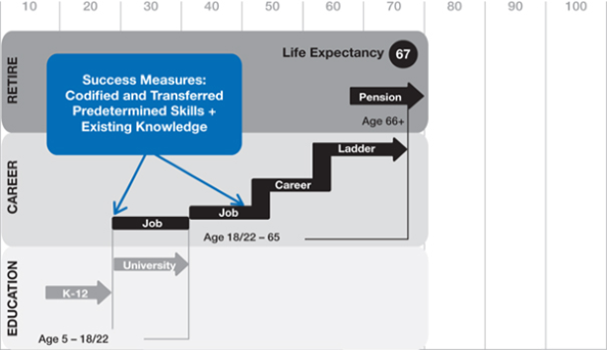
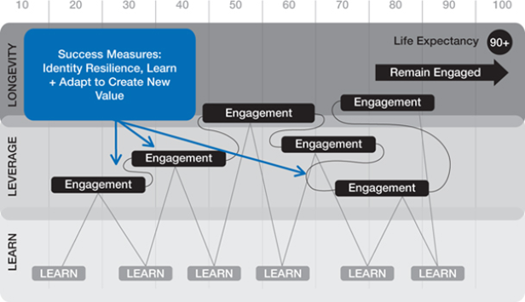

Slide 17
Key Recommendations:
Weise(2020) Long Life Learning
“If we want to move from a future we dont want to a future we want, we have to consciously practice bold thinking to achieve the desired future.”
Expose graduates to a wide variety of skills, mentoring them on reliable resources, strengthening soft skills and enabling them to move on a continuous learning path.
Create opportunities for working learners for re-skilling and up-skilling opportunities.
Factory forced learning model based on fixed time to learning outcome based model

Slide 18
I argue the need for developing a new learning ecosystem to for accessible, engaging, and cost effective skill development.

