Slide 1
Pakistan’s Growth Potential: What Should Foreign Investors Worry About?
Presentation at consulate general of switzerland
May 8, 2018
Farrukh Iqbal, Director, Institute of Business Administration

Slide 2
Approach
When making decisions about long term investments in a country, foreign investors must form an opinion of that country’s growth potential relative to that of other countries where they might invest
In this talk I will focus on the long run growth potential of Pakistan in the comparative perspective of India, a neighboring country with similar history and institutions
I will not spend a lot of time on short-run issues such as what is happening to macroeconomic indicators over six months or a year;
I will, instead, focus on long run growth issues, based on my reading of the international growth economics literature

Slide 3
The Short Run View
Low oil prices
Improved domestic energy supply
Improved domestic security
Low inflation environment
Best growth performance in 2017 in last 10 years
CPEC
So why do OICCI members think they will invest only $3 billion over the next five years?

Slide 4
The Basic Model of Long Run Growth
Capital
Labor (especially educated labor)
Policies
Institutions
Geography

Slide 5
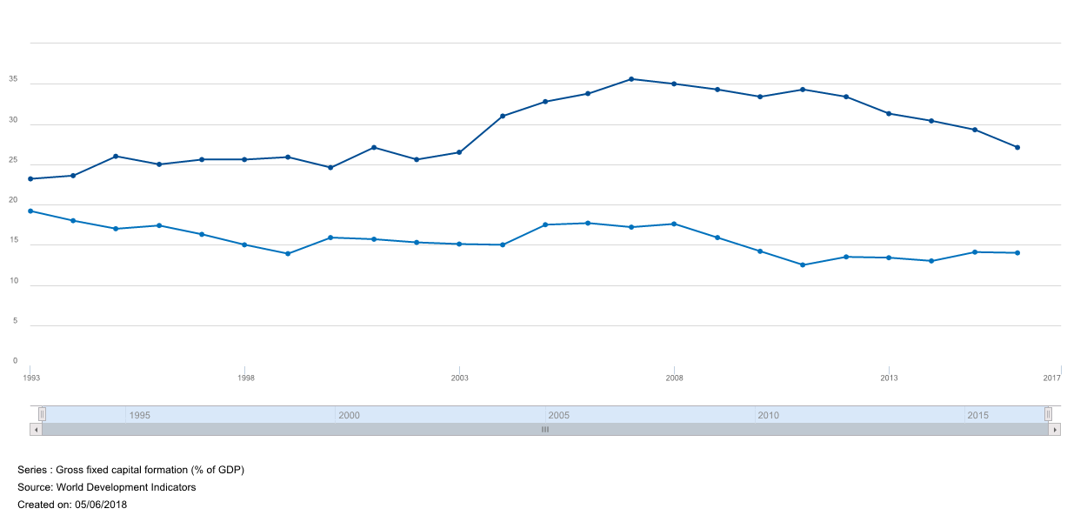
Gross fixed capital formation (% GDP)

Slide 6
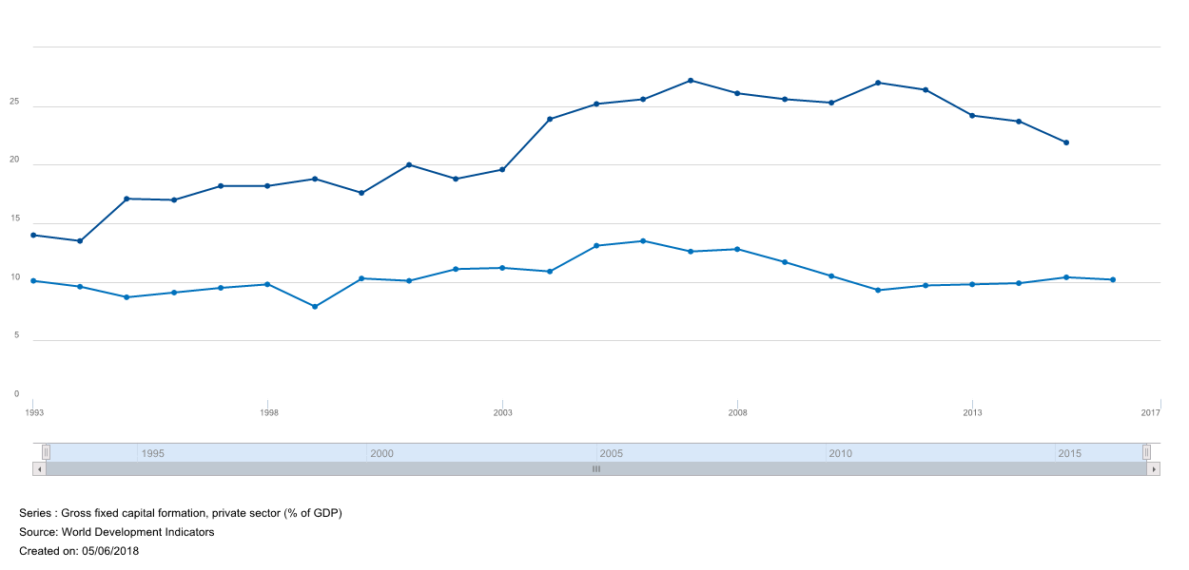
Private Investment Trends

Slide 7
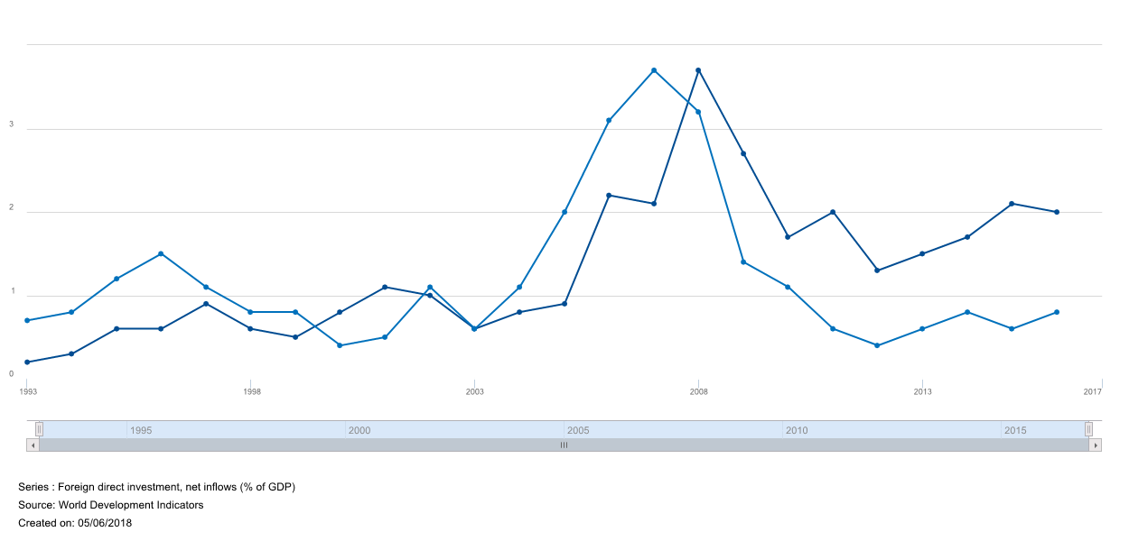
Foreign Investment Trends

Slide 8
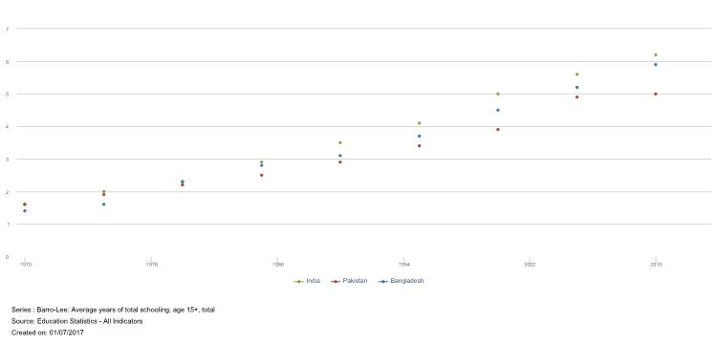
Years of total schooling (age 15+)

Slide 9
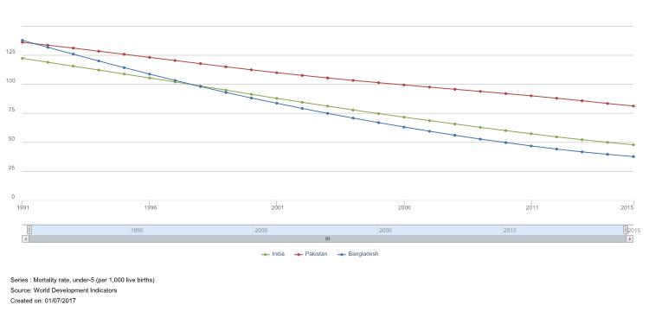
Mortality rates (age under 5)

Slide 10
Policies
Openness to trade
Ease of doing business
Logistics
Macroeconomic management
Tax burden (11 of 12 proposals in OICCI wish list for new budget had to do with taxes)
Policy arbitrariness and uncertainty

Slide 11
Institutional Quality
Security
Corruption
Rule of Law
Voice
Transparency

Slide 12
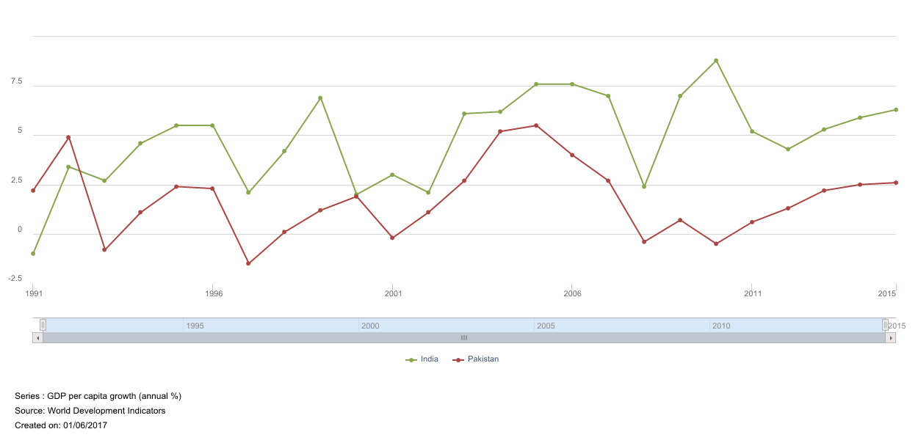
Outcomes: Growth rates

Slide 13
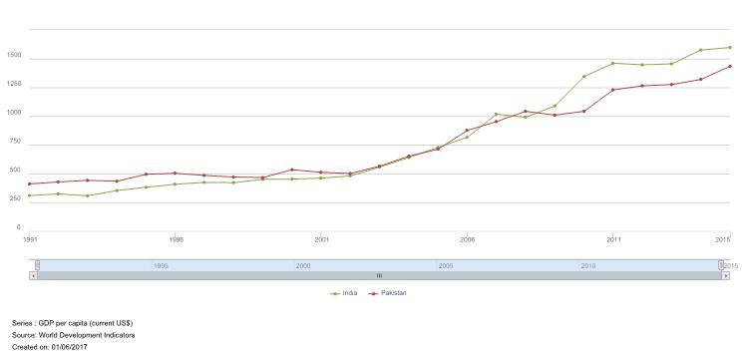
Outcomes: Per capita incomes

Slide 14
Conclusions
The subtitle of my talk was What Should Foreign Investors Worry About in Pakistan?
They should worry about why domestic investors have not been increasing their investments relative to GDP for the past 20-25 years
Even though the policy and institutional environment has fluctuated over the past quarter century, domestic private investment has stayed around 10% of GDP
India’s private investment rates clearly reflect optimism; Pakistan’s do not
Education may be the key because it offers increasing returns to scale; Pakistan needs to do much better on this especially with regard to education quality
That is why I am in the education business!

