Slide 1
Advanced Econometrics (Program Evaluation Tools) Workshop
6-7 Feb 2023 Zahid Asghar

Slide 2
Program/Impact Evaluation Key Tools

Slide 3
Health Insurance Subsidy Program Data

Slide 4
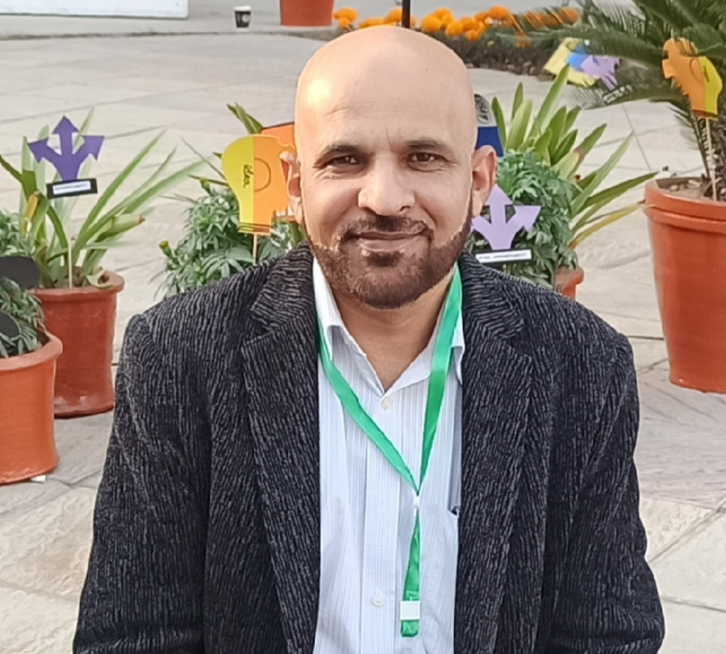
Resource Person

Slide 5
::: {style=“text-align: center;”} Prof.Dr. Zahid Asghar :::

Slide 6
How can we help researchers better use their conceptual knowledge and skills to analyze real-world data?
Outline
- Directed Acyclical Graphs
- Difference in Differences Estiamtors
- Instrumental Variable and its 3 key assumptions
- Regression Discontinuity Design
- Matching
- Application of all these tools on Health Insurance Subsidy Program data

