Slide 1
Development of Industry and Industrial Policy
Zahid Asghar

Slide 2
Kawasakinomics
Bottom up approach
Tough competition : explore the unexplored
Continuous upgrade : products can be imitated as Korea, China and many others have imitated Japan. e.g Korea in electronic industry
Not natural resource but highly trained human capital is main factor for strong industrial base
Industrial development is basically a Talent war : Japan, Singapore, Israel

Slide 3
Implicit in the oft-repeated Japanese statement,
“We are an island nation with no natural resources,”
is the understanding that these deficiencies have only served to spur Japan’s competitive innovation.
Strong industrial base must be backed by the strength of the institutions, high quality human capital

Slide 4
Domestic demand
A nation’s companies gain competitive advantage if domestic buyers are the world’s most sophisticated and demanding buyers for the product or service. Sophisticated, demanding buyers provide a window into advanced customer needs; they pressure companies to meet high standards; they prod them to improve, to innovate, and to upgrade into more advanced segments. As with factor conditions, demand conditions provide advantages by forcing companies to respond to tough challenges. - e.g Japanese pioneered compact, quiet air-conditioning units powered by energy-saving rotary compressors

Slide 5
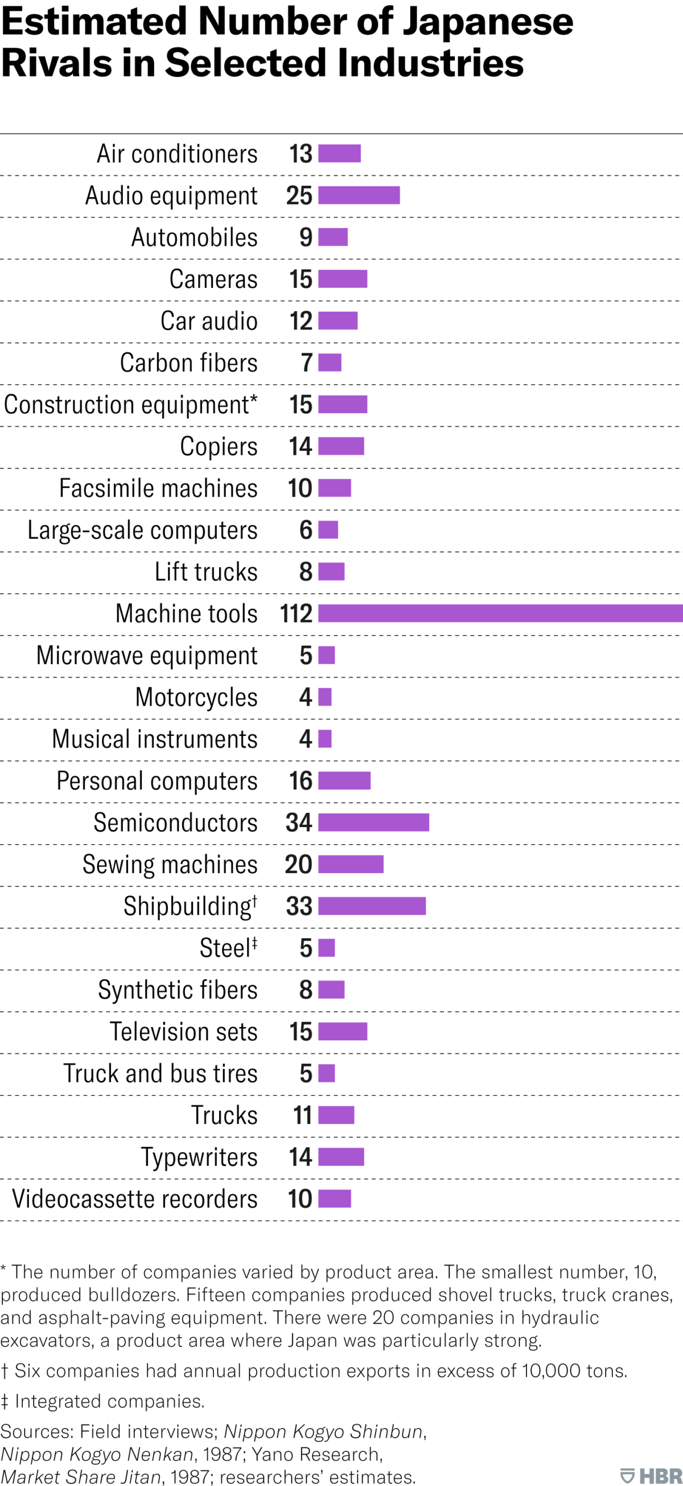
Local intense Rivalary is key
Japanese firms: most intense domestic competion

Slide 6
Pakistan case
Pakistani firms are uncompetitive, although heavily subsidized and protected by the government. In many of the prominent industries in which there is hardly any competition, and government has played a large role in distorting competition.

Slide 7
Policy consistency alone not enough
Pakistan’s auto industry is an obvious example of the failure of import substitution policies. - Auto industry has been protected for the last 40 years, but it has not been able to achieve economies of scale, and the cost of production is still high.
First five-year auto development policy 2002: focused on achieving higher localization of cars through deletion programs and increasing the volume of local production to at least 500,000, aiming to achieve economies of scale.
Currently fourth auto development policy and despite the consistency of policies (high protection and localization), we are far from achieving these aims, as they were in many ways contradictory.
Pakistan has not been able to export a single car, and its auto-part exports at $15 million are not even one 0.3 per cent that of Turkey.

Slide 8
What is wrong
Pakistan economy crashes every once in a while: feature by design
Very low investment rate
Fiscal problem: For every USD govt raises in revenue, it has to spend 2.7 USD Income 1000 USD, spending 2700 USD
Sins: Income and pensions
If no borrowing, country to shut down
Balance of Payment: X=1000, M=2750 USD
High Import taxes in the name of import substitution doing more damage than good

Slide 9
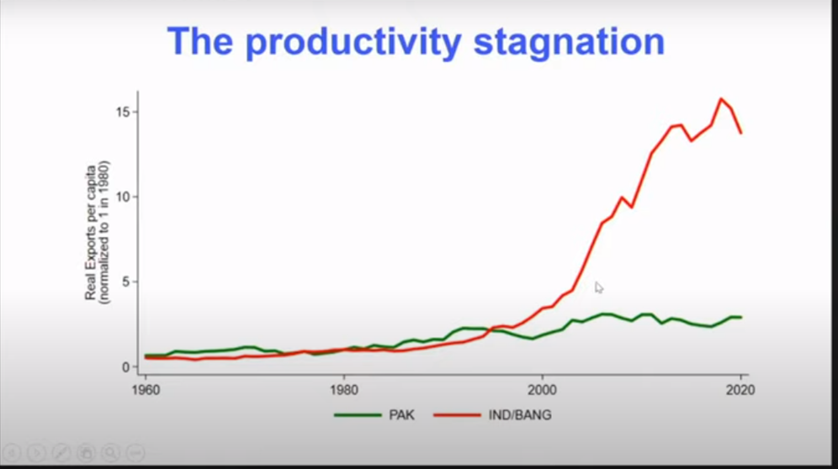
stagnancy

Slide 10
Why Export Matters
global competitiveness
Capacity to innovate and compete with the rest of the world
1992: Indian export increased 13 times while Pak only doubles
Vietnam : 15 B USD in 2001 and 220 B USD in 2018
Export per capital India increased by 6.8 times while BD by 6.2 as compared to Pakistan
Uncompetitiveness as compared to neighboring countries
Export : dynamism, technology absorption and adaptation, building reputation, brand names
Sports, textile, surgical: no branding
Reasons: Mangerial skills, organizational skills, skills, skills…

Slide 11
Complexity vs Complicated
Aggregate productivity stagnant or declining : Farms/firms becoming less productive over time
Productivity decline in firms specially in family-owned
Yield has grown but due to intensive use of inputs
On the import side: high duties negatively affected firms’ productivity as well as sales and wages
Import duties from 15% in FY10 to 21.3% in FY20 implying higher cost of importing intermediaries and capital equipment
Producitivity is key in all economic sectors from the point of view of employment, poverty reduction and export orientation

Slide 12
Flawed Economic Discourse
Pipedreams: SEZs, Roads, Corridors, Gas pipelines
Stuck: hardcore paradigm of development where as
Reality: Software is primary requirement and has symbiotic relationship with hardcore infrastructure

Slide 13
Boosting Domestic Productivity
Boosting domestic productivity which means raising the capacities and capabilities of your people
Import taxes to protect domestic industry leading to no improvement in domestic capacity
One needs hard work, local thinking, building teams, build institutions and throwing industry to tough competition by shedding protention diapers

Slide 14
Challenges
Global market saturated with goods and services
Challenges for Industrial Development in Digital Era

Slide 15
Software : Cant be exported
Rule of Law (Contracts are honored)
Development and Allocation of Talent
Organisational and managerial capacity
Knowledge acquisition
Stuck in MH paradigm
All this : Cant be bought, domestic capacity and domestic reforms One has to built all this as it can not be imported . Broad conceptual parameters - Education, Health investment for better inputs - Boosting domestic productivity

Slide 16

Thank you

