Slide 1
USAID’s Khyber Pakhtukhwa Revenue Mobilization (KPRM) Activity
Zahid Asghar

Slide 2
Cement Production
We have data from Cement Manufacturers Association. Lets explore this data as follows:
Read data
## Rows: 1,116 ## Columns: 6 ## $ Date <chr> "07/1991", "07/1991", "07/1991", "08… ## $ `Series Name` <chr> "Total Cement Sales", "Domestic Ceme… ## $ Output <dbl> 599, 599, NA, 632, 632, NA, 633, 633… ## $ Unit <chr> "Thousand Metric Ton", "Thousand Met… ## $ `Observation Status` <chr> "Normal", "Normal", "Missing value",… ## $ `Observation Status Comment` <lgl> NA, NA, NA, NA, NA, NA, NA, NA, NA, …
Selecting and Renaming variables
## # A tibble: 372 × 6 ## Date Category Output Unit Obser…¹ Obser…² ## <date> <chr> <dbl> <chr> <chr> <lgl> ## 1 1991-07-01 Total Cement Sales 599. Thousand Metric Ton Normal NA ## 2 1991-08-01 Total Cement Sales 632. Thousand Metric Ton Normal NA ## 3 1991-09-01 Total Cement Sales 633 Thousand Metric Ton Normal NA ## 4 1991-10-01 Total Cement Sales 701. Thousand Metric Ton Normal NA ## 5 1991-11-01 Total Cement Sales 635. Thousand Metric Ton Normal NA ## 6 1991-12-01 Total Cement Sales 689. Thousand Metric Ton Normal NA ## 7 1992-01-01 Total Cement Sales 580. Thousand Metric Ton Normal NA ## 8 1992-02-01 Total Cement Sales 612. Thousand Metric Ton Normal NA ## 9 1992-03-01 Total Cement Sales 725. Thousand Metric Ton Normal NA ## 10 1992-04-01 Total Cement Sales 641. Thousand Metric Ton Normal NA ## # … with 362 more rows, and abbreviated variable names ## # ¹​`Observation Status`, ²​`Observation Status Comment` ## # ℹ Use `print(n = ...)` to see more rows ## # A tibble: 372 × 7 ## Date Category Output Unit Obser…¹ Obser…² year ## <date> <chr> <dbl> <chr> <chr> <lgl> <dbl> ## 1 1991-07-01 Total Cement Sales 599. Thousand Met… Normal NA 1991 ## 2 1991-08-01 Total Cement Sales 632. Thousand Met… Normal NA 1991 ## 3 1991-09-01 Total Cement Sales 633 Thousand Met… Normal NA 1991 ## 4 1991-10-01 Total Cement Sales 701. Thousand Met… Normal NA 1991 ## 5 1991-11-01 Total Cement Sales 635. Thousand Met… Normal NA 1991 ## 6 1991-12-01 Total Cement Sales 689. Thousand Met… Normal NA 1991 ## 7 1992-01-01 Total Cement Sales 580. Thousand Met… Normal NA 1992 ## 8 1992-02-01 Total Cement Sales 612. Thousand Met… Normal NA 1992 ## 9 1992-03-01 Total Cement Sales 725. Thousand Met… Normal NA 1992 ## 10 1992-04-01 Total Cement Sales 641. Thousand Met… Normal NA 1992 ## # … with 362 more rows, and abbreviated variable names ## # ¹​`Observation Status`, ²​`Observation Status Comment` ## # ℹ Use `print(n = ...)` to see more rows ## # A tibble: 31 × 2 ## year prod_yr ## <dbl> <dbl> ## 1 1991 3890. ## 2 1992 7504. ## 3 1993 8092. ## 4 1994 7746. ## 5 1995 8992. ## 6 1996 9658. ## 7 1997 9519. ## 8 1998 9324. ## 9 1999 9585 ## 10 2000 9882. ## # … with 21 more rows ## # ℹ Use `print(n = ...)` to see more rows

Slide 3
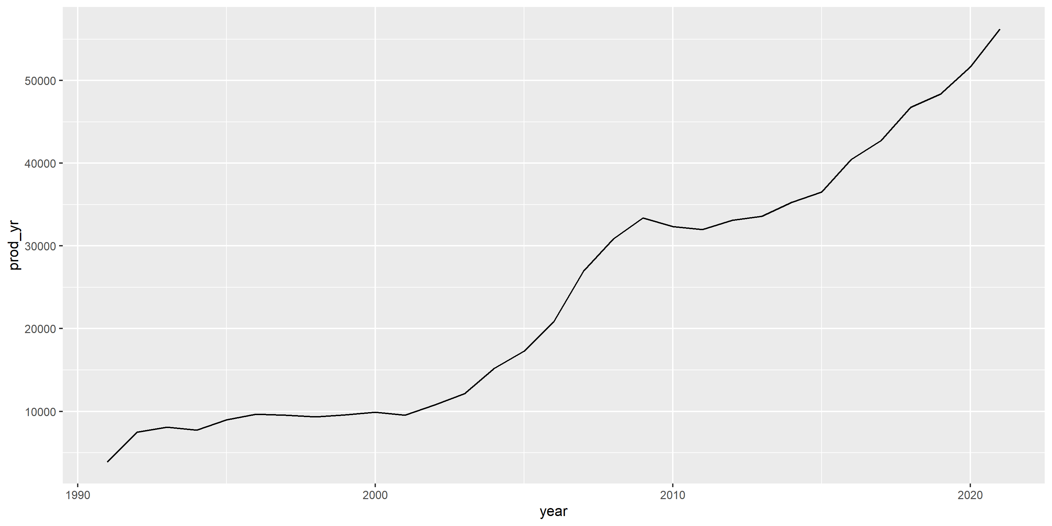
Annual cement sale
What happens if year 2022 is included?
Why annual is less informative?

Slide 4
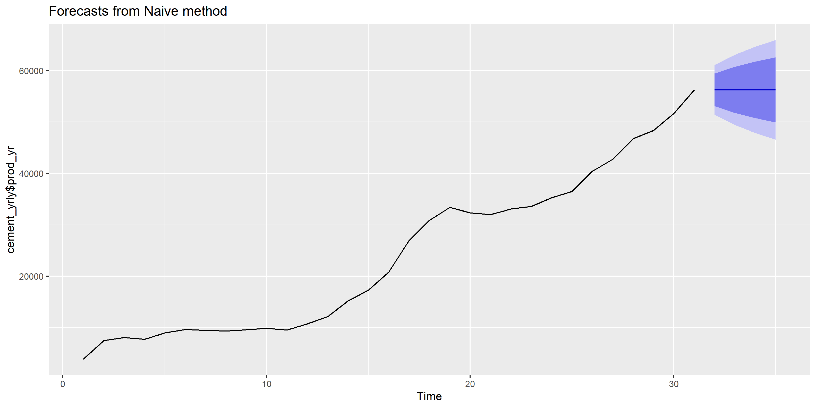

Slide 5
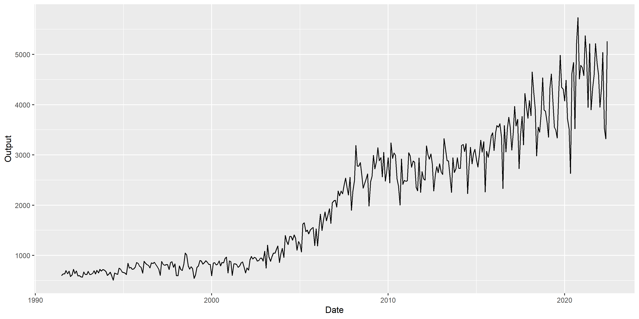
Monthly cement production

Slide 6
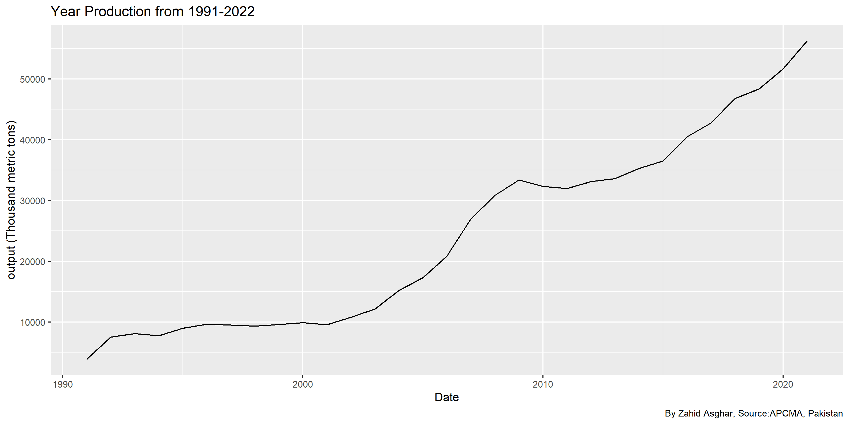
Labels, data source, theme

Slide 7
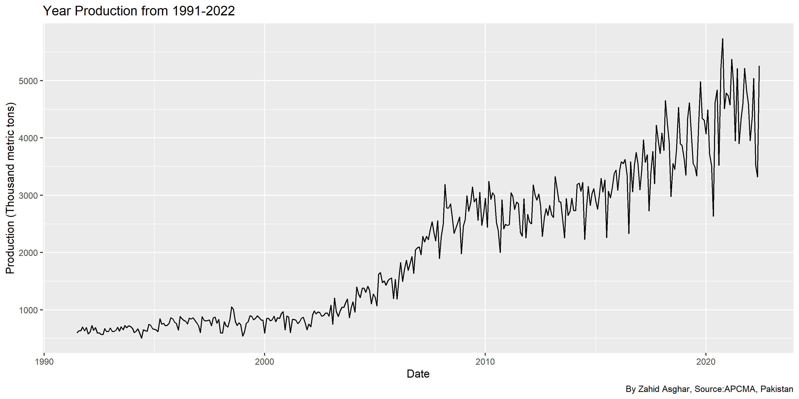

Slide 8
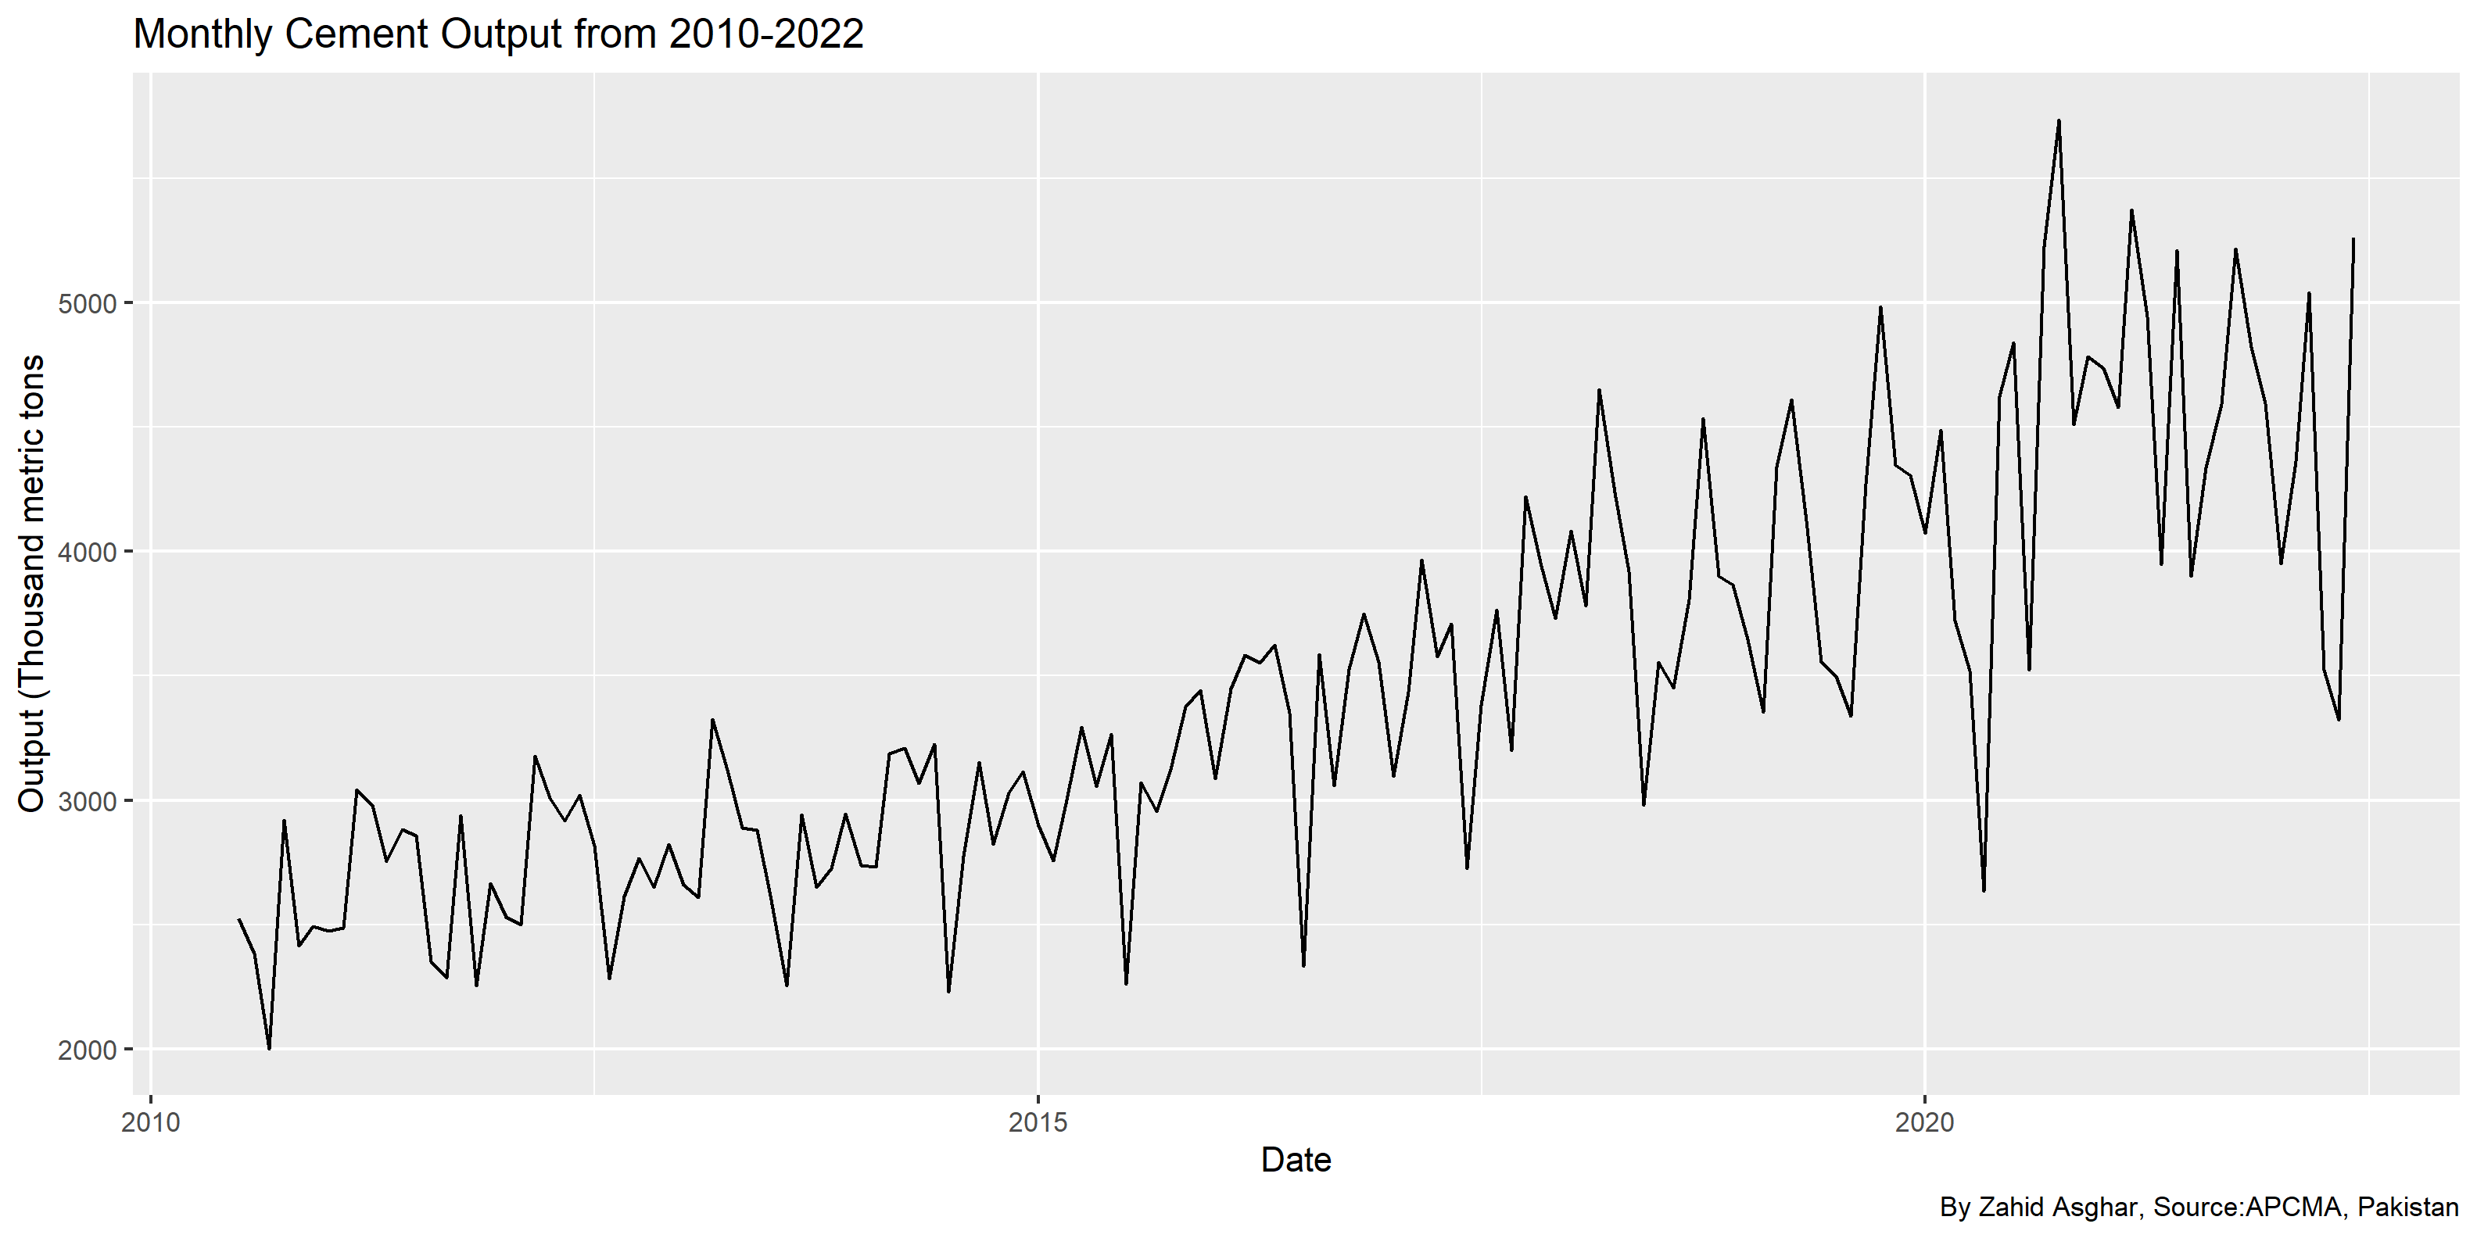
Last 10 years data
## # A tibble: 144 × 7 ## Date Category Output Unit Obser…¹ Obser…² year ## <date> <chr> <dbl> <chr> <chr> <lgl> <dbl> ## 1 2010-07-01 Total Cement Sales 2524. Thousand Met… Normal NA 2010 ## 2 2010-08-01 Total Cement Sales 2383. Thousand Met… Normal NA 2010 ## 3 2010-09-01 Total Cement Sales 2002. Thousand Met… Normal NA 2010 ## 4 2010-10-01 Total Cement Sales 2920. Thousand Met… Normal NA 2010 ## 5 2010-11-01 Total Cement Sales 2416. Thousand Met… Normal NA 2010 ## 6 2010-12-01 Total Cement Sales 2493. Thousand Met… Normal NA 2010 ## 7 2011-01-01 Total Cement Sales 2473. Thousand Met… Normal NA 2011 ## 8 2011-02-01 Total Cement Sales 2488. Thousand Met… Normal NA 2011 ## 9 2011-03-01 Total Cement Sales 3043. Thousand Met… Normal NA 2011 ## 10 2011-04-01 Total Cement Sales 2980. Thousand Met… Normal NA 2011 ## # … with 134 more rows, and abbreviated variable names ## # ¹​`Observation Status`, ²​`Observation Status Comment` ## # ℹ Use `print(n = ...)` to see more rows

Slide 9
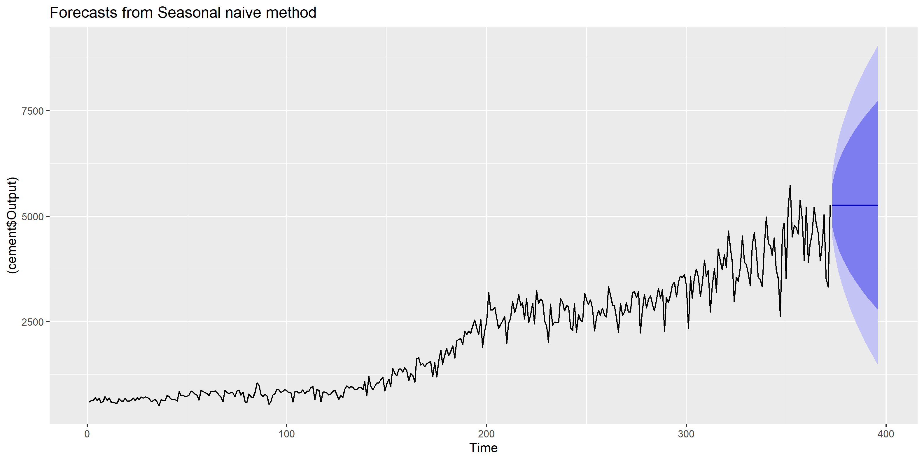
Forecasting
Why series seems reversed? This is because date is placed in reverse order. So lets use a verb for sorting date in ascending order by sort

Slide 10
ARIMA models
## Series: cement$Output ## ARIMA(4,1,1) with drift ## ## Coefficients: ## ar1 ar2 ar3 ar4 ma1 drift ## 0.137 -0.106 0.082 -0.169 -0.83 10.54 ## s.e. 0.064 0.059 0.059 0.057 0.04 2.67 ## ## sigma^2 = 100902: log likelihood = -2661 ## AIC=5337 AICc=5337 BIC=5364 ## ## Training set error measures: ## ME RMSE MAE MPE MAPE MASE ACF1 ## Training set -0.403 315 202 -2.99 10.1 0.811 -0.00574

Slide 11
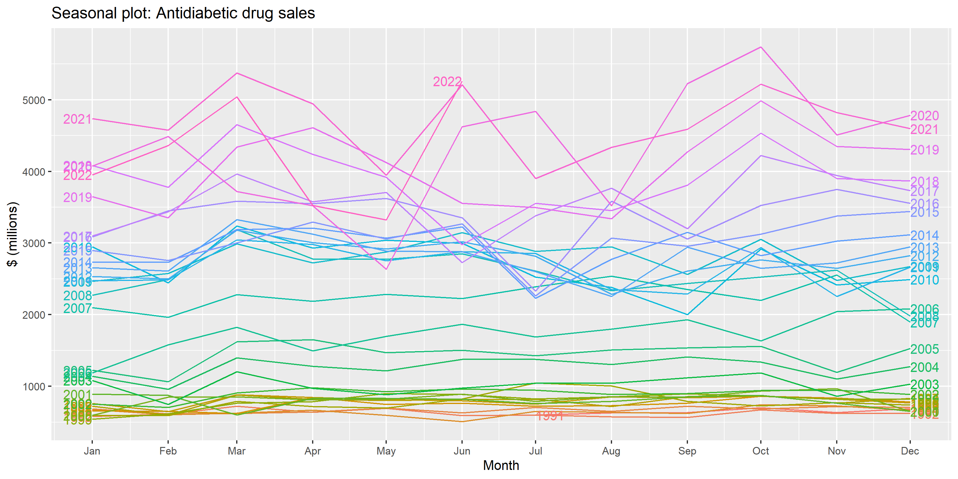
Seasonal Plot

Slide 12
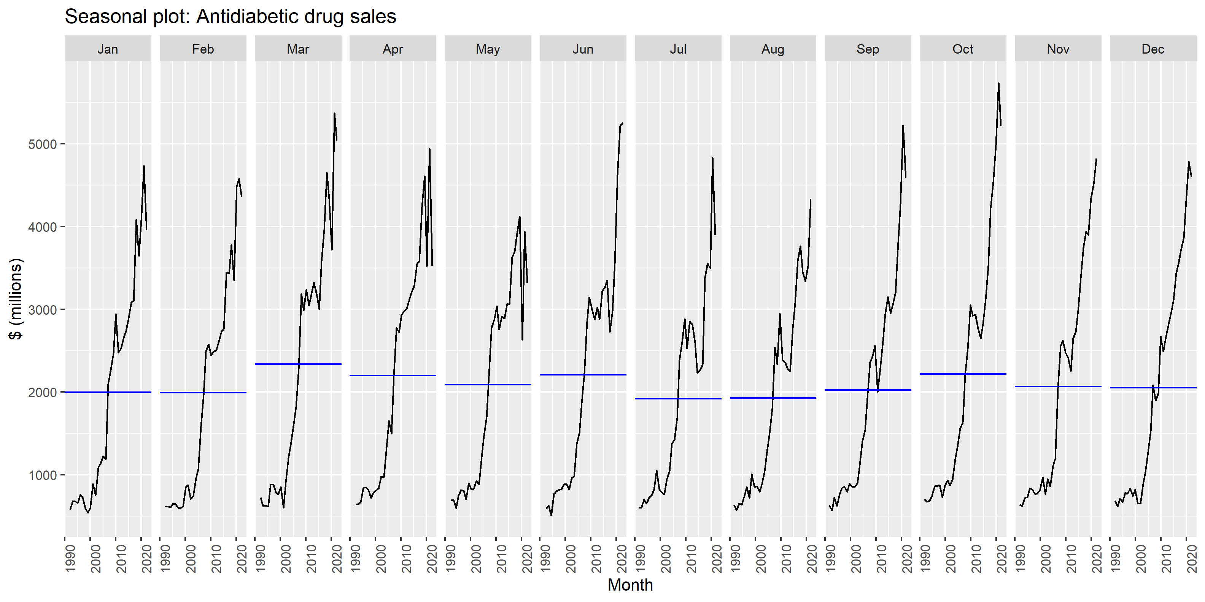
Monthly Analysis

Slide 13
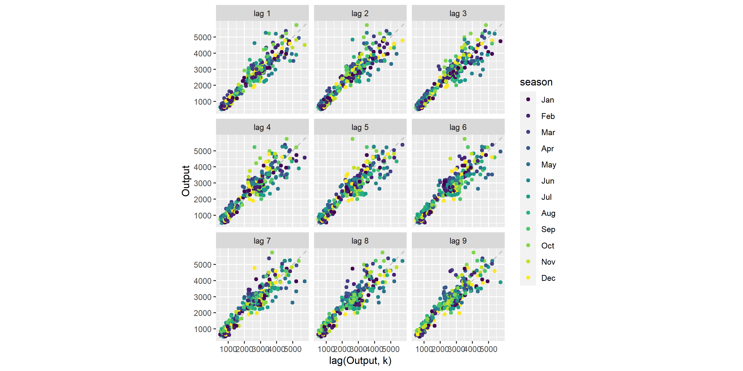
Lag Plots

Slide 14
Shiny Interactive View

