Slide 1

GOVERNMENT OF TELANGANA
MINORITIES WELFARE DEPARTMENT
TELANGANA MINORITIES STUDY CIRCLE & CAREER COUNSELING CENTRE

Slide 2
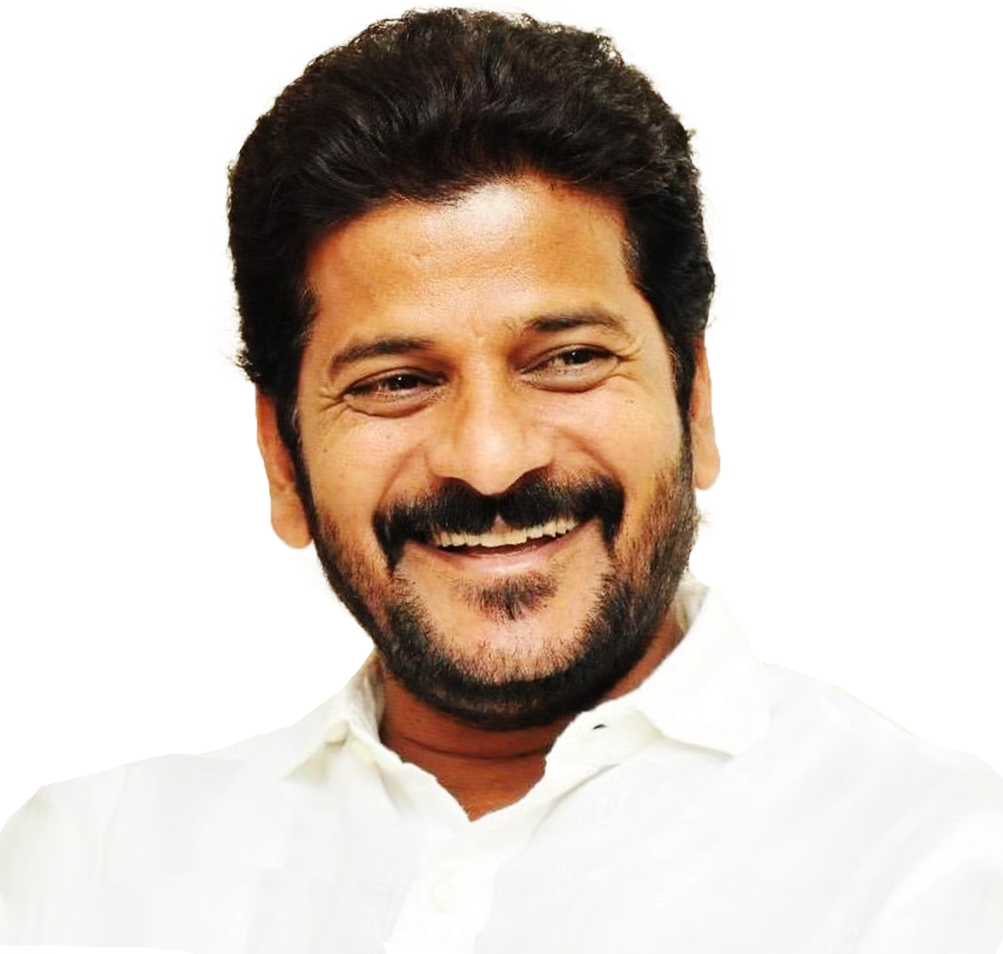
MINORITIES WELFARE DEPARTMENT TELANGANA MINORITIES STUDY CIRCLE & CAREER COUNSELING CENTRE
Sri A. Revanth Reddy
Hon’ble Chief Minister of Telangana

Slide 3
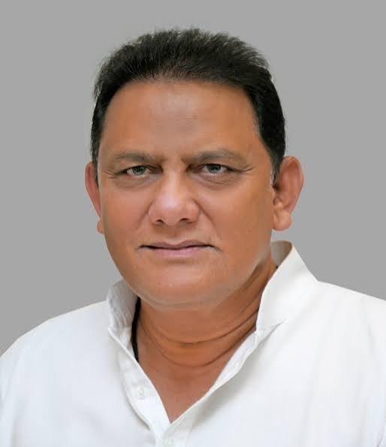
MINORITIES WELFARE DEPARTMENT TELANGANA MINORITIES STUDY CIRCLE & CAREER COUNSELING CENTRE
Sri MOHAMMAD AZHARUDDIN Hon’ble Minister for Minorities Welfare & Public Enterprises in Telangana

Slide 4
TELANGANA MINORITIES STUDY CIRCLE & CAREER COUNSELING CENTRE
The Government have issued orders to start Telangana Minorities Study Circle, Hyderabad with prime objective of Study Circle is to increase the Employment percentage of the Minorities in Central/State Government, Quasi Government and Private Sector by providing free coaching for the various jobs/posts notified by the Government and other Agencies and inaugurated on 24.09.2015 in terms of G.O.Ms.No.37, Minorities Welfare (Estt.I) Department, dt.03.08.2015.
Further, the Government have permitted the Director, Telangana Minorities Study Circle, Hyderabad to start the Career Counselling Centre vide Government Memo No.163/Estt.I/A1/2017, dt.30.10.2017, Minorities Welfare (Estt.I) Department.

Slide 5
TELANGANA MINORITIES STUDY CIRCLE & CAREER COUNSELING CENTRE
COURSES OFFERED for Notification:
U.P.S.C. Civil Services Recruitment. (Civil Services)
Telangana Public Service Commission (Group – I, II, III & IV)
S.I (Sub Inspector), Police Constable, other Recruitment from Police Recruitment Board
Staff Selection Commission
Rail Recruitment Board.
IBPS –Banking Probationary Officers
Armed Forces Recruitment
IELTS & GRE
Basic Foundation Course
Para Military, CDS(Combined Defense Services), NDA (National Defense Academy), Central Excise, Teachers/ Lecturers/Engineers Recruitment.
Any other Competitive exams leading to employment.
The total no.of (11,960) Candidates, have been imparted free coaching, in various courses since the inception of the Telangana Minorities Study Circle to till now.

Slide 6
2021-2022 (No. of STUDENTS BENEFITTED)
1 | UPSC CSE – 2022 | 100
2 | Basic Foundation Course Coaching | 304
Sub Total |  | 404

Slide 7
2022-2023 (No. of STUDENTS BENEFITTED)
1 | Combined Group-I (Prelims), II & III coaching in Erswhile Districts | 1124
2 | Combined Group-I (Prelims), II & III Coaching in Urdu Medium at TGSMC | 69
3 | Group – IV Caoching in all Districts | 413
4 | SI/ Constable free coaching conducted by Police Department under supervision of DMWOs concerned in Nizamabad and Khammam | 167
5 | UPSC CSE -2023 | 100
6 | Group-IV, AEE, Women and Child Welfare Officers Coaching at Nizamabad | 66
Sub Total |  | 1939

Slide 8
2023-2024 (No. of STUDENTS BENEFITTED)
1 | Group – IV Coaching at Hanamkonda | 67
2 | TGT/ PGT, JL/DSC/S. A under supervision of DMWOs concerned in Hyderabad and Karimnagar. | 73
3 | Group – III Coaching under supervision of DMWOs concerned in Hyderabad and Karimnagar | 64
4 | Group – II Coaching at Karimnagar. | 71
5 | UPSC CSE -2024. | 50
6 | NEET & EAMCET Coaching. | 409
Sub Total |  | 734

Slide 9
2024-2025 (No. of STUDENTS BENEFITTED)
1 | Group – I (Prelims) Coaching at Hyderabad, Khammam, Karimnagar, Nizamabad & Adilabad | 301
2 | UPSC CSE – 2025 (In –House Coaching). | 100
3 | Combined Group – II & III Examination Coaching at Karimnagar & Nizamabad | 93
4 | Group- I (Mains) Test Series. | 47
5 | Group – II Mock Test | 108
6 | IELTS, GRE & TOEFL | 245
Sub Total |  | 894

Slide 10
2025-2026 (No. of STUDENTS BENEFITTED)
1 | GRE Coaching | 48
2 | (04) Months Basic Foundation Course at Hyderabad, Karimnagar, Adilabad & Nizamabad. | 362
3 | UPSC Civil Services Examination -2026 ( In-House Coaching) | 100
Sub Total |  | 510

Slide 11
2026-2027 (No. of STUDENTS BENEFITTED)
1 | IELTS Coaching | 153 | Completed
2 | AEE Coaching at Hyderabad. | 16 | Completed
3 | (04) Months Basic Foundation Course at Hyderabad. | 20 | Under Process
4 | UPSC CSE – 2027 ( In-House Coaching) at Hyderabad | 100 | Under Process
5 | Police Constable at Hyderabad | 260 | Under Process
6 | Sub Inspector of Police at Hyderabad | 105 | Under Process
Sub Total |  | 654
Grand Total |  | 5135 | (Beneficiaries, 2021–2026)
Grand Total |  | 11,967 | Total Beneficiaries Trained Since the Inception of the Study Circle Till Date

Slide 12
TELANGANA MINORITIES STUDY CIRCLE
ACHIEVEMENTS :
The total (08) Minorities Study Circles and Career Counseling Centre established under the supervision of the DMWO’S Concerned in the following Districts i.e., Mahabubnagar, Hanumakonda, Khammam, Adilabad, Nizamabad, Karimnagar, Nalgonda and Sanga Reddy.
The total number of 11,967 candidates have been trained in various courses till now since the inception of the Study Circle and (990) candidates are benefited
Every year (100) Candidates will be selected for UPSC Civil Service Examination In-house coaching with digital board classes, Central AC,Library Facilities, Weekly test series, Full length test, Grand test etc.
In TGPSC Group-I Services exam (05) Candidates were selected .
In TGPSC Group-II Services exam (05) Candidates were selected.
In TGPSC Group-III Services exam (02) Candidates were selected.
In TGPSC Group-IV Services exam (25) Candidates were selected
In TGLPRB Police Recruitment exam (07) Candidates were selected for Constable and (02) candidates are selected for Sub Inspector
In TGT, PGT, JL, DSC & S.A. Exam (21) candidates were selected.

Slide 13
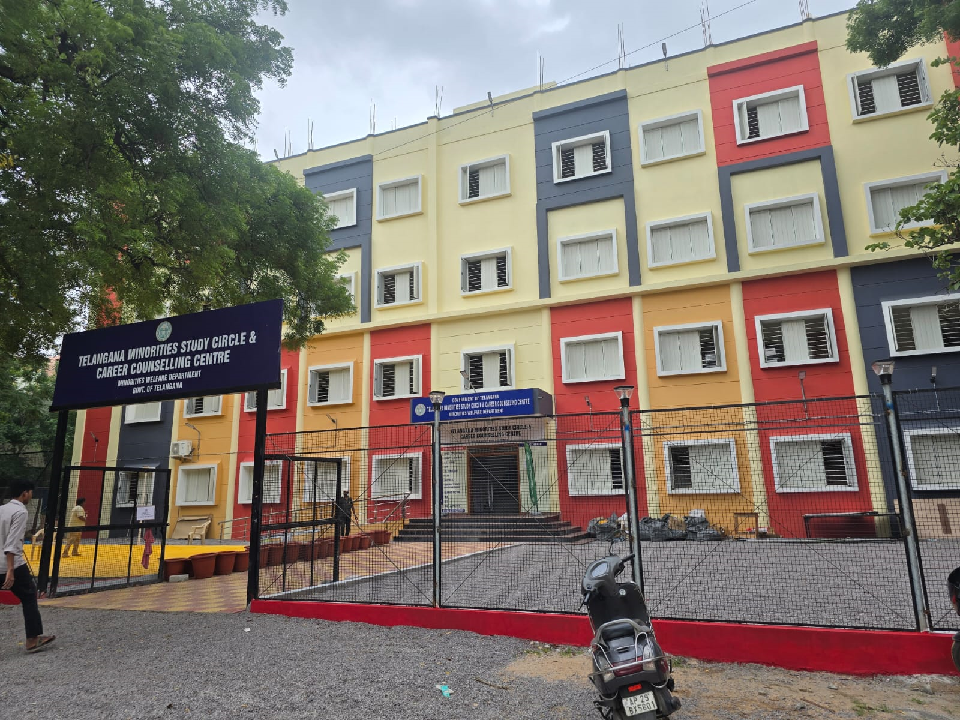
TELANGANA MINORITIES STUDY CIRCLE & CAREER COUNSELING CENTRE
2026-2027 ON-GOING PROGRAMMES

Slide 14
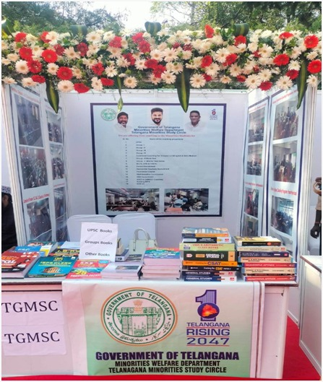
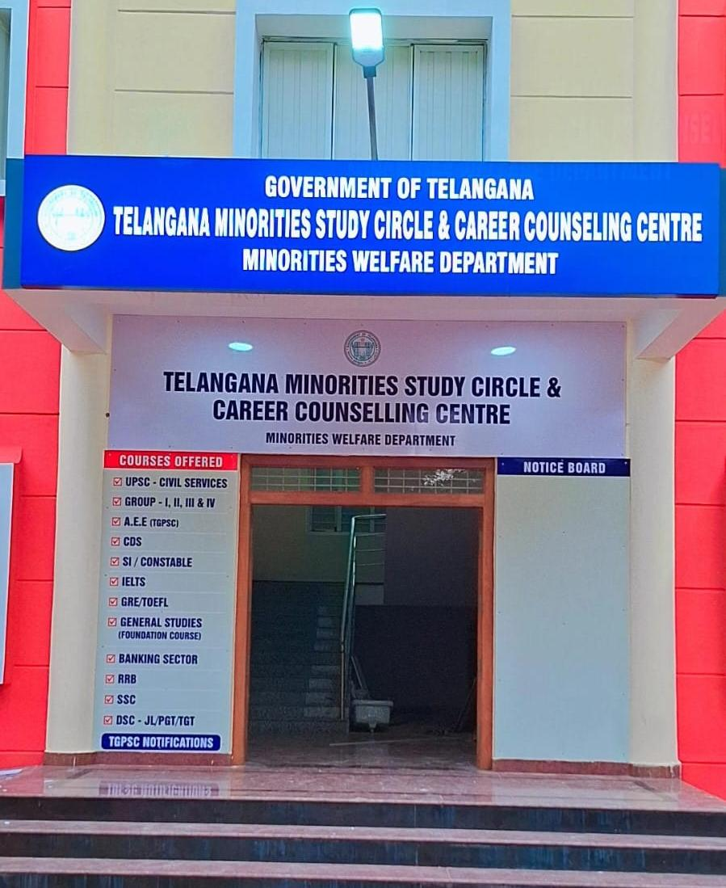
The photograph with caption of major events and programmes

Slide 15
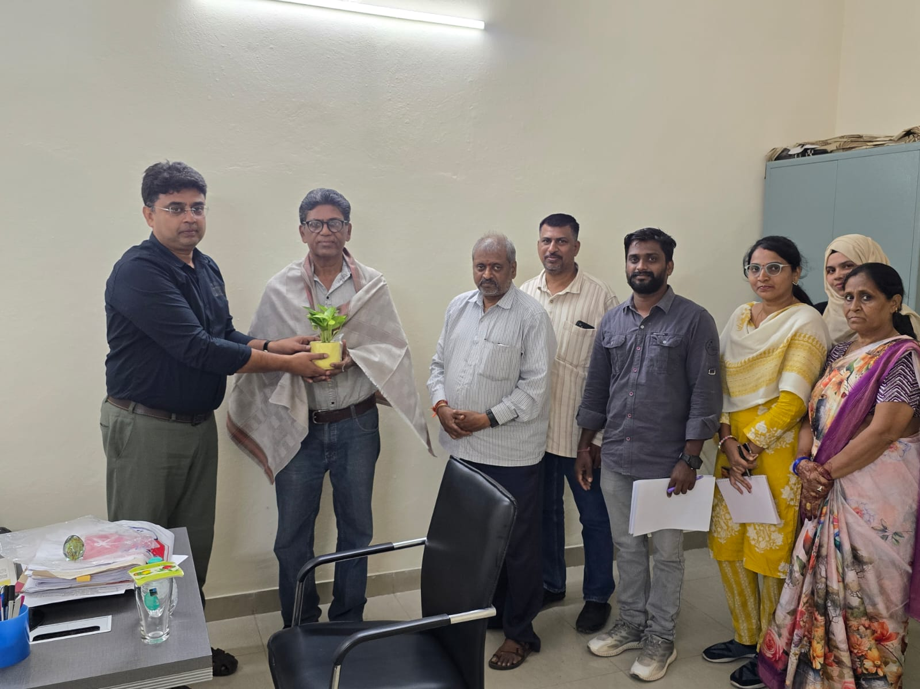
Renowned Faculty D.B. Kumar Sir invited to join TGMSC.

Slide 16
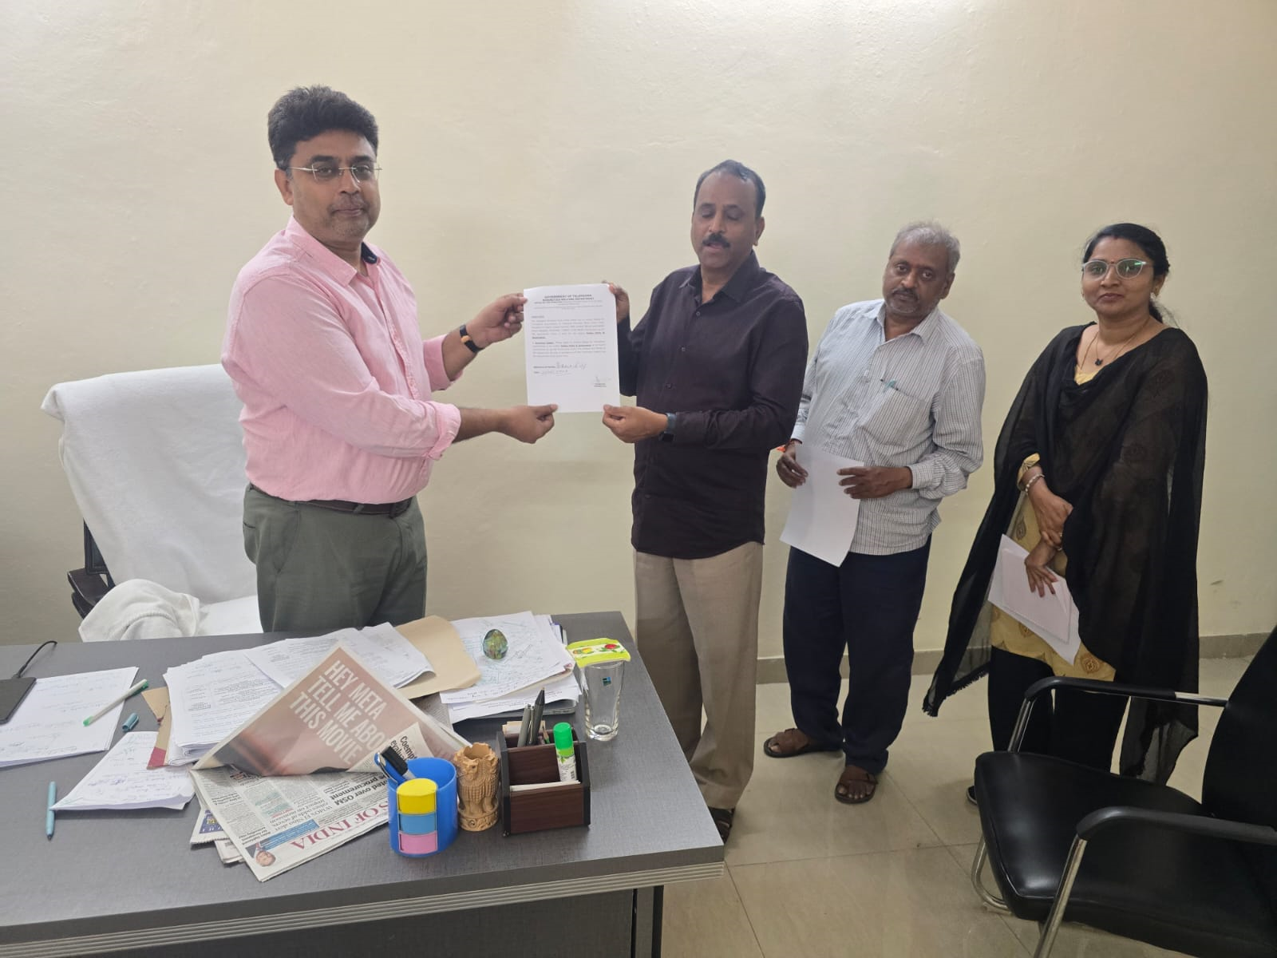
Renowned Faculty Krishna Reddy Sir invited to join TGMSC.

Slide 17
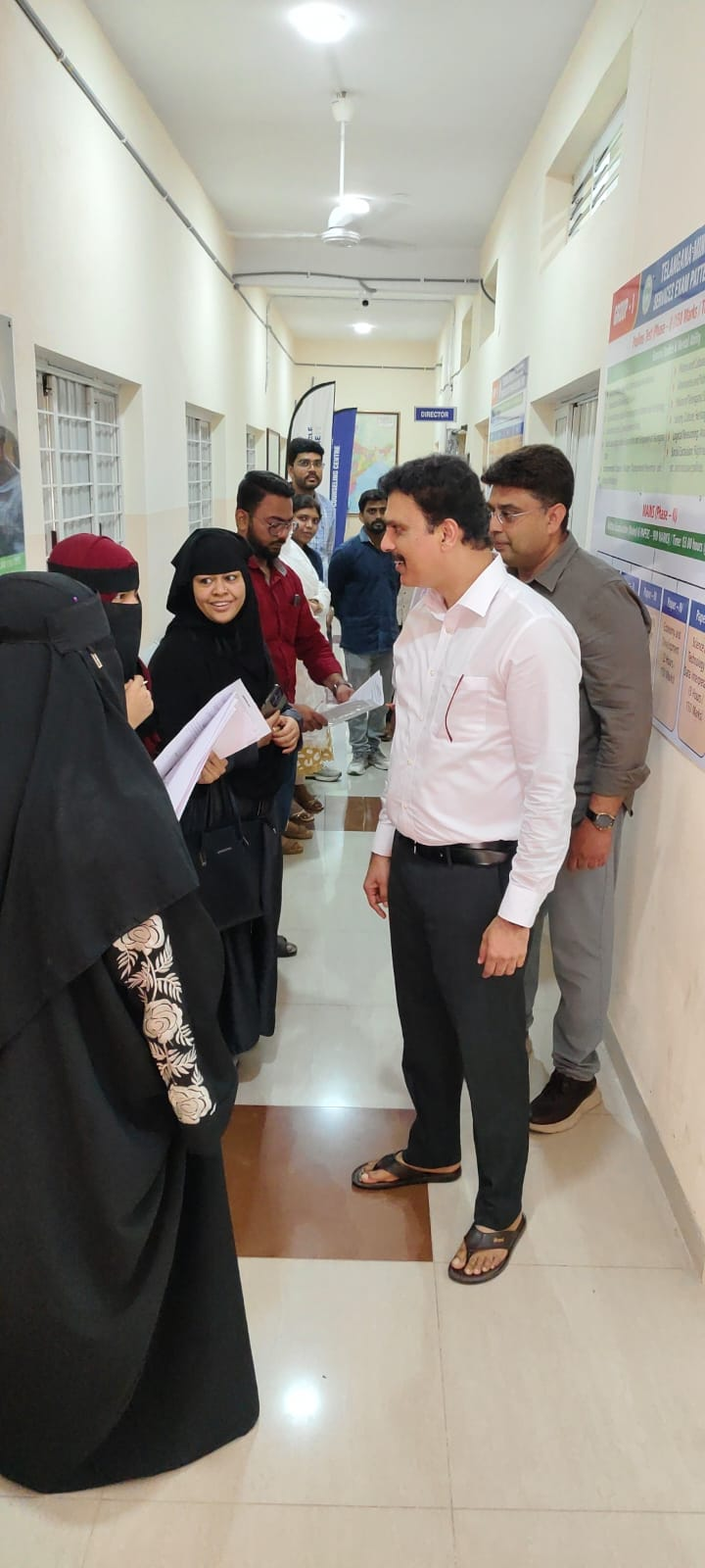
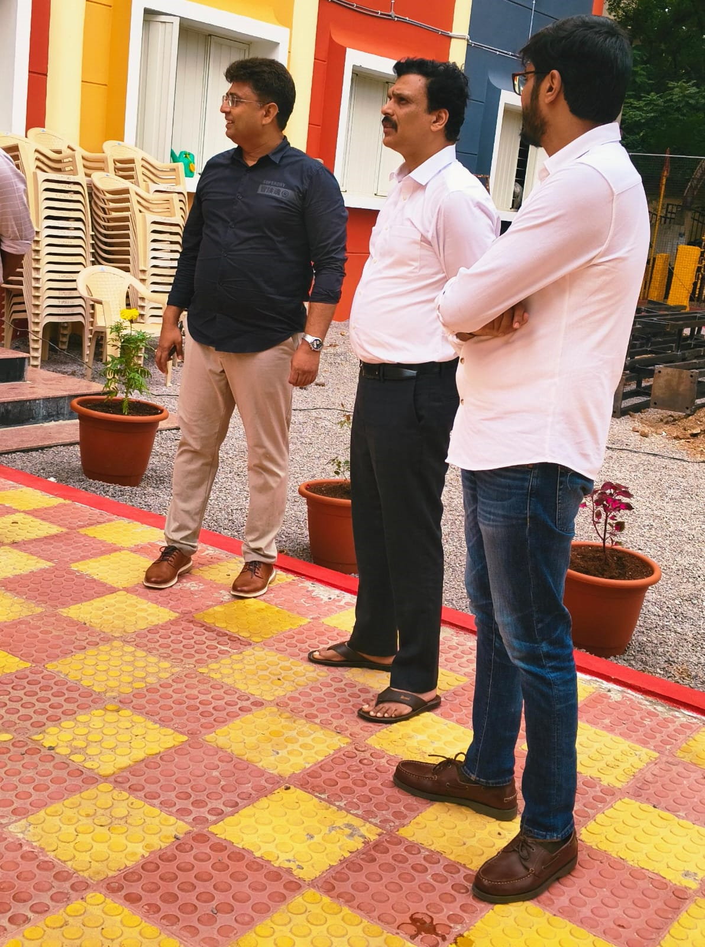
Hon’ble Secretary Janab Shafiullah Sir Visits to TGMSC.

Slide 18
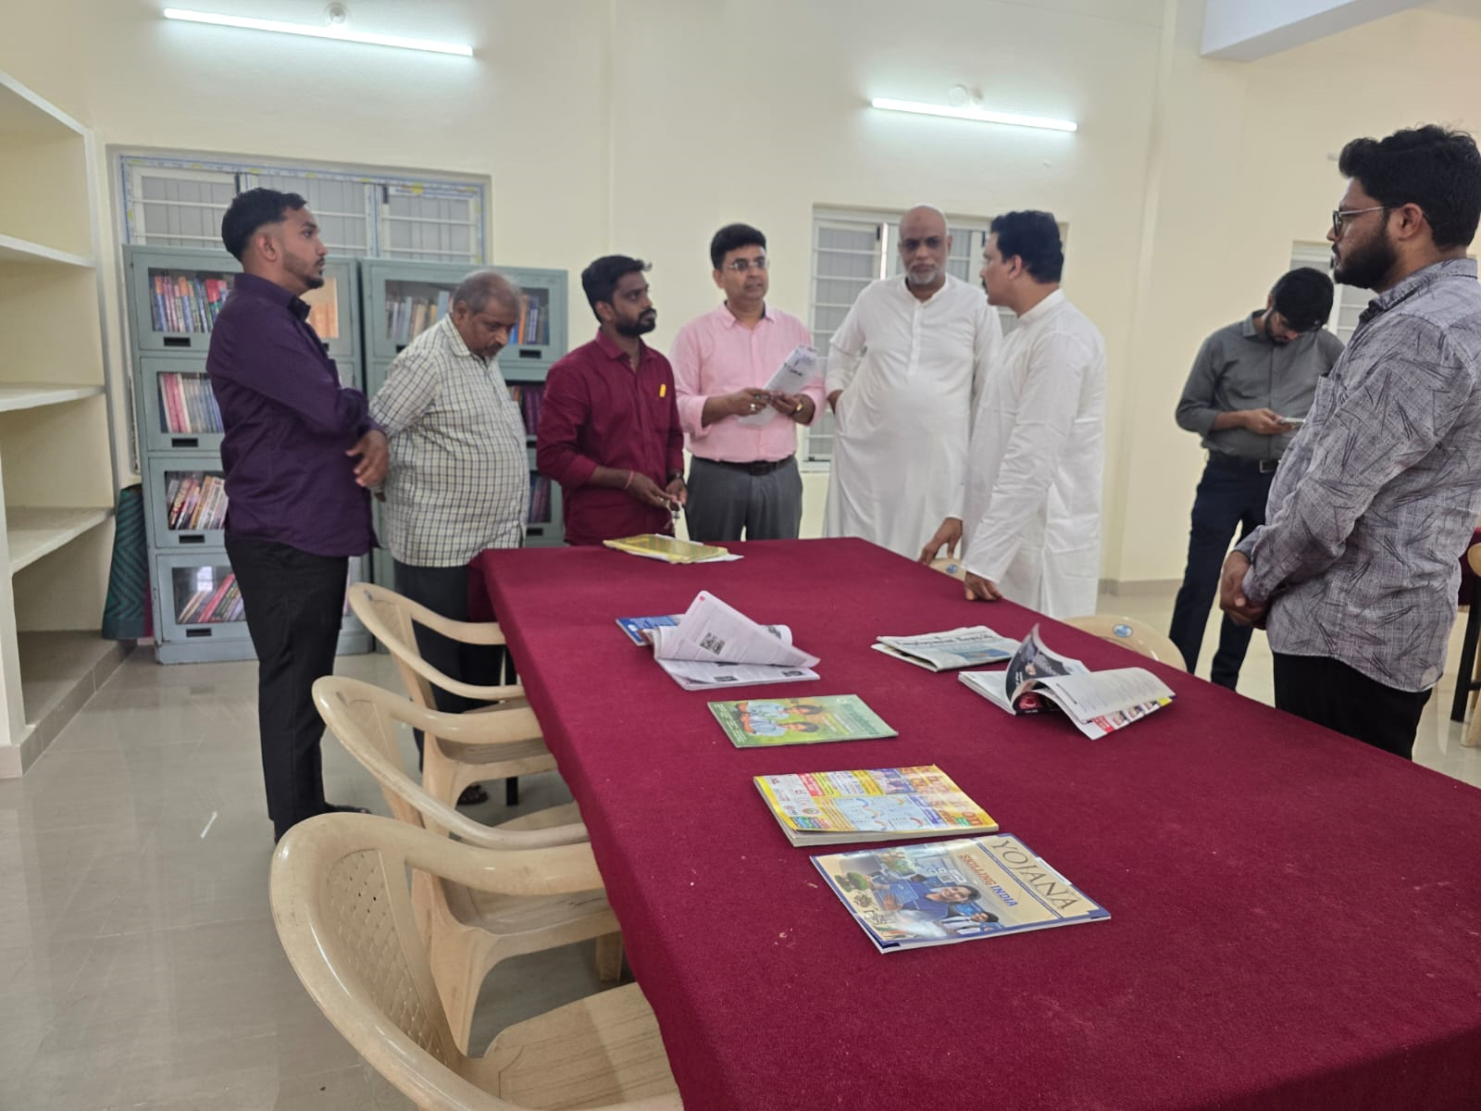
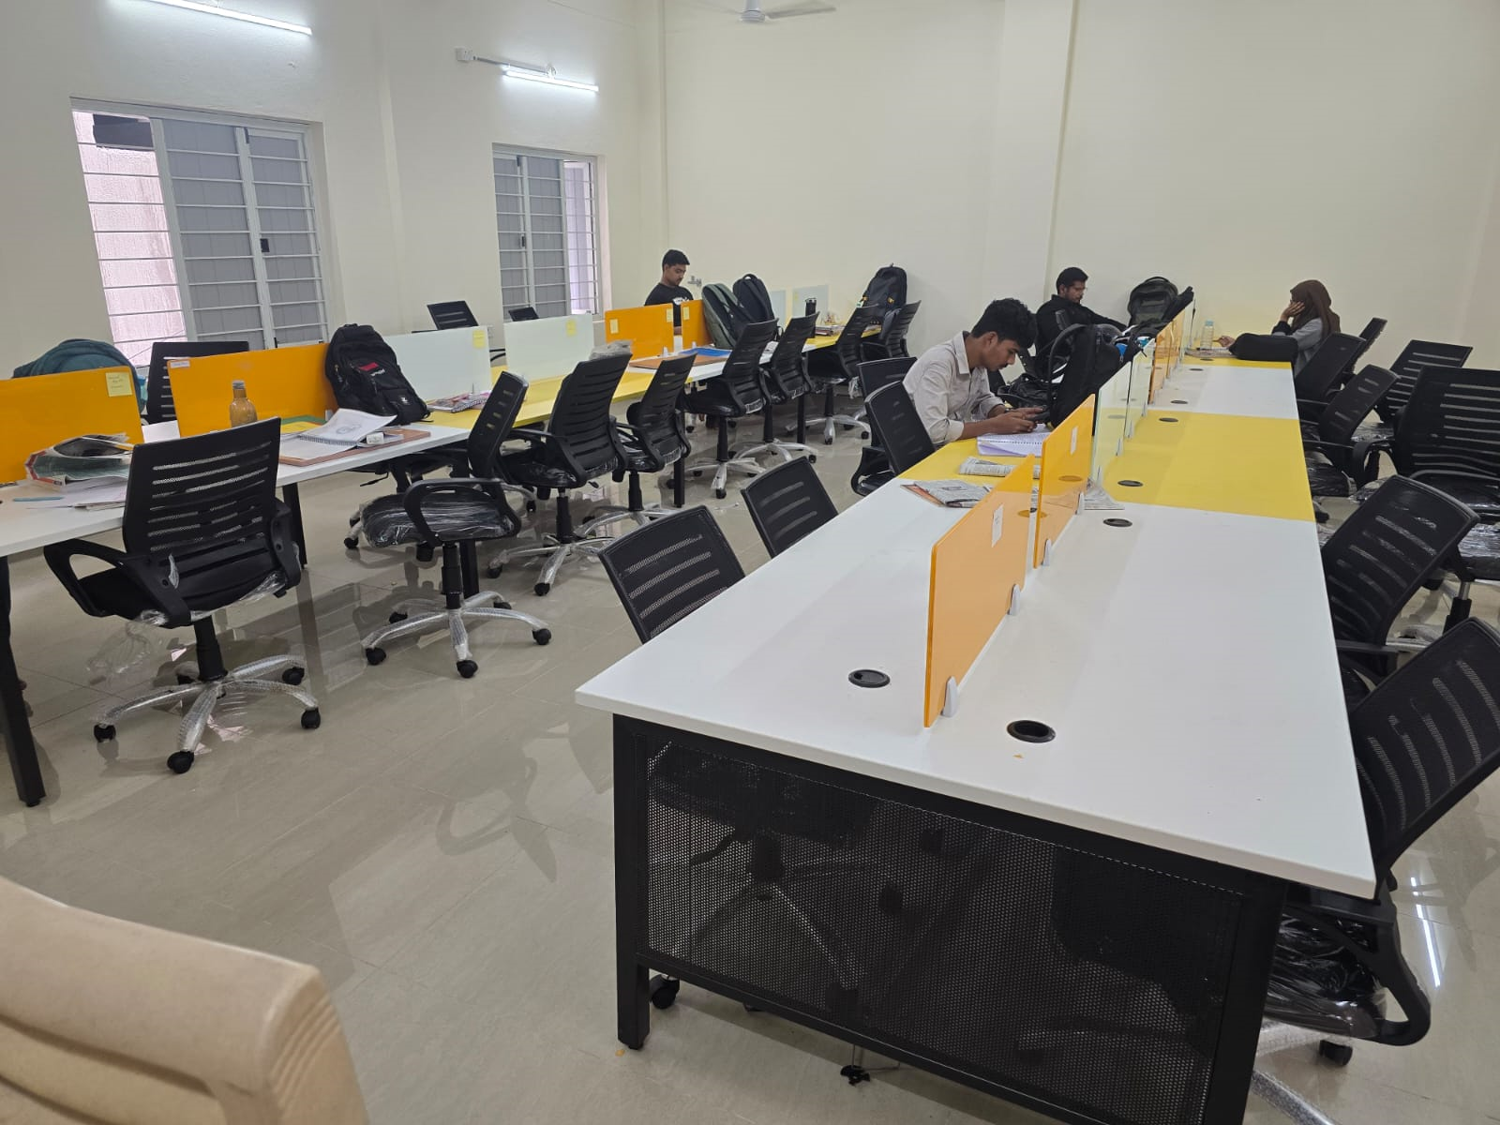
LIBRARY RENOVATED

Slide 19
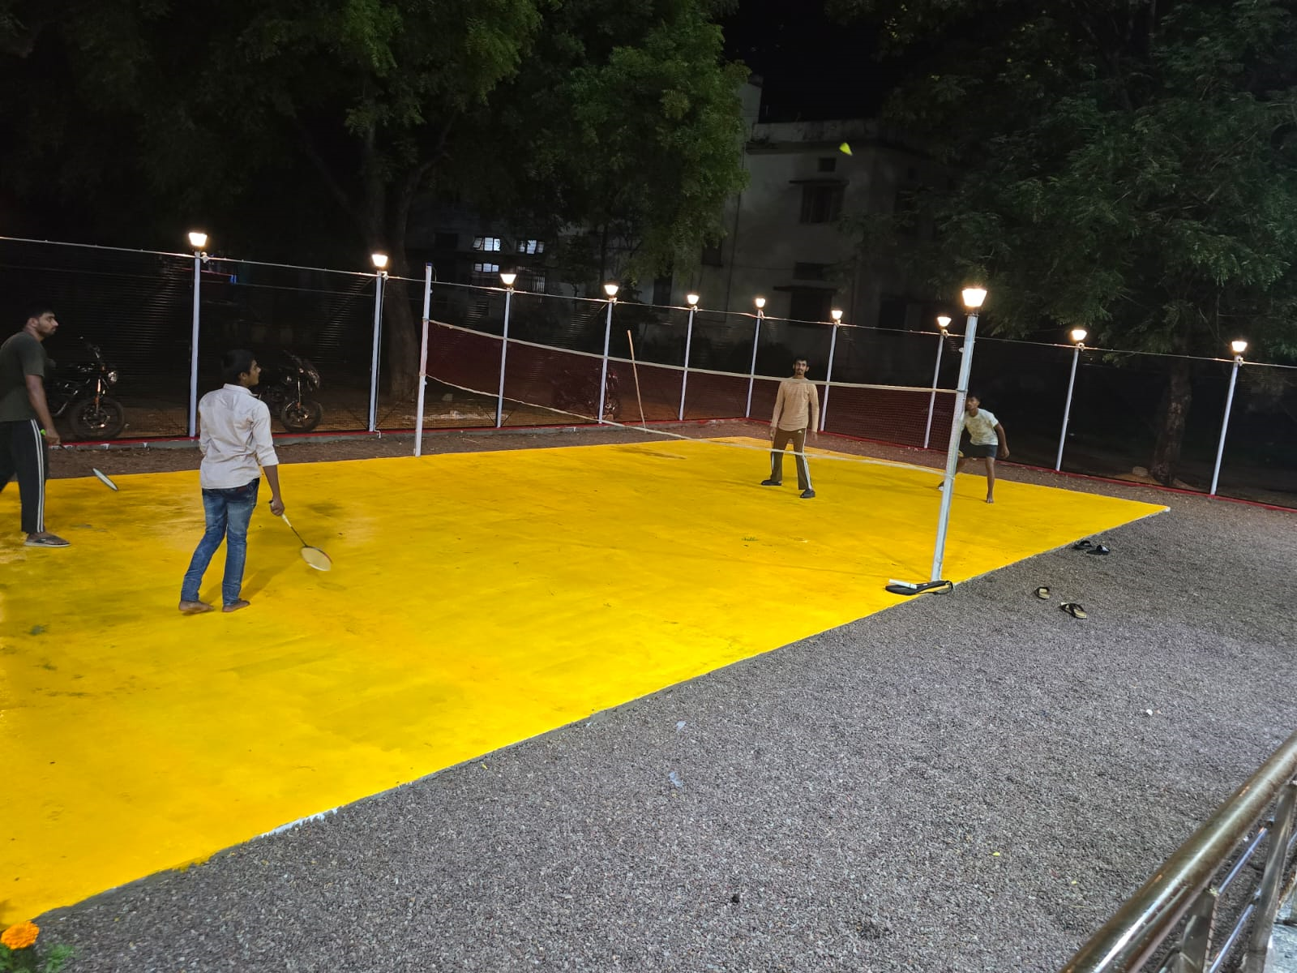
STUDENTS SPORTS ACTIVITY

Slide 20
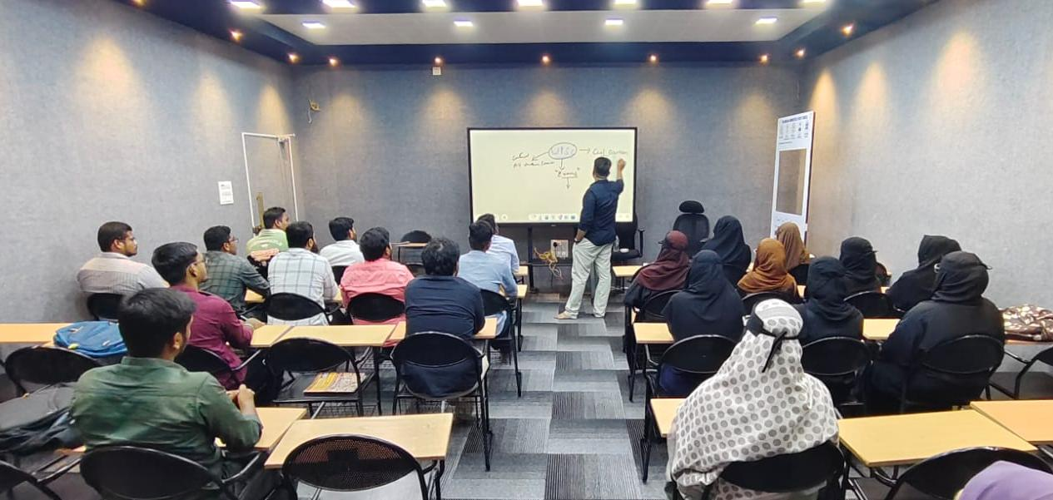
UPSC (CIVIL SERVICES) 2026-2027, BATCH STARTED MOTIVATION CLASS BY SYED TARIQ ANWAR, Director, TGMSC.

Slide 21
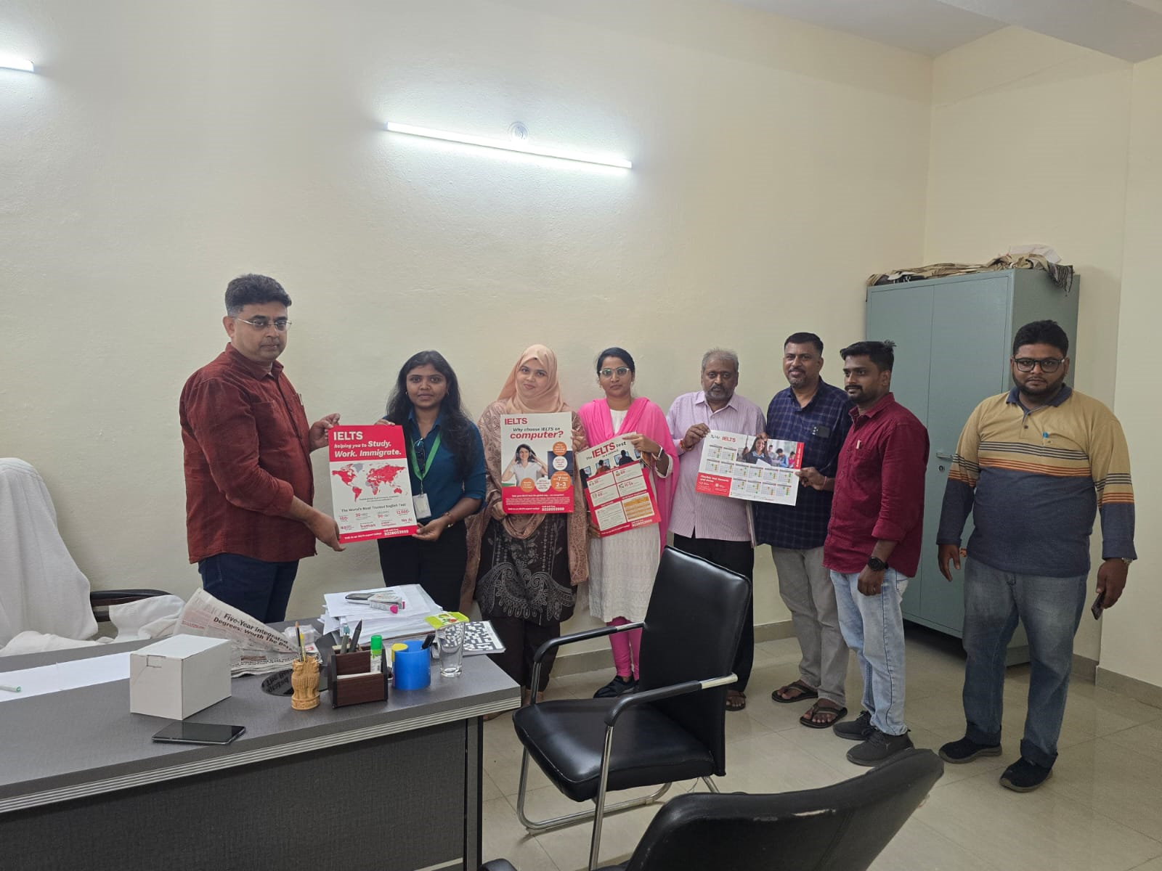
TGMSC Agreement with IDP for IELTS

Slide 22
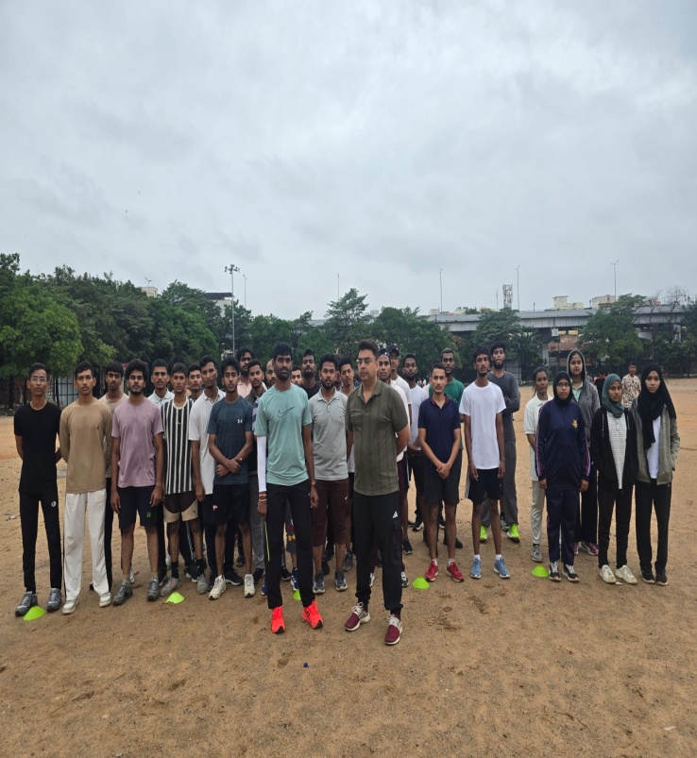
POLICE RECRUITMENT BOARD PHYSICAL TRAINING SESSIONS at NTR Stadium by TGMSC.
DIRECTOR
TGMSC&CCC

Slide 23
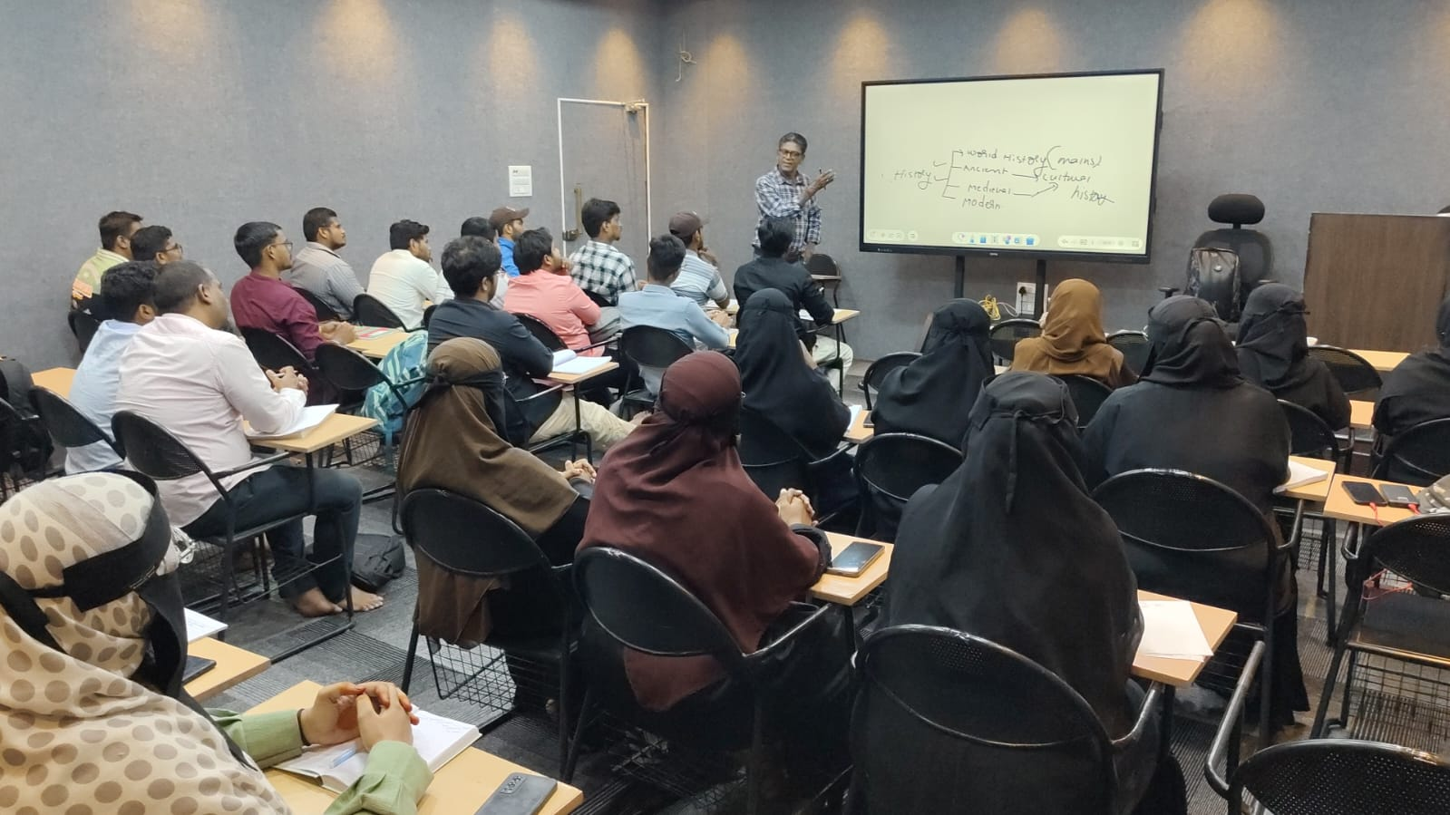
UPSC (CIVIL SERVICES) 2026-2027, CLASS BY DR. D.B. KUMAR Sir.

Slide 24
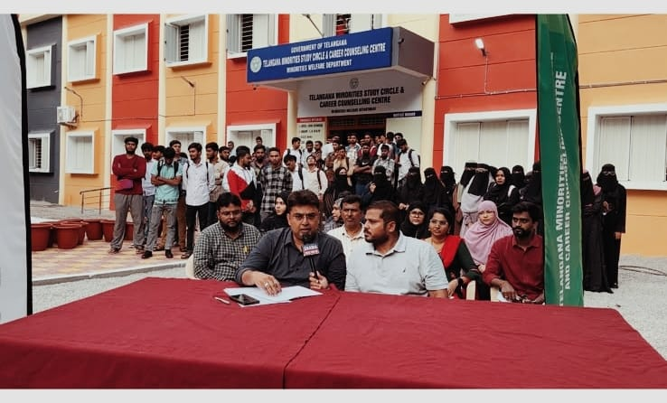

Slide 25
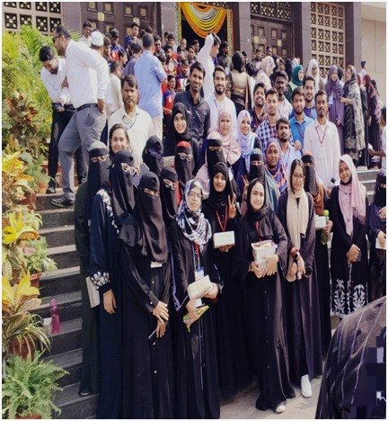

Slide 26
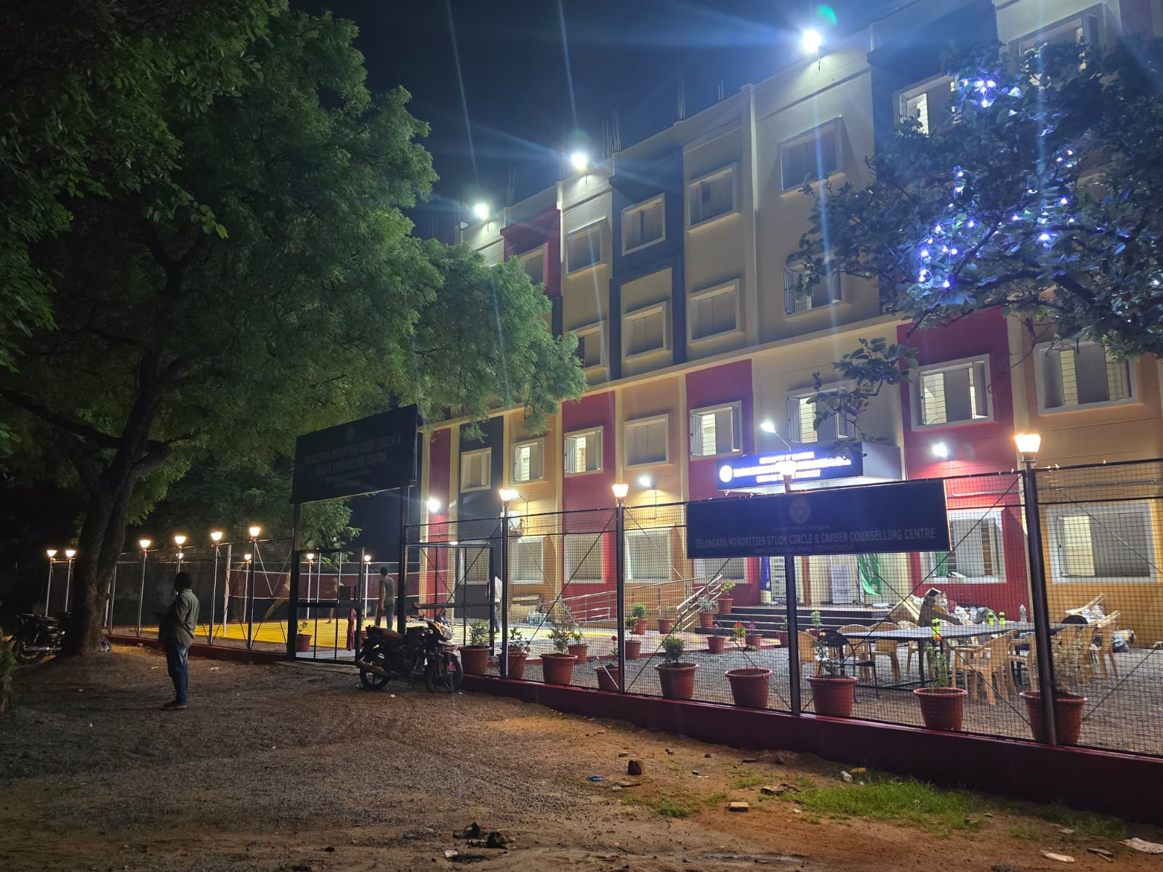
TGMSC - CAMPUS OUTLOOK NIGHT VIEW

Slide 27
Thank You

