Slide 1
DATA PRESENTATION
MARKETING ANALYTICS PORTFOLIO PROJECT

Slide 2
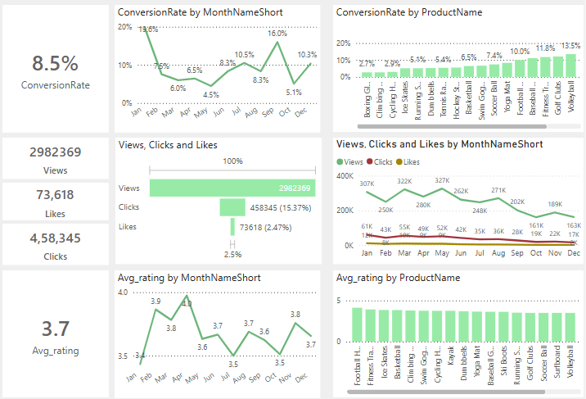
Overview
Decreased Conversion Rates:
The conversion rates demonstrated a strong
rebound in December, reaching 10.3 %, despite a
notable dip to 5.1% in October.
Reduced Customer Engagement :
There is a decline in overall social media
engagement, with views dropping throughout
the year.
While clicks and likes are low compared to views,
the click-through rate stands at 15.3% meaning
that engaged users are still interacting effectively.
Customer Feedback Analysis :
Customer ratings have remained consistent with
averaging around 3.7 throughout the year.
Although stable the average rating is below the target
of 4.0, suggesting a need for focused improvements
in customer satisfaction for products below 3.5.

Slide 3
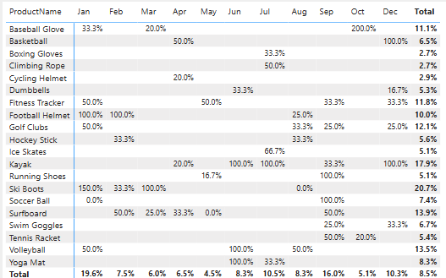
Decreased Conversion Rates
General Conversion Trend:
Throughout the year the conversion Rates varied,
with a higher number of products converting Successfully in
months like January, July, September, and December. This
suggests that while some products have strong seasonal
peaks, there is potential to improve conversion rates in
lower-performing months through targeted interventions.
Lowest Conversion Months:
May experienced the lowest overall conversion rates at 4.5%,
with no products standing out significantly in terms of conversion.
This indicates a potential need to revisit the marketing strategies
or promotions during the period to boost performance.
Highest Conversion Rates:
January recorded the highest overall conversion rates at 19.6%,
Driven significantly by Ski Boots with a remarkable 150%
Conversions. This indicates a strong start to the year, likely
fueled by seasonal demands and effective marketing strategies.

Slide 4
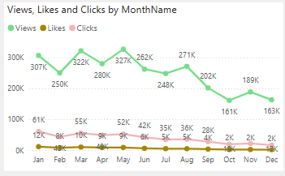
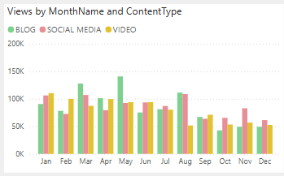
Reduced Customer Engagement
Declining Views:
Views peaked in March and May but declined From
august and on, indicating reduced audience engagement
in later half of the year.
Low Interaction Rates:
Clicks and likes remained consistently low compared to
views, suggesting the need for more engaging content
or stronger calls to action.
Content Type Performance:
Blog content drove the most views, especially in March
and May, while social media and video content maintained
steady but slightly lower engagement

Slide 5
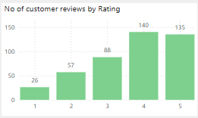
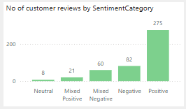
Customer Feedback Analysis
Customer Ratings Distribution:
The majority of customer reviews are in the higher ratings, with 140 reviews at 4 stars
and 135 reviews at 5 stars, indicating overall positive feedback.
Lower ratings (1-2 stars) account for smaller proportions with 26 reviews at 1 star
and 57 reviews at 2 stars.
Sentiment Analysis:
Positive sentiment dominates with 275 reviews, reflecting a generally satisfied
customer base. Negative sentiments is present in 82 reviews with a smaller
number of Mixed and neutral sentiments , suggesting some areas for improvement
but overall strong customer approval.
Opportunity for Improvement:
The presence of Mixed positive and Mixed negative Sentiments suggest that there
are opportunities to convert those mixed experiences into more clearly positive ones,
potentially boosting overall ratings. Addressing the concerns in mixed reviews could
elevate customer satisfaction.

Slide 6
Goals & Actions
Goals
Actions
Increase Conversion Rates:
Goal: Identify the factors impacting conversion rates and
provide recommendations to improve it.
Insight : Highlight key stages where visitors drop off and
suggest improvements to optimize the conversion funnel.
Enhance Customer Engagement:
Goal : Determine which type of content drives the highest
engagement.
Insight : Analyse the interaction levels with different types
of marketing content to inform better content strategies.
Improve Customer Feedback Scores:
Goal : Understand common themes in customer reviews
and provide actionable insights.
Insight : Identify recurring positive and negative feedback
to guide product and service improvements.
Increase Conversion Rates:
Target High-Performing Product Categories : Focus marketing efforts on
product that demonstrated high conversion rates, such as Kayaks,
Ski Boots and Baseball Gloves. Implement seasonal promotions or
personalized campaigns during peak months(e.g. such as January and
September) to capitalize on these trends.
.
Enhance Customer Engagement:
Revitalize Content Strategy : To turn around declining views and low
interaction rates, experiment with more engaging content formats,
such as interactive videos of user-generated content. Additionally
boost engagement by optimizing call-to-action placement in
social media and blog content, particularly during historically lower
engagement months(e.g. August to December).
Improve Customer Feedback Scores:
Address Mixed and Negative feedback : Implement a feedback loop where
mixed and negative reviews are analysed to identify common issues. Develop
improvement plans to address these concerns. Consider following up with
dissatisfied customers to resolve issues and encourage re-rating, aiming
to move average ratings closer to the 4.0 target.

