Slide 1
INTERNSHIP ANALYTICAL MODELING OF HgCdTe HOMOJUNCTION PHOTODETECTOR FOR LWIR FREE SPACE OPTICAL COMMUNICATION SYSTEM
Name: Mohmad Zaheer
Class: E4 – C1
ID: B192091
Under the guidance of
Dr. Vijaya Kumar Devarakonda
Assistant Professor
IIITDM, Kurnool

Slide 2
TABLE OF CONTENT
INTRODUCTION
APPLICATION OF LWIR
STRUCTURE OF HgCdTe
MODELLING
ANALYTICAL MODELLING
RESULTS
CONCLUSION

Slide 3
INTRODUCTION
Free space optical(FSO) system
FSO communication involves transmitting data via light through the atmosphere without physical mediums like fiber optics.
FSO systems are critical for high-speed, secure communication over long distances, especially where laying physical cables is impractical.
Significance of LWIR:
The long-wavelength infrared (LWIR) range (8-12 𝜇-m) is crucial for FSO system due to its low atmospheric absorption, allowing effective data transmission even in adverse weather conditions.

Slide 4
PHOTODECTORS
A photodetector is an electronic device that converts light into an electrical signal. It works by absorbing photons (light particles) and generating a corresponding electrical current or voltage. Photodetectors are essential components in various applications, including optical communication systems, imaging devices, and sensors, where they detect and measure light intensity, wavelength, or other optical properties.
Types of photodetector
Photodiode
Phototransistors
Photoconductors
HgCdTe Photodetector

Slide 5
HgCdTe
HgCdTe (Mercury Cadmium Telluride) is a versatile semiconductor material with a tunable bandgap, making it ideal for detecting different infrared wavelengths.
By adjusting the cadmium concentration (x in Hg_{1-x}Cd_{x}Te ) , the bandgap can be tailored to specific wavelengths within the LWIR range.
Properties:
Tunable Bandgap: Adjusting Cd concentration allows tunning for specific LWIR wavelengths.
High Quantum Efficiency: Efficient photon absorption and conversion to electrical signals.
Low Dark current: Minimizes noise improving the detector’s signal- to-noise ratio.

Slide 6
HOMOJUCTION PHOTODETECTOR
Homojunction:
A homojunction is a junction formed between regions of the same semiconductor material but with different doping levels or concentration.
Application in HgCdTe:
In HgCdTe, homojunction are particularly effective for LWIR detection, offering advantages such as reduced surface recombination, lower dark current, and enhanced quantum efficiency.
HgCdTe is a direct energy band gap material, and it has a very sharp optical absorption characteristic.

Slide 7
APPLICATION OF LWIR
1. Thermal Imaging:
Surveillance and Security: LWIR cameras are widely used for night vision and surveillance, as they can detect heat from objects even in complete darkness.
Search and Rescue: Used to locate people and animals based on their body heat in low visibility conditions.
Building Inspections: Identifies heat leaks, insulation issues, and other thermal anomalies in structures.
2. Environmental Monitoring:
Climate Studies: LWIR is critical for studying Earth’s thermal radiation and understanding climate patterns.
Pollution Detection: Measures the concentration of gases like CO₂ and water vapour in the atmosphere by detecting their unique absorption signatures in the LWIR range.

Slide 8
3. Industrial Applications:
Quality Control: LWIR imaging is used to monitor processes that involve heat, such as welding, casting, and drying, ensuring uniformity and quality.
Predictive Maintenance: Identifies overheating components in machinery and electrical systems before failure occurs.
4. Medical and Biological Uses:
Thermography: Non-invasive imaging technique used to detect abnormal heat patterns in the human body, which can indicate conditions like inflammation or vascular issues.
5. Remote Sensing:
Agriculture: Monitors plant health by measuring surface temperature and detecting stress indicators in crops.

Slide 9
MODELLING
1. Dark Current:
The dark current of the P⁺ - N photodetector has been modelled here by considering
The diffusion of the thermally generated carriers from the neutral regions, J_{DIFF}
generation-recombination of carriers in the depletion region, J_{GR}
Tunnelling of carriers through the barrier, J_{TUN}. In order to generalize the analysis, we have however considered both trap assisted tunnelling (TAT) as well as band-to-band tunnelling (BTB). The tunnelling component of current thus constitutes two components e.g., J_{TAT} arising from the trap assisted tunnelling and J_{BTB} arising out of band-to-band tunnelling. The net current can be written as:
J_{TOTAL} = J_{DIF} + J_{GR} + J_{TUN ,}
Where J_{TUN} = J_{BTB} + J_{TAT}

Slide 10
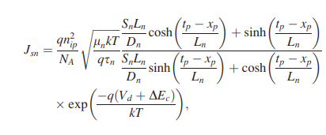
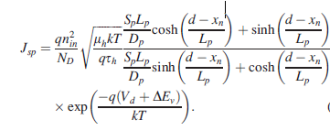
2. Diffusion Current:
The diffusion of minority carriers from both P⁺ and N regions, contribute diffusion current. The minority carrier diffusion current under application of a bias voltage, V can be obtained by solving 1-D diffusion equation under appropriate boundary conditions. Diffusion current density due to holes injected from P⁺ region in N-Hg_{0.78} Cd_{0.22}Te region is modelled as
Diffusion current density due to electrons injected from intrinsic N region in P⁺ -Hg_{0.78} Cd₀.₂₂Te region is modelled.

Slide 11
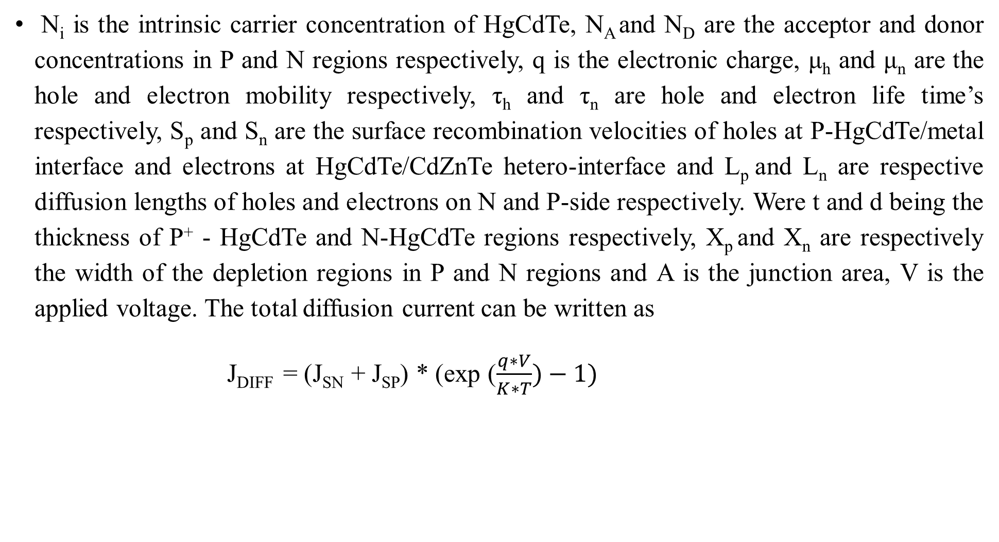
N_{i} is the intrinsic carrier concentration of HgCdTe, N_{A} and N_{D} are the acceptor and donor concentrations in P and N regions respectively, q is the electronic charge, μ_{h} and μ_{n} are the hole and electron mobility respectively, τ­_{h} and τ_{n} are hole and electron life time’s respectively, S_{p} and S_{n} are the surface recombination velocities of holes at P-HgCdTe/metal interface and electrons at HgCdTe/CdZnTe hetero-interface and L_{p} and L_{n} are respective diffusion lengths of holes and electrons on N and P-side respectively. Were t and d being the thickness of P⁺ - HgCdTe and N-HgCdTe regions respectively, X_{p} and X_{n} are respectively the width of the depletion regions in P and N regions and A is the junction area, V is the applied voltage. The total diffusion current can be written as
J_{DIFF} = (J_{SN} + J_{SP}) * (exp ($\frac{q∗V}{K∗T})−1)$

Slide 12

3. Generation – Recombination:
The generation-recombination current component arises due to impurities and defects within the depletion region that acts as intermediate states for the thermal generation and recombination of carriers. These intermediate states are known as Shockley-Read-Hall centres. This current could be important than diffusion current, although depletion region is much less than the minority carrier’s diffusion length, especially at low temperature. The generation-recombination component of current density and associated resistance area product can be approximated as Where m*_{nn} and m*_{pp} are the effective masses of electrons and holes in the N and P regions, respectively.

Slide 13

4. Trap Assisted Tunnelling Current:
In this case the minority carriers may tunnel from the occupied trap states on the quasi-neutral side to the empty band states on the other side of the junction or through the trap sites present in the depletion region of the junction. In the P⁺- junctions, the major contribution of TAT may be due to tunnelling of electrons, via trap levels to the conduction band on the n side. This trap-assisted tunnelling current density can be calculated as. where X_{w} is the total width of the depletion region, m*_{pp} is the effective mass of holes in the valence band, M is the matrix element associated with the trap potential, E is the electric field across the depletion region, and N_{t} is the trap density responsible for trap assisted tunnelling, which is different from the SRH trap density. E_{t} is the position of the trap levels in the bandgap measured from the top of the valence band.

Slide 14


5. Band-To-Band Tunnelling Current:
At relatively higher bias voltage, the electrons from the filled in states in the valence band on the P⁺ side tunnel to the conduction band on the n side. This band-to-band current density can be obtained as. V is the applied voltage, m*_{pp} is the effective mass of holes in the valence band, E is the electric field across the depletion region, and ħ=h/2π, h being Planck’s constant
6. Responsivity:
The current responsivity (R) of the photodetector is given as
R = $\frac{ηqλ }{hc}$

Slide 15
7. Carrier Lifetime:
In the present lifetime modelling, we have considered bulk recombination processes in HgCdTe to involve radiative recombination and two non-radiative recombination mechanisms. The direct band-to-band photon assisted recombination is radiative recombination and the phonon assisted recombination processes consists of Auger and Shockley-Read-Hall (SRH) recombination mechanisms which are non-radiative recombination processes. The modelling of the radiative recombination process is straightforward. For direct bandgap HgCdTe semiconductors, the lifetime of carriers due to radiative recombination for low level injection can be approximated. The non-radiative Auger recombination is quite complex. It is an important mechanism in determining the performance of light-emitting devices and infrared detectors made from narrow-gap semiconductors. A semiconductor with a single conduction band and heavy-hole and light-hole valence band there can be at least ten different types of Auger transitions occur. Out of these transitions, the two most significant transitions that occur at the minimum threshold energy (E_{T}≈E_{g}) are the Auger-1 or CHCC (involving two conduction band electrons and a heavy hole) and Auger-7 or CHLH (involving one conduction band electron and one heavy hole and one light hole).

Slide 16
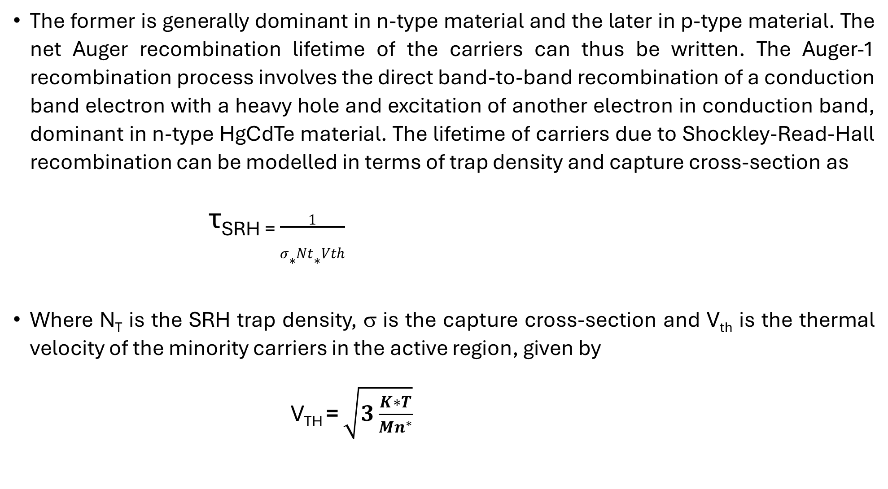
The former is generally dominant in n-type material and the later in p-type material. The net Auger recombination lifetime of the carriers can thus be written. The Auger-1 recombination process involves the direct band-to-band recombination of a conduction band electron with a heavy hole and excitation of another electron in conduction band, dominant in n-type HgCdTe material. The lifetime of carriers due to Shockley-Read-Hall recombination can be modelled in terms of trap density and capture cross-section as
τ_{SRH =} $\frac{1}{σ∗Nt∗Vth}$
Where N_{T} is the SRH trap density, σ is the capture cross-section and V_{th} is the thermal velocity of the minority carriers in the active region, given by
V_{TH} = $\sqrt{3\frac{K∗T}{Mn^{∗}}}$

Slide 17
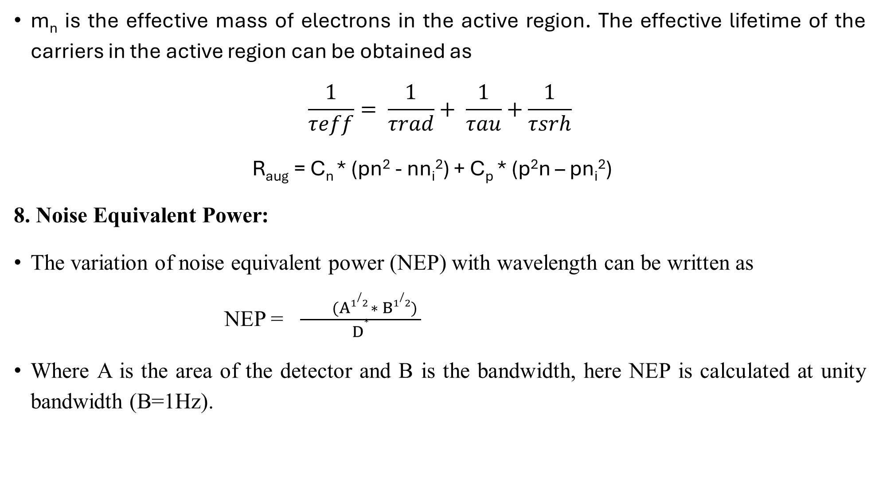
m_{n} is the effective mass of electrons in the active region. The effective lifetime of the carriers in the active region can be obtained as
$$\frac{1}{τeff}= \frac{1}{τrad}+ \frac{1}{τau}+\frac{1}{τsrh}$$
R_{aug} = C_{n} * (pn² - nn_{i}²) + C_{p} * (p²n – pn_{i}²)
8. Noise Equivalent Power:
The variation of noise equivalent power (NEP) with wavelength can be written as
NEP = $\frac{ (A1/2 ∗ B1/2) }{D∗}$
Where A is the area of the detector and B is the bandwidth, here NEP is calculated at unity bandwidth (B=1Hz).

Slide 18

9. Quantum Efficiency:
The quantum efficiency (η) of a P-N junction photodetector has generally three major components. These components arise from the contribution of the three regions e.g., neutral N-region (η_{n}), neutral p-region (η_{p}) and the depletion region (η_{dep}). The optical generation rate of electron-hole pairs, as a function of distance x from the surface can be written as
Where α(λ) is the optical absorption coefficient of the material, which is a function of wavelength λ, R is the Fresnel reflection coefficient at the entrance, P_{opt} is the incident optical power, ν is the frequency of radiation and A is the device area. The quantum efficiency components can be obtained as

Slide 19
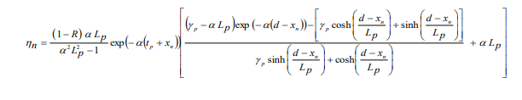
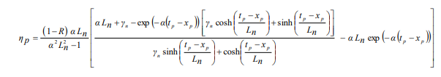
Where L_{p} and L_{n} are the hole and electron diffusion lengths in n and p regions respectively. γ_{n} = S_{n}L_{n}/D_{n} and γ_{p} = S_{p}L_{p}/D_{p} are the ratio of surface to bulk recombination velocity in p and n regions respectively. The contribution of the photo-generated carriers in the depletion region to the total quantum efficiency can be obtained as
𝜂_{dep} = (1- R) {exp (-𝛼 (t_{p} – x_{p} )) – exp ( -𝛼 (t_{p} + x_{n}))}

Slide 20

10. Specific Detectivity:
The most important figure of merit of the photodetector for use in optical communication is the specific detectivity D*, which depends on the wavelength of incident light λ, the quantum efficiency η and zero bias resistance area product, R₀A. As the dark current of the detector is contributed by three major components e.g., diffusion, generation-recombination and tunnelling (which includes trap assisted tunnelling (TAT) and band to band tunnelling (BTB)), the detectivity of the photodetector under consideration should be estimated from the net value of R₀A product arising out of this mechanism. The specific detectivity of the photodetector which is a function of the applied voltage can be written as

Slide 21
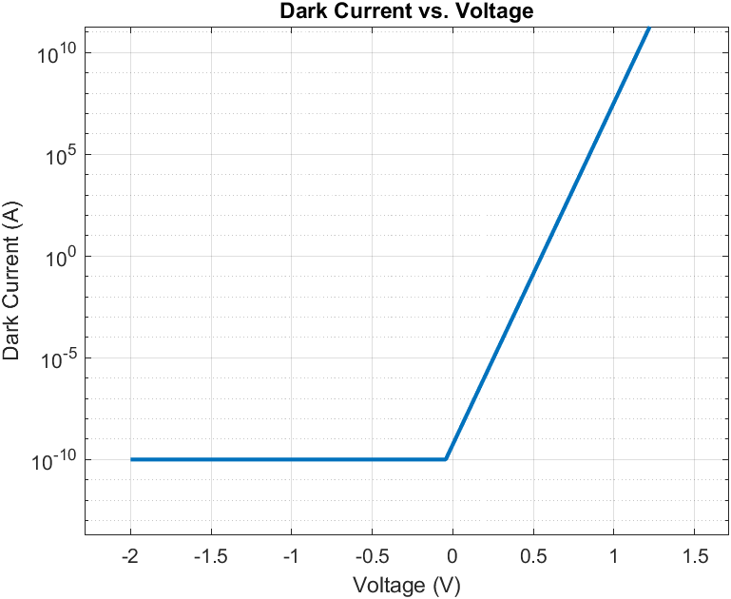
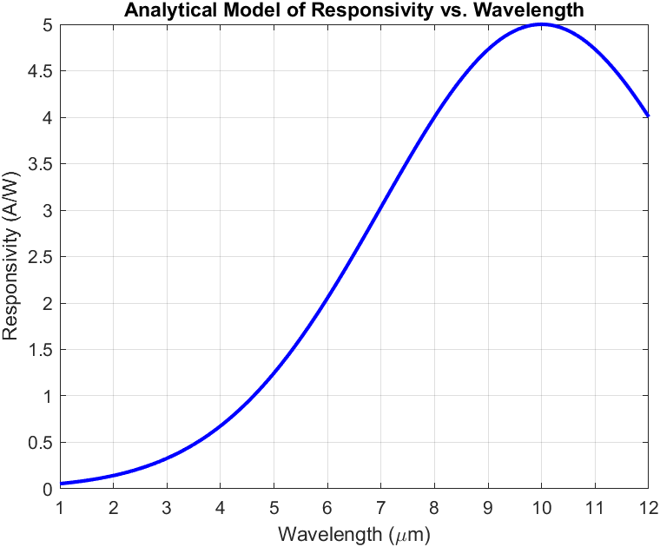
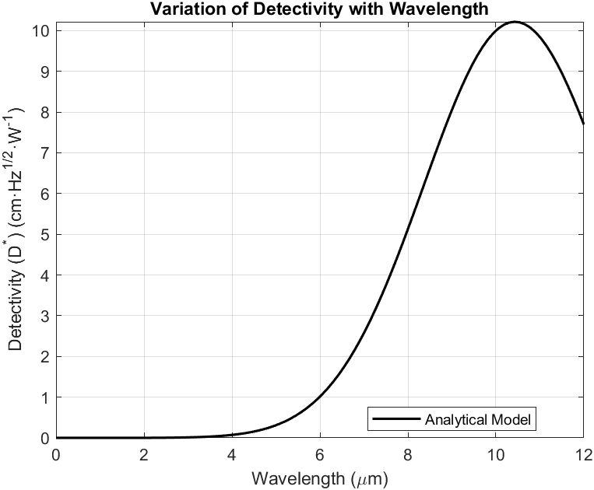
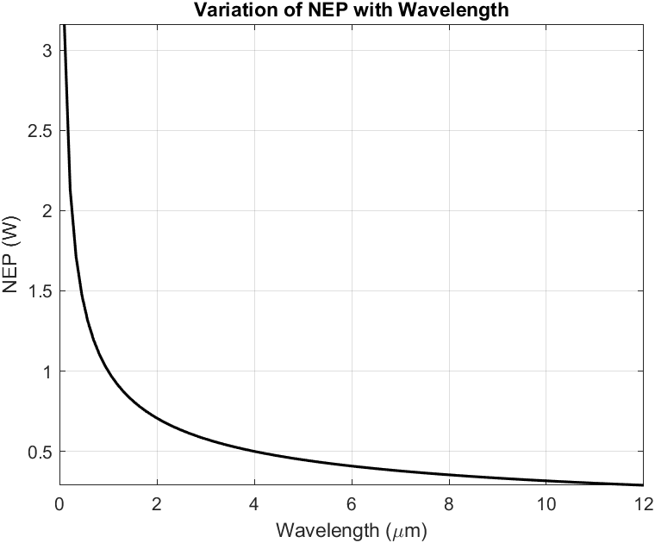
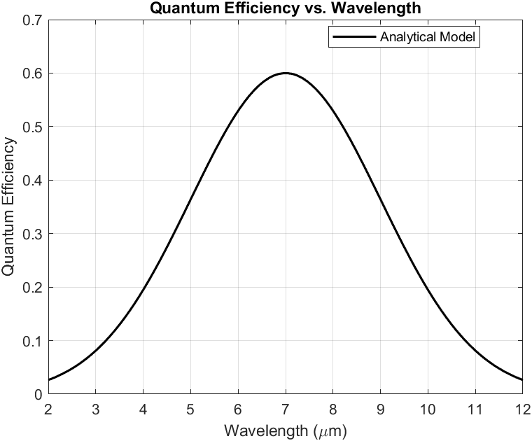
RESULTS

Slide 22
CONCLUSION
The performance of the device has been examined by developing an analytical model for the dark current, quantum efficiency, responsivity and detectivity and results obtained from analytical model. The device exhibited a very low dark current of the order of 2×10⁻¹¹A, quantum efficiency ~50%, responsivity ~4.75A/W, detectivity~5×10¹⁰ mHz^{1/2}W⁻¹ and noise equivalent power (NEP) ~ 10⁻¹⁶ W at wavelength of operation 10.6 µm and bias voltage of 0.5V.
References:
1. Physics of Semiconductor Devices.
2. Solid State Electronic Devices, 6th Edition

