Slide 1
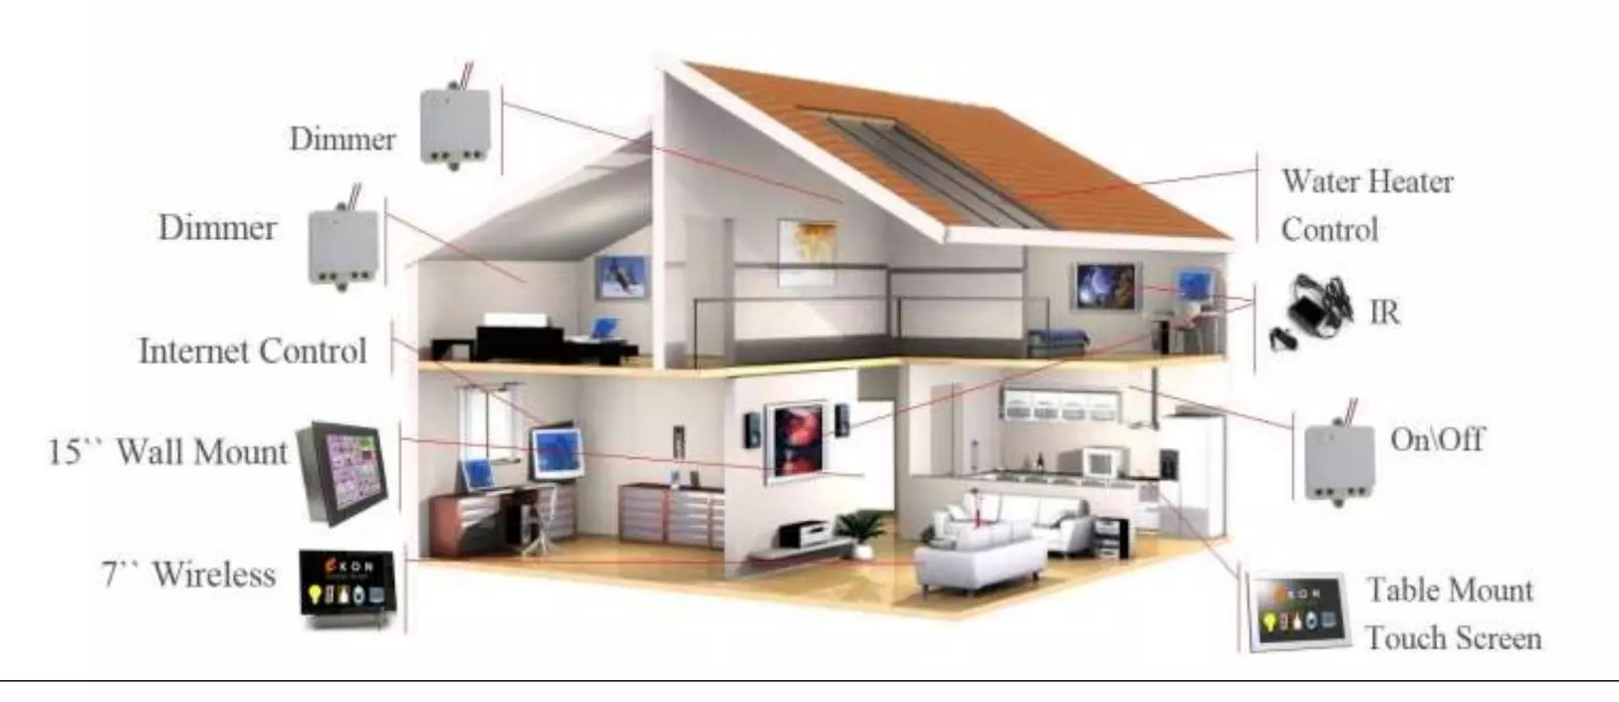
MINI PROJECT HOME AUTOMATION
Under the guidance of
P.Tejasvey Madam
A. Ramya Sree
ID: B191978
2. Mohmad Zaheer
ID: B192091

Slide 2
TABLE OF CONTENT
INTRODUCTION
HOME AUTOMATON
FLOW CHART
Block diagram
STATE DIAGRAM
VERILOG MODULES
Rtl schematic
stimulation
COMPARATIVE ANALYSIS
CONCLUSION

Slide 3
INTRODUCTON
Smart home technology refers to the integration of various devices and systems within a household to automate and enhance living experiences. This includes features like energy management, home security, entertainment systems, and remote access through connected devices and networks.
Smart homes leverage advancements in internet of things (ioT), artificial intelligence, and cloud computing to provide homeowners with increased convenience, efficiency, and control over their living environment
Verilog is a powerful hardware description language (HDL) used to design and simulate digital systems. It allows engineers to model the behaviour of complex electronic systems at various levels of abstraction, from gate-level to system-level. Verilog's concise syntax and powerful simulation capabilities make it a popular choice for designing and verifying digital circuits, ranging from simple logic gates to sophisticated microprocessors.

Slide 4
HOME AUTOMATION
Home automation, also known as domotics, refers to the use of technology to control and automate various household systems and devices. This can include everything from lighting, heating, and air conditioning to security systems, home entertainment systems, and kitchen appliances. Home automation systems allow homeowners to monitor and control these devices remotely through smartphones, tablets, or computers, often via a centralized hub or platform. The ultimate goal of home automation is to enhance the convenience, efficiency, and security of home living.
Increased security
Home automation systems enhance security by providing real-time monitoring of sensors, such as door and window contacts, motion detectors, and smoke detectors. In case of unauthorized entry or potential hazards, the system can trigger alarms, send notifications, and activate security measures, providing homeowners with peace of mind.

Slide 5
Energy efficiency
By automating lighting and temperature control based on occupancy and ambient conditions, home automation systems can optimize energy consumption and reduce utility bills. Smart thermostats, for instance, can adjust the heating and cooling systems based on schedules and preferences, minimizing energy waste.
Enhanced comfort
Home automation systems enhance comfort by providing personalized control over various aspects of the home environment. Users can adjust lighting levels, set desired temperatures, control appliances, and even remotely manage their homes from anywhere with an internet connection.

Slide 6
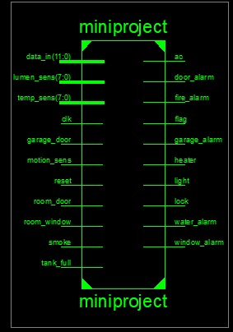
Block Diagram

Slide 7
STATE DIAGRAM
RESET
START
Temp_sensor
Temp_sensor
Temp_sensor
Temp_cool
Temp_heat
Temp_norm
Lum_sensor
Lum_sensor
Lum_sensor
Lum_sensor
Lum_sensor
Lum_sensor
Lum_sensor
Lum_sensor
Lum_sensor
Light_dim
Light_bright
Light_norm

Slide 8
VERILOG MODULES
Password verification module
This module implements a password verification mechanism to ensure only authorized users can access and control the home automation system. It compares the input password with a stored reference value, granting access only if they match. This security feature prevents unauthorized individuals from manipulating the system's functionalities.
Security module
The security module continuously monitors data from sensors related to security, such as door and window contacts, motion detectors, and fire alarms. It analyzes this data in real-time, triggering appropriate actions based on predefined rules. This includes activating alarms, sending notifications, and controlling security measures like door locks and cameras.
Comfort module
The comfort module focuses on managing the home's environment for optimal user comfort. It receives data from sensors related to temperature, light levels, and occupancy, and controls actuators like lights, heaters, and air conditioners based on predefined settings and user preferences. This module provides personalized control over the home environment for a comfortable and energy-efficient living experience.

Slide 9
SECURITY MODULE
Door alarm
The door alarm module monitors door contacts, triggering an alarm if an unauthorized door opening is detected. It can send notifications to the user, activate external security measures like sirens, and even control door locks to prevent entry.
Window alarm
Similar to the door alarm, the window alarm module monitors window contacts, detecting unauthorized openings. It triggers alarms, sends notifications, and can even activate window blinds or shutters to deter entry.
Garage alarm
The garage alarm module secures the garage by monitoring garage door sensors. It triggers alarms if unauthorized opening is detected and can even control garage door openers, ensuring the garage remains secure.

Slide 10
Fire alarm
The fire alarm module detects smoke and heat, triggering an alarm in case of a potential fire hazard. It can send notifications to the user, activate sirens, and even control sprinklers to mitigate the fire.
COMFORT MODULE
Light control
The light control module adjusts the lighting based on ambient light levels, occupancy, and user preferences. It can automatically dim lights in the evening, switch off lights in empty rooms, and even create personalized lighting scenes for different activities.
Temperature control
The temperature control module manages the heating and air conditioning system based on indoor temperature, occupancy, and user preferences. It can automatically adjust the temperature to maintain a comfortable indoor environment, reducing energy consumption and improving comfort.

Slide 11
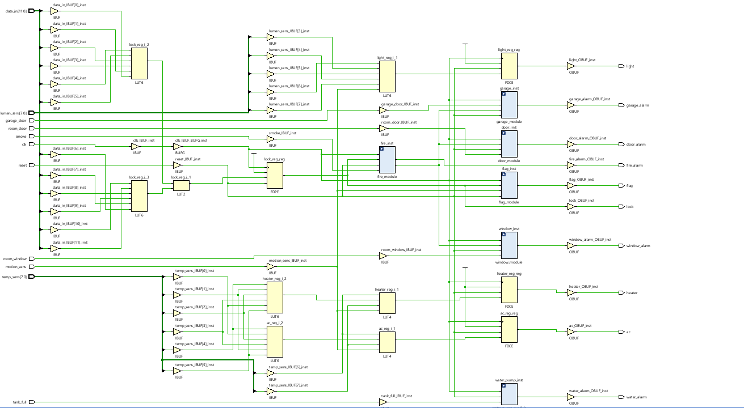
RTL SCHEMATIC

Slide 12
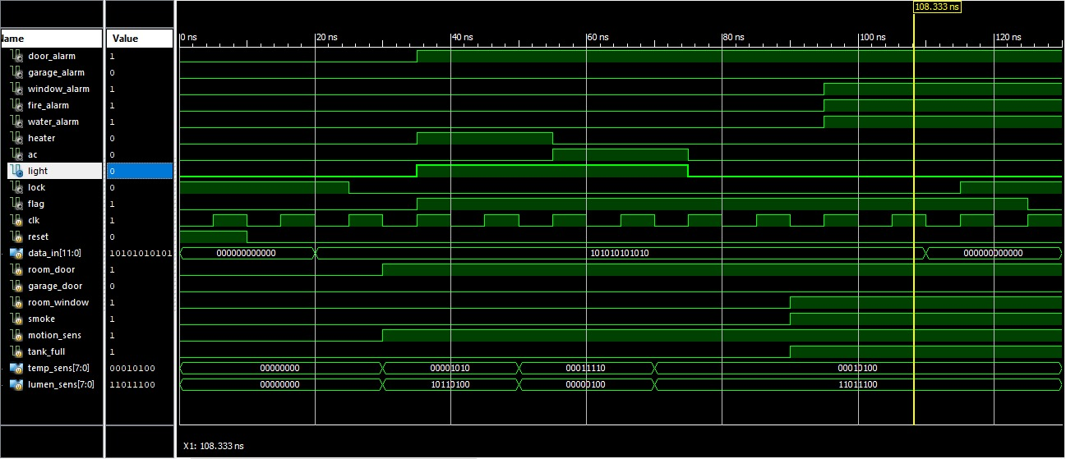
STIMULATION

Slide 13
COMPARATIVE ANALYSIS
Sl. No. | WORK | Advantages | Disadvantages
1. | IOT based home automation | Easy accessibility | Less Features
2. | Bluetooth based home automation | Wireless Technology | Slow Response
3. | Microcontroller based home automation | High performance | High cost
4. | Gesture based home automation | Increases Convenience | Complex design
5. | Remote controller home automation | Time saving | Easily hackable

Slide 14
CONCLUSION
Verilog provides RTL description which is advantageous for designer for debugging. RTL schematic can be modified by the designer and implemented by editing Verilog code. The wave form is obtained as desired.
Concluding the main aim of this project is to design a controller at an affordable price which contains an automated in-house security system. Every sensor in this controller has unique detection system for different incidents such as motion detection, fire, temperature and light etc.

