Slide 1
Design and Analysis of Algorithms Project Phase 1
Research Paper: Optimal Islanding for Restoration of Power Distribution System Using Prim's MST Algorithm
Group Members:
Anna Ahmed(19i-0477)
Maria Hassan(19i-0478)
Muhammad Zahid(19i-0469)

Slide 2
Presentation Distribution
Name | Points Covered
Anna Ahmed | Point 2, Point 3, Point 4
Maria Hassan | Point 5, Point 6, Part in Dry-run
Muhammad Zahid | Point 1, Major Part in Dry-run

Slide 3
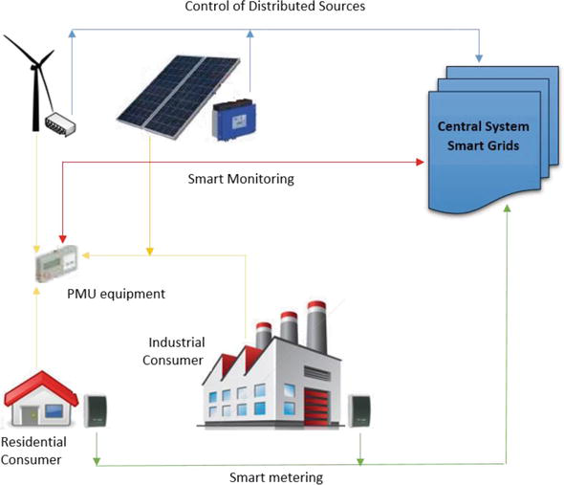

Point 1
For this paper, we need to have basic understanding of New weight co-efficient which is explained later,Impedence, Effective Power, IEEE 69 Bus, Islanding, Active Distribution Network, and PRIMS MST
Distributive Generation
ADN

Slide 4
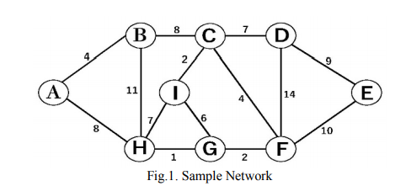
Prim’s MST

Slide 5
2. Brief Discussion of the related work discussed by the authors.
The leading-edge methods used in earlier studies to resolve PDS restoration problems include Artificial Intelligence, Knowledge-based, Expert system, Heuristic search etc.
The new algorithms to solve the restoration problem in distribution networks consists Fuzzy Logic Control, Optimization, Petri net, Genetic Algorithm etc.
Multi-agents (MAS) based method has been suggested for service restoration in many approaches
Feeder and Zone agents were proposed in "A cooperative multi-agent framework for self-healing mechanisms in distribution systems”. DGs were not considered in this.
Synchronous machines are considered instead of DGs in many scenarios.
In a case, the restoration was achieved through forming micro-grids, and sectionalizing switches completed reconfiguration.
In "Integrated approach for optimal island partition and power dispatch", a two-stage optimal controlled islanding and restoration scheme, along with varying loads is used.

Slide 6


3. What is the aim of the paper? What is the problem addressed in the paper?
The aim of the paper is to find the most feasible path of power flow in Power Systems which considers the priority of loads and minimum power loss and sharing, formulated as a multi-objective program.
Maximum load restoration with consideration of load priority:
Minimum loss during the restoration period:
The problem addressed in the paper is that when Power systems suffer an outage, and are unable to load centers of a distribution network. Then distributed generation can work as a back up power source.
Power Distribution Systems(PDSs) are prone to faults, and DGs integrated into a PDS can make it an Active Distribution Network and this can control a combination of distributed energy source i.e. generators, loads and storage.
Depending upon DGs power, the solution is to form single island which can restore power to as many loads as possible.

Slide 7
Continued: How The Paper is different from the previous work
1.Power System Reconfiguration based on Prim’s Algorithm:[14] They considered just the impedance of branches as the weights of the graph, which ignores many important factors like node demand and priority.
2. A Multi-Agent Design for Power Distribution Systems Automation:[15]
A decentralized Multi-agents (MAS) based method has been suggested for service restoration. Q-learning is used to find the strategy capable of restoring as many loads as possible.
3. Multi-Agent Based Distribution Automation Solution for Self-Healing Grids:[17]
Different agents have been proposed, and Prim’s algorithm was used to solve the restoration problem. But in this paper, power grid capacity constraints were used as graph’s edge weights.
4. A Decentralized Multi-Agent System Approach for Service Restoration Using DG Islanding:[12] Decentralized MAS approach is used and it proposes a novel idea to utilize the V2G feature of the EVs for service restoration.
5. Integrated Approach for optimal island partition and power dispatch:[22] It proposes a two-stage optimal controlled islanding and restoration scheme, along with varying loads. Here loads were restored without considering switching and load priorities
Notes:
greedy policy: There are different action selection mechanisms [64] which select the actions based
on the Q−values. The Q−values, Q(s, a) of any given state reflects the effective_x0002_ness of the action , with higher values corresponding to better actions
Point 3 multi agents: Substation Control Agent (SCA), Load Control Agent (LCA) and Restoration Agent (RA).
point 5 A two-stage approach that integrates optimal island partition and power dispatch is proposed in this paper, considering photovoltaics (PVs), batteries (BEs) and electric vehicles (EVs) as the power sources. In the first
stage, energy indices are defined to describe the energy demand and the maximum energy that these distributed energy resources (DERs) can provide, and islands are partitioned based on an energy constraint. Considering the
variability the loads and PVs, the energy constraint is a necessary but not sufficient condition for island operation, so in the second stage, a power dispatch model is proposed as a test for the island partition result

Slide 8

4. Details of the methodology adopted to solve the identified problem.
A new weight coefficient is introduced to find the optimum restoration path.
An optimal path is found using Prim’s MST technique.
A single island is formed without preset boundaries where DGs’ power can be maximally utilized.
To check the effectiveness of the Power distribution system. The system will be exposed to further failures.
A new concept of islanding is presented, in which a single island is formed, containing multiple Distributed Generation(s) and their powers are merged to determine the optimality of the islanded scheme.

Slide 9
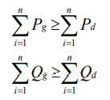


Constraints:
DG Constraints: To balance the generating capacity of the DGs with load demand.
Power Flow Constraints: To calculate with single iteration cycle.
Voltage Limits: The real time bus voltages are restricted to a specific range.

Slide 10

Continued:
Current Limits: Branch current constraints must be kept with prescribed limits.
Radial Constraints:
Each subgraph is a connected graph.
The number of branches equals the number of nodes minus the given number of subgraphs.
The resulting graph does not have cycles or loops in it.

Slide 11
How the authors have provided the evidence to justify their claims? (Results)
Prim's MST algorithm is efficiently implemented in the IEEE 69-bus system
Case 1:
On the occurrence of a major fault between nodes 2 and 3, the primary grid is disconnected from the network and DGs can be utilized to restore power to important loads.
A single island is created through the restoration process. DGs’ powers are merged for the benefit of the network.

Slide 12
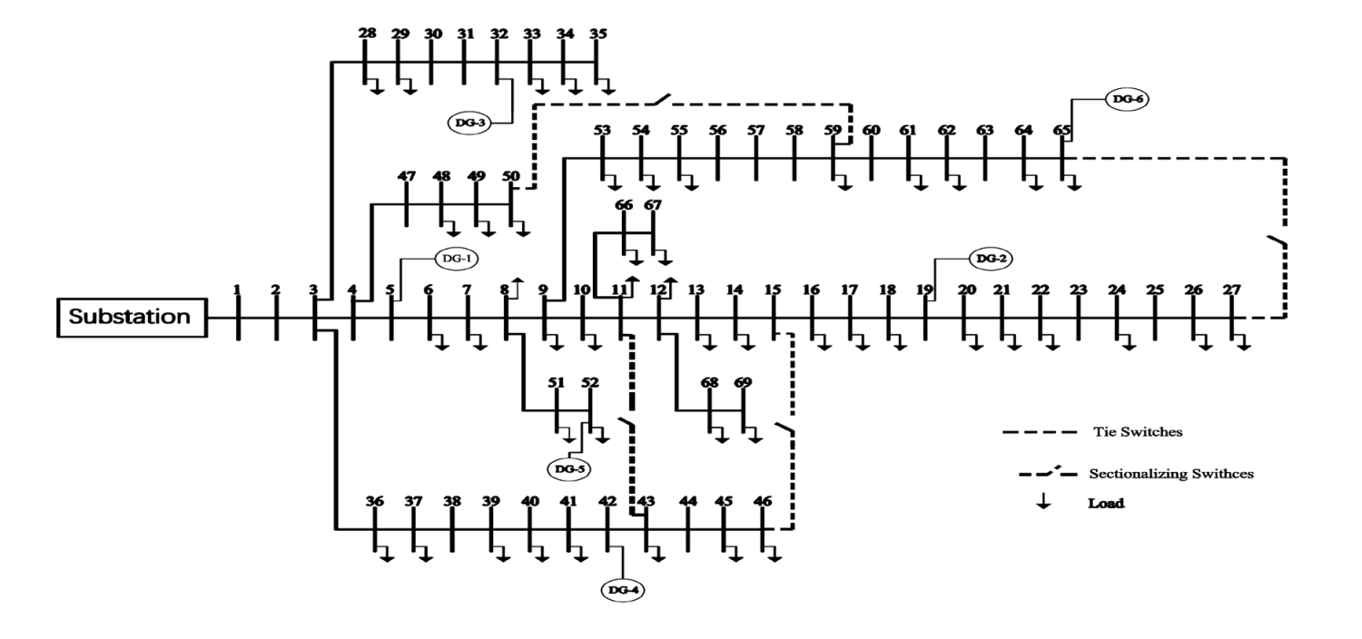
IEEE 69-Bus System

Slide 13
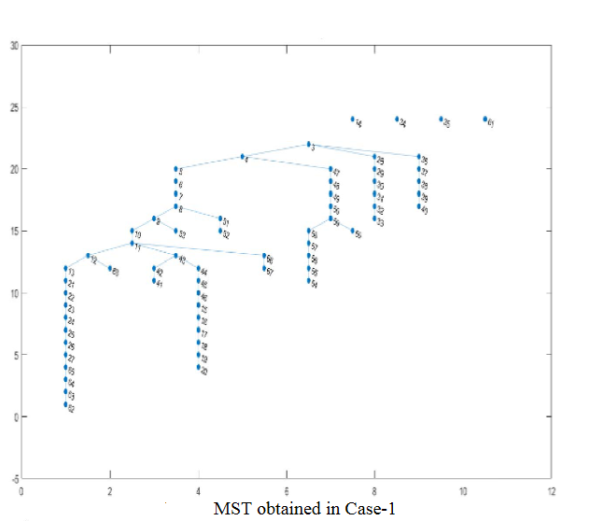
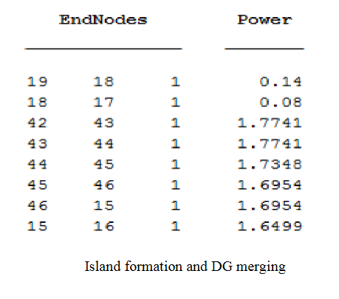

Slide 14
Case 2:
It is a load shedding scenario.
A sudden DG failure (DG-3, in this case) further devastates the plan.
Some loads are managed and shedded, and a new restoration scheme is arranged.
Prim’s MST Algorithm starts finding a suitable path by searching nearby DGs and tie switches, following the conditions of the low impedance, load demand, DGs’ spare capacity, and other constraints.
If there is not enough spare power, then some low priority nodes are ignored,.
In case-2, we have obtained two islands due to the failure of DG-3.

Slide 15
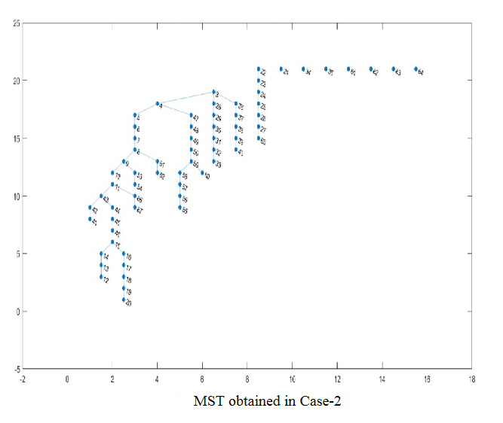

Slide 16
Prim's MST algorithm is efficiently implemented in the IEEE 69-bus system
Restored nodes are shown in the final MST, lines joining them with each other to form a tree, whereas nodes disconnected from each other and shown separately in the graph (some nodes may not be displayed) are un-restored loads.
Here, the final MST of case-1 and case-2 is considered an Island

Slide 17
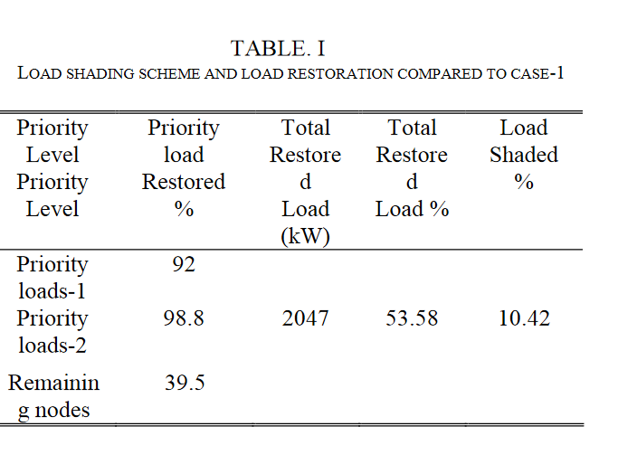
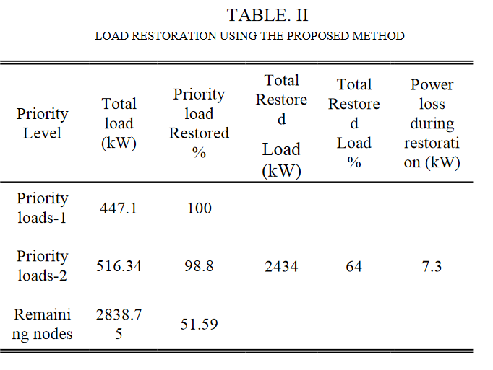
Table. II presents the statistical results of load restoration for case-1. It can be seen that a total of 2434kW (which equals 64% of total demand) is restored. Table. I presents the results of case-2, which explain the shedding of some of the loads, which is nearly 10.42% of the load shed in case-1, which is due to the unavailability of DG-3. The loads restored in case-2 represent 53.58% of the total demand.

Slide 18
Challenges Faced during Implementation
IEEE 69-bus distribution system was used because it is easier to implement. The algorithm could not be tested on any complex system.
Calculations such as of reactive or active powers or weight coefficient were not given
No dataset was shared in the paper through which the MST was generated or through which the graphs like the voltage profile were made
Total required loads and the restored load values through DG’s were not specified as well
Impedance data of each node was not provided
The algorithm was not practically implemented on real life power system restoration plans.

Slide 19
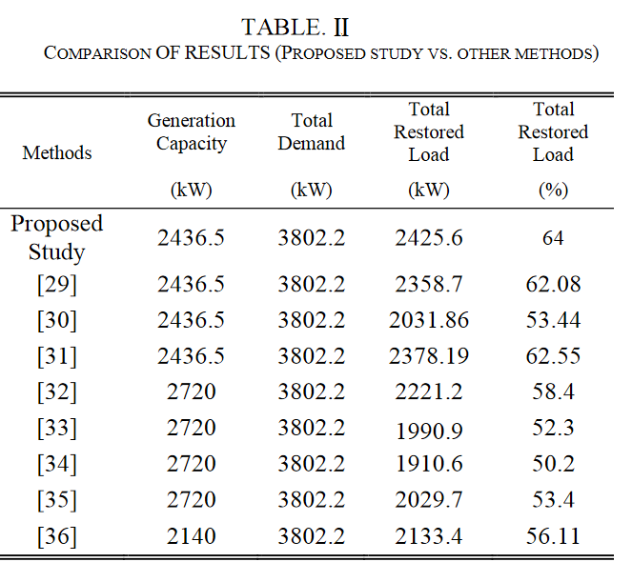
Conclusion
A comparison of the results shows that this strategy supports the idea of a single island with multiple DG coordination, and negates the impacts of high losses, which could be caused by single large islands.

Slide 20
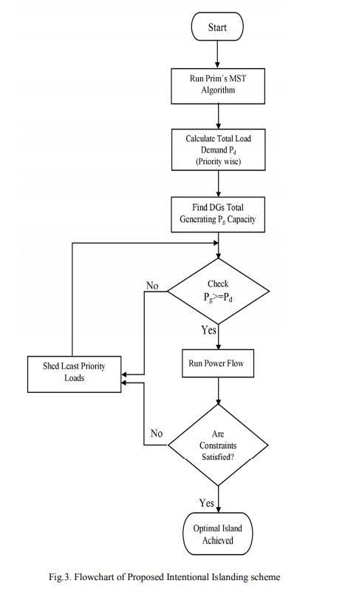
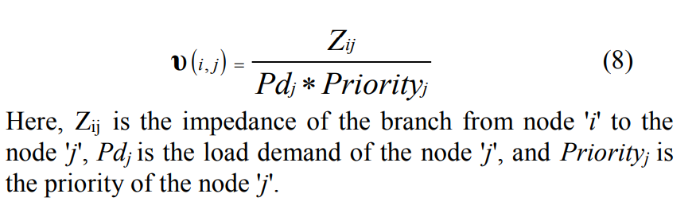
Dry-Run
Notes:
This is the flowchart used for the islanding scheme. at the start of creating a new MST (island), the algorithm selects any of the un-used DG nodes, saves its effective power, and then looks for the adjacent nodes. The v(i,j) which is the weight of the node is calculated, and the node with least weight is used is selected and this goes on until there is not enough effective power left. the Power of the DG

Slide 21
Dry-Run ( The Grid which will be used for MST).
Notes:
This is the grid from which islands will be created.

Slide 22
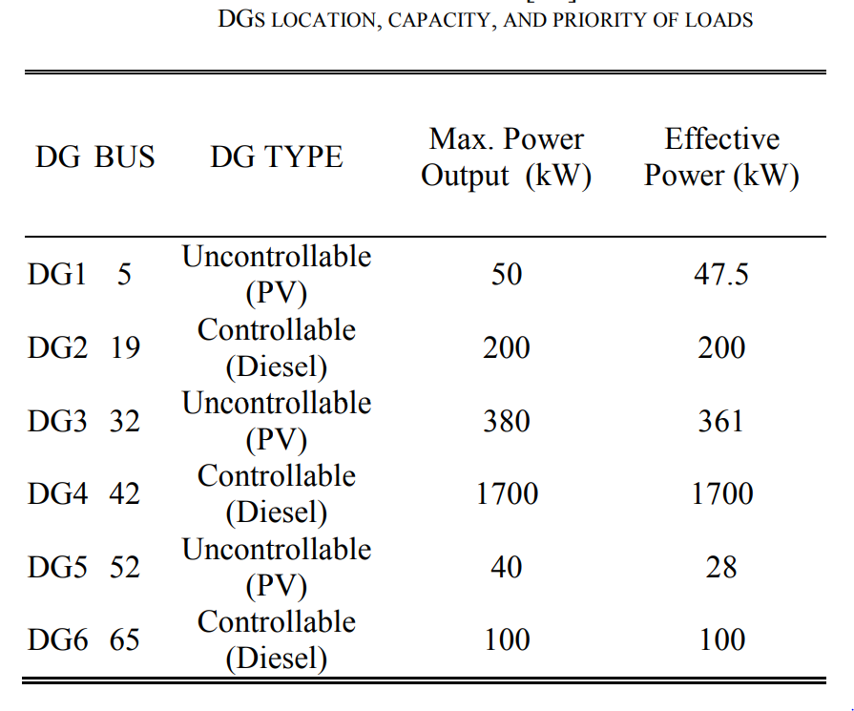
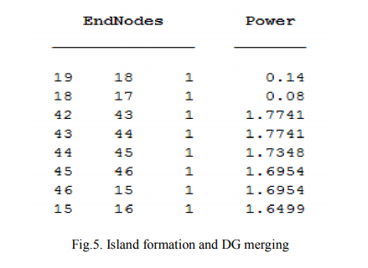
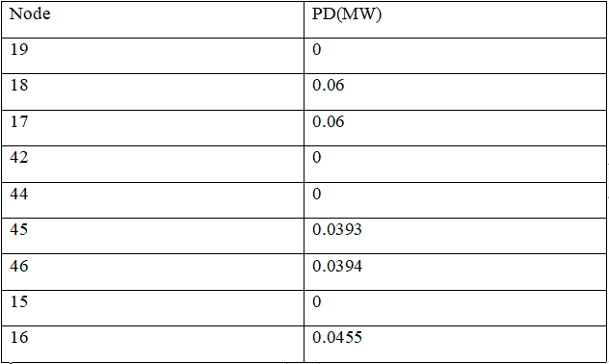
DG-Information (Nodes considered while making mst)
Notes:
The islands created using the flow chart. On the left we have the inforamtion about the DGS and at the right we have an example of the Islands created.We select DG2 (node 19). Here we have the demand of 18 is 0.06MW, and the remaining power is 0.14MW, similarly, node 17 had demand 0.06MW, and the remaining power is 0.08, now the next node might a more demand which the DG cannot cater so the island is created and inserted in an array.
Then constraints are checked if they are satisfied or not, here the constraints are not satisfied and we select another DG to creae another MST(Island) . We then choose DG4 (node 42), which effective power 1.7MW, 42 checks wieght V(42,41) and V(42,43), here V(42,43) is less so we choose node 43, and by repeating the steps we get to node 46, here we have a switch which which connects to node 15, at node 15 we check the weight V(15,14) and V(15,16), here V(15,16) is less so we choose node 16, and similarly we then go to node 17 which is already presented in previous island created so the islands are merged. And the same process continues until effective power does not becomes less than a nodes required power.

Slide 23
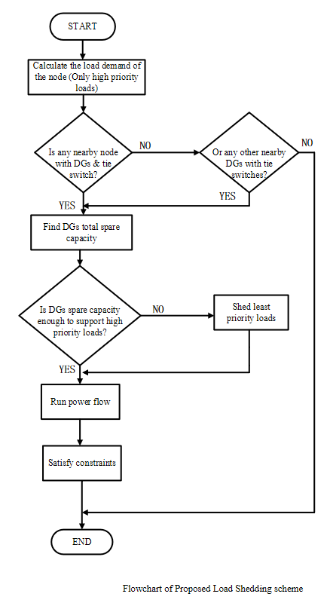
Case 2

Slide 24
THANK YOU

