Slide 1

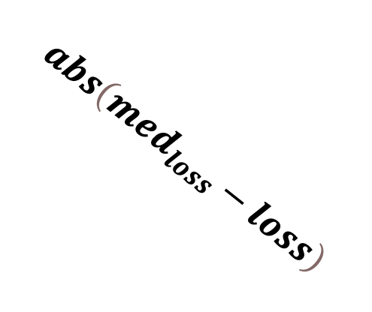
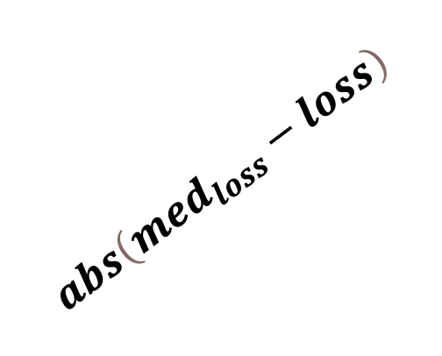
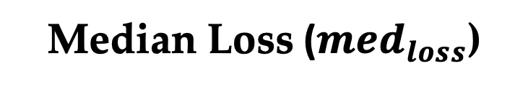
Median Loss ($med_{loss}$)
Good
Region
$$abs\left(med_{loss}−loss\right)$$
$$abs\left(med_{loss}−loss\right)$$
ασ
ασ
Good Client
d
Bad Client
ασ
βσ
βσ
-3σ
-2σ
-1σ
0σ
1σ
2σ
3σ
Local Training Loss

Slide 2
Median Loss ($med_{loss}$)
Good
Region
$$abs\left(med_{loss}−loss\right)$$
$$abs\left(med_{loss}−loss\right)$$
ασ
ασ
Good Client
d
Bad Client
ασ
βσ
βσ
-3σ
-2σ
-1σ
0σ
1σ
2σ
3σ
Local Training Loss

