Slide 1
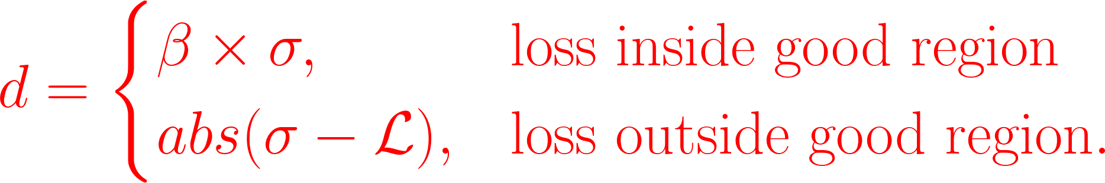

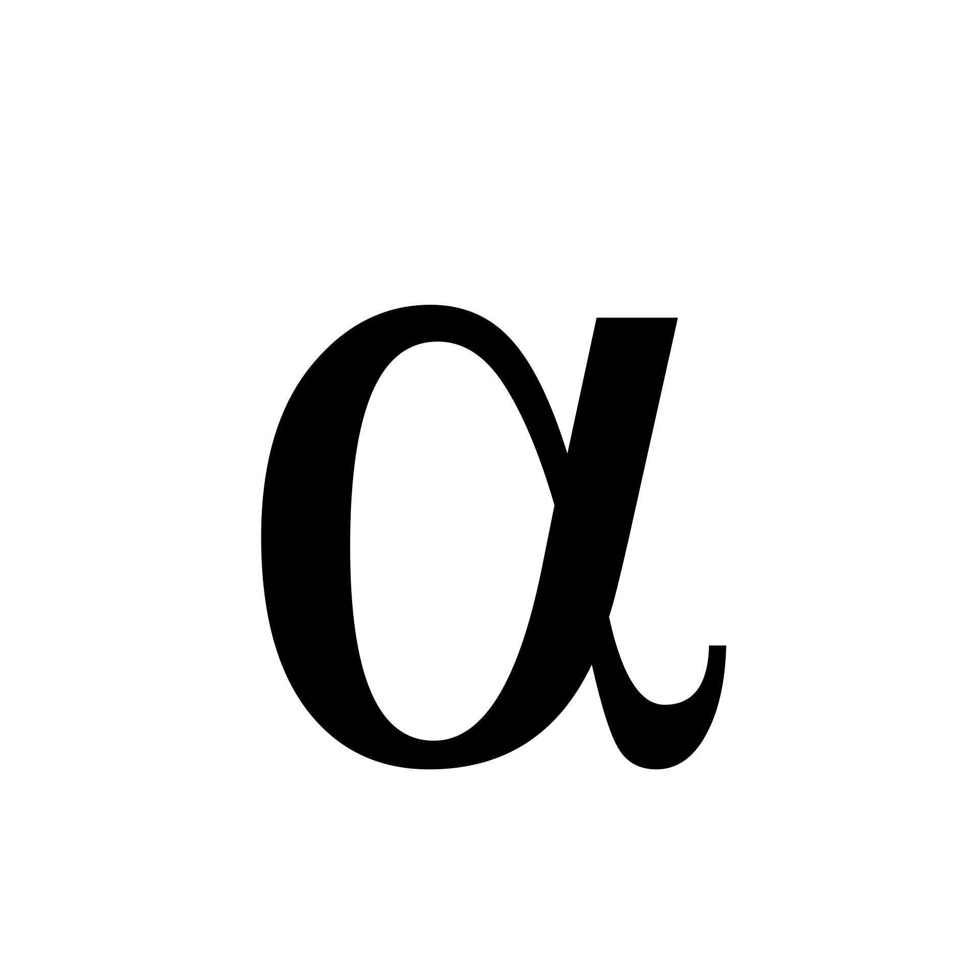
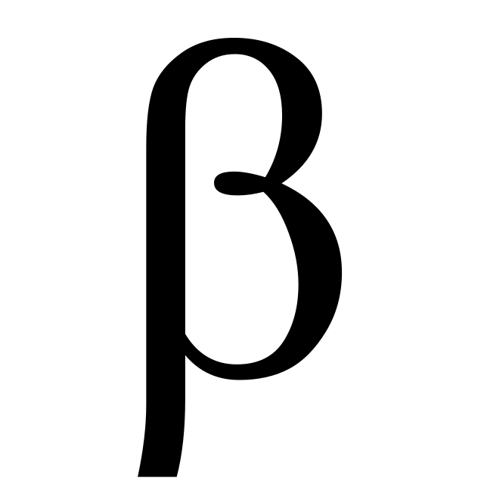

Median Loss
Good Client
Bad Client
Good Region
d
=1
=0.5
d
-3
-2
-1
0
1
2
3
Local Training Loss

