Slide 1
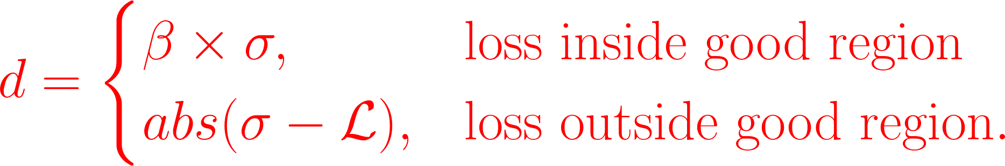


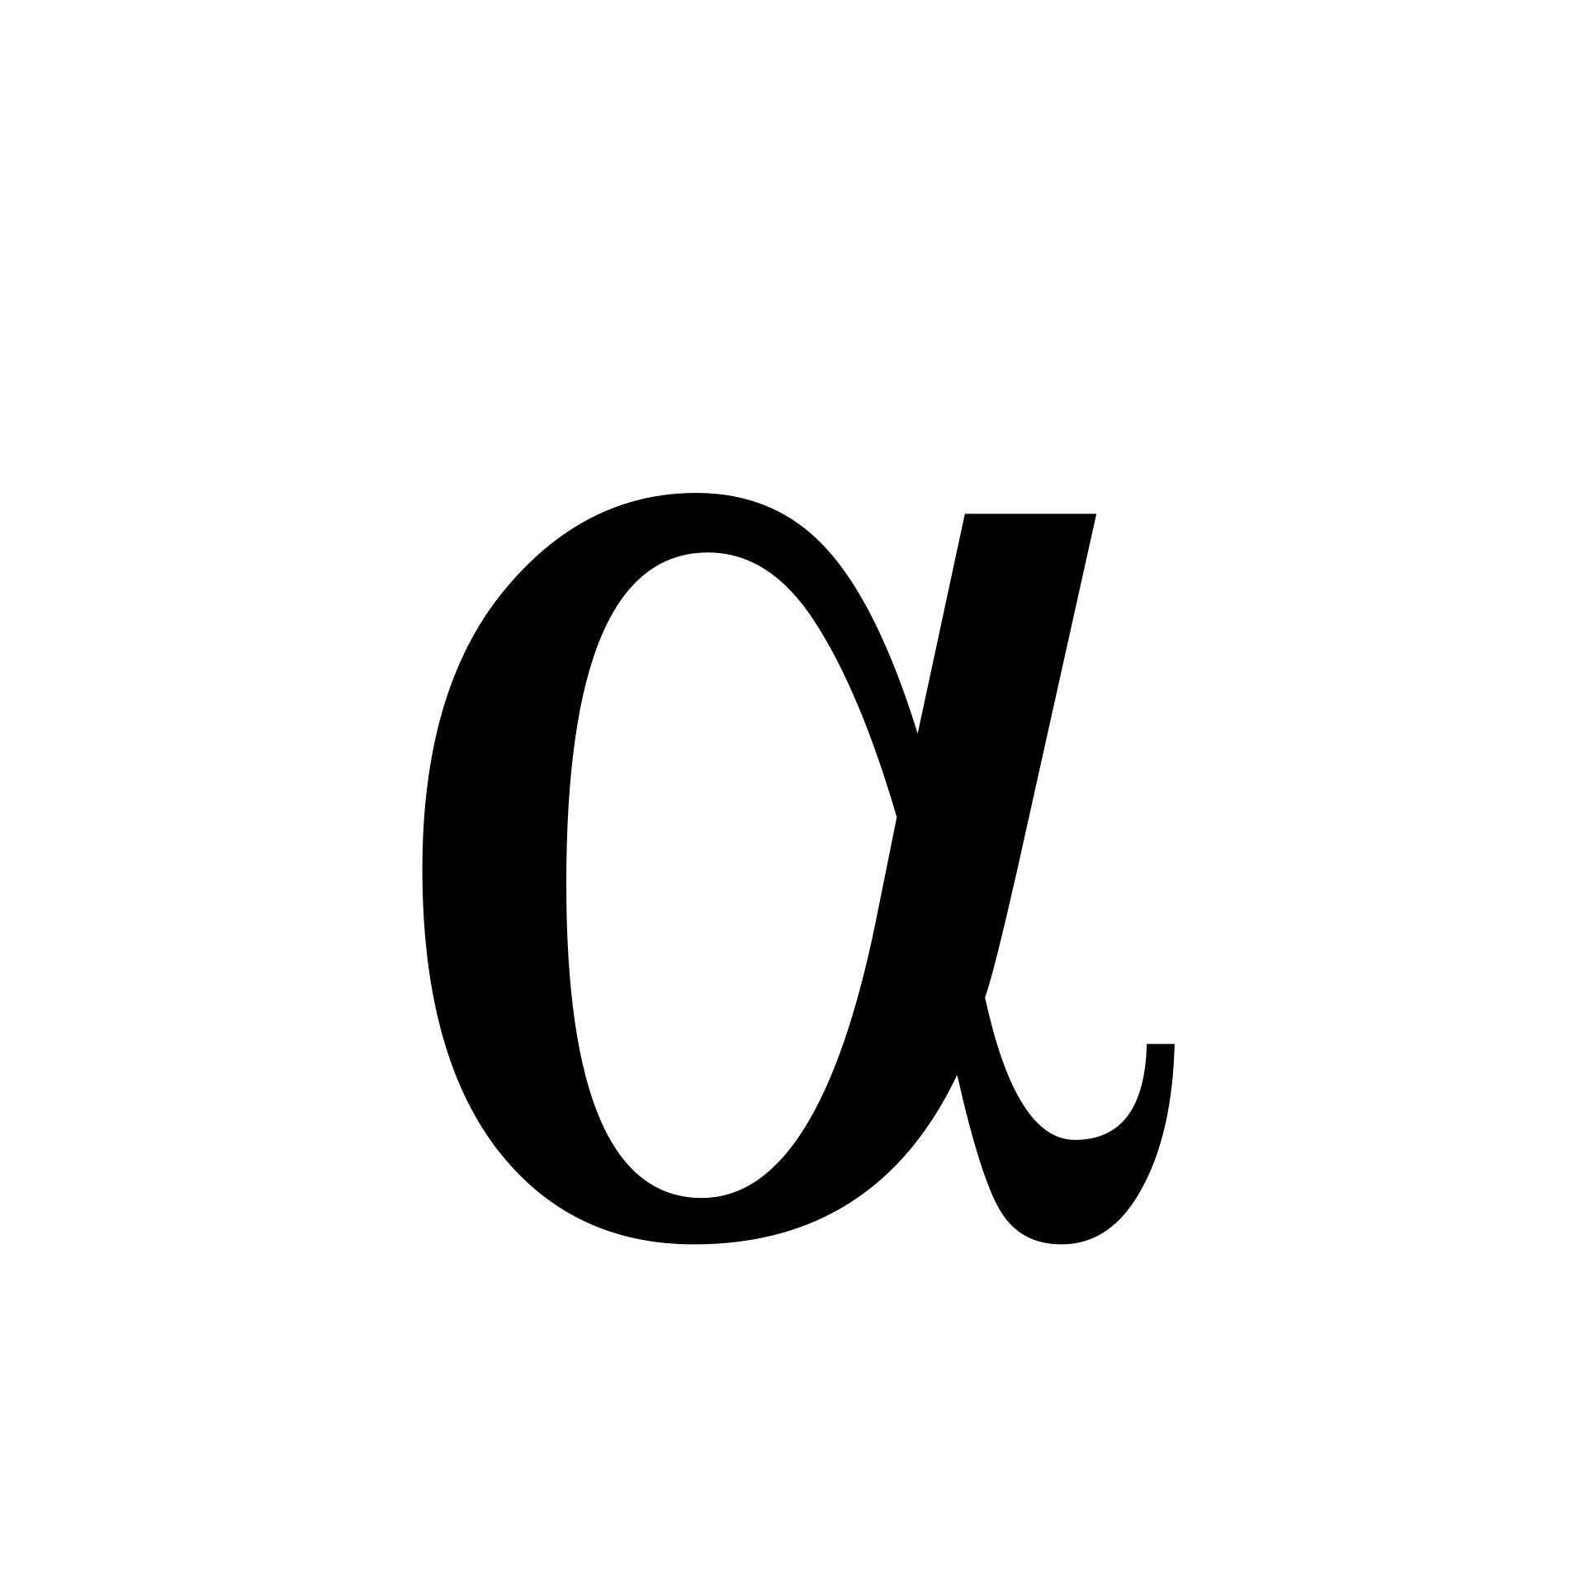
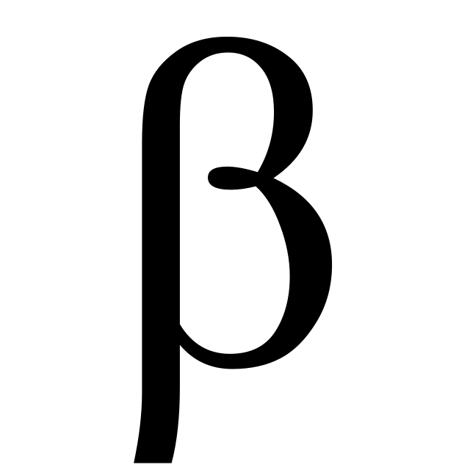
Median Loss
Good Client
Good Region
-1 to +1
Bad Client
d
= 1
= 0.5
d
-3
-2
-1
0
1
2
3
Local Training Loss

