Slide 1
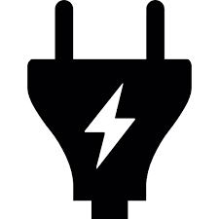

Inductor
Diode
Input voltage sample
MOSFET
PWM
Control
Output voltage sample
Bulk capacitor
Power Factor Correction (PFC)
Rectifier

