Slide 1

Protocol 6
Problem Statement
SAFETY FROM FIRE HAZARDS AND SPREAD OF HAZARDOUS GASES

Slide 2


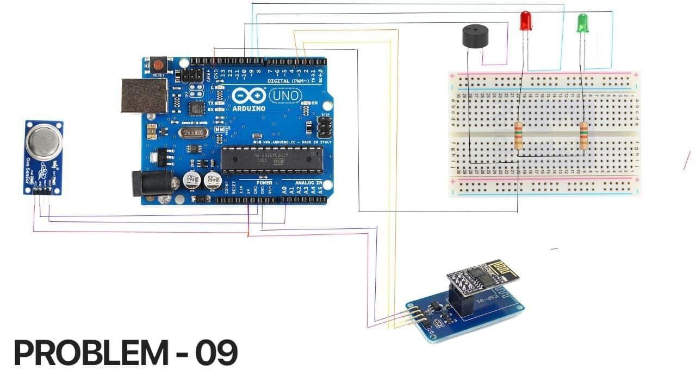

Components:
01
Arduino
01
ESP8266 WiFi Module attached with ESP01 module
01
MQ2 gas sensor
01
Green & Red LED
01
Buzzer
02
220 OHM Resistors
01
Breadboard
Many
Connecting Wires

Slide 3
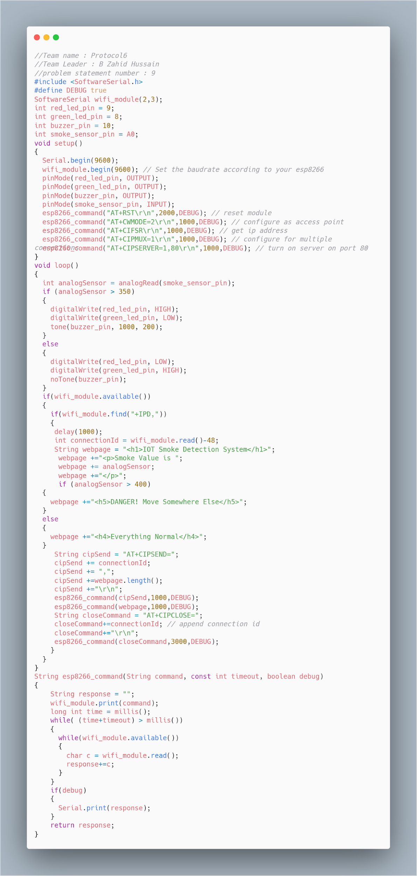
FEASIBILITY
01
Easy to setup
02
Low Cost
Low Cost
03
Quick Response
04
Intuitive Dashboard

Slide 4
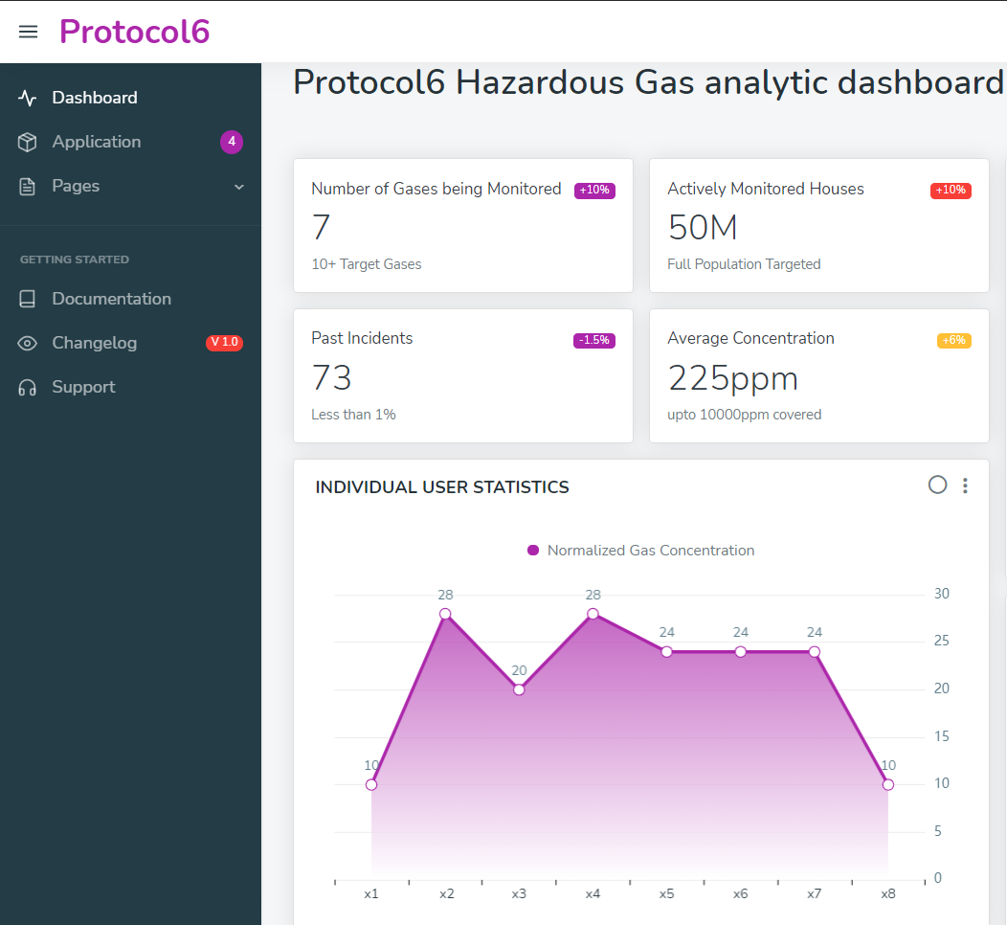
Dashboard will Contain
01
Number of actively monitored houses `
02
Total number of past incidents
03
Number of gases that are being monitored
04
Individual user statistics

Slide 5
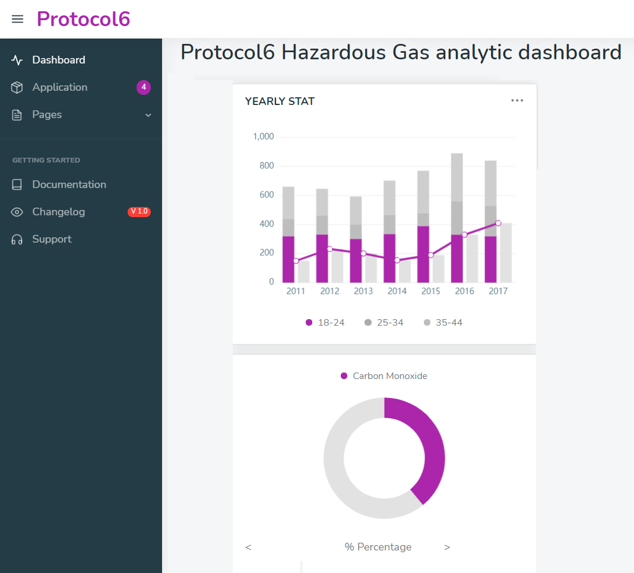
Dashboard will Contain
05
Yearly statistics `
06
Individual gas concentration percentage

Slide 6
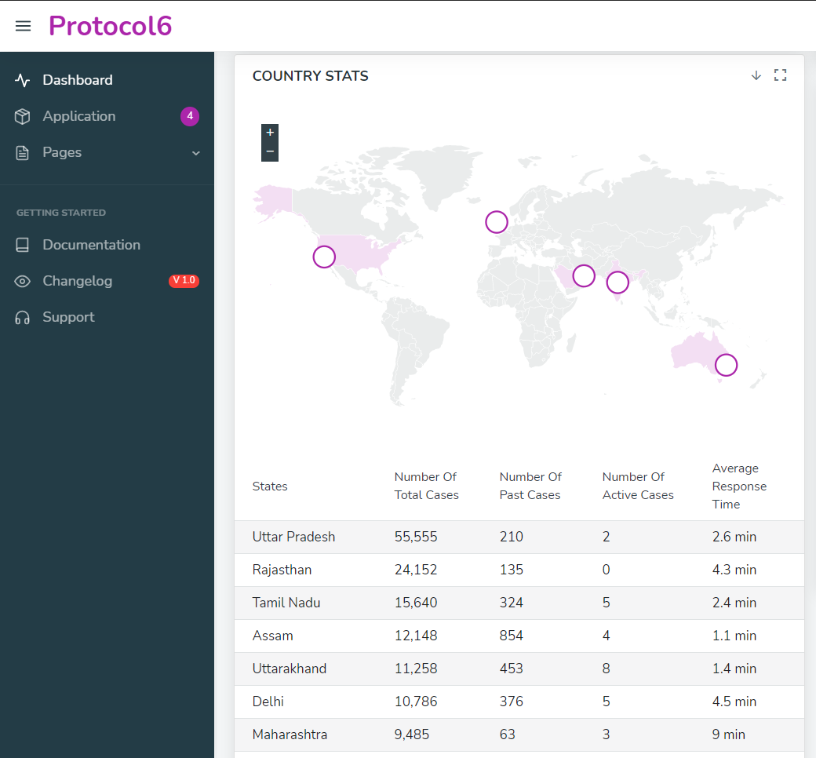
Dashboard will Contain
07
Interactive country map
08
State wise statistics

Slide 7
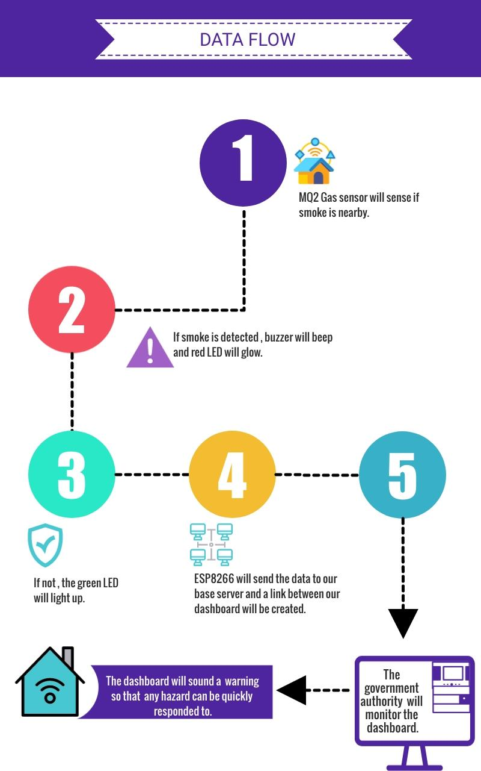
HOW IT WORKS
Get instant alert when the gas concentration increases to specified level

Slide 8

“The future belongs to those who believe in the beauty of their dreams”
THANK YOU !
Questions Are Welcome!

