Slide 1
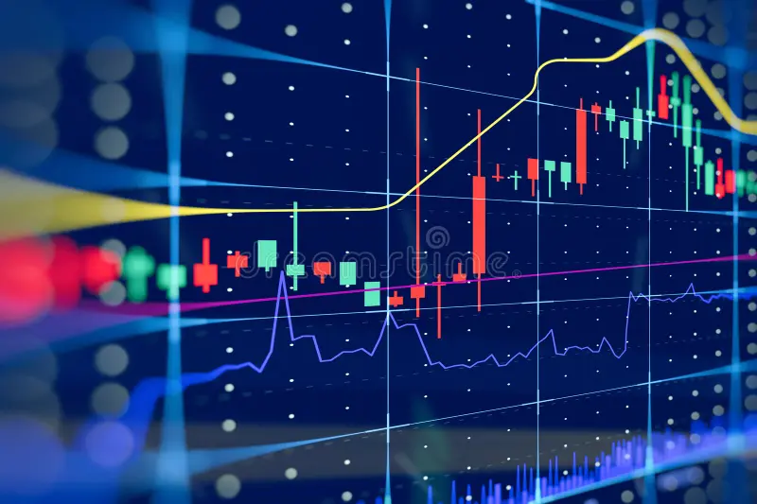
ForexFlow Terminal
Machine Learning Directional Prediction & Volatility-Adaptive Risk Management
Author: Zahid Ahmad Wahidi
Supervisor: Mr. Miguel Simon | Technical Support: Mr. Adi Malik
Date: 13 November 2026

Slide 2
01 | MOTIVATION
Problem Statement & Research Objective
The Market Challenge
• Forex is a decentralized, 24- hour OTC(Over-The-Counter) global market.
• Price action exhibits high noise and low signal-to-noise ratios.
• Sudden macroeconomic releases trigger severe volatility shocks.
Key Terms: Forex: Foreign Exchange | OTC: Over-The-Counter (decentralized trading) | Signal-to-Noise Ratio: Useful market trends vs. random price swings | Volatility Shock: Sudden, extreme price jumps caused by major news
Research Objective
• Predict next-hour price direction across major pairs.
• Replace missing volume with rolling 24H return volatility.
• Automate ATR(Average True Range)-adjusted Take-Profit and Stop-Loss brackets.
ForexFlow Terminal | Graduation Thesis Defense | Slide 2 of 10

Slide 3
02 | ENGINEERING
System Architecture & Data Pipeline
1. Market Data Ingestion
• Universe: EUR/USD, USD/JPY, GBP/USD, USD/CAD, AUD/USD XAU/USD.
• Granularity: 720-day lookback at 1-hour OHLC(open,high,low,close) intervals.
• Timezone normalized to Europe/Berlin for session alignment.
2. Real-Time Macro Context Feed
• Live XML parser streams breaking global economic headlines.
• Provides immediate context for intraday liquidity spikes.
• Cached architecture ensures fast, resilient UI updates.
3. End-to-End Execution Flow
Row Matrices
Feature pipline
RF Model
Buy
Risk Boundaries
Model Output
Sell
ForexFlow Terminal | Graduation Thesis Defense | Slide 3 of 10

Slide 4
03 | QUANTITATIVE INPUTS
Feature Engineering & Target Formulation
Engineered Predictor Matrix (X)
• Log Return: to stabilize price variance.
• SMA_24: Normalized distance from the 24-period moving average to measure trend stretch.
• RSI_14: identifying overbought or oversold conditions.
• Lag_1 & Lag_2: Short-term memory features capturing values from (t-1) and (t-2).
• Volatility_14: 14-period rolling standard deviation measuring recent price swing intensity.
• Hour (0–23): Cyclical timestamp feature capturing intraday trading session patterns.
Key Terms: SMA_24: Simple Moving Average (24 periods) | RSI_14: Relative Strength Index (14 periods) | Volatility_14: Rolling Standard Deviation (14 periods)
Binary Target Formulation (y)
• Target = 1 (Bullish) Up
if next-hour Log Return > 0.
• Target = 0 (Bearish) Down
if next-hour Log Return <= 0.
• Strict alignment removes missing NaN warm- up rows cleanly.
• Prevents data leakage between current features and future returns.
ForexFlow Terminal | Graduation Thesis Defense | Slide 4 of 10

Slide 5
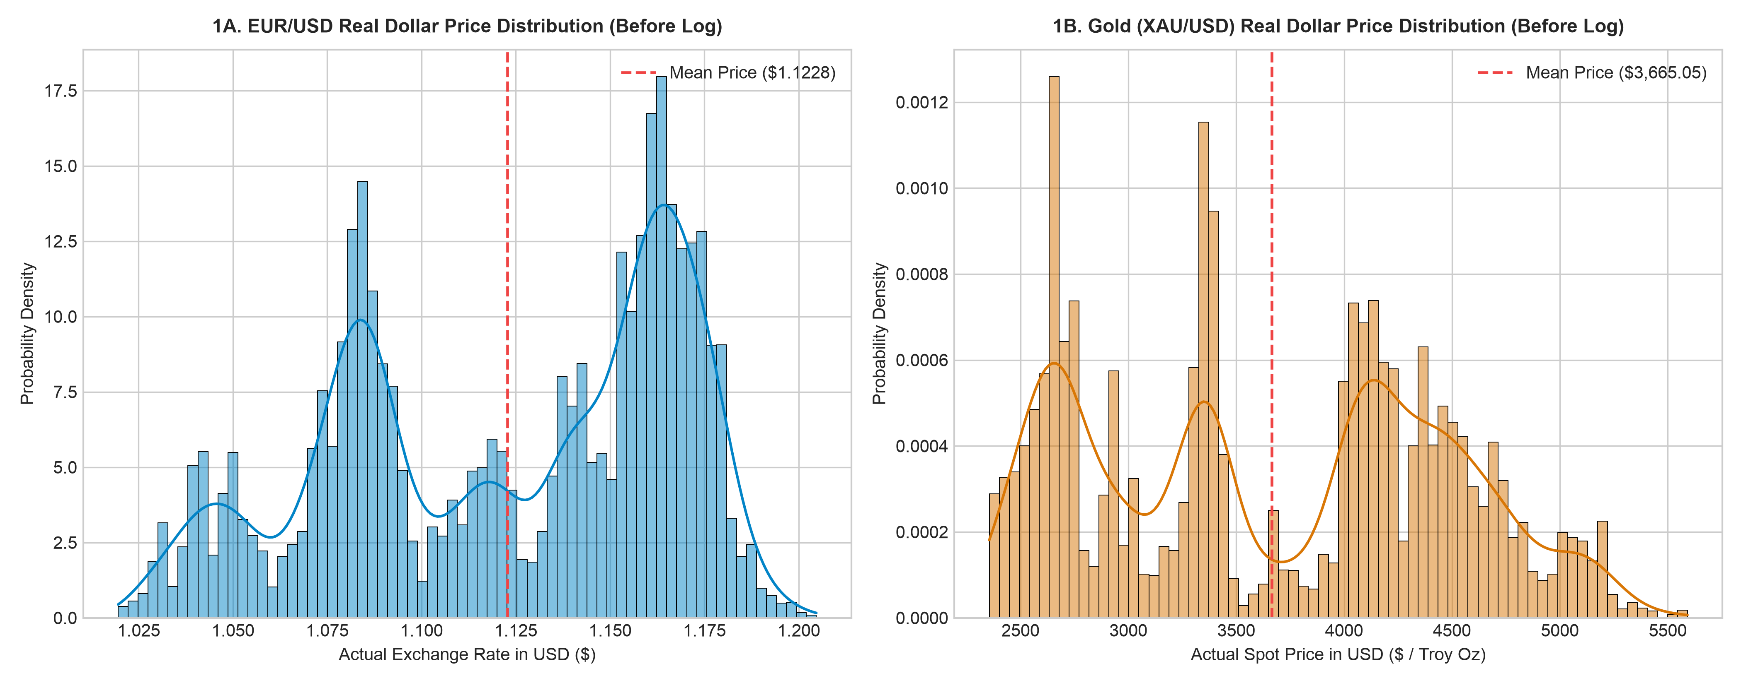

Slide 6
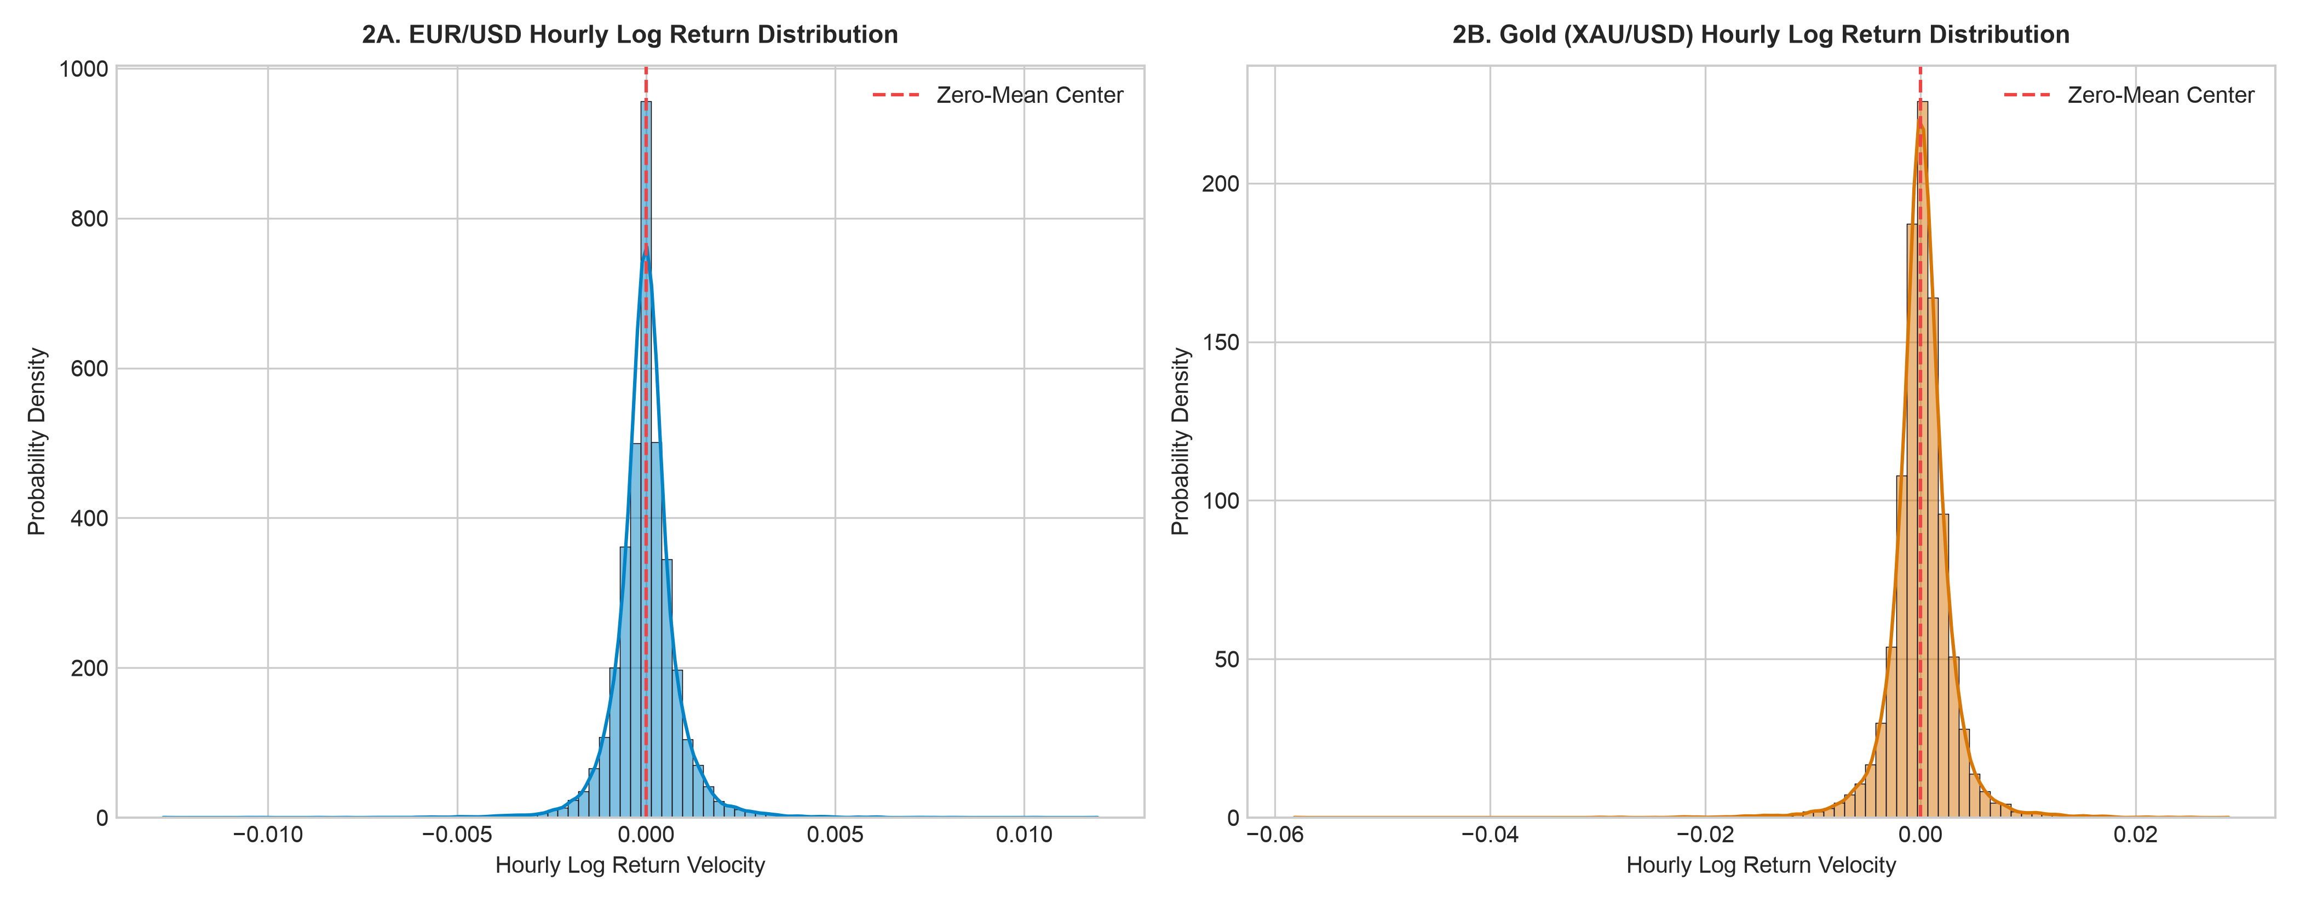
Before taking log returns, raw (XAU/USD) traded around $2,500–$5,590/oz where as EUR/USD traded around $1.05–$1.18 so log returns put both onto one comparable percentage scale.

Slide 7
04 | MODELING
Supervised Machine Learning Methodology
Random Forest Classifier Architecture
• Ensemble of decorrelated decision trees (n_estimators=150).
• Constrained tree depth (max_depth=5) to prevent noise memorization.
• Outputs calibrated class probabilities via predict_proba().
• Handles non-linear interactions between RSI regimes and hour-of-day.
Bias-Free Validation Protocol
• Chronological 80% Training / 20% Testing time-series split.
• Zero random shuffling eliminates look-ahead bias.
• Model is evaluated strictly on unseen future market observations.
• Retrains dynamically per currency pair on user selection.
ForexFlow Terminal | Graduation Thesis Defense | Slide 5 of 10

Slide 8
05 | RISK ENGINE
Volatility & Dynamic Risk Management
Solving the OTC (Over-The-Counter)
Volume Gap
• Spot Forex lacks a central clearinghouse, so raw volume equals zero.
• Replaced empty volume with 24H Rolling Log-Return Std Dev (%).
• Acts as a live intraday risk thermometer for regime shifts.
• Explains confidence shifts during high-impact macro news.
ATR(Average True Range)-Adaptive Exit Brackets
• Computes 14-period Average True Range (ATR) dynamically.
• Take-Profit (TP): Set at 1.5 x ATR in the predicted direction.
• Stop-Loss (SL): Set at 1.0 x ATR as a protective risk floor.
• Enforces an asymmetric 1.5:1 Reward-to-Risk ratio across all pairs.
ForexFlow Terminal | Graduation Thesis Defense | Slide 6 of 10

Slide 9
06 | EVALUATION
Empirical Backtest & Model Interpretability
Out-of-Sample Evaluation Metrics
• Accuracy, Bullish Precision, and F1-Score tracked on 20% test split.
• 2x2 Confusion Matrix separates True Positives from False Alarms.
• Simulated Strategy Return compounds +1 (Long) and -1 (Short) signals.
• Demonstrates economic utility beyond raw classification accuracy.
Gini Feature Importance (Transparency)
• Eliminates 'black-box' opacity for financial decision-makers.
• Ranks relative predictive weights of RSI_14, Lag_1, Lag_2, and Hour.
• Reveals structural differences across G10 pairs (e.g., EUR/USD vs USD/JPY).
• Embedded directly inside the terminal's Academic Validation expander.
ForexFlow Terminal | Graduation Thesis Defense | Slide 7 of 10

Slide 10
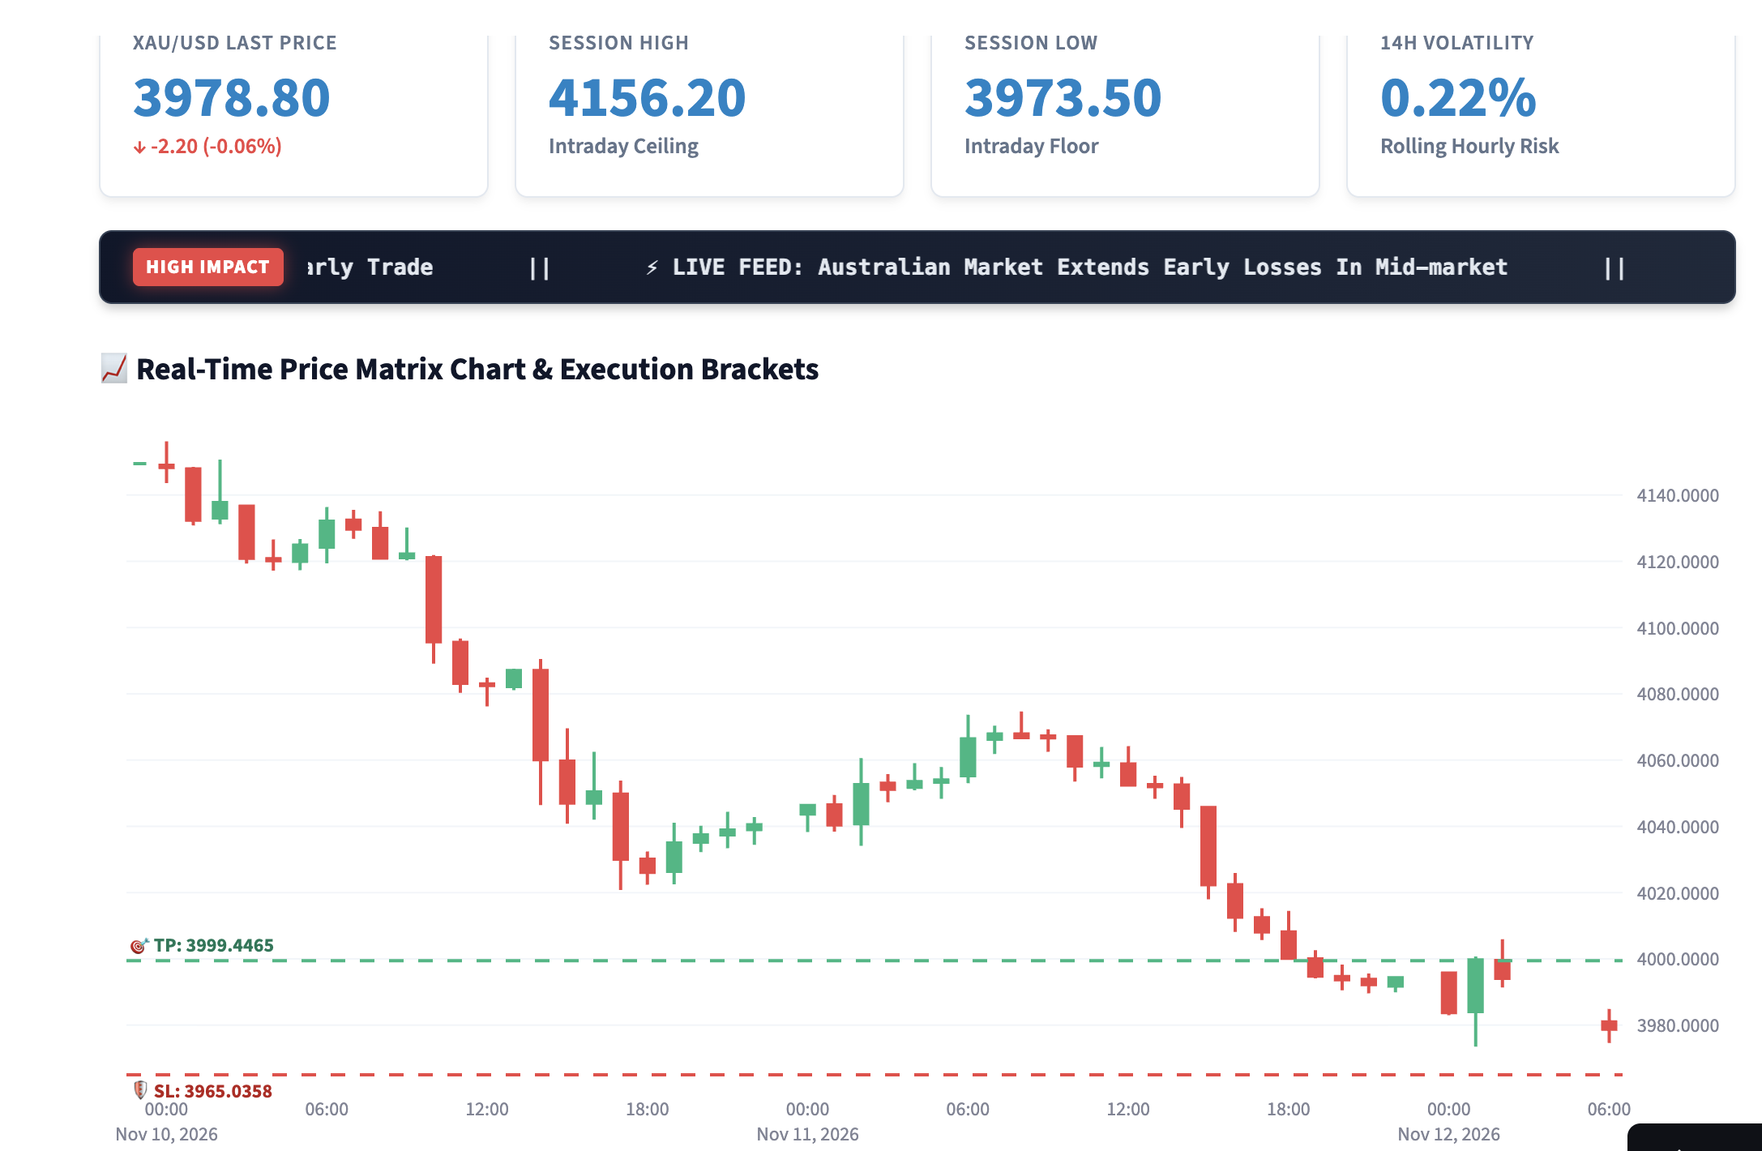
07 | LIVE WALKTHROUGH
Live System Demonstration: ForexFlow_Terminal
ForexFlow Terminal | Graduation Thesis Defense | Slide 8 of 10

Slide 11
08 | CRITICAL REFLECTION
Limitations & Future Research Directions
Current System Limitations
• Simulated strategy returns do not yet deduct broker spreads or slippage.
• Macroeconomic RSS headlines are displayed visually rather than scored.
• Hourly yfinance feeds exclude tick-level order book depth.
Future Extensions
• Integrate FinBERT NLP sentiment scores from live headlines into X.
• Benchmark Random Forest against XGBoost and LightGBM classifiers.
• Incorporate dynamic spread/commission modeling into backtest returns.
Key Terms: FinBERT NLP: Financial AI model that scores news sentiment | X (Feature Matrix): Input data fed into the ML model | XGBoost & LightGBM: High-speed gradient boosting algorithms | Dynamic Spread: Real-time gap between buy and sell prices
ForexFlow Terminal | Graduation Thesis Defense | Slide 9 of 10

Slide 12
Conclusion & Key Takeaways
01 Reproducible ML Pipeline
Engineered a bias-free, chronological Random Forest workflow for hourly G10 Forex and Gold forecasting.
02 Volatility-Adaptive Risk
Solved the OTC volume gap using 24H return volatility and 1.5:1 ATR Take-Profit/Stop-Loss brackets.
03 Production Analytics UI
Delivered ForexFlow Terminal, uniting live market data, macro news, and model validation.

Slide 13
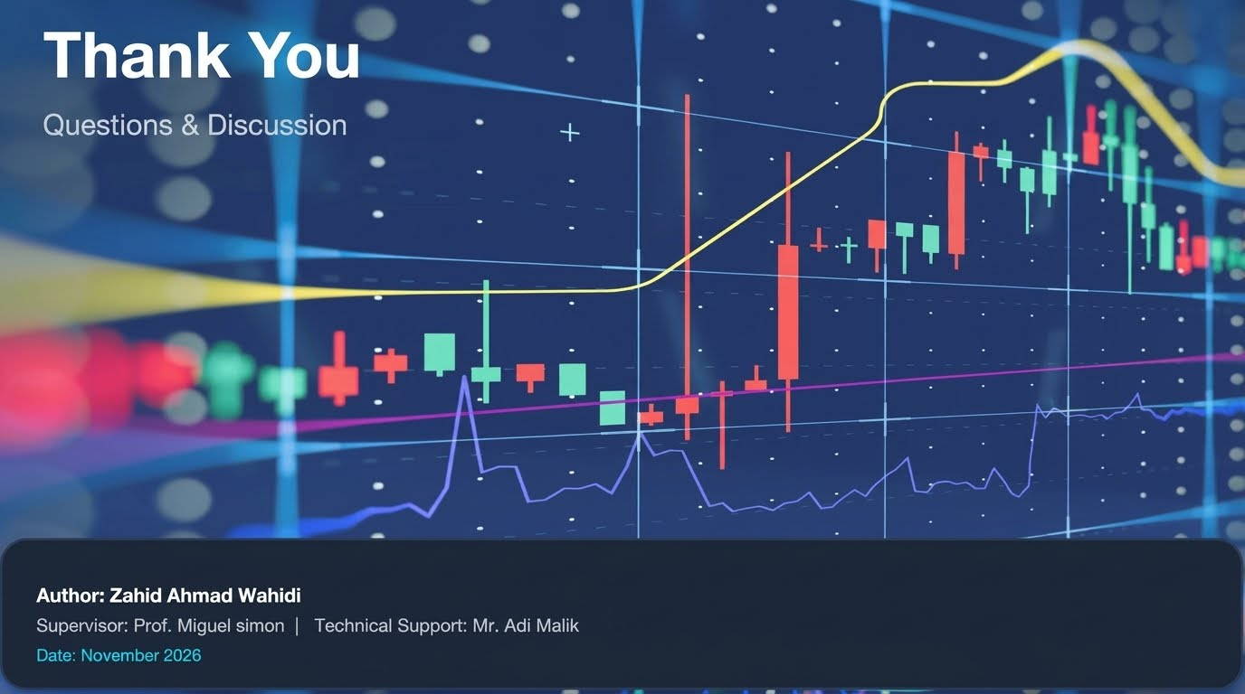

Scan to Try the Live App
Author: Zahid Ahmad Wahidi
Supervisor: Mr. Miguel Simon | Technical Support: Mr. Adi Malik
Date: 13 November 2026
Github Repo : ZahidAhmadWahidi/ForexFlow

