Slide 1
NLP Project
Uttiya Ghosh: MT2019127
Mohd. Zahid Faiz: MT2019514
Subarna Kanti Samanta: MT2019523

Slide 2
Aim
Build an intelligent code-completion system for java script.The traditional existing sytems are limited to static/terminal level completions, which we have tried to extend this to non- terminal level completions.

Slide 3
Introduction
Code completion software is an important tool for many developers, but it traditionally fails to model any long term program dependencies such as scoped variables, instead settling for suggestions based on static libraries.
Major works related to code completions are n- gram models, probabilistic grammars, and log-bilinear models which are naive in nature, they only encode hierarchical library information based on a very local scope to make predictions.
Here we have done deep learning approach for code completion for non-terminals (program structural components) and terminals (program text) that takes advantage of running dependencies to improve predictions.
The dynamically typed nature of JavaScript creates an added challenge for the code completion problem as there is far less syntactic information available.

Slide 4
Dataset
150k Javascript Dataset
dataset consisting of 150'000 JavaScript files and their corresponding parsed ASTs that were used to train and evaluate
The dataset is split into two parts -- 100'000 files used for training and 50'000 files used for evaluation.
https://www.sri.inf.ethz.ch/js150

Slide 5
Lets move to implementation

Slide 6
AST → Data
CallExpression
describe('view1 controller', function(){
var view1Ctrl = $controller('View1Ctrl’);
}
Identifier
LiteralString
FunctionExpression
describe
view1 controller
BlockStatement
['CallExpression:NA', 'Identifier:TP', 'NULL'],
['Identifier:TP', 'describe', 'LiteralString:TP'],
['LiteralString:TP', 'view1 controller', 'FunctionExpression:NA'],
['FunctionExpression:NA', 'BlockStatement:NA', 'NULL'],
['BlockStatement:NA', 'ExpressionStatement:NA', 'NULL'],
['ExpressionStatement:NA', 'CallExpression:NA', 'NULL'],
['CallExpression:NA', 'VariableDeclaration:NP', 'NULL'],
['VariableDeclaration:NP', 'VariableDeclarator:TA', 'CallExpression:NA'],
['CallExpression:NA', 'Identifier:TP', 'NULL'],
['Identifier:TP', '$controller', 'LiteralString:TA'],
['LiteralString:TA', 'View1Ctrl', 'NULL'],
['VariableDeclarator:TA', 'view1Ctrl', 'NULL']
[
{ "id":0, "type":"CallExpression", "children":[1,2,3] },
{ "id":1, "type":"Identifier", "value":"describe" },
{ "id":2, "type":"LiteralString", "value":"view1 controller" },
{ "id":3, "type":"FunctionExpression", "children":[4] },
{ "id":4, "type":"BlockStatement", "children":[5] },
{ "id":5, "type":"ExpressionStatement", "children":[6] },
{ "id":6, "type":"CallExpression", "children":[7,9] },
{ "id":7, "type":"VariableDeclaration", "children":[8] },
{ "id":8, "type":"VariableDeclarator", "value":"view1Ctrl"},
{ "id":9, "type":"CallExpression", "children":[10,11] },
{ "id":10, "type":"Identifier", "value":"$controller" },
{ "id":11, "type":"LiteralString", "value":"View1Ctrl" },
0]
ExpressionStatement
CallExpression
VariableDeclaration
CallExpression
VariableDeclarator
Identifier
LiteralString
view1Ctrl
$controller
View1Ctrl

Slide 7
Why the Pre order traversal of lstm is replaced with the inorder traversal?
The inorder traversal contains the parent node
in the middle and we need the parent
node in front so we switched to PRE ORDER traversal.
A
A
B
C
B
C
Inorder -> BAC
Pre-order -> ABC

Slide 8
Model Summary

Slide 9
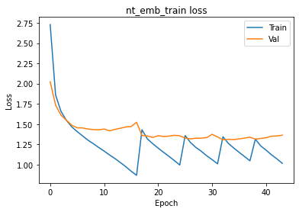
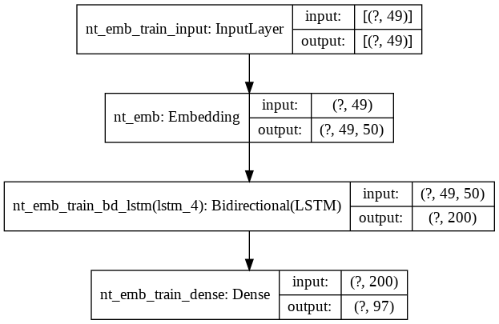
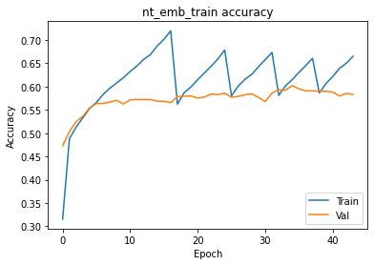
It’s Accuracy and Loss
Model to generate the embeddings for the
non terminals

Slide 10
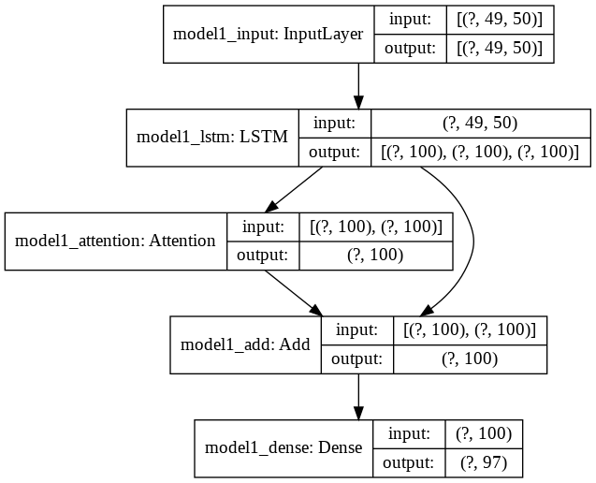
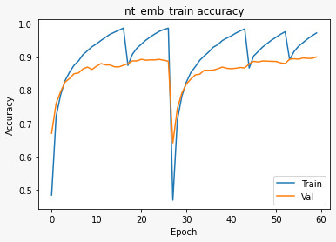
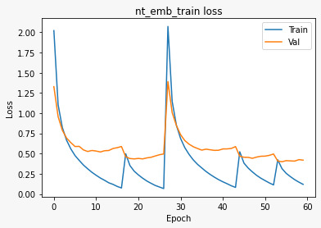
Model to predict the parent non terminal node
It’s Accuracy and Loss

Slide 11
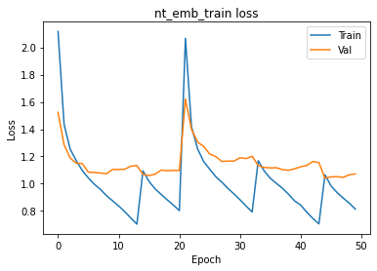
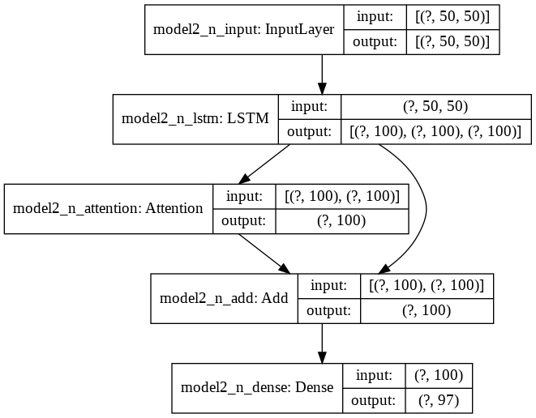
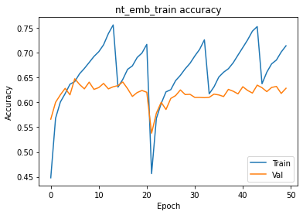
Model to predict the left child non-terminal node
It’s Accuracy and Loss

Slide 12
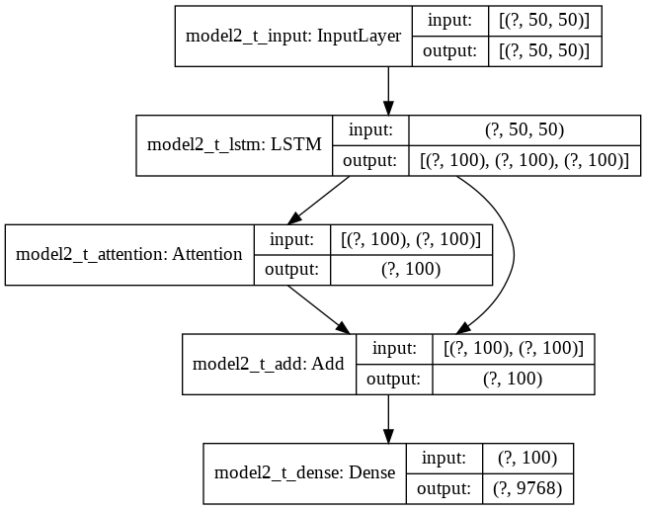
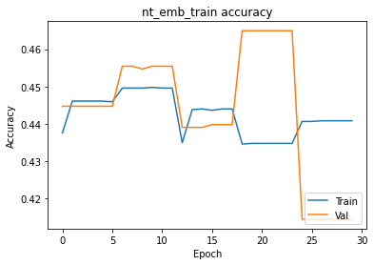
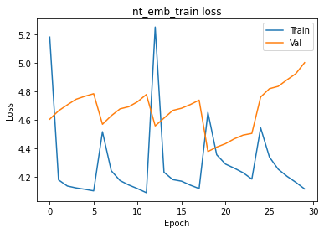
Model to predict the second left child if the node is
a terminal node
It’s Accuracy and Loss

Slide 13

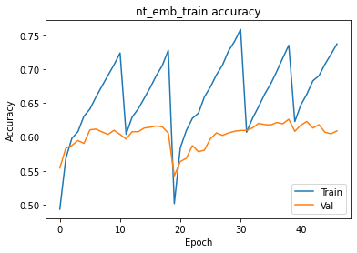
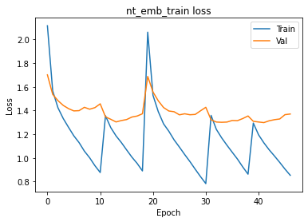
This model is used to predict the
right sibling (Third element of triplet)
It’s Accuracy and Loss

