Slide 1

HTTP/2: Faster web delivery through multiplexing and header compression
Mawlana Bhashani Science and Technology University
Department of Information and Communication Technology (ICT)
Md Zahid Fahamid
ID: IT-24012 | Department of ICT, MBSTU, Bangladesh
Assignment presentation
November 2026 | Tangail, Bangladesh
Notes:
Assalamu alaikum and good day, everyone. My name is Md Zahid Fahamid, ID IT-24012, from the Department of Information and Communication Technology at Mawlana Bhashani Science and Technology University. Today I will talk about HTTP/2, the protocol that quietly carries most of the modern web. In the next ten minutes I will explain the problem it solves, how it works, and what I measured when I compared it with HTTP/1.1.

Slide 2
Presentation outline
Mawlana Bhashani Science and Technology University | Dept. of ICT
01
Introduction and the problem with HTTP/1.1
02
Related work and the research gap
03
How HTTP/2 works
04
Experiments and results
05
Conclusion and future work
HTTP/2: Faster web delivery
Md Zahid Fahamid | IT-24012
02
Notes:
Here is the outline. First, the introduction and the problem with HTTP/1.1. Second, related work and the research gap. Third, how HTTP/2 works. Fourth, my experiments and results, which include the setup, a results chart and a comparison table. And finally, the conclusion and future work. The sources I used are listed at the end.

Slide 3
Introduction and research problem
Mawlana Bhashani Science and Technology University | Dept. of ICT
HTTP/1.1 handles many small requests inefficiently.
01
Why this matters
A modern page needs dozens of scripts, images and API calls, so browsers open about six parallel connections per host.
02
What HTTP/1.1 leaves unresolved
One response at a time per connection, plus long text headers repeated on every request.
03
Objective
Explain how HTTP/2 fixes this and measure the gain under network latency.
HTTP/2: Faster web delivery
Md Zahid Fahamid | IT-24012
03
Notes:
Let me start with the problem. Every time you open a web page, your browser does not download one file. It downloads dozens: HTML, style sheets, scripts, images, fonts and API calls. HTTP/1.1, the version used for most of the web's history, handles this poorly. On one connection it answers one request at a time, so a slow response blocks everything behind it. Browsers work around this by opening several parallel connections, typically six per host. The 2024 Web Almanac found that the median desktop page opens 13 connections over HTTP/1.1, compared with 10 over HTTP/2 and above. Every extra connection costs a TCP and TLS handshake. On top of that, HTTP/1.1 repeats long text headers, such as cookies and user-agent strings, on every single request. Developers even invented hacks like domain sharding, image sprites and file bundling to get around these limits. So my objective is simple: understand how HTTP/2 removes these problems, and measure how much it helps.

Slide 4
Related work and research gap
Mawlana Bhashani Science and Technology University | Dept. of ICT
Study / approach | Key idea | Relevant limitation
HTTP/1.1 pipelining | Send several requests without waiting for replies | Replies return in order, so one slow reply blocks the rest
SPDY (Google, 2009) | Multiplexing and header compression on one connection | Gain fell to about 7% on slower, high-latency links; hurt by packet loss [3]
HTTP/3 over QUIC | HTTP over UDP-based QUIC avoids TCP blocking | Needs QUIC support; mostly deployed through CDNs [4]
Research gap
HTTP/2 removes request-level blocking, but still runs on one TCP connection. How large is the gain, and when does it shrink?
HTTP/2: Faster web delivery
Md Zahid Fahamid | IT-24012
04
Notes:
Now, related work. The first attempt to speed up HTTP/1.1 was pipelining, where the client sends several requests without waiting. But replies must still come back in order, so one slow reply blocks the others, and browsers rarely enabled it. Other workarounds, like parallel connections, domain sharding and bundling, help, but every new connection pays handshake costs. Next is SPDY, created by Google in 2009. It introduced multiplexing and header compression on a single connection and became the basis for HTTP/2. A study from the University of Washington by Wang and colleagues in 2014 found significant gains in simple tests, but the benefit dropped to about 7 percent on slower, high-latency networks, and a single connection can even hurt when packet loss is high. Finally, HTTP/3 moves HTTP onto QUIC to avoid that weakness, but it needs UDP and QUIC support, and in the 2024 Web Almanac about 85 percent of HTTP/3 responses came from CDNs. So the research gap is this: HTTP/2 removes request-level blocking, but it still depends on one TCP connection. How much does it help, and when does the gain shrink?

Slide 5
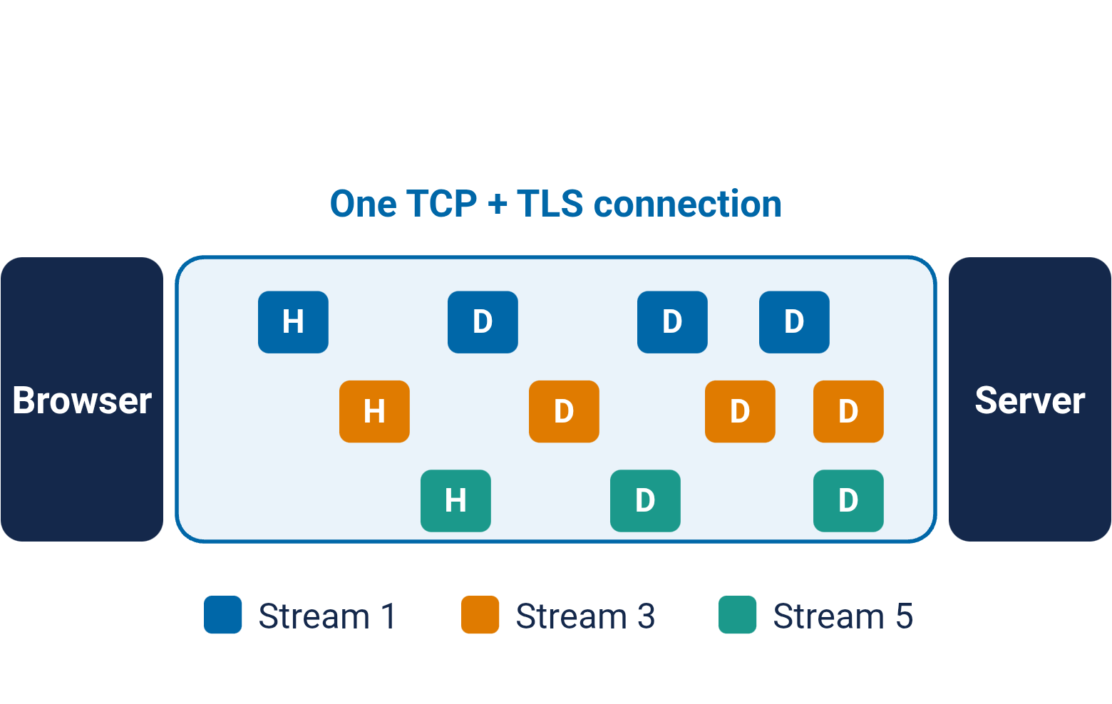
How HTTP/2 works
Mawlana Bhashani Science and Technology University | Dept. of ICT
HTTP/2 (RFC 9113): one connection, many streams
01
Binary framing
Messages are split into frames tagged with a stream ID.
02
Multiplexing
Many requests share one connection, with flow control and priorities.
03
HPACK compression
Repeated headers such as cookies become short table references.
HTTP/2: Faster web delivery
Md Zahid Fahamid | IT-24012
05
Notes:
So how does HTTP/2 work? It is standardised in RFC 9113, published in June 2022, which replaced the original RFC 7540 from 2015. The big idea is on the left: one connection carries many streams at the same time. First, binary framing. Instead of plain text, HTTP/2 splits every message into small binary frames and tags each frame with a stream identifier. Second, multiplexing. Because frames from different streams can be interleaved, the browser can request dozens of resources at once over a single connection, with flow control and priorities deciding what goes first. A slow response no longer blocks the others at the HTTP layer. Third, HPACK header compression, defined in RFC 7541. Both sides keep a table of headers they have already sent, so a long cookie is sent once and afterwards replaced by a tiny reference. HTTP/2 also defined server push, which let servers send resources before they were requested, but it rarely helped. Chrome disabled it by default in version 106, and only about 1.25 percent of HTTP/2 sites had used it.

Slide 6
Experimental setup
Mawlana Bhashani Science and Technology University | Dept. of ICT
Test page
1 HTML file plus N resources of 10 KB each, with N = 10, 25, 50, 100 and 200
Baselines
HTTP/1.1 with 6 connections (browser default) and HTTP/1.1 with 12 connections (two host names, like domain sharding)
Evaluation metrics
Page load time (ms, mean of 20 runs), connections opened, request and response header bytes
Implementation
Node.js 22 servers and clients behind a latency proxy: 50 ms round-trip time, 2 round trips to set up each new connection (TCP + TLS). Bandwidth limits and packet loss are not modelled.
HTTP/2: Faster web delivery
Md Zahid Fahamid | IT-24012
06
Notes:
To test the idea, I built a small experiment. The test page is one HTML file plus N resources of ten kilobytes each, and I varied N from 10 up to 200. I compared three setups: HTTP/1.1 with six connections, which is what a browser normally does; HTTP/1.1 with twelve connections using two host names, which imitates domain sharding; and HTTP/2 with a single connection. I measured page load time, the number of connections, and the header bytes per request. To make the network realistic, every connection goes through a proxy that adds a round-trip time of 50 milliseconds and charges two round trips to set up each new connection, for TCP and TLS. Each setup ran twenty times, in random order, and I report the mean. Importantly, bandwidth limits and packet loss were not modelled, so this is a latency-focused test.

Slide 7
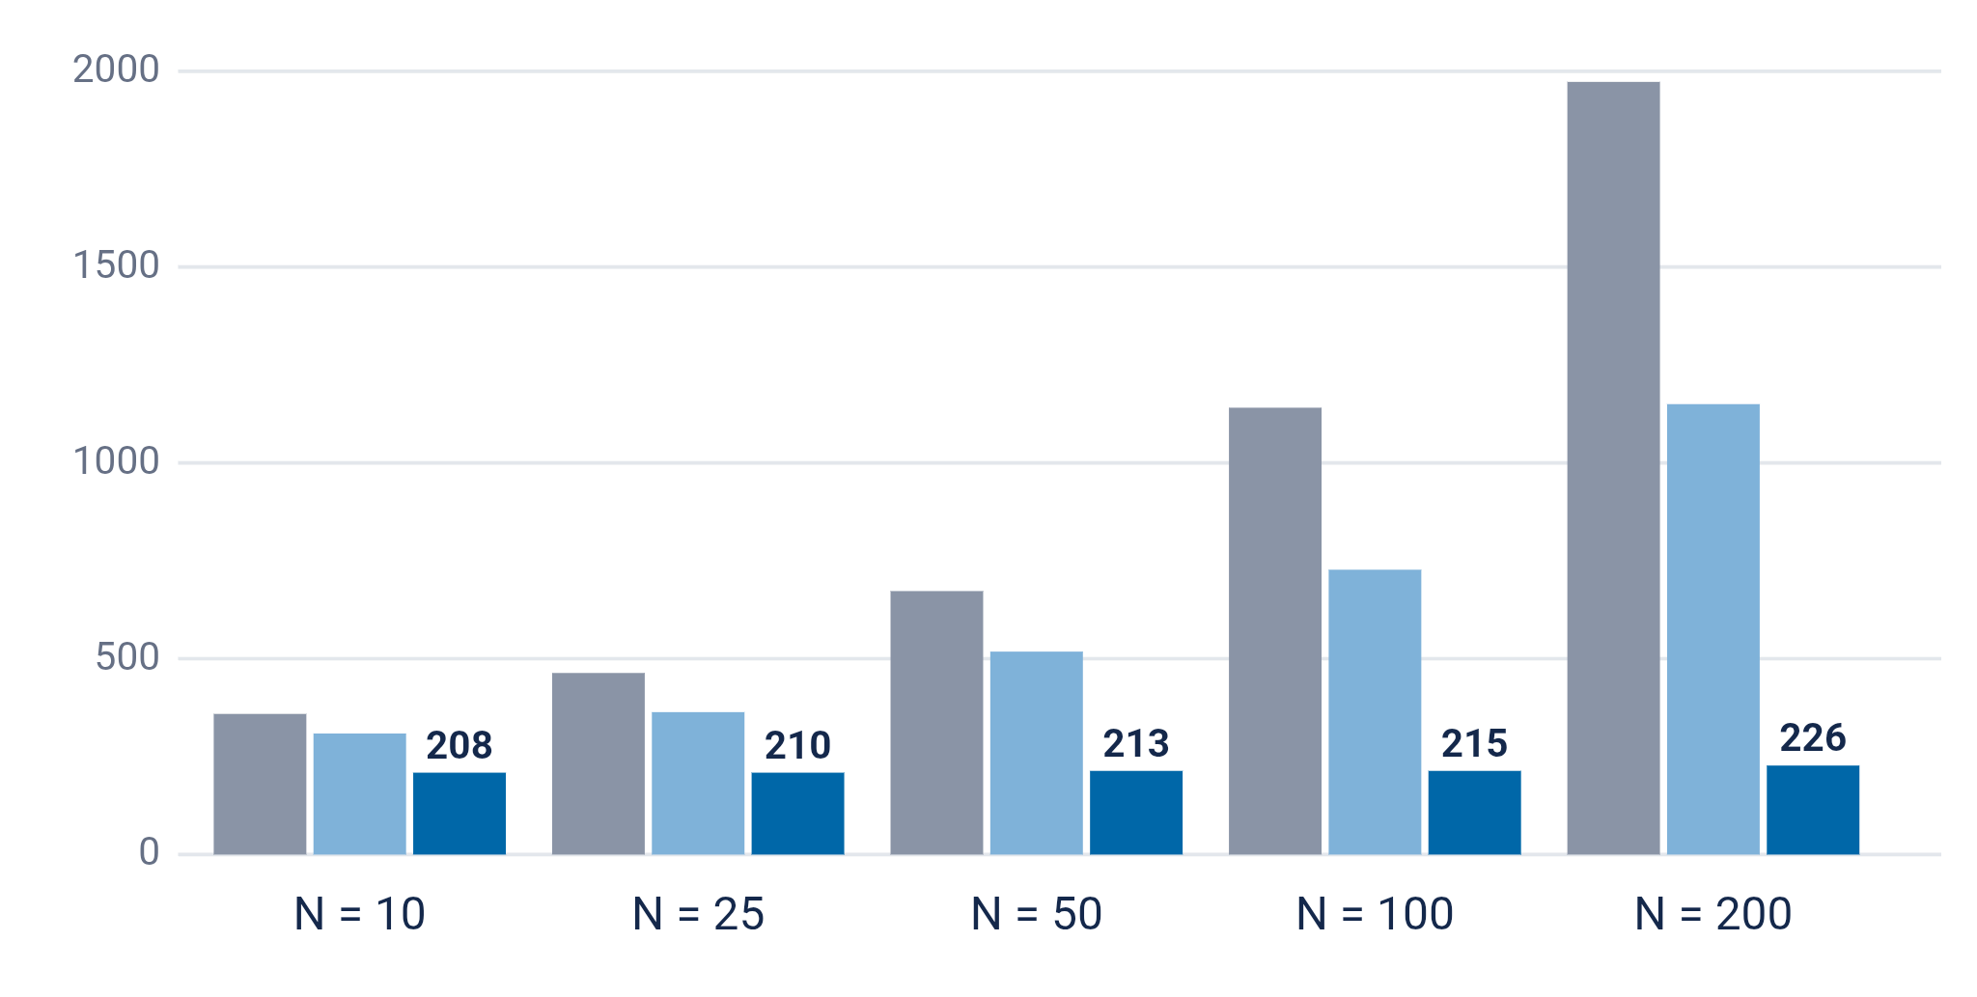
Results and discussion
Mawlana Bhashani Science and Technology University | Dept. of ICT
Main finding
With 200 resources, HTTP/2 loaded the page in 226 ms, against 1,975 ms for HTTP/1.1.
HTTP/2 time stays almost flat, because all requests share one connection.
HTTP/1.1, 6 connections
HTTP/1.1, 12 connections
HTTP/2, 1 connection
Mean page load time in ms (20 runs), 50 ms RTT, 10 KB resources.
HTTP/2: Faster web delivery
Md Zahid Fahamid | IT-24012
07
Notes:
Here are the results. The chart shows mean page load time as the number of resources grows. With HTTP/1.1 and six connections, the grey bars, load time rises steadily: about 359 milliseconds for ten resources and nearly two seconds for two hundred. The sharded setup, in light blue, is faster but still grows. HTTP/2, in dark blue, stays almost flat, from 208 to 226 milliseconds. The reason is multiplexing: HTTP/2 sends all requests together on one connection, so the whole page costs roughly one extra round trip, while HTTP/1.1 must work through many rounds of six requests at a time. The main finding is that the more resources a page has, the bigger the benefit of HTTP/2 on a high-latency link.

Slide 8
Quantitative comparison
Mawlana Bhashani Science and Technology University | Dept. of ICT
Method (N = 100) | Load time | Connections | Request bytes / request
HTTP/1.1, 6 connections | 1,140 ms | 6 | 703 B
HTTP/1.1, 12 connections | 727 ms | 12 | 703 B
HTTP/2 (proposed) | 215 ms | 1 | 31 B
HTTP/2 was 5.3x faster than standard HTTP/1.1 and sent about 96% fewer request bytes.
HTTP/2: Faster web delivery
Md Zahid Fahamid | IT-24012
08
Notes:
This table gives exact numbers for a page with one hundred resources. HTTP/1.1 with six connections took 1,140 milliseconds. Sharding to twelve connections cut that to 727 milliseconds, but it needed twelve handshakes. HTTP/2 took just 215 milliseconds with one connection, which is 5.3 times faster than the standard HTTP/1.1 setup and 3.4 times faster than the sharded one. Header compression also shows clearly. HTTP/1.1 sent about 703 bytes per request, while HTTP/2 averaged 31 bytes, a reduction of roughly 96 percent. Responses also carried less header overhead, about 68 bytes against 456 bytes.

Slide 9
Conclusions and future work
Mawlana Bhashani Science and Technology University | Dept. of ICT
HTTP/2 cuts page load time on high-latency links by sharing one connection.
01
Contribution: up to 8.7x faster loads (200 resources) and far smaller headers
02
Limitation: emulated, loss-free network; one lost TCP packet can stall all streams, and Rapid Reset (2023) abused multiplexing
03
Next step: repeat with real browsers and packet loss, and compare with HTTP/3 over QUIC
HTTP/2: Faster web delivery
Md Zahid Fahamid | IT-24012
09
Notes:
To conclude. In my test, HTTP/2 reduced page load time by up to almost nine times, at two hundred resources, by multiplexing requests on a single connection and compressing headers. There are limits. My experiment used an emulated, loss-free network, and because all streams share one TCP connection, a lost packet can stall all of them. Also, multiplexing can be abused: in 2023, the HTTP/2 Rapid Reset attack, CVE-2023-44487, reached 398 million requests per second against Google, and Cloudflare and AWS reported record attacks too. For future work, I want to repeat the test with real browsers and packet loss, and compare HTTP/2 with HTTP/3 over QUIC.

Slide 10
Selected references
Mawlana Bhashani Science and Technology University | Dept. of ICT
[1] M. Thomson and C. Benfield, Eds., "HTTP/2," RFC 9113, IETF, Jun. 2022.
[2] R. Peon and H. Ruellan, "HPACK: Header Compression for HTTP/2," RFC 7541, IETF, May 2015.
[3] X. S. Wang, A. Balasubramanian, A. Krishnamurthy and D. Wetherall, "How speedy is SPDY?," USENIX NSDI, 2014.
[4] R. Marx, B. Pollard and C. Böttger, "HTTP," The 2024 Web Almanac, HTTP Archive, Dec. 2024.
[5] M. Bishop, Ed., "HTTP/3," RFC 9114, IETF, Jun. 2022.
[6] Google, AWS and Cloudflare, "HTTP/2 Rapid Reset (CVE-2023-44487)," coordinated disclosure, Oct. 2023.
[7] Chrome for Developers, "Removing HTTP/2 Server Push from Chrome," 2022.
HTTP/2: Faster web delivery
Md Zahid Fahamid | IT-24012
10
Notes:
These are the main references: the HTTP/2 and HPACK RFCs, the SPDY study from NSDI 2014, the 2024 Web Almanac HTTP chapter, the HTTP/3 RFC, the Rapid Reset disclosure and the Chrome note on removing server push.

Slide 11
Thank you
Mawlana Bhashani Science and Technology University | Dept. of ICT
Questions and discussion
Md Zahid Fahamid
Department of ICT, Mawlana Bhashani Science and Technology University
it24012@mbstu.ac.bd
HTTP/2: Faster web delivery
Md Zahid Fahamid | IT-24012
11
Notes:
Thank you for listening. HTTP/2 is not magic, but by sending many requests over one connection and compressing repetitive headers, it makes the web noticeably faster, especially on slow links. I am happy to take any questions.

