Slide 1

BrainAI
The cognitive architecture for AI that lives in the world
Thinks, remembers, and learns like a brain — built for robots and agents, not chat.
INVESTOR OVERVIEW
Mohammed Zahid Imityaz Wadiwale · zahid.wadiwale1234@gmail.com
Notes:
Open with the vision: BrainAI is the cognitive core for AI that operates in the physical world. This is an investor overview — I'll cover the problem, why now, the tech, the evidence, the market, and the ask.

Slide 2




THE SHIFT
AI is leaving the screen and entering the physical world.
Robots, drones, vehicles, and always-on agents now need to perceive, act, stay safe, and keep learning — continuously, on the edge, for years. The models that won the chat era were never designed for that job.
Embodied
Always learning
Safety-critical
Energy-constrained
BrainAI · Investor Overview
2
Notes:
Frame the shift: AI is moving off the screen into robots, drones, and always-on agents. Those need continual, safe, efficient cognition — which the chat-era models were never designed for.

Slide 3


Today's best models can't run the physical world
A large language model is a brilliant mind with four disqualifying gaps for embodiment
It forgets
It has no body
Learning a new task silently overwrites old skills — fatal for a robot that must adapt for years.
No native senses, actuators, or safety envelope. Bolting a chatbot onto a robot is not a control system.
It burns compute
It can't flag doubt
Uniform effort on every token — trivial or hard. Unaffordable and too slow at the edge.
Same confidence whether certain or guessing — and no way to stop before a costly mistake.
BrainAI · Investor Overview
3
Notes:
The problem in four gaps: forgetting, no body, uniform compute, no actionable uncertainty. Each is disqualifying for embodiment. The rest of the deck answers these.

Slide 4


Why now
Three waves are converging — and none has a cognitive layer built for the others
Robots are arriving
Compute hits an energy wall
Neuromorphic goes commercial
Humanoids move from demo to deployment across logistics, manufacturing, and service.
Data-centre AI already tops 200 TWh/yr (IEA). The edge cannot pay that bill.
Intel, IBM, Qualcomm, BrainChip ship brain-like chips that bill for sparsity.
$5B → $38–50B by 2035
Efficiency is the constraint
~$8B → $20–35B by 2030s
Market figures are analyst estimates (Goldman Sachs, MarketsandMarkets, IEA); ranges vary by scope.
BrainAI · Investor Overview
4
Notes:
Why now: three waves converging — humanoid robots deploying, an AI energy wall, and neuromorphic chips going commercial. None of them ships the cognitive layer in the middle. Numbers are analyst estimates.

Slide 5

THE SOLUTION
BrainAI is the cognitive core for embodied AI
One brain-inspired model that perceives, reacts, remembers, plans, stays safe, and keeps learning — organized like a brain rather than as one monolithic network. Every design choice answers a specific thing a chatbot cannot do, and every choice was kept or cut by measurement.
Reacts instantly
Never forgets
Safe by construction
Consolidates offline
Sparse & efficient
Knows when unsure
BrainAI · Investor Overview
5
Notes:
The solution: one brain-inspired model, organized like a brain. Six capabilities map to the six gaps. Emphasize every choice was measured, not asserted.

Slide 6

How it works
Separate parts, each with a job — the reason it is fast, safe, and able to learn
Inputs flow through three latency-tiered pathways. Cheap reflexes answer instantly; a salience gate only wakes the expensive 'conscious' pathway when the input is worth it. A five-way memory keeps new knowledge out of the weights, a world model imagines consequences, and every action clears a safety layer the learner cannot modify.
Reflex
Conscious
instant
gated, deep
5 memories
World model
no forgetting
imagines ahead
Safety
Sleep
non-negotiable
consolidates
BrainAI · Investor Overview
6
Notes:
How it works, simply: latency-tiered pathways with a salience gate, five-way memory that keeps knowledge out of the weights, a world model, and a non-negotiable safety layer. Don't go too deep — this is the intuition slide.

Slide 7

What's defensible
Not a wrapper on someone else's model — a measured, original architecture
A real architecture, not a prompt
Novel spiking cognitive design: latency-tiered gating, differentiability-split memory, non-learned safety. Hard to copy, expensive to reproduce.
Honesty-first evidence
Every component measured against a simpler control; negative results published. The numbers are trustworthy — a rare and defensible asset.
Neuromorphic-native
Built to spike. As brain-like chips ship, BrainAI is the software that already speaks their language of sparsity and energy.
BrainAI · Investor Overview
7
Notes:
The moat: it's a real, novel architecture (hard to copy), backed by honesty-first evidence (trust), and neuromorphic-native (rides the hardware wave). Defensibility is technical + credibility + timing.

Slide 8
PROOF IT WORKS
Every claim is measured — against a simpler control
2.16×
74%
3.7×
600
faster —
genuine compute gating
less catastrophic
forgetting
more stable under
live online learning
fake sources resisted
(belief integrity)
Breadth, too: the 5.4M model learned 64 domains — five non-Latin languages from scratch — cutting held-out loss 5.49 → 2.25 bits/byte. All reproducible on a laptop CPU.
Full multi-control benchmark suite; 114 automated tests; negative results reported in the paper.
BrainAI · Investor Overview
8
Notes:
Proof: the headline measured numbers. Stress that each is against a simpler control, and the whole suite is reproducible on a laptop with 114 tests. This is what separates it from slideware.

Slide 9
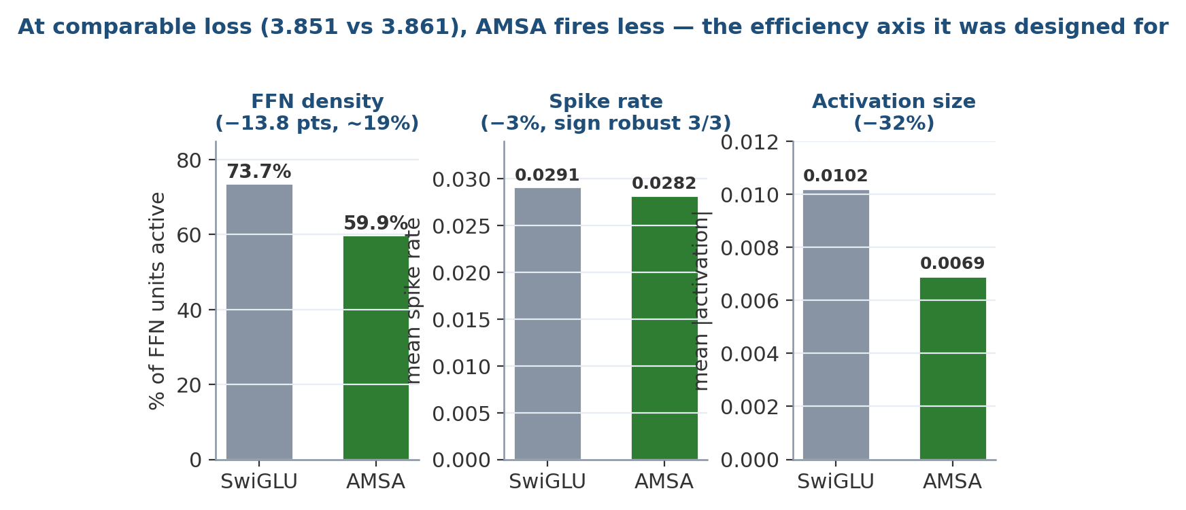
The efficiency wedge
Same accuracy, fewer neurons firing — which is money on neuromorphic and edge hardware
Why it matters
On neuromorphic hardware, spikes are the electricity bill. BrainAI reaches comparable accuracy while activating ~19% less of the network — a structural efficiency edge that compounds at the edge, where power and battery are the binding constraint.
Measured across 3/3 seeds at one model size; the FFN-density gap is the structural, robust part.
BrainAI · Investor Overview
9
Notes:
The efficiency wedge — the investor-relevant one. Same accuracy, ~19% sparser network. On neuromorphic/edge hardware, sparsity is the electricity bill. This is the commercial angle of the brain-like design.

Slide 10
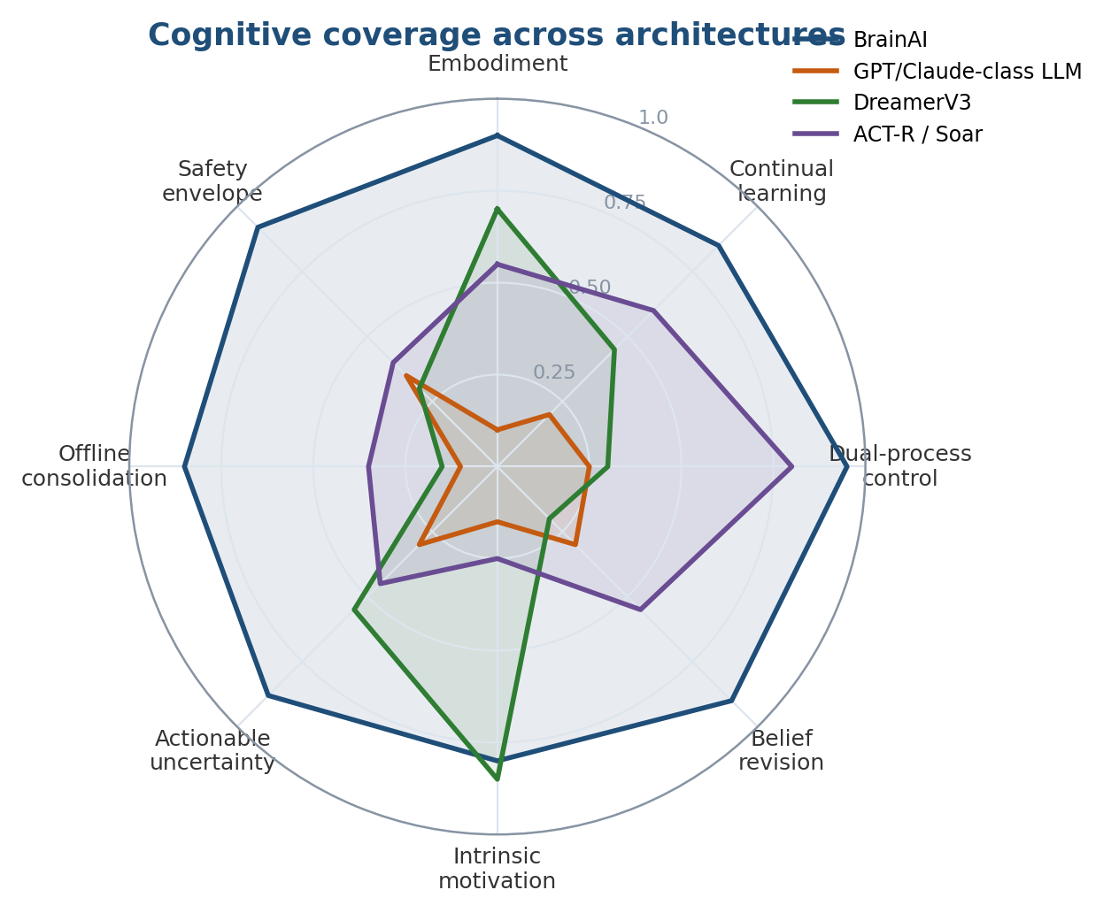
Why a chatbot is the wrong tool for a robot
BrainAI covers the axes embodiment actually needs
An LLM optimises language fluency. An embodied agent needs memory, continual learning, awareness, and safety. On those axes BrainAI reaches much further — by design, not accident.
BrainAI · Investor Overview
10
Notes:
Differentiation: the radar shows a chatbot is the wrong tool for a robot. BrainAI reaches the axes embodiment needs. Say plainly: we're not competing with ChatGPT, we're the layer robots need.

Slide 11
A large, fast-forming market
BrainAI sits at the intersection of three of them
Embodied / humanoid robots
Neuromorphic & edge AI
The energy problem
$5B → $38–50B
~$8B → $20–35B
200+ TWh/yr
by 2035 · ~28–45% CAGR
by early 2030s · ~22% CAGR
AI data-centre draw, rising (IEA)
BrainAI is the cognitive-software layer these markets lack: robotics companies build bodies, chipmakers build silicon — neither ships the brain in between.
Estimates: Goldman Sachs, MarketsandMarkets, Persistence/Grand View, IEA. Ranges vary by scope; shown as directional.
BrainAI · Investor Overview
11
Notes:
Market: three large, fast-growing pools — humanoid robots, neuromorphic/edge, and the energy problem. Present the numbers as directional analyst ranges. The key line: nobody ships the brain in between.

Slide 12
Who pays
The cognitive layer is licensable across the embodied stack
Robotics OEMs
Industrial & logistics
Humanoid & mobile-robot makers who need a learning, safe control brain — not another cloud chatbot.
Warehouses, manufacturing, inspection — long-running autonomy that adapts on site without forgetting.
Neuromorphic chipmakers
Defense & critical edge
Silicon vendors (Loihi/Akida-class) who need native software that exploits sparsity.
Autonomous, power-constrained, safety-bounded systems that must learn in the field.
BrainAI · Investor Overview
12
Notes:
Who pays: robotics OEMs, industrial/logistics, neuromorphic chipmakers, defense/critical edge. The cognitive layer is licensable across the whole embodied stack.

Slide 13
Business model
Licence the brain; earn per deployment
Architecture licence + SDK
Annual platform licence to robotics and chip partners to embed BrainAI as their cognitive core.
Per-device royalty
A margin on every shipped unit running BrainAI — revenue scales with the robotics wave itself.
Co-development & research
Funded partnerships with OEMs and neuromorphic vendors to tune BrainAI to their silicon and tasks.
Illustrative model — to be finalised with go-to-market. Founder to confirm pricing and first design partners.
BrainAI · Investor Overview
13
Notes:
Business model: architecture licence + SDK, per-device royalty that scales with the robotics wave, and funded co-development. Flag that pricing and first partners are to be finalized — invite discussion.

Slide 14
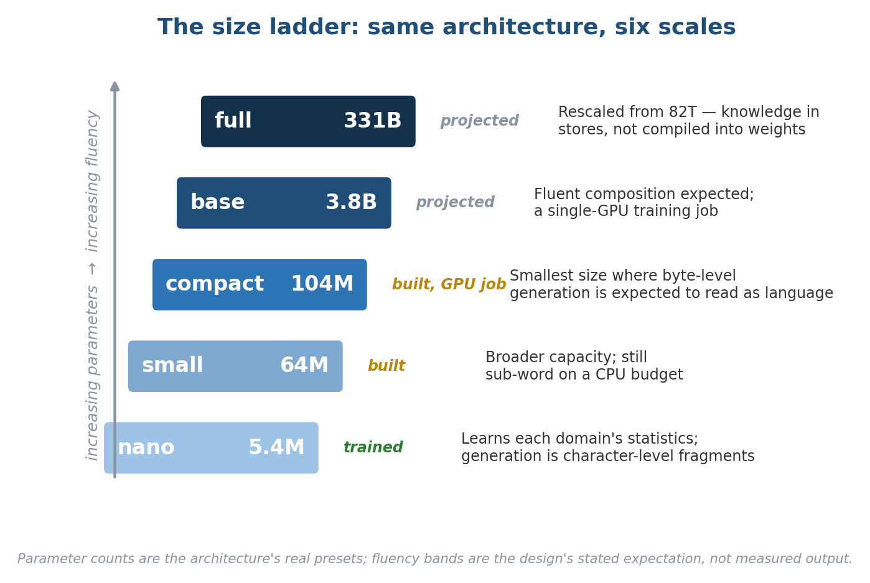
The roadmap is a scaling ladder
The architecture is proven; capital converts it into fluent, deployable product
Where the money goes
nano (5.4M) — trained, architecture proven.
compact (104M) — the rung where generation is expected to read as language. A budget-GPU job.
base (3.8B) — fluent, deployable; a single-GPU run.
The claim is narrow and testable: the deficit is capacity, and the cheapest next step (nano→compact) is where it's proven.
BrainAI · Investor Overview
14
Notes:
Roadmap = scaling ladder. Architecture is proven at nano; capital funds compact and base, where generation becomes fluent and deployable. The claim is narrow and cheap to test (nano→compact).

Slide 15

What's already built
A de-risked research asset, not a slideware idea
Full architecture, implemented
Trained & measured at nano
Every subsystem coded, wired, and forward/backward-verified — from spiking core to safety controller.
5.4M-parameter model trained across 82 domains / 245M tokens; results reproduce on a CPU.
114 automated tests
Honest, published evidence
A regression test for every catalogued failure mode; the science is reproducible end to end.
Full paper with multi-control benchmarks — including the results that went against our own designs.
BrainAI · Investor Overview
15
Notes:
Traction: this is a de-risked research asset — full architecture built, trained and measured, 114 tests, honest published evidence. Not vaporware.

Slide 16
The competitive gap
Everyone is building around the brain — nobody is building the brain
Player
Strength
What's missing
LLM labs (OpenAI, Anthropic, Google)
Language & reasoning
No body, no continual learning, no safety envelope, cloud-scale energy
Robotics companies (Figure, Tesla, 1X…)
Bodies & actuation
Bolt on general LLMs or narrow policies — no lifelong cognitive core
Neuromorphic vendors (Intel, IBM, BrainChip)
Efficient silicon
Hardware without brain-native cognitive software to run on it
BrainAI
The cognitive core
Embodied, continual, safe, sparse — the layer the others lack
BrainAI · Investor Overview
16
Notes:
Competition: LLM labs, robotics companies, and neuromorphic vendors all build around the brain; none builds the brain. BrainAI is the missing cognitive core at the intersection.

Slide 17
THE ASK
Raise to train the ladder and land first design partners
Train compact & base — prove fluent embodied generation
[ $ amount ]
seed round — to fill in
Stand up 2–3 robotics / neuromorphic design partners
Harden the SDK and safety layer for real hardware
Grow a small research + engineering team
Funding amount, valuation, and milestones to be set by the founder.
BrainAI · Investor Overview
17
Notes:
The ask: state the round size and use of funds — train the ladder, land 2–3 design partners, harden the SDK/safety for hardware, hire a small team. Fill in the amount, valuation, and milestones before pitching.

Slide 18
Why us
A builder who ships — and reports the truth
Mohammed Zahid Imityaz Wadiwale — Founder
Designed and implemented the entire BrainAI architecture solo: spiking core, five-memory system, world model, safety layer, and a 114-test reproducible benchmark suite — and published the results that went against his own designs. The rare founder who treats a number as more important than a narrative.
Add co-founders / advisors / key hires here.
The principle that runs through everything: design intent never overrides a measurement. That discipline is why every BrainAI result can be trusted — and why the architecture is what's left standing after it.
BrainAI · Investor Overview
18
Notes:
Why us: solo-built the entire architecture and published results against your own designs. Lead with the honesty principle — it's your differentiator as a founder. Add co-founders/advisors here.

Slide 19
THE VISION
The operating system for embodied intelligence
Every robot, drone, and edge agent will need a brain that learns for years, stays safe, and sips power. BrainAI intends to be that brain — the cognitive layer the physical-AI era is missing.
BrainAI · Investor Overview
19
Notes:
Vision: the operating system for embodied intelligence — the brain every robot and edge agent will need. Zoom out and make it big.

Slide 20
BrainAI
Let's build the brain for the physical-AI era.
Mohammed Zahid Imityaz Wadiwale · zahid.wadiwale1234@gmail.com
Notes:
Close warmly and open the conversation. Have the proof and roadmap slides ready to flip back to for technical questions.

