Slide 1
BioNode — AIoT BioCNG Micro-Refinery
Water hyacinth in. 200-bar vehicle-grade BioCNG out. Autonomously. At the bus terminal.
BEAR Summit 2026 · CES Pavilion Top 10 · Novo Theatre, Dhaka · 25–26 July 2026
No pipeline
No import
No chemist
500K+
95%
CNG vehicles
Fuel-import dependency
in Bangladesh
paid in scarce foreign exchange
200 bar
≥95%
Output pressure
CH₄ purity target
vehicle-grade BioCNG
vehicle-grade quality
Team BioNode · Silicon River · Built in Bangladesh. Fuel for the World.

Slide 2



Two national crises. One machine connects them.
Nobody today links these two problems — that is the entire opportunity.
A fuel crisis
Bangladesh's 500,000+ CNG vehicles run on fuel that is 95% imported, paid in scarce foreign exchange. When Middle East supply shocks hit in 2022–2024, CNG prices surged and hundreds of thousands of drivers lost income overnight. No local alternative exists.
A waterway crisis
Water hyacinth — a zero-value invasive weed — chokes 30%+ of the country's navigable waterways, costing millions annually to clear and generating nothing.
The missing link
No solution today converts the free weed into the fuel drivers need. BioNode is that link.

Slide 3



The Solution: a refinery the size of a shipping container
Water hyacinth goes in one end. Vehicle-grade BioCNG comes out the other — on-site, at the terminal, autonomously. Four integrated stages inside one ruggedized enclosure:
Anaerobic Digestion
1
Bacteria convert water-hyacinth biomass into raw biogas.
H₂S Scrubbing
CO₂ Separation
Iron‑sponge removes hydrogen sulfide >99%.
Membrane raises methane purity to ≥95%.
H₂S Scrubbing
2
Iron-sponge module removes hydrogen sulfide (>99% removal).
CO₂ Separation
3
Membrane stage lifts methane to ≥95% purity.
Anaerobic Digestion
Multi‑Stage Compression
Bacteria convert water‑hyacinth to raw biogas.
Compress biomethane to 200 bar for CNG.
Multi-Stage Compression
4
Biomethane compressed to 200 bar — standard vehicle CNG pressure — filling cylinders on-site.
The entire fuel supply chain collapses into a single container. Feedstock comes from the adjacent canal. No pipeline, no truck delivery, no import.

Slide 4
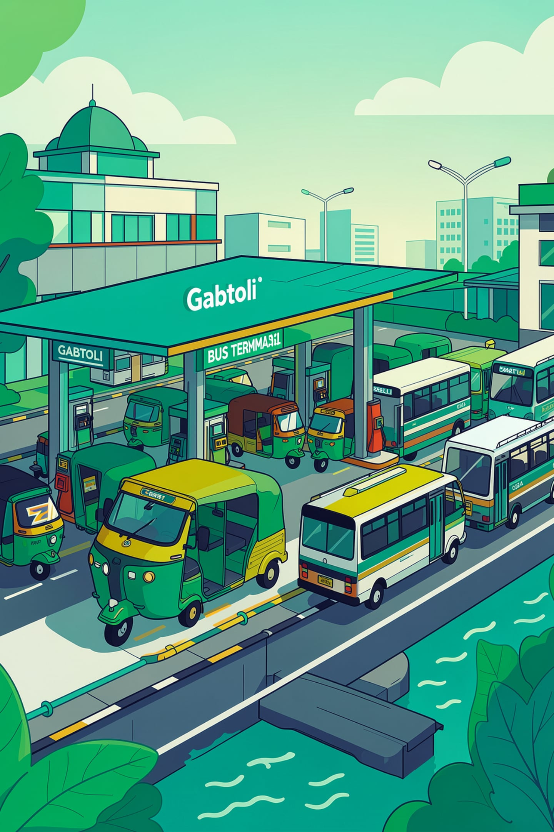

A day at Gabtoli terminal
A BioNode unit sits at Gabtoli bus terminal in Dhaka, beside the Turag canal.
1
Morning
Local workers harvest water hyacinth from the canal and load the digester.
2
All Day
The Edge-AI control loop runs continuously — adjusting pH and temperature through the PLC, monitoring gas quality, managing compression, with no human intervention.
3
By 6 AM
The unit has filled a batch of cylinders at 200 bar.
4
Drivers
Auto-rickshaw and bus operators fill up at ~20% below the imported CNG rate. The terminal operator earns a daily revenue share. The canal is cleared of weed as a byproduct.
The same cycle repeats every day — recurring, on-site revenue.

Slide 5

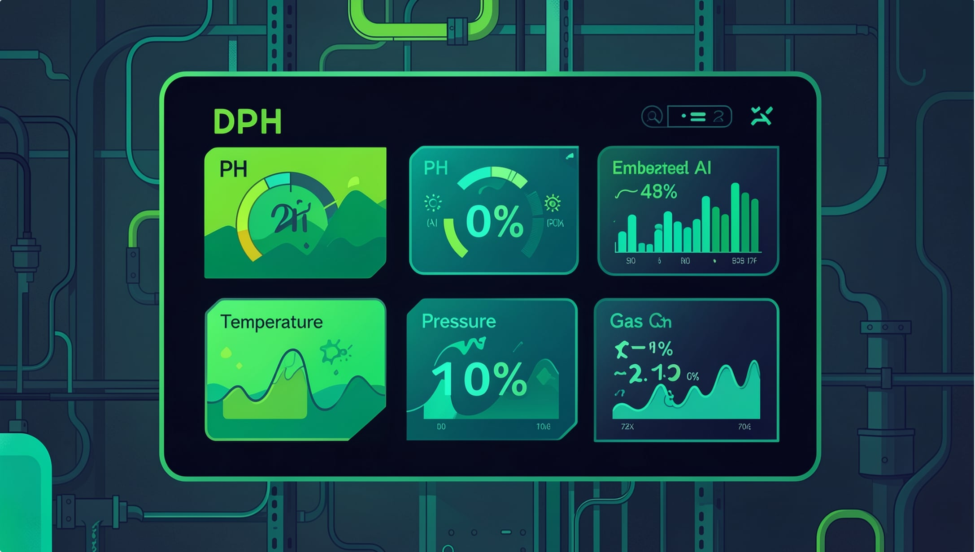



The AI is the operating condition — not a feature
Anaerobic digestion is biologically fragile: small deviations in pH, temperature, or organic loading can crash the digester and halt gas production for days. Autonomous terminal deployment is impossible without intelligent control.
Sensing
A real-time array measures pH, temperature, pressure, and gas composition continuously.
Deciding
An embedded inference engine processes the data and issues corrections via the PLC to solenoid valves, heating elements, and feed pumps — holding optimal digester conditions 24/7.
Energy
The AI load-shifts between the floating solar array, battery buffer, and grid to maximise efficiency.
Proof
A live dashboard already runs today, catching a simulated pH fault and auto-correcting it. Without AI, BioNode is a manual biogas plant needing a biochemist on-site daily — and the Energy-as-a-Service model collapses.

Slide 6




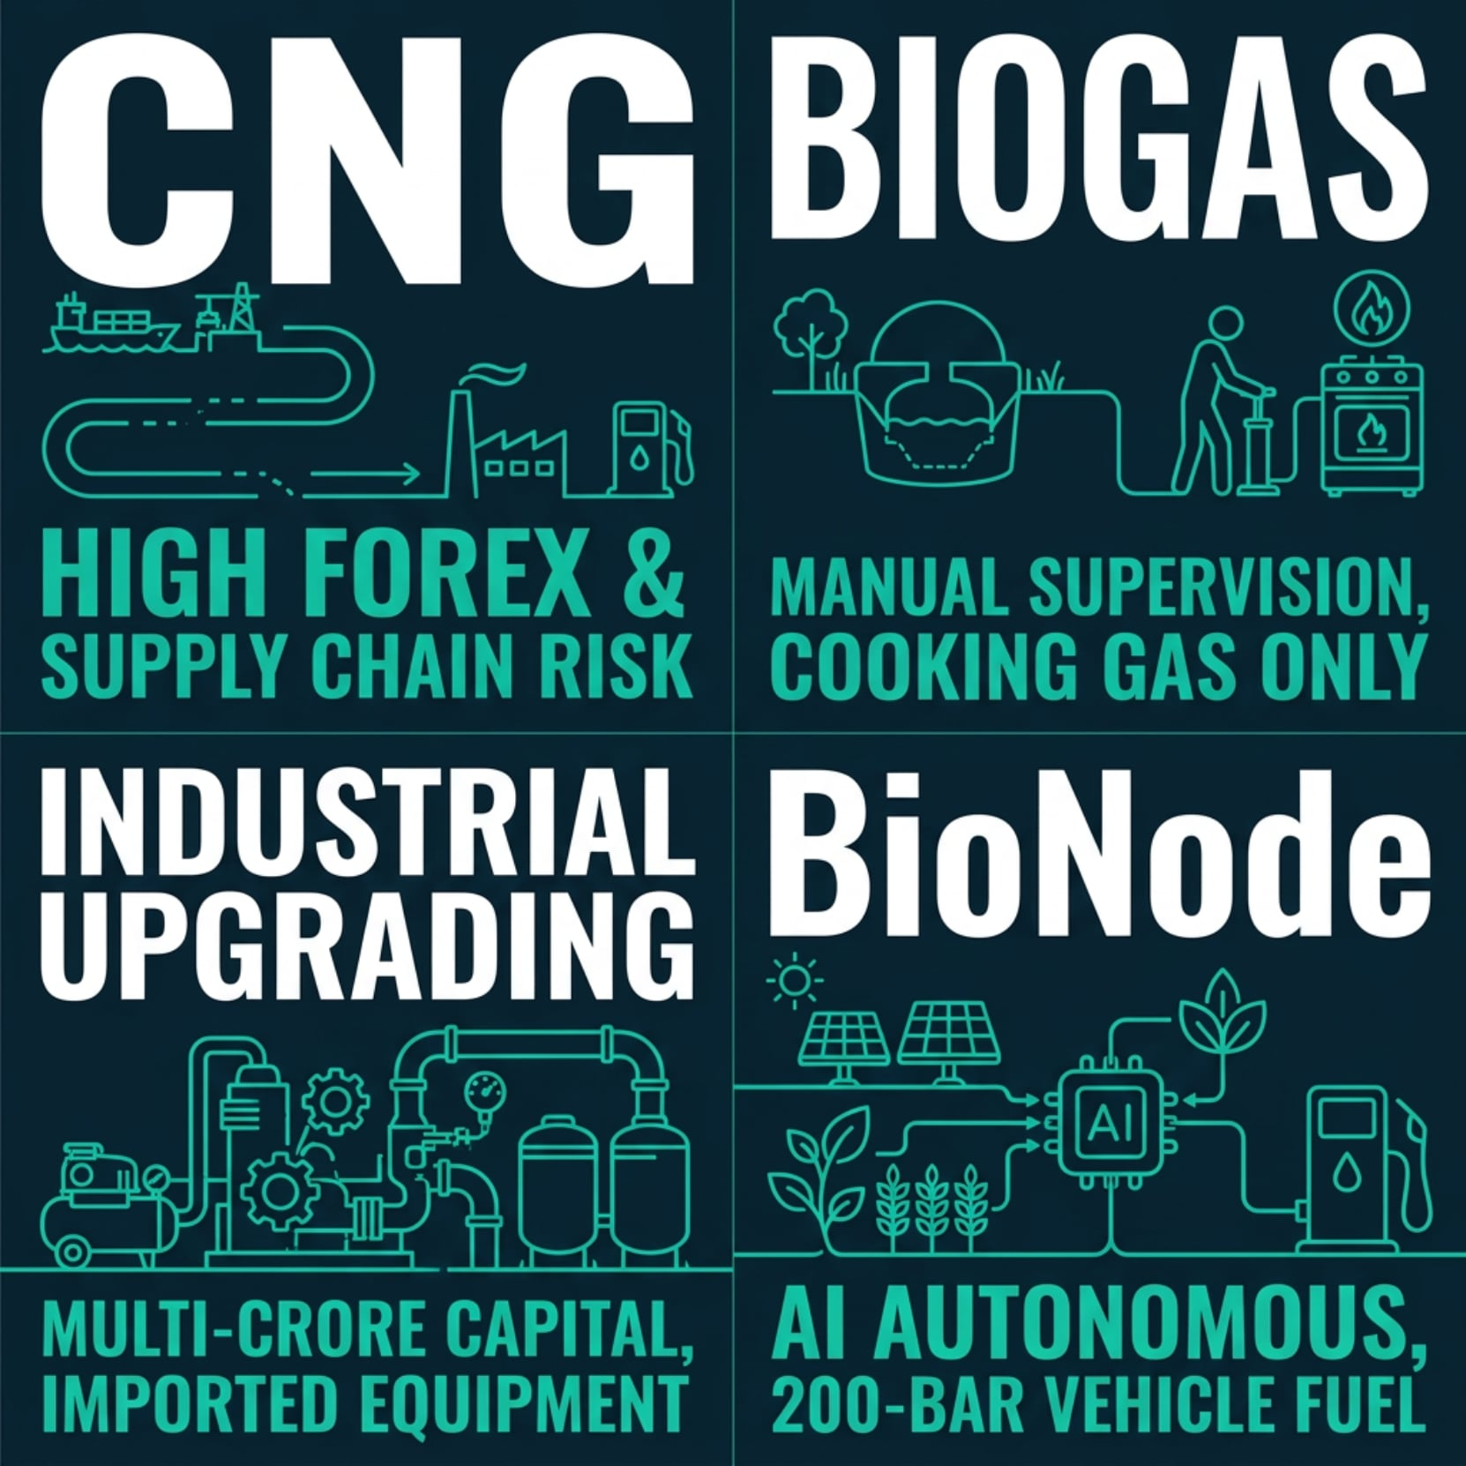
Four things no existing system does at once
Edge-AI Autonomy
Zero Supply Chain
24/7 pH / temperature / gas control replaces the trained operator.
The unit sits at the point of consumption; feedstock is harvested locally, eliminating pipeline and truck dependency.
Full End-to-End in One Enclosure
Solar–Water Symbiosis
Raw biomass to 200-bar compressed vehicle fuel — no off-site step.
A floating aquavoltaic array on the same canal powers the control system through load-shedding; one water body supplies feedstock, cools the panels, and hosts the array.
Why competitors fall short
Imported CNG depends entirely on forex and global supply chains. Rural biogas plants make dilute, low-pressure cooking gas needing daily manual supervision. Industrial upgrading needs multi-crore capital and imported equipment on 3-month LC cycles. None connect the free feedstock to vehicle-grade fuel. BioNode does.

Slide 7
Where we are — honestly — and the 3-month MVP plan
We are deliberately transparent about maturity: the idea is CES-gold, but a CES booth needs a machine that runs flawlessly for days. Here is the truth and the plan.
DONE TODAY
Architecture & Design
Full system architecture and AIoT control design; live Edge-AI dashboard prototype; finalised 13-item BOM; local sourcing secured (Nawabpur electronics, Dholaikhal fabrication).
BUILDING FOR SUMMIT
Bench-Scale Demo
Bench-scale 50-litre digester producing first measurable biogas, H₂S scrubbing on the output, and a 72-hour autonomous AI run — water hyacinth in, purified biomethane confirmed out, dashboard live.
MVP · JUL → NOV 2026
Mentored MVP
Close the full chain to a fillable cylinder, add professional casing and branded interfaces, and stand up the first costed pilot unit.
PILOT · JAN 2027
3-Unit Dhaka Pilot
Gabtoli, Sayedabad, Mohakhali — with real field numbers: kg of BioCNG sold, to how many drivers, over how many days.

Slide 8


Market & business model
Energy-as-a-Service: BioNode owns, operates, and sells — recurring daily revenue from every unit.
$880M
$44M
Bangladesh TAM/yr
Target ARR
CNG vehicle fuel market
5% market share by Year 5
$2.8B
$375K
Global TAM by 2032
Carbon Revenue/yr
Invasive-biomass fuel markets across Vietnam, Nigeria, Myanmar, Pakistan
At Dhaka pilot scale; CO₂ offset ~15,000 tonnes/yr at 200-unit scale
Revenue streams
BioCNG Sales
Daily fuel sales at ~20% below imported CNG rate — competitive and profitable from day one.
Jan 2027 Pilot
2027 Rollout
2028 Expansion
2030 Scale
Carbon Credits
3-unit pilot launch & CES demo
20-unit Dhaka launch & Series A
Regional scaling across markets
500 units & carbon platform live
$225K–$375K/yr at pilot scale; scales to ~50M tonnes CO₂ offset at 10,000-unit deployment.
Terminal Revenue Share
The first revenue arrives the day a unit is switched on.
Operators earn daily share — aligning incentives and securing local partnerships.

Slide 9
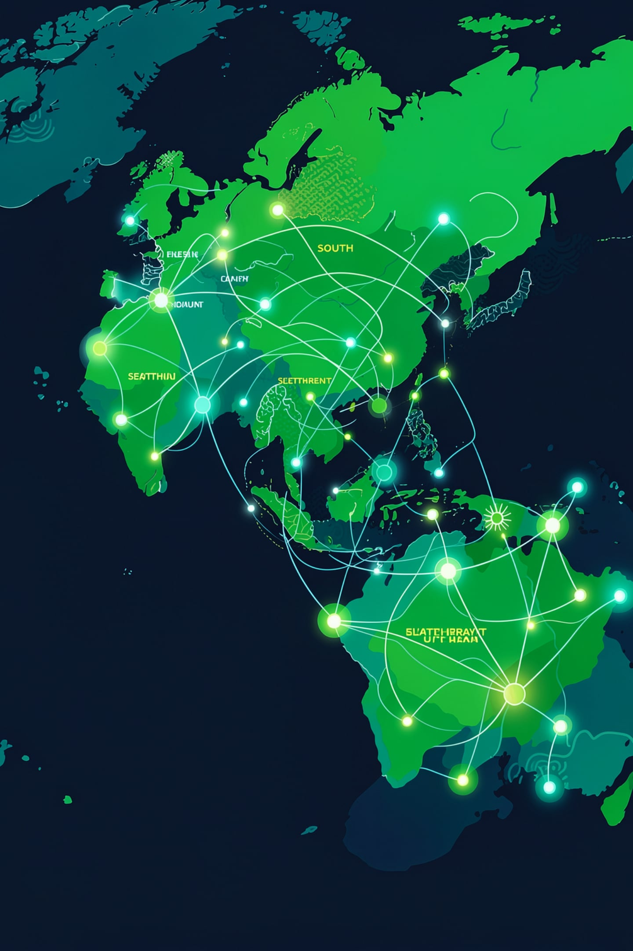
2036: not a machine — a platform
If BioNode succeeds beyond our wildest expectations, it becomes the global standard for decentralised clean fuel in the Global South — the way solar panels became the standard for rural electrification.
10,000+
Units deployed
Across 50+ countries, connected to one cloud data layer
1B
People served
With access to locally produced clean vehicle fuel
50M
Tonnes CO₂/yr
Offset at full global scale
50+
Countries
Micro-refinery manufacturing, maintenance, and feedstock logistics — a new industry built in Bangladesh
Bangladesh stops importing fuel — and starts exporting clean-energy technology. Silicon River's first globally scaled deep-tech company.

Slide 10
BioNode
See the live demo at our booth
Water hyacinth in. BioCNG out.
Team BioNode · Silicon River
BEAR Summit 2026 · CES Pavilion Top 10 · Novo Theatre, Dhaka
BUILT IN BANGLADESH. FUEL FOR THE WORLD.

