Slide 1
Welcome to the presentation MAT102

Slide 2

Submmitted By -
Abrar Hossain Zahin ID – 2022-2-60-040
Submitted to –
Dr. Anindita Paul Professor Department of MPS
Use of Differential Equation in Real Life

Slide 3
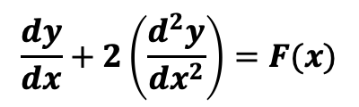
What is Differential Equation ?
“Rate of Changes”
An equation which involves derivatives of a dependent variable with respect to other independent variable is called a differential equation.

Slide 4
Differential equations are used in many cases………..
Population Growth Model.
World of Music.
To Calculate the Movement of Electricity.
To Explain Thermodynamics Concepts.
Radio Activity Decay.
Economics, Biology, Physics, Chemistry, Geology.
Maxwell’s Eqution & Newton’s 2nd Law of Motion.
Chemical Reactions, etc.

Slide 5
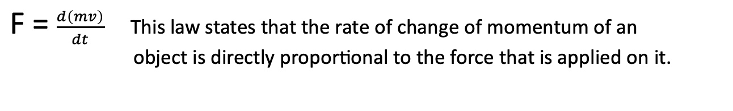
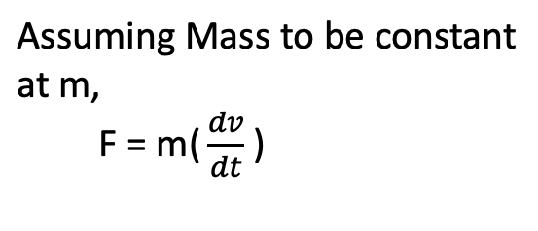

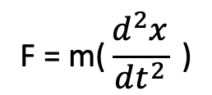

Newton’s 2nd Law of Motion
If Mass is variable,
F = ma
That force is equal to mass multiplied by acceleration.
However, if the mass is variable, That is either it is increasing or decreasing with respect to time.

Slide 6










Radioactive Decay
Uranium
235_{U}
92
Radioactive elements like uranium, radium, cobalt etc on being unstable. Spontaneously decay, to give the daughter nucleus and the alpha, beta or gamma rays, depending on the type of decay .
α, β, γ
Partical
Radium
226_{Ra}
Radioactive Elements
88
Daughter Nucleus
Cobalt
59_{Co}
27

Slide 7
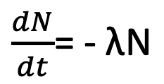


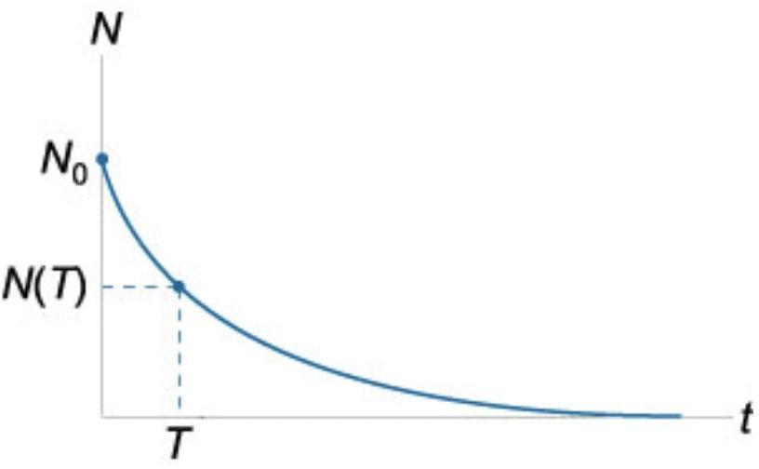
Law of Radioactive Decay
The amount of radioactive element that decaying per unit time is directly proportional to the total amount of radioactive element present The quantity of the element is actually decreasing as time progresses.
On solving above differential equation we get,
One use of this equation is to find the half-life of radioactive elements
N(t) = N e⁻λt
Where,
0
N - Quantity of Element at time t t - time
N₀ - Quantity Of Element at t=0 λ - Decay Constant
Which is nothing but the time that is required for half of the atoms in the sample to decay

Slide 8
References
https://byjus.com › Maths › Math Article
https://youtu.be/zm_UqjVLViU

Slide 9
Thank you all for watching my presentation
Do you have any question for me ?

