Slide 1
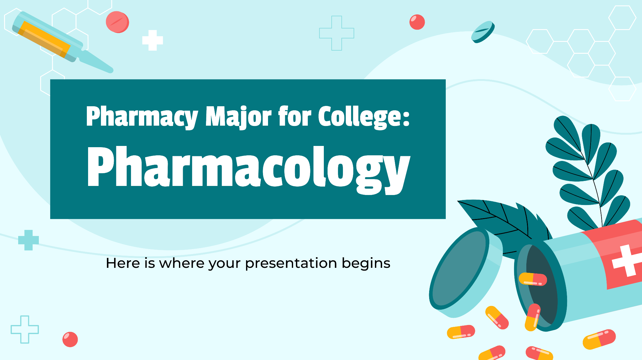
ACI Pharmaceuticals Ltd.

Slide 2
Table of contents
1
2
6
3
Introduction
4
Marketing Mix
Marketing Environment
5
Observation
Recommendations
Marketing Strategy

Slide 3
Group Members
Minhajul Haque Shafin
ID : 2022-2-60-054
Abrar Hossain Zahin
ID : 2022-2-60-040
Shafiqul Islam Fahim
Id : 2022-2-60-085
Jannatul Ferdose
ID : 2023-2-77-066

Slide 4
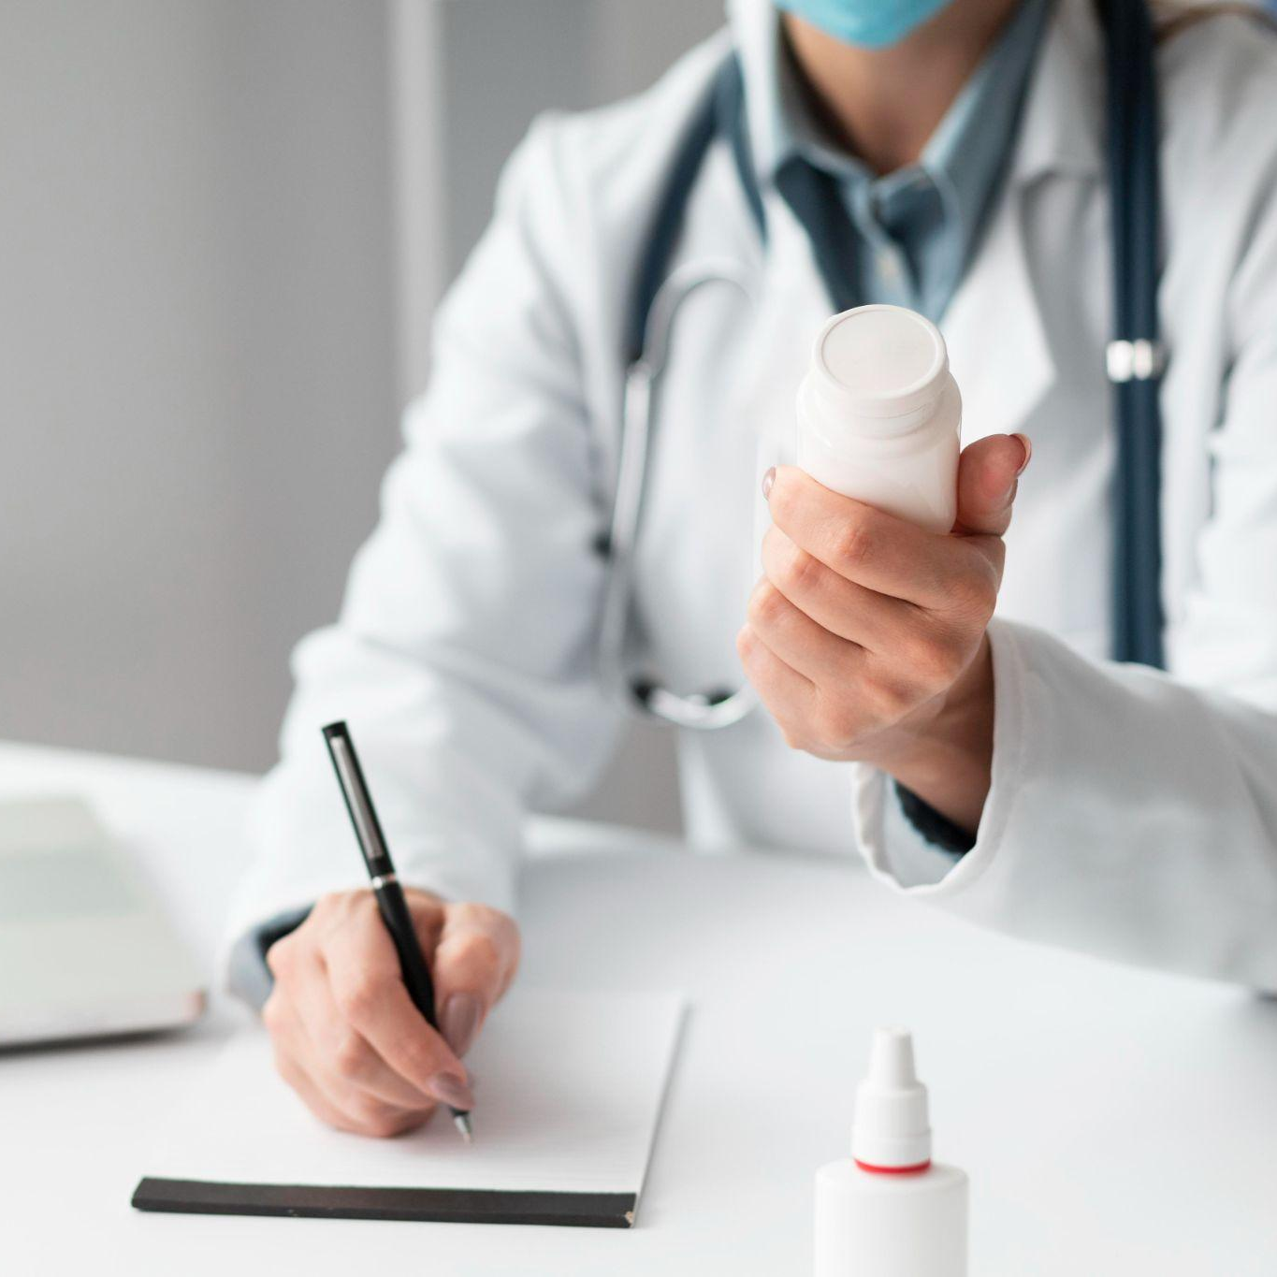
Introduction
Advanced Chemical Industries, or ACI Pharmaceuticals aims to improve the health and quality of life for people in Bangladesh and globally by providing high-quality, affordable, and innovative pharmaceutical products. The company is committed to customer satisfaction and is, therefore, strongly oriented toward collaboration with clients in the tailoring of products in response to customers' needs.

Slide 5
Mission
ACI's commitment to enhancing life quality through accessible, innovative, and sustainable products.
Vision
The aspiration to lead the pharmaceutical sector in Bangladesh by maintaining quality, fostering employee growth, ensuring customer satisfaction, and using modern technology.
Core Values
Ethical business practices, innovation, customer-centric approaches, teamwork, and a focus on quality to secure a strong market position.

Slide 6



Marketing Strategy
Segmentation
Targeting
Positioning, Differentiation
Divide the total market into smaller segments
Select the segment or segments to enter
Position the market offering in minds & target customers

Slide 7
Segmentation
Demographic Segmentation
Geographical Segmentation
Behavioral Segmentation
Phsychographical Segmentation

Slide 8
Segmentation
Demographical
Generic Drugs Young Adults Middle-aged individuals Senior Citizen Specialty Drugs Lower-income groups Middle-Upper income groups Healthcare Professionals Urban Professionals
Psychographic
Health-conscious customers Lifestyle Proactive healthcare seekers
Behavioral
Usage rate Loyalty status Heavy status Brand loyal customers Occasional users
Geographical
Urban Markets Rural Markets

Slide 9
Targeting
Retail and Wholesale Channels
Doctors and Specialists
Pharmacies
Wholsealers
Direct Marketing
Seminar Conferences
Key Opinion Leaders
Hospital
and Clinic

Slide 10

Innovative and Leadership
High-Quality, Affordable Healthcare
Wide Reach and Accessibility
Sustainability and Social Responsibility
Differentiation through Product Range
Brand Trust and Loyalty
Positioning
Differentiation
Generic Drugs
Speciality Medicines
OTC Products

Slide 11

“ Marketing mix is the set of controllable, tactical marketing tools that the firm blends to produce the response it wants in the target market ”

Slide 12
Marketing Mix
‘Product’
High-quality healthcare products
‘Price’
Competitive pricing for generic medicines
‘Place’
‘Promotion’
450+ prescription drugs
Vitamins, supplements, herbal remedies, self-care and ayurvedic products
Cost plus & value-based pricing for high-end products
Nationwide presence
Advertising
International exports
Online & retail availability
Direct supply to hospitals and clinics
Sales promotion
Special offers
Social media Campaign
Sponsoring events

Slide 13
Marketing Environment
Micro Environment
Organizations
1.Top management
2. Shareholders
3. Finance
4. R&D
5. Purchasing
6. Operations
Suppliers
1. Raw materials suppliers
2. Equipment suppliers
Customers
1.Professionals
Patients
2. Government
Competitors
1. Domestic
2. International
Intermediaries
Distributors
Retailers
Macro Environment
Political
1. Government policies
2. Political stability
Economic
1. Economic Growth
2. Exchange rate
Social
1. Cultural preferences
2. Demographic factor
Technological
1. Automation in production
Environmental
1. Environmental impact
2. Climate change

Slide 14
1.High Quality Product
2.Affordable prising
3. Environmental Policy
4. Maintain Market Growth
5. Efficient & Effective marketing team
6. Advanced technology
1. Extreme reliance on imports
2. Unethical Competitors
3. World Economic Recession
4. Absence of facility for bio-equivalence study
5. Capitals are borrowed from bank
6. No good R&D activity
1. Potential domestic and international market
3. Establishment of API Part
4.Expend Product line
5. Increasing demand of cultivation for Agribusiness
6. Ability to move to better strategic group
1. Maximum Retail Price
3. Export may be reduced if world economy is affected.
4. Associated industries are highly competitive
5. Increased inflation of the economy.
Strengths
Weaknesses
SWOT
Analysis
Opportunities
Threats

Slide 15
Observation
Strong market position
Dynamic marketing strategy
High quality product
Distribution Network
Trust and Loyalty
Dependency
Growth

Slide 16
Recommendations
Innovation Focus
API production
Global Expansion.
Digital Transformation
Sustainability

Slide 17
Conclusion
ACI Pharmaceuticals Ltd. has successfully established itself as a key player in Bangladesh's pharmaceutical industry, driven by a strong focus on quality, product diversity, and extensive distribution.

Slide 18
References
https://www.aci-bd.com/about-us/aci-environmental-policy.html
https://www.aci-bd.com/interviews/innovative-marketing-strategy-key-to-attract-consumers-attention.html
https://www.scribd.com/document/248167506/Swot-of-ACI
https://www.acipharma.net/
https://www.aci-bd.com/medicus/HospitalClinics.php

Slide 19
Thank You

