Slide 1


Why Computer Science is Inevitable for our Futuristic Society

Slide 2
SUBMITTED TO
Syeda Shabnam Mahmud
Department of English
Course : ENG102
Section : 14

Slide 3
SUbMITTED by
Abrar Hossain Zahin ID: 2022-2-60-040
Dept. of Computer Science And Engineering
Haa-Meem Ahamed ID: 2022-1-10-042
Dept. of Business Administration
Raiyan Fardin Haque ID: 2022-1-60-240
Dept. of Computer Science And Engineering
Afsin Sultana
ID: 2022-1-60-113
Dept. of Computer Science And Engineering

Slide 4
REspONsIbILITIEs
Raiyan Fardin Haque
Abrar Hossain Zahin
Content Creator
Interviewer
Fieldworker
Survey Question Creator
Fieldworker
Afsin Sultana
Haa Meem Ahmed
Interview Question Creator
Slide creator
Field worker
Fieldworker
Article collector
Survey questioner

Slide 5
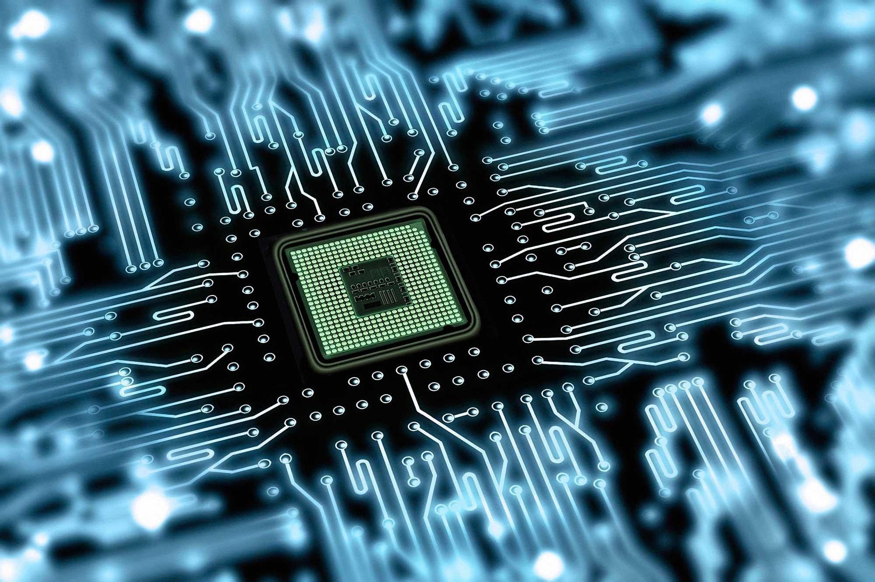
Why did we choose this topic
Computer science is integral to our future. The future generation will be mostly dependent on artificial intelligence. Cyber security will reach the pinnacle of development. Most of the tasks will be performed by robots. We have brought up this topic to provide some information about the subjects' needs, benefits, uses

Slide 6
REsEarch QUEsTIONs
How advanced AI is getting nowadays
Why is robotics mostly dependent on computer science

Slide 7
METHOD
Qualitative (Interview question)
Quantitative (Survey Question)

Slide 8
INTErvIEw QUEsTIONs
What are the forthcoming AI revolutions in our society?
What could be the predicted impact of AI in the future?
How has computer science enhanced medical treatment?
What role does computer science play in cyber security?

Slide 9


INTErvIEwEE prOﬁLE
Tanni Mittra
Senior Lecturer
Department of Computer Science & CEnognitnaecet:ring
tanni.ewubd.edu
Dr. Anisur Rahman
Associate Professor
Department of Computer Science & Engineering
Proctor
Contact: anis@ewubd.edu

Slide 10
SurveyQuestion
1. What is your opinion on the fact that the future mostly depends on computer science?
(a) Agreeable
2. Have you heard about artificial intelligence?
(b) Disagreeable
(a) Yes
3. When You read about high-profile individuals giving dire warnings about AI, What best describes your response?
(a) AI is helpful (b) AI is harmful

Slide 11
SurveyQuestion
How interested are you in having a robot ?
Very interested
Not much interested
Not interested at all
How worried are you about robots?
Very worried
A little worried
Not worried at all

Slide 12



SUrvEy parTIcIpaNTs
Students
Schools, Colleges, Universities
Tech. gadget users Common people, office workers
Computer Engineers Professionals

Slide 13



