Slide 1
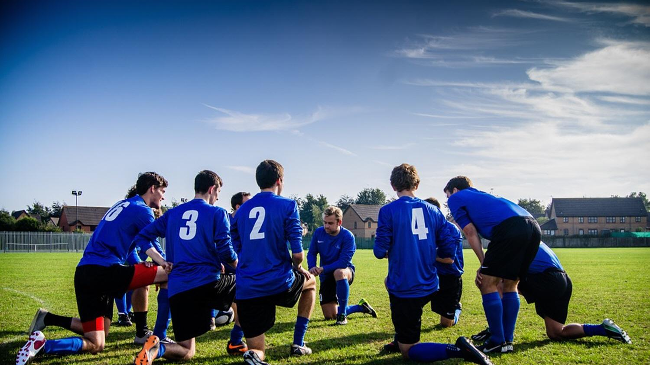
একুশে শর্ট পিচ প্রিমিয়ার লিগ ২০২৪।

Slide 2
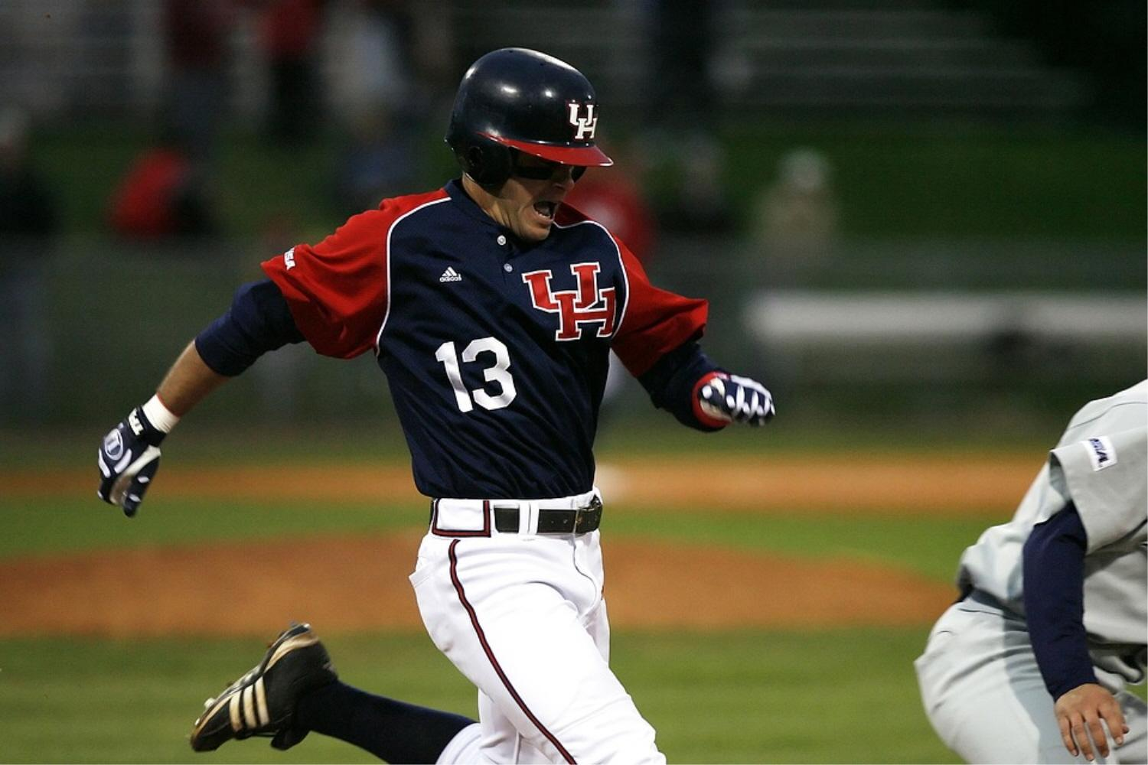
Md. Nafis Iqbal
Dept: Pharmacy Session: 2022-23
Player Type:
All Rounder

Slide 3
Md. Ibn Hossain Emon
Dept: Physics
Session: 2022-23
Player Type:
All Rounder

Slide 4
Shah Mohammad Firoz
Dept: SWE Session: 2019-20
Player Type:
All Rounder

Slide 5
Md. Jihadul Islam
Dept: Chemistry Session: 2022-23
Player Type:
Batting

Slide 6
Nahid Hasan Nirob
Dept:
Applied Mathmatics
Session: 2020-21
Player Type:
All Rounder

Slide 7
Md. Masum
Dept: DSCR Session: 2020-21
Player Type:
All Rounder

Slide 8
Md. Limon Hossain
Dept: Fisheries Session: 2021-22
Player Type:
All Rounder

Slide 9
Arman Hossain
Dept: Chemistry Session: 2021-22
Player Type:
All Rounder

Slide 10
Md. Rubayet Hassan Rimon
Dept: EEE Session: 2021-22
Player Type:
All Rounder

Slide 11
Md. Rakibul Islam
Dept: IIT Session: 2021-22
Player Type:
All Rounder

Slide 12
Md. Shifatul Islam Rafi
Dept: Pharmacy Session: 2022-23
Player Type:
Batting

Slide 13
Mohammad Fahimul Islam
Dept: Meteorology Session: 2020-21
Player Type:
Balling

Slide 14
Mithu
Dept: Zoology Session: unknown
Player Type:
All Rounder

Slide 15
Md. Rafiqul Islam
Dept: Zoology Session: unknown
Player Type:
All Rounder

Slide 16
Rafid
Dept: IIT Session: 2020-21
Player Type:
All Rounder

Slide 17
Mondol Mohammad Sultan
Dept: Mathematics Session: 2019-20
Player Type:
All Rounder

Slide 18
Jahangir Alom
Dept: unknown Session: 2020-21
Player Type:
All Rounder

Slide 19
Md. Sujon
Dept: Botany Session: 2019-20
Player Type:
All Rounder

Slide 20
Hasan Tareq Hemel
Dept: Mathematics Session: 2017-18
Player Type:
Batting

Slide 21
Mohir Alam
Dept: Mathematics Session: 2018-19
Player Type:
All Rounder

Slide 22
Abdur Rahman
Dept: Applied Math Session: 2017-18
Player Type:
All Rounder

Slide 23
Ashik Azim
Dept: Statistics Session: 2019-20
Player Type:
All Rounder

Slide 24
Hasibul Hassan
Dept: Math Session: 2019-20
Player Type:
All Rounder

Slide 25
Md. Enan
Dept: SWE Session: 2022-23
Player Type:
All Rounder

Slide 26
Habib
Dept: Chemistry Session: 2020-21
Player Type:
Batting

Slide 27
Md. Morshed Alam Shafik
Dept: Math Session: 2020-21
Player Type:
All Rounder

Slide 28
Saidur Rahman
Dept: unknown Session: 2018-19
Player Type:
Batting

Slide 29
Kazi Nazmul Huda
Dept: Fisheries Session: unknown
Player Type:
Batting

Slide 30
Rouful
Dept: Math Session: unknown
Player Type:
All Rounder

Slide 31
Md. Tuhin Hasan
Dept: Physics Session: 2023-24
Player Type:
All Rounder

Slide 32
Md. Ruhul-Amin
Dept: Geology Session: 2023-24
Player Type:
Balling

Slide 33
Md. Ridoy Khan
Dept: Math Session: unknown
Player Type:
All Rounder

Slide 34
Ahmmod Awal Dipon
Dept: Botany Session: 2018-19
Player Type:
All Rounder

Slide 35
Md. Asifur Rahaman
Dept: Applied Stat. Session: unknown
Player Type:
All Rounder

Slide 36
Abdullah Al Masud Pervez
Dept: BMB Session: 2020-21
Player Type:
All Rounder

Slide 37
Shakil
Dept: SWE Session: 2022-23
Player Type:
All Rounder

Slide 38
Erik Hossen Joy
Dept: Pharmacy Session: 2023-24
Player Type:
Batting

Slide 39
Md. Shanto Ahammad
Dept: Math Session: 2023-24
Player Type:
Batting

Slide 40
Md. Shajib Pramanik
Dept: Pharmacy Session: 2023-24
Player Type:
All Rounder

Slide 41
Joy
Dept: Biochemistry Session: 2023-24
Player Type:
All Rounder

Slide 42
Sadik Hossen
Dept: Physics Session: 2023-24
Player Type:
Bowler

Slide 43
Md. Mashiur Rahman
Dept: unknown Session: 2020-21
Player Type:
Batter

Slide 44
Parvej Shah
Dept: IIT Session: 2023-24
Player Type:
All Rounder

Slide 45
Md. Abdullah
Dept: Stat. Session: 2023-24
Player Type:
Batter

Slide 46
Md. Jobayer
Dept: Botany Session: 2023-24
Player Type:
Batter

Slide 47
Md. Atiqur Rahman
Dept: Oceanography Session: 2023-24
Player Type:
All Rounder

Slide 48
Md. Rony Hasan
Dept: Physics Session: 2020-21
Player Type:
All Rounder

Slide 49
Md. Mahfuzar Rahman Miju
Dept: Stat. Session: unknown
Player Type:
All Rounder

Slide 50
Md. Omar Faruk
Dept: unknown Session: 2018-19
Player Type:
All Rounder

Slide 51
Md. Islam Hossain Irfan
Dept: unknown Session: 2022-23
Player Type:
Bowler

Slide 52
Md. Moniruzzaman Sourov
Dept: Oceanography Session: 2021-22
Player Type:
All Rounder

Slide 53
Sadat
Dept: Fisheries Session: 2020-21
Player Type:
All Rounder

Slide 54
Md. Miraj Morshed
Dept: Physics Session: 2021-22
Player Type:
All Rounder

Slide 55
Jewel Hasan
Dept: Physics Session: 2020-21
Player Type:
All Rounder

Slide 56
Maksuduzzaman Apu
Dept: Zoology Session: 2019-20
Player Type:
All Rounder

Slide 57
Md. Tanvir Newaz Shifat
Dept: Physics Session: 2021-22
Player Type:
All Rounder

Slide 58
Md. Limon Ahmed
Dept: Fisheries Session: 2023-24
Player Type:
Bowler

Slide 59
Ashraful Alam
Dept: EEE Session: 2020-21
Player Type:
All Rounder

Slide 60
Abdullah Al mamun
Dept: Stat. Session: 2022-23
Player Type:
All Rounder

Slide 61
Md. Rakibul Hasan Munna
Dept: Stat. Session: 2023-24
Player Type:
Batter

Slide 62
Mehedi Hasan Sabbir
Dept: EEE Session: unknown
Player Type:
Bowler

Slide 63
Md. Mohiuddin
Dept: ACCE Session: 2021-22
Player Type:
All Rounder

Slide 64
Md. Shofiul Emon
Dept: Math. Session: 2022-23
Player Type:
All Rounder

Slide 65
Md. Iftiak Ahmed Kaif
Dept: ISRT Session: 2023-24
Player Type:
All Rounder

Slide 66
Mamun
Dept: Physics Session: 2022-23
Player Type:
All Rounder

Slide 67
Shakil Hossen
Dept: ACCE Session: 2020-21
Player Type:
All Rounder

Slide 68
Md. Nahid Hossain
Dept: Physics Session: 2020-21
Player Type:
All Rounder

Slide 69
S M Muhit Misbah
Dept: Pharmacy Session: 2023-24
Player Type:
Batter

Slide 70
Foysal Badsha
Dept: unknown Session: 2023-24
Player Type:
All Rounder

Slide 71
Mijanur Rahman Mijan
Dept: unknown Session: 2023-24
Player Type:
All Rounder

Slide 72
Muhtasim Fuad
Dept: Physics Session: 2020-21
Player Type:
Batter

Slide 73
Abdus Shaheed Nasim
Dept: SWE Session: 2018-19
Player Type:
All Rounder

Slide 74
Md. Rakib Anuwer Sagar
Dept: Physics Session: 2022-23
Player Type:
Batter

Slide 75
Md. Sadikuzzaman Sarker
Dept: EEE Session: 2020-21
Player Type:
All Rounder

Slide 76
Md. Rowshon Ali
Dept: Fisheries Session: 2023-24
Player Type:
All Rounder

Slide 77
Nur Mohammad
Dept: Geography & Env. Session: 2019-20
Player Type:
Batter

Slide 78
Abrar Hamim
Dept: DSCR Session: 2021-22
Player Type:
All Rounder

Slide 79
Md. Nurul Amin Tayeb
Dept: DSCR Session: 2021-22
Player Type:
All Rounder

Slide 80
Md. Mehedi Hasan
Dept: GEB Session: 2022-23
Player Type:
All Rounder

Slide 81
Md. Shajid Hossain Saju
Dept: Stat. Session: 2020-21
Player Type:
All Rounder

Slide 82
Md. Sajib Hasan
Dept: Physics Session: 2022-23
Player Type:
All Rounder

Slide 83
Md. Asif Hasan
Dept: Fisheries Session: 2017-18
Player Type:
All Rounder

Slide 84
Md. Atiqur Rahman
Dept: NE Session: 2022-23
Player Type:
All Rounder

Slide 85
Abir
Dept: DSCR Session: 2017-18
Player Type:
All Rounder

Slide 86
Nahid Hasan Sagar
Dept: MS Session: 2022-23
Player Type:
Batter

Slide 87
Hasanur Rahman Showrav
Dept: Chemistry Session: 2020-21
Player Type:
All Rounder

Slide 88
Arfin
Dept: Stat. Session: unknown
Player Type:
Batter

Slide 89
Mijanur
Dept: Chemistry Session: 2022-23
Player Type:
All Rounder

Slide 90
Shoayeb
Dept: unknown Session: 2014-15
Player Type:
All Rounder

Slide 91
Nahid Alam
Dept: INFS Session: 2017-18
Player Type:
All Rounder

Slide 92
Omar Faruk
Dept: Geology Session: 2019-20
Player Type:
All Rounder

Slide 93
Shafayet
Dept: BMB Session: 2022-23
Player Type:
All Rounder

Slide 94
Ridowan Rakib
Dept: Zoology Session: unknown
Player Type:
Batter

Slide 95
Rysul Hasan
Dept: Physics Session: 2022-23
Player Type:
All Rounder

Slide 96
Hasan Maruf
Dept: Geology Session: unknown
Player Type:
Batter

Slide 97
Saju Ahmed
Dept: Botany Session: 2022-23
Player Type:
Batter

Slide 98
Mahbub Morshed Abir
Dept: Microbiology Session: 2023-24
Player Type:
Batter

Slide 99
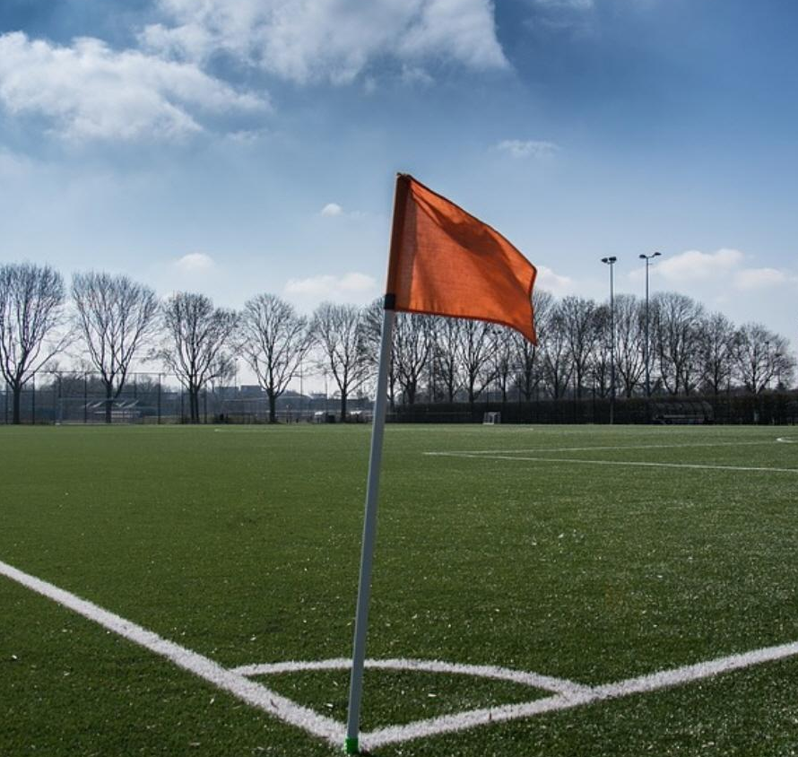
SCORE It makes me very happy when I create goals or score goals myself, but the most important thing is that the team reaches its goal and plays positive football. Mesut Ozil

Slide 100
SCORE The important thing is to be there, score when needed. It's better if the goals are beautiful, better still if they are important. Wayne Rooney

Slide 101
SCORE It makes me very happy when I create goals or score goals myself, but the most important thing is that the team reaches its goal and plays positive football. Mesut Ozil

