Slide 1


Decoding Asmi Hassan: A Text Mining of Iraqi Drama
How Natural Language Reveals the Hidden Depth of Audience Engagement
Presented by Zahraa Hussein obeid, supervised by Basad Hussein

Slide 2
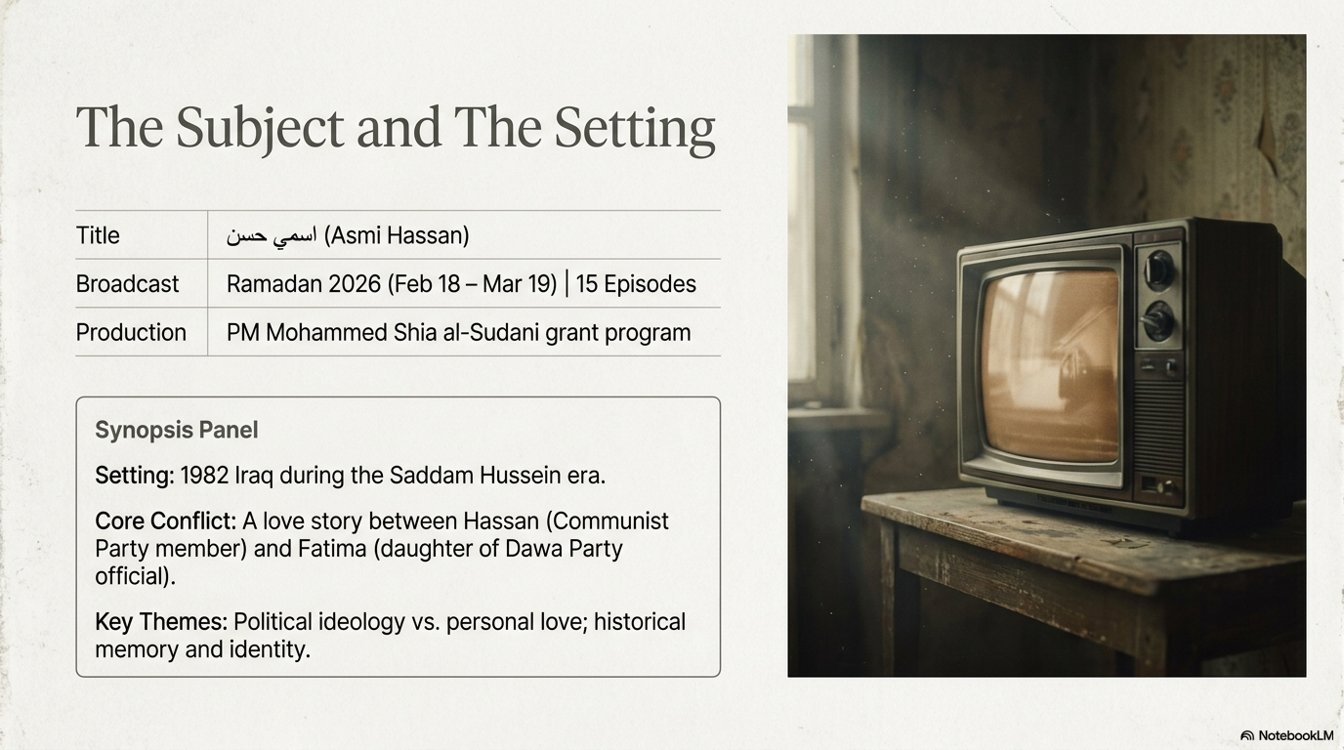

Slide 3
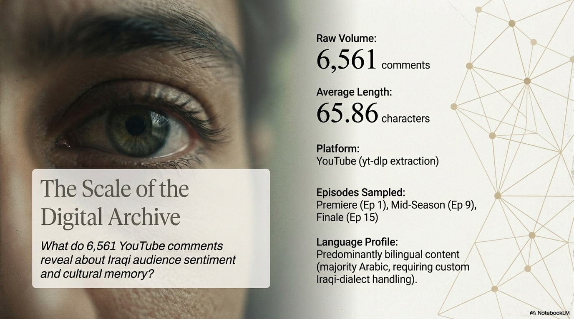

Slide 4
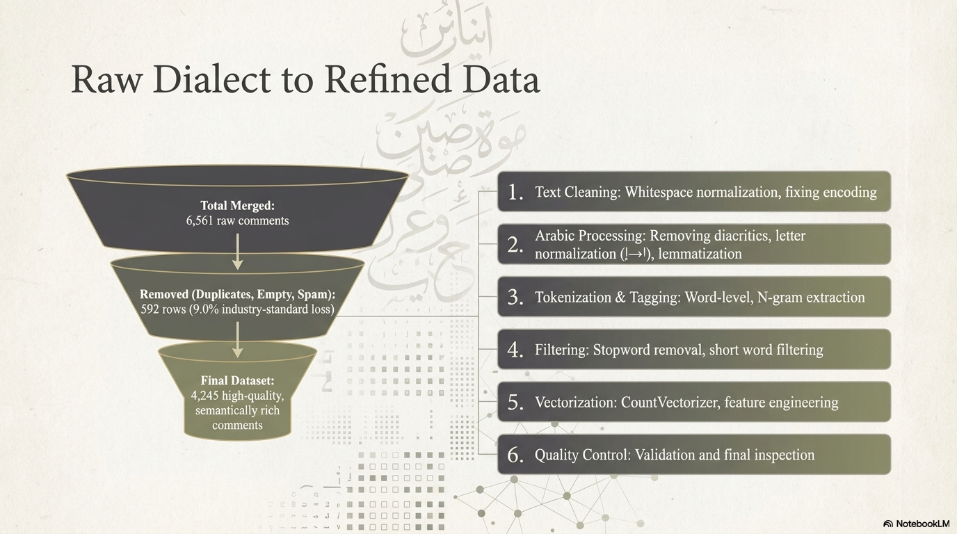

Slide 5
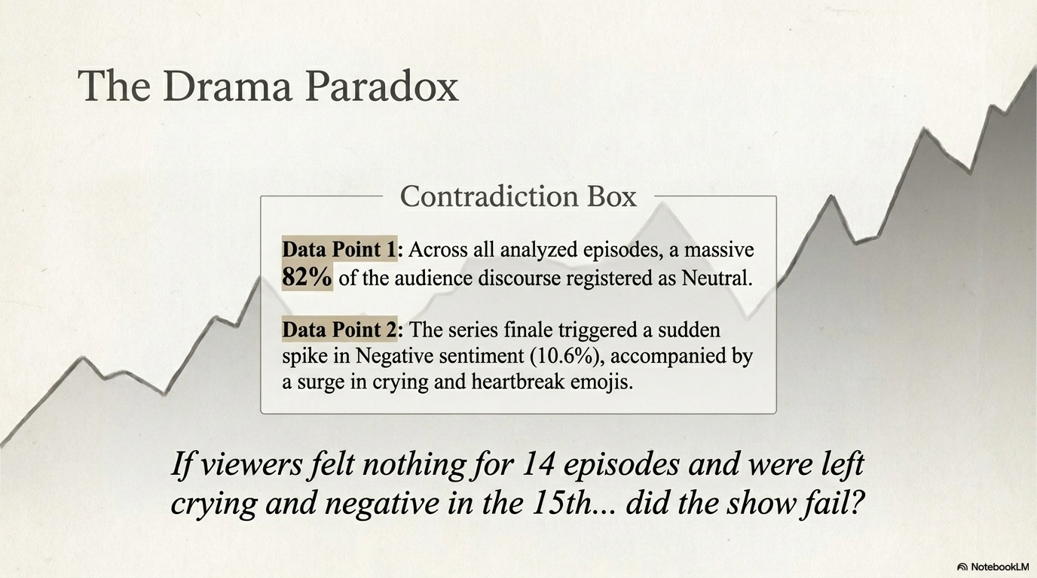

Slide 6
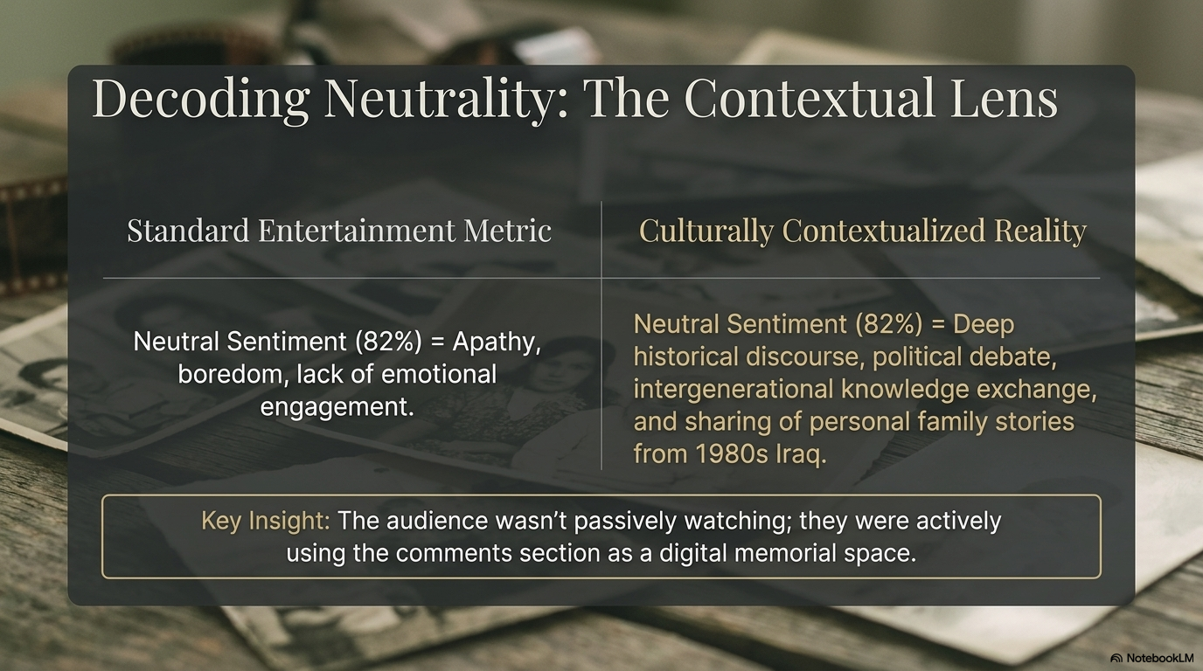

Slide 7
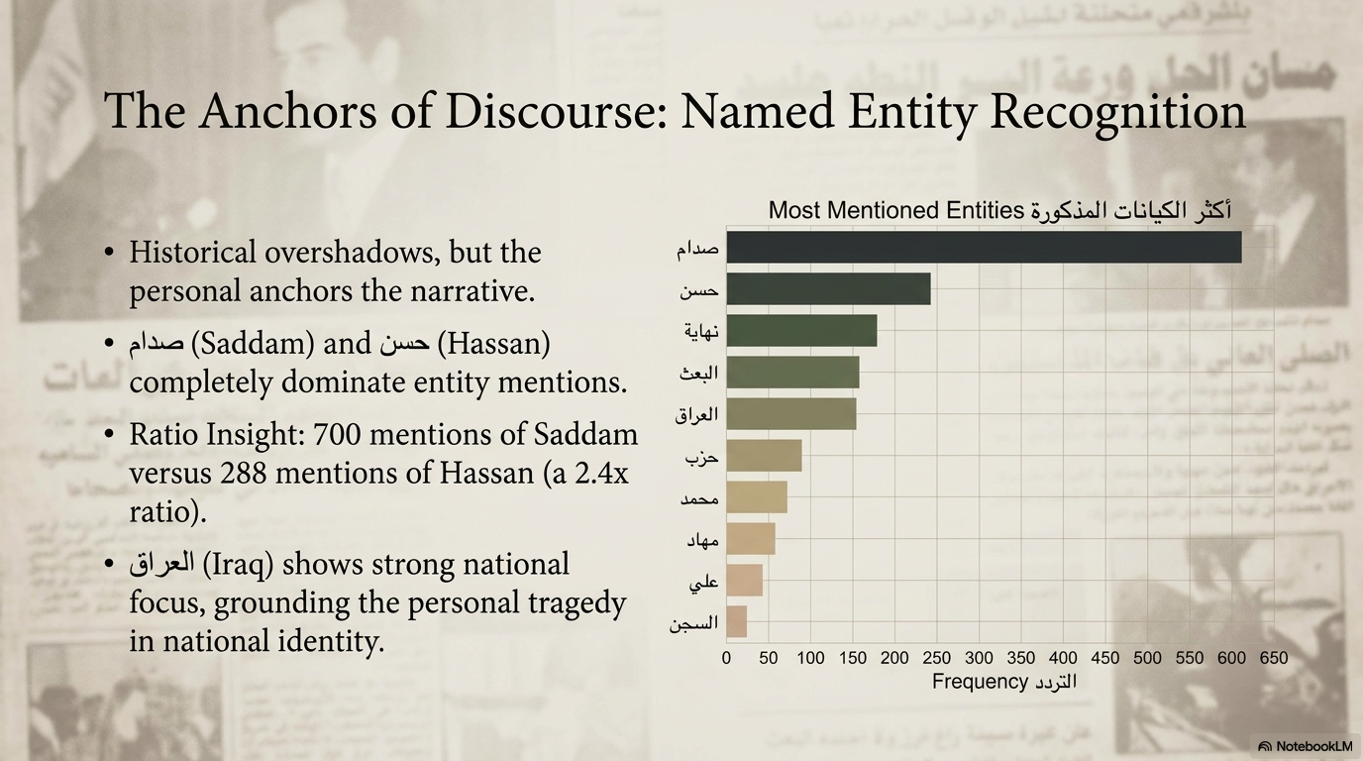

Slide 8
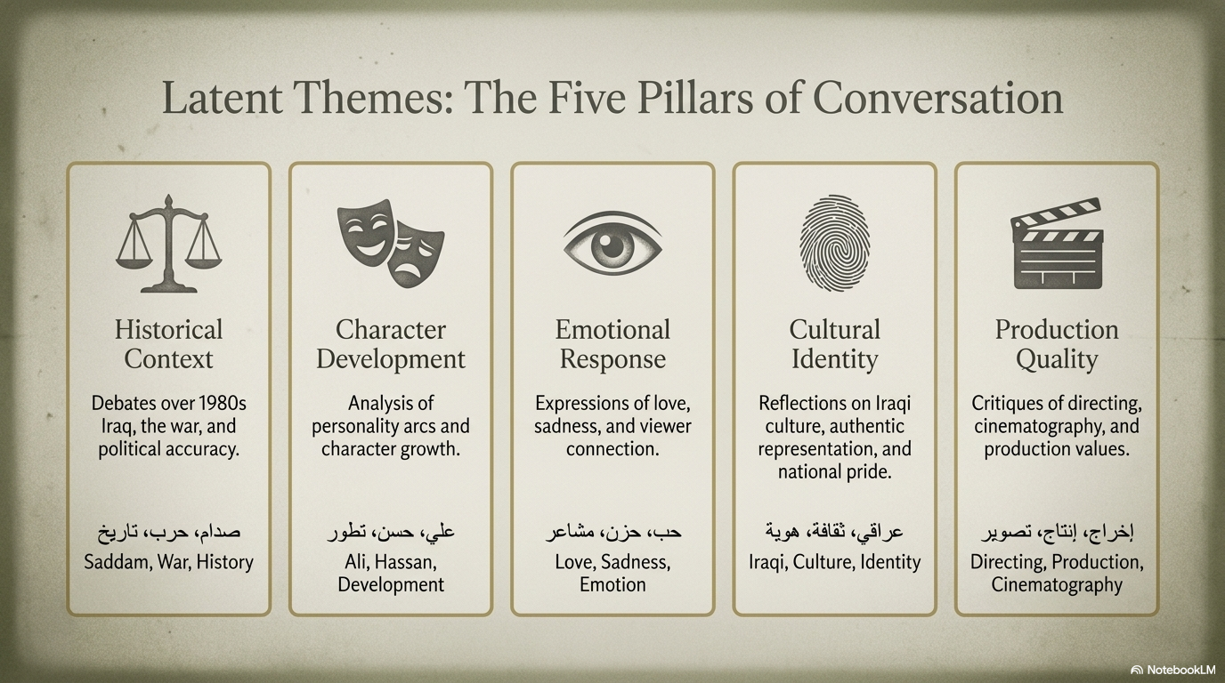

Slide 9
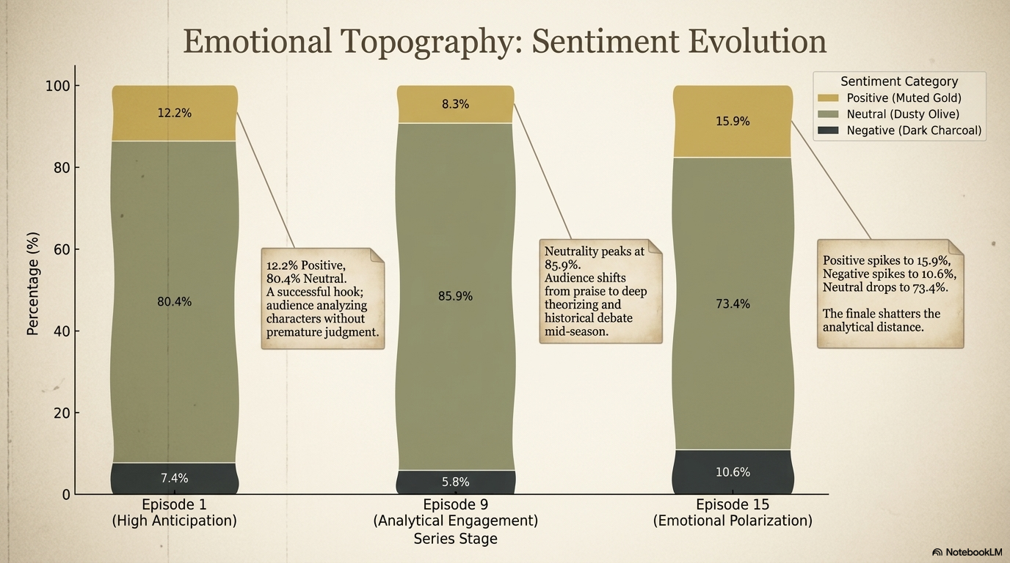

Slide 10
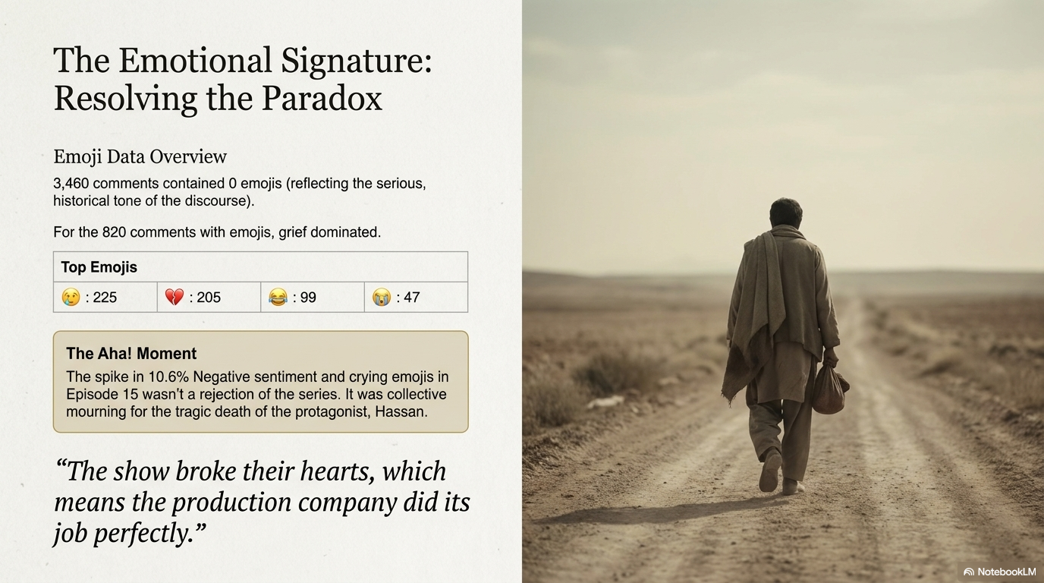

Slide 11


Slide 12
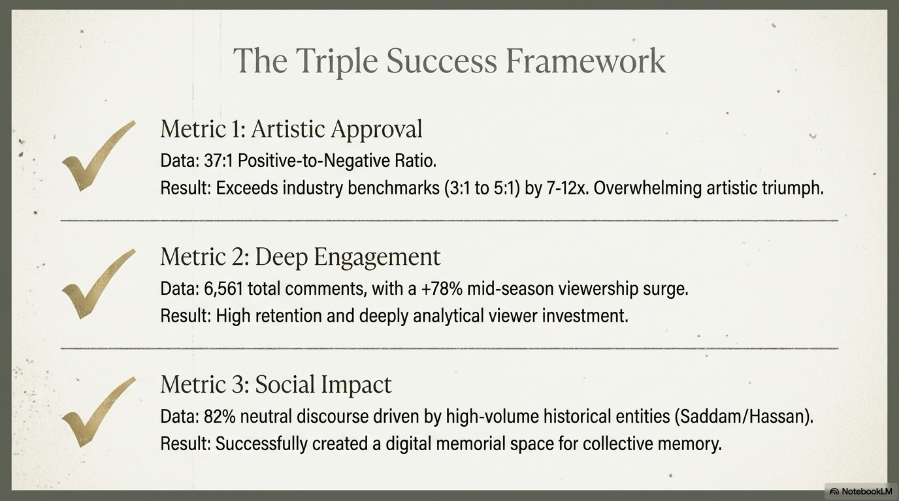

Slide 13
