Slide 1
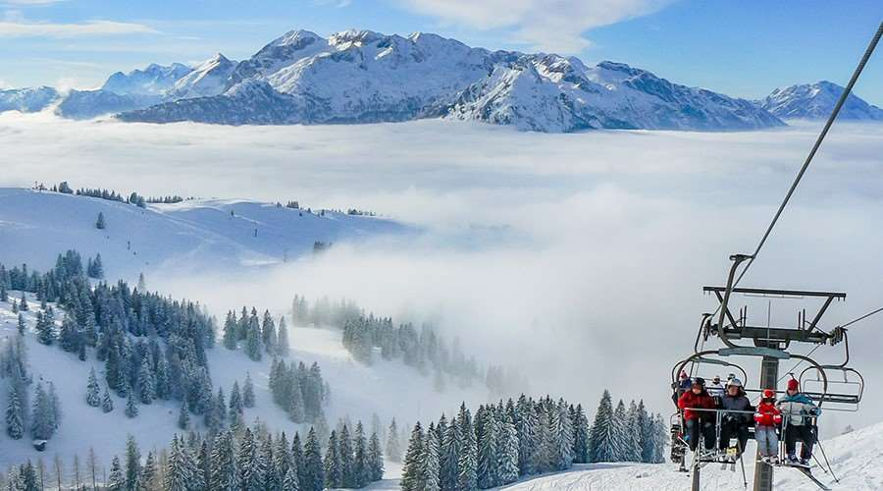
Big Mountain Resort Data Analysis Ticket Price Optimization and Operational Cost Reduction
Zahra Barani
Nov. 2023

Slide 2
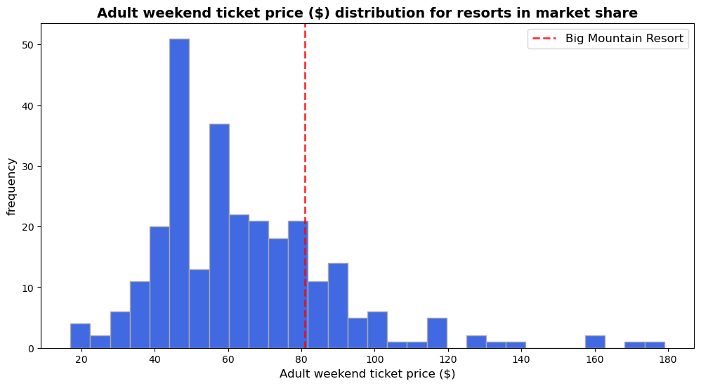
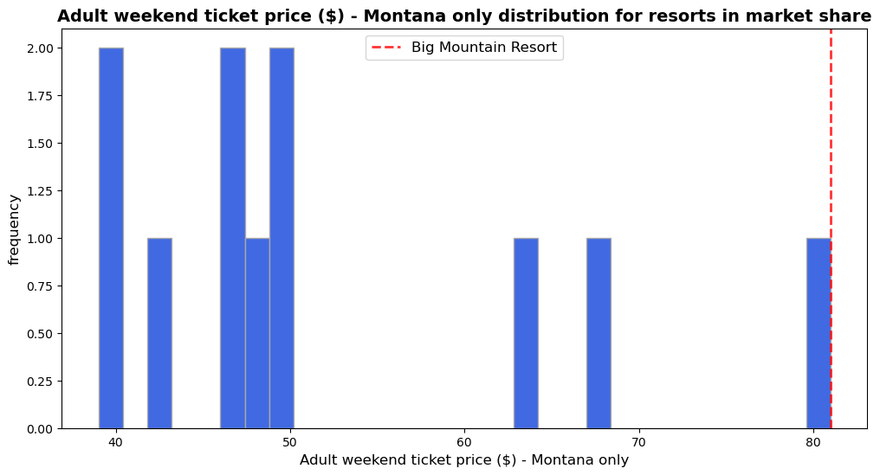
Opportunity
Big Mountain has spent $1.54 million on a new chair lift to increase the distribution of visitors.
How to increase revenue (from ticket prices) or reduce costs for the upcoming season, while remaining competitive with other resorts?
The current adult ticket price for Big Mountain is $81.00
Anticipating a total of 350,000 visitors for the season.
Visitors, on average, engage in five days of skiing.

Slide 3
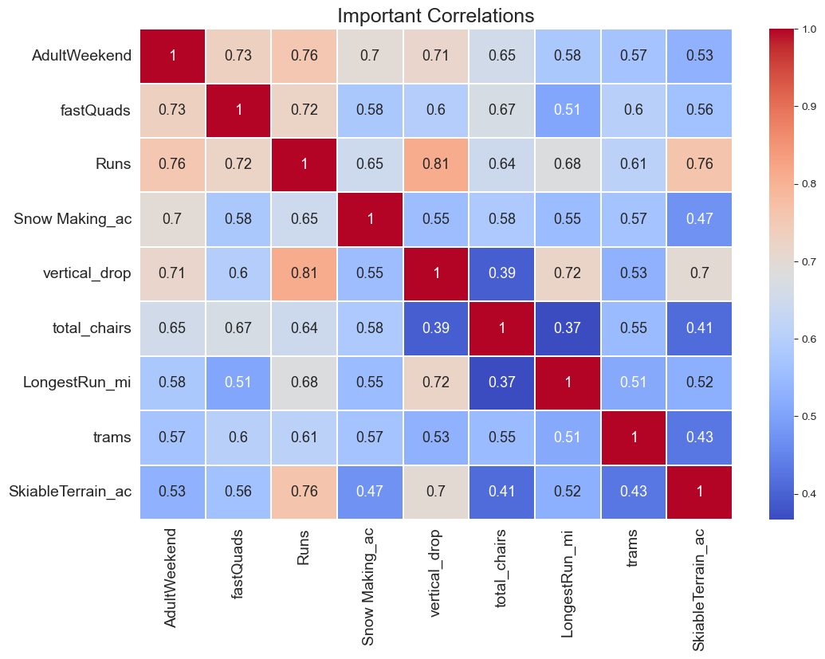
Key Findings and Recommendation
Eight features exhibit a positive correlation with the ticket price, as indicated in the right plot.
Big Mountain ranks among the top resorts in seven out of the eight critical facilities, underscoring its competitive advantage.
Ticket Price Increase: Employing Random Forest Modeling, the recommendation is to set the current ticket price at $85.48. This adjustment enables Big Mountain to remain competitive while justifying the increase based on its existing facilities.
Run Closures: Temporarily closing 3 to 5 runs is recommended, with minimal impact on revenue.
Enhance Guest Experience: Lowering a run by 150 feet to increase the vertical drop, installing an extra chairlift, and adding one more run are suggested to support a $1.99 ticket price increase, resulting in an additional $3.48 million in seasonal revenue.
Important feature having a positive correlation with ticket price (without modeling)

Slide 4
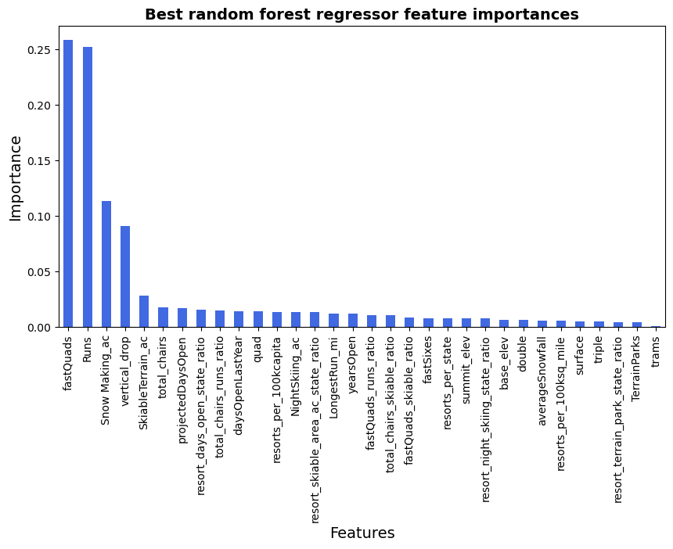
Modeling Results & Analysis
Both the Linear Regression and Random Forest models were tested.
The Linear Regression model yielded a mean absolute error of $11.79, while the Random Forest model achieved $9.53.
Random Forest model was selected due to its significantly lower cross-validation mean absolute error, nearly $2 less than the Linear model.
The top four influential features in both models are 'vertical_drop,’ ‘snow Making_ac,' 'fastQuads,' and ‘runs’ (right plot).

Slide 5
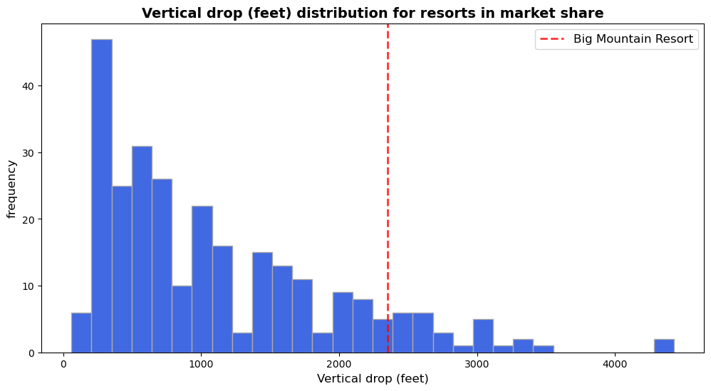
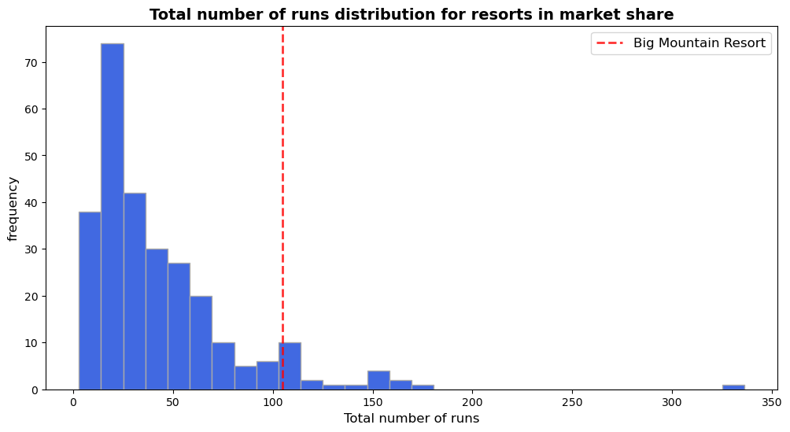
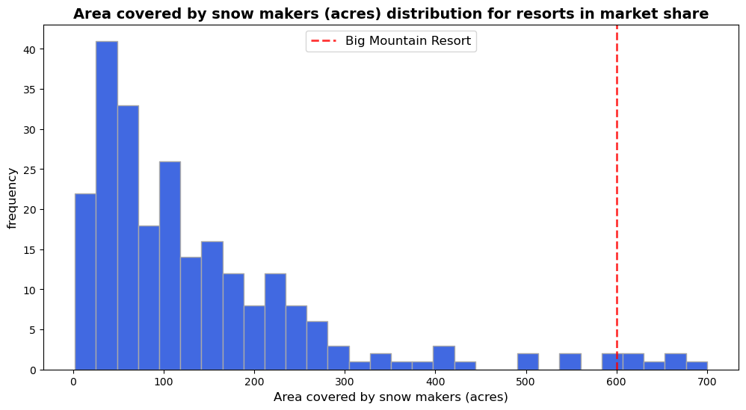
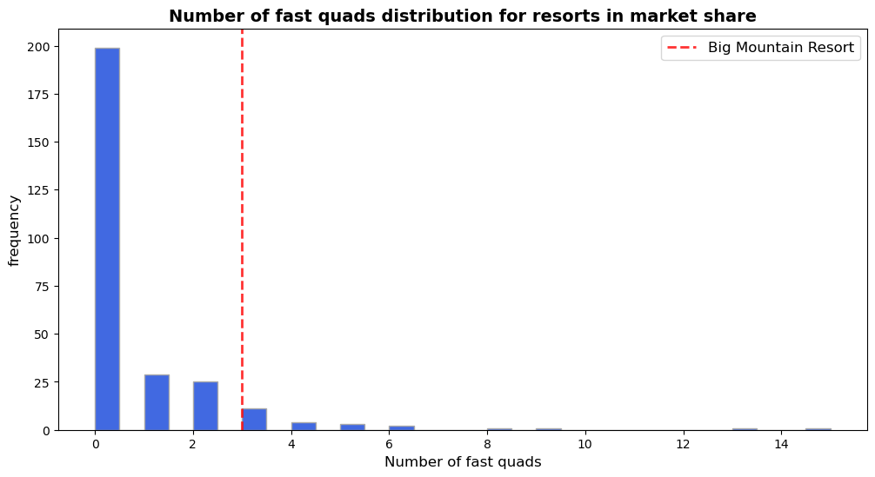
Modeling Results & Analysis: Big Mountain Resort in Market Context
New TaS₂ (Tina)
Big Mountain performs exceptionally well in terms of 'vertical drop' and 'Snow Making (ac).’
It stands out for the number of runs, positioning it high in the league table.
Most resorts lack fast quads, whereas Big Mountain has three.

Slide 6
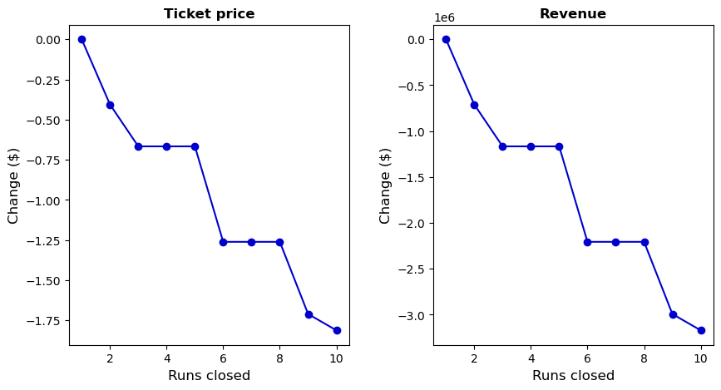
Business Intelligence Recommended Options Analysis
Four scenarios recommended by business intelligence were investigated. Two options appear promising:
Run Closures: When closing 2 or 3 runs consecutively, it reduces ticket prices and revenue. If Big Mountain closes 3 runs, closing 4 or 5 doesn't impact ticket prices. Closing 6 or more leads to a significant drop (right plot).
Vertical Drop Expansion: By increasing the vertical drop—adding a run 150 feet lower, installing an additional chairlift, and introducing another run—it can boost ticket prices by $1.99, potentially resulting in approximately $3.47 million in additional revenue over the season.

Slide 7
Conclusions and Future Work
Big Mountain possesses substantial facilities to accommodate a ticket price increase while staying competitive in the resort market. Our recommended strategies are as follows:
Increase the current ticket price by $4.48 (from $81), potentially generating an additional $7.8 million in revenue annually. This gain not only covers the $1.54 million operational expenses for the new chairlift but also contributes approximately $6.3 million to our annual revenue.
Optimize operational costs by considering the temporary closure of 3 to 5 runs. However, further data and analysis are needed to assess potential cost savings and the impact on the customer experience.
Elevate the guest experience by enhancing the vertical drop, adding a new run positioned 150 feet lower, and installing an extra chairlift for skiers' convenience. This is projected to support a ticket price increase of $1.99, potentially resulting in around $3.48 million in additional seasonal revenue.
Future Work
Analyze detailed operating costs of all facilities to provide insights for informed decisions on facility closures and cost-effective investments.
Examine the factors contributing to Big Mountain's ticket prices being lower than model suggestions.

