Slide 1
Database Management System
Course Instructor: Dr. Rabeeya Saleem
Spring 2026
Week-02

Slide 2
Levels of Database Abstraction
EXTERNAL / VIEW
What an individual user sees
Customer sees balance, not pin_hash
Implementation
CONCEPTUAL / LOGICAL
What data exists and how it is related
Customer → Account → Card → Transaction
Abstraction
INTERNAL / PHYSICAL
How data is stored and accessed
Pages • files • indexes • devices
Abstraction Supports to Simplicity and Security of Data

Slide 3
External or View Level
The highest level: customized for a particular user or role
ATM Customer View
AVAILABLE BALANCE
Visible:
• Available balance
• Withdrawal amount
• Recent transactions
Hidden:
• pin_hash
• Internal storage details
• Other customers’ accounts
PKR 65,000
Different users can have different views of the same underlying database.

Slide 4
Conceptual or Logical Level
Describes the complete logical structure of the database.
CUSTOMER
ACCOUNT
CARD
ATM_TRANSACTION
ATM_MACHINE
customer_id • name
account_no • balance
card_no • expiry
transaction_id • amount
atm_id • location
CUSTOMER ──owns──► ACCOUNT
ACCOUNT ──uses──► CARD
CARD ──creates──► ATM_TRANSACTION
ATM_TRANSACTION ──occurs at──► ATM_MACHINE

Slide 5
Internal or Physical Level
(The lowest level of abstraction)
ATM example: The DBMS may use an index on card_no to locate the customer’s account quickly.
Disk / SSD
Data File
Pages / Blocks
Index
Record

Slide 6
Data Independence
Data independence in a Database Management System (DBMS) is the ability to modify the database structure at one level without altering the application programs or data schemas at the higher levels.
Eliminate the need to make updates when changes occur in data storage or logical definition
Logical Data Independence: Change in conceptual level without changes in user level/external level
  Rename / restructure attributes
  Add New Entity
  Add Relationship

Slide 7
Data Independence
Physical Data Independence: Changes in physical storage or devices (internal level) without changing the logical schema
Add an Index
Change database location
Change File organization

Slide 8
Data Independence
Change Student name to std_first and std_last name (Logical Independence)
May effect External View as Application depends on Logical Data
Move database file from one drive to another
  Physical Independence
  Performance can change without changing database meaning
Logical: Change what the database represents
Physical: Change how the database stores/accesses it

Slide 9
A
Add an index on StudentID
Physical
B
Create a faculty-only view
External
C
Add a new Department table
Conceptual
D
Move data files to a faster SSD
Physical
E
Hide salary from interns
External
F
Split Address into street, City and Country
Logical
G
Create a View to hide employee salary
External

Slide 10
Data Model
A data model is a collection of concepts used to describe:
Data structure
Relationships between data
Data constraints
Permitted operations
It provides a blueprint for organizing and representing real-world information inside a database.

Slide 11
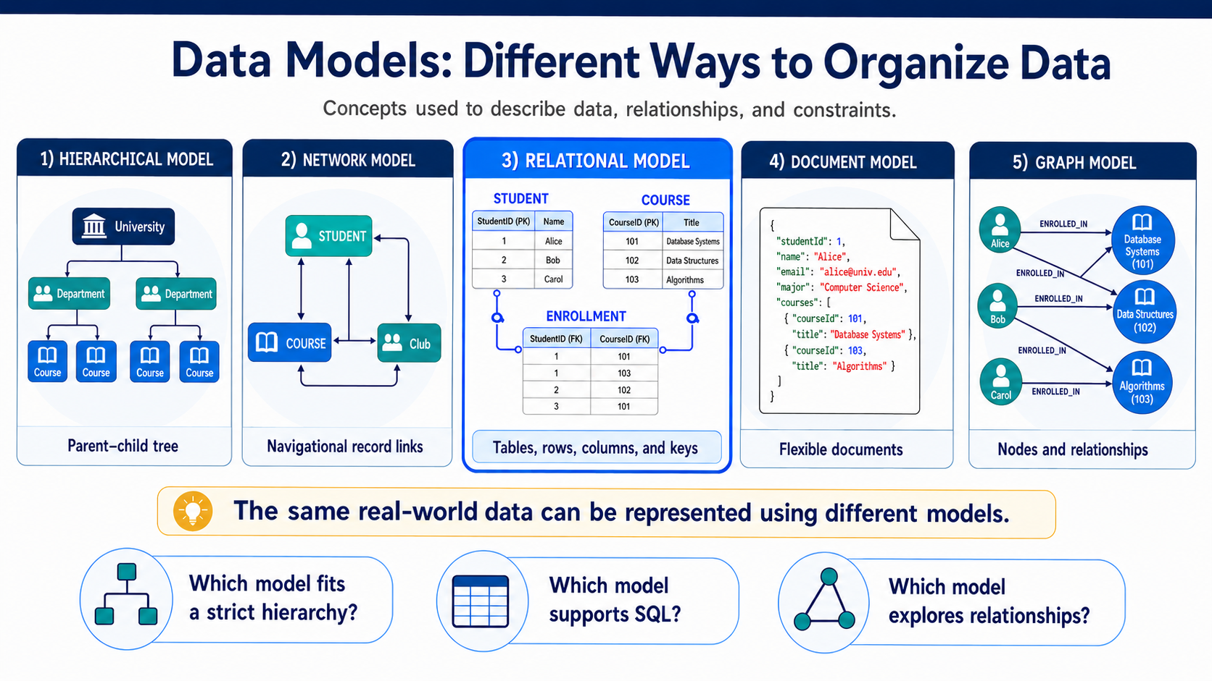

Slide 12
Hierarchical Model
Follow Parent-child relation
UNIVERSITY
Organizes records in a tree structure.
One root record appears at the top.
Each child normally has one parent.
Relationships follow fixed parent–child paths.
Suitable for naturally hierarchical information.
CS DEPARTMENT
SE DEPARTMENT
COURSE 1
COURSE 2
COURSE 3
COURSE 4
Limitation: Many-to-many relationships are difficult to represent.

Slide 13
Network Model
Organizes records through navigational links.
A record may have multiple parent records.
Supports more complex relationships than a hierarchy.
Applications navigate predefined paths between records.
Example: A student can join multiple courses and clubs.
Limitation: The structure can become difficult to understand and maintain.

Slide 14
Network Model
COURSE
STUDENT
CLUB
More expressive than a tree, but predefined navigation paths can become complex to understand and maintain.
PROJECT

Slide 15
Relational Model
Organizes data into tables called relations.
Rows represent individual records.
Columns represent attributes.
Primary keys identify records.
Foreign keys connect related tables.
SQL is commonly used to query the data.

Slide 16
Relational Model
StudentID
Name
StudentID
CourseID
CourseID
Title
1
Ayesha
1
101
101
Database Systems
2
Bilal
1
102
102
Data Structures
3
Hina
2
102
103
Algorithms
3
103
Rows = records • Columns = attributes • Primary keys identify rows • Foreign keys connect tables
• SQL queries the relationships.

Slide 17
Document Model
Stores information as flexible documents, commonly in JSON-like format.
Each document may have a different structure.
Related information can be embedded inside one document.
Suitable for content and web applications.
Supports rapidly changing data structures.

Slide 18
Document Model
{
"studentId": 1,
"name": "Ayesha",
"major": "Computer Science",
"courses": [
{"id":101,"title":"Database Systems"},
{"id":103,"title":"Algorithms"}
]
}
Flexible structure
Different documents may contain different fields.
Embedding
Related information can live together in one document.
Good fit
Content-heavy and rapidly changing web applications.

Slide 19
Graph Model
Represents data using nodes, relationships and properties.
Nodes represent entities.
Edges represent relationships.
Designed for highly connected information.
Efficient for relationship exploration.

Slide 20
Graph Model
DB Systems
Ayesha
Bilal
Hina
Algorithms
Best when the central question is about paths, connections, influence, recommendations, or relationship exploration.

Slide 21
Class activity
Match each system with the most suitable model:
  Organizational reporting structure
  University registration system
  Student profile with flexible fields
  Social-network connections
Hierarchical
Relational
Document
Graph
Notes:
Product catalogue where different product categories have different attributes. (Document)

Slide 22
How a DBMS Processes a Request
User / App
SQL / Schema
Query / DDL
Processor
Execution
Engine
Storage
Manager
Database

Slide 23
DBMS Component
DDL Processor
Processes database definitions, structures, and constraints.
Query Processor
Interprets queries and helps determine an execution strategy.
Execution Engine
Performs the operations required by the selected plan.
Buffer Manager
Moves database pages between storage and memory.
Storage Manager
Organizes and retrieves persistent data.
Transaction Manager
Coordinates concurrent operations and maintains correctness.

Slide 24
DDL Processor
The DDL processor handles commands that define or modify the database structure.
Responsibilities
  Processes CREATE, ALTER and DROP
  Validates table and attribute definitions
  Processes keys and constraints
  Updates the system catalogue
  Requests creation of required storage structures

Slide 25
The System Catalogue
The system catalogue is the DBMS’s database about the database.
It stores metadata such as:
  Table names
  Column names and data types
  Primary and foreign keys
  Constraints
  Indexes
  User permissions
  Storage information

Slide 26
Query Processor: Understanding the Request
The query processor translates an SQL request into an executable plan.
Main tasks
  Parsing — checks SQL syntax.
  Validation — confirms that tables and columns exist.
  Authorization — checks whether access is permitted.
  Translation — converts SQL into internal operations.
  Optimization — selects an efficient execution plan.
SQL describes what result is required; the DBMS decides how to obtain it

Slide 27
Execution Engine: Running the Plan
The execution engine performs the operations selected by the query processor.
Possible operations
  Scan a table
  Search an index
  Filter records
  Join tables
  Sort results
  Calculate aggregates
  Insert, update or delete records

Slide 28
Query Processing
Query processor: Creates the plan.
Execution engine: Performs the plan.
Who decides to use an index?
The query processor or optimizer.
Who actually performs the index search?
Execution Engine

Slide 29
Buffer Manager: Managing Main Memory
Accessing data from memory is faster than repeatedly reading it from disk.
The buffer manager:
  Loads database pages into main memory
  Keeps frequently accessed pages available
  Reuses available memory space
  Tracks modified or “dirty” pages
  Writes modified pages back to storage
What should happen when the required page is not in the buffer?
If the requested page is not in memory → the buffer manager asks storage to read it, then places it in the buffer pool.

Slide 30
Storage Manager: Organizing Persistent Data
The storage manager controls how database information is stored and retrieved.
Responsibilities
  Organizes files, records and pages
  Maintains indexes
  Allocates and releases storage space
  Performs physical read and write operations
  Coordinates storage access with the buffer manager

Slide 31
Buffer Manager vs. Storage Manager
Buffer manager | Storage manager
Manages pages in memory | Manages data on persistent storage
Decides which pages remain in RAM | Organizes files, records and indexes
Reduces disk access | Performs physical storage operations

Slide 32
Transaction Manager: Protecting Correctness
A transaction is a logical unit of work containing one or more operations.
The transaction manager:
  Coordinates simultaneous transactions
  Prevents conflicting updates
  Supports COMMIT and ROLLBACK
  Maintains transaction isolation
  Helps restore consistency after failure
  Supports ACID properties

Slide 33
One Course Registration Request Through All Components
DDL
QUERY
EXECUTE
BUFFER
STORAGE
TRANSACTION
Tables + constraints already defined
Validate request + choose plan
Check student, prerequisites & seat
Load Student/Course/Enrollment pages
Read records + write enrollment
Commit one correct registration
Concurrency challenge: Two students request the final seat at the same time. Which component guarantees that only one registration commits?
Notes:
Answers to the Questions
Who defines the schema?
The DDL Processor processes schema definitions such as tables, columns, keys and constraints.
Where are database pages held temporarily?
The Buffer Manager holds them in the buffer pool in main memory (RAM).
Who controls concurrency?
The Transaction Manager coordinates simultaneous operations and prevents conflicting updates.
Two students request the final seat—who succeeds?
Only one transaction is permitted to commit, typically the one that obtains the required lock first. The other registration is rejected or rolled back, preventing overbooking.

Slide 34
Class Activity
Borrowing the Last Library Book
Which component involve in Database Design?

Slide 35
DDL Processor
Book, Student and Borrowing tables/constraints already exist.
Query Processor
Validates borrowing request and selects an execution plan.
Execution Engine
Checks eligibility and whether the book is available.
Buffer Manager
Loads required Book and Student pages into memory.
Storage Manager
Reads the book record and stores the borrowing record.
Transaction Manager
Ensures only one borrowing transaction commits.

Slide 36
Questions?
Student questions
Which component checks whether the book is available?
Where are the required records temporarily held?
Who prevents both students from borrowing the same copy?
What should happen to the unsuccessful request?
Execution Engine
Buffer pool in RAM
Transaction Manager
Reject / roll back and inform the student

Slide 37
From Real-World Data to Database Design
Real-world system
E/R design
Relational schema
Database tables

Slide 38
Understanding Relation Model
Student ID | Name | Program | Semester
S101 | Ayesha | BSCS | 2
S102 | Hamza | BSAI | 4
S103 | Sara | BSCS | 2
What does each row represent?
What does each column describe?
Which column could uniquely identify a student?

Slide 39
Understanding Relation Model
A relation is a named collection of related records represented mathematically as a set of tuples.
The above table shows data relevant to student details → Relation name : STUDENT
Relation: Complete table
Attribute: Named column
Tuple: Complete row
Value: One individual data item
Domain: Set of permitted values

Slide 40
Understanding Relation Model
Suggest three attributes for an ATM_MACHINE relation.
Domains Control Permitted Values: A domain is the set of valid values that an attribute may contain.
Attribute | Example domain
student_id | Valid university registration numbers
name | Character strings
semester | Integers from 1 to 8
program | BSCS, BSAI, BSSE
grade | A, B+, B, C+, C, D, F
A domain provides meaning and restricts invalid values

Slide 41
Degree and Cardinality of a Relation
Two useful measurements describe a relation.
  Degree: The number of attributes or columns.
  Cardinality: The number of tuples or rows in the current relation instance.
STUDENT(student_id, name, program, semester)
Degree ? Cardinality ?
Degree = 4
If 300 student records exist, cardinality = 300
Key point: Here cardinality refers to Relation/Table cardinality

Slide 42
Properties of a Relation
In the theoretical relational model:
  Every relation has a unique name.
  Every attribute has a unique name within the relation.
  Each attribute draws values from a domain.
  Each cell contains one atomic value.
  Duplicate tuples are not allowed.
  Tuple order has no logical meaning.
  Attribute order has no logical meaning.

Slide 43
Class Activity
The university stores course registrations in the following relation:
Student ID | Student Name | Program | Course ID | Course Title | Semester | Grade
S101 | Ayesha | BSCS | CS201 | Database Systems | 3 | A
S102 | Hamza | BSAI | CS201 | Database Systems | 3 | B+
S101 | Ayesha | BSCS | CS205, CS207 | Data Structures | 3 | A
S103 | Sara | BSSE | CS201 | Database Systems | 12 | Excellent
S102 | Hamza | BSAI | CS201 | Database Systems | 3 | B+

Slide 44
Class Activity
Identify the following:
Relation name
Attributes
Degree and cardinality
Possible domains
Duplicate tuple
Non-atomic value
Problems students should discover
CS205, CS207 contains multiple values in one cell.
Semester 12 is outside the valid domain.
Grade Excellent violates the grade domain.
Hamza’s registration appears twice.
Course ID and Course Title do not match in one tuple.
Student and course data are repeatedly stored.

Slide 45
Entity - Relational Model (ER Model)
To design a database → need to understand the basic components of Entity -Relational Data Model
Entity
Attributes
Relationship
Constraints

Slide 46
Entity
A distinguishable real-world object.
Examples:
  One student
  One course
  One instructor
  One department
Entity set: Collection of same entities
Represented by Rectangle

Slide 47
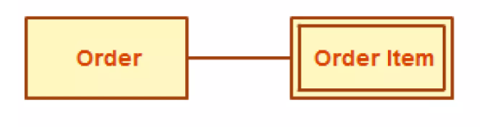
Classification of Entities
Strong Entity (Independent)
  It possesses a key attributes to uniquely identify its records.
Weak Entity (Dependent)
  Depends entirely on a strong entity. It lacks key and uses a composite identifier instead.
  Here Order (Strong Entity) and Order Item (Weak Entity) as it will be meaningless without order entity

Slide 48
Attributes
Entities represented by their properties → Attributes
All attributes have value
Student Entity → name, age, registration_number, course_id
Each attributes assigned with specific domain/range
  Student name should be alphabetic, age should be numeric and registration number should be alphanumeric / specific regix
Represented by Oval

Slide 49
Types of attributes
Simple attributes: Simple value attributes that can’t be divided into sub-attribute. Student Phone number/ Student Age
Composite Attributes: Combination of more than one attributes. Student Full Name as Student first name and last name
Derived Attributes: Not exist in database but can be derived from existing attributes. Age can be derived from DOB (represented by dashed oval)

Slide 50

Types of attributes
Single-value Attributes: Contains single value. Registration number for each student
Multi-value Attributes: Contains more than one values. Person can have more than one phone number / emails
Teacher entity may have multiple subjects to teach in a semester

Slide 51
Relationship Cardinality
Relationship cardinality defines the maximum number of entity instances that can participate in a relationship with another entity.
Cardinality | Meaning
1:1 | One entity instance relates to one instance of another entity
1:N | One entity instance relates to many instances of another entity
N:1 | Many entity instances relate to one instance of another entity
M:N | Many instances on both sides can be related

Slide 52
One-to-One Relationship (1:1)
A one-to-one relationship exists when one instance of Entity A can be associated with at most one instance of Entity B, and vice versa.
Student ↔ Student-Profile
Employee ↔ Company ID Card
Department ↔ Department Head
To implement 1-1 relationship
  The UNIQUE foreign key prevents several profiles from referencing the same student.

Slide 53
One-to-Many Relationship (1:N)
A one-to-many relationship exists when one record in Entity A may be associated with many records in Entity B, while each B record belongs to only one A record.
Customer ↔ Car
Department ↔ Employee
Customer ↔ Order
To implement 1-M relationship
  The foreign key is normally placed on the many side..

Slide 54
Many-to-Many Relationship (M:N)
A many-to-many relationship exists when many instances of Entity A can relate to many instances of Entity B.
Student ↔ (enroll) Course (Enrollment)
Books -- Author (Published Books)
Product and Order (Order Item)
To implement M-N relationship
  Create a bridge Table to build relationship

Slide 55
Participation
Cardinality: maximum number of related entities
Participation: whether participation is require or optional (total / partial)
A customer may own a car ( 1 – N)
  Car (total) Customer (total) → Customer (1:N) Car (1:1)
A car with Accident ?
  Car (Partial) Accident (Total) → Car (0:N) Accident (1, 1)
Employee and Parking Space ?

Slide 56
Participation
Employee and Parking Space ?
  Employee (Partial) Parking Space (total) Emp (1:1) Partial (1:1)
Employee and Department ?
  Employee (Total) Dept (Partial) , Employee(1, 1), Dept (0,N)
Doctor and Appointment ?
  Doctor (Partial) Appointment (Total) , Doctor (0,N), Appointment (1:1)

Slide 57
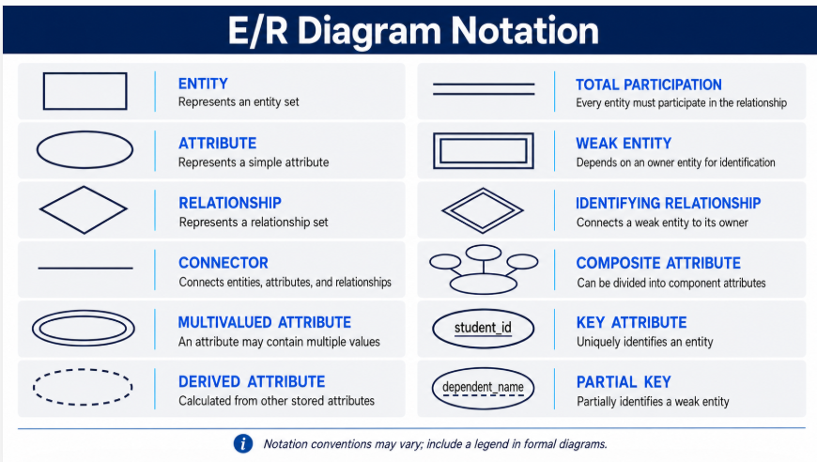

Slide 58
A university registrar’s office maintains data about the following entities:
courses, including number, title, credits, syllabus, and prerequisites;
course offerings, including course number, year, semester, section number, instructor(s), timings, and classroom;
students, including student-id, name, and program;
instructors, including identi cation number, name, department,‑ and title.
Further, the enrollment of students in courses and grades awarded to students in each course they are enrolled for must be appropriately modelled. Construct an E-R diagram for the registrar’s of ce.
Document all assumptions that you make about‑ the mapping constraints.

Slide 59
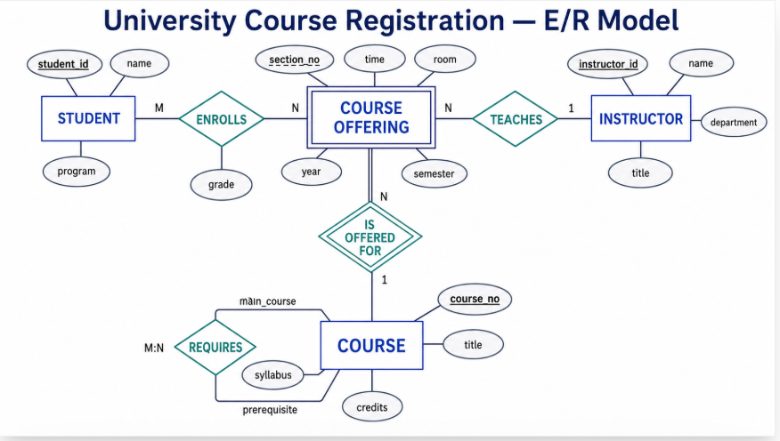

Slide 60
Activity-01
In a University database we might have entities for Students, Modules and Lecturers. –
Students might have attributes such as their ID, Name, and Course whereas Lecturers might have attributes such as LID, Name, Rank and Modules might have attributes such as ModuleNumber, ModuleName, CrHr and could have relationships (studies) with Student and Modules and (tutor) with Lecturers and Modules.
Identify entity, Attributes and relationship?
Draw the ER Diagram from the above requirement analysis?

Slide 61
Activity-02 (Country Bus)
A Country bus Company owns a number of buses.
Each bus is allocated to a particular route, although some routes may have several buses. Each route passes through a number of towns.
One or more drivers are allocated to each stage of a route, which corresponds to a journey through some or all of the towns on a route.
Some of the towns have a garage where buses are kept and each of the buses are identified by the registration number and can carry different numbers of passengers, since the vehicles vary in size and can be single or double-decked.
Each route is identified by a route number and information is available on the average number of passengers carried per day for each route.
Drivers have an employee number, name, address, and sometimes a telephone number.

Slide 62
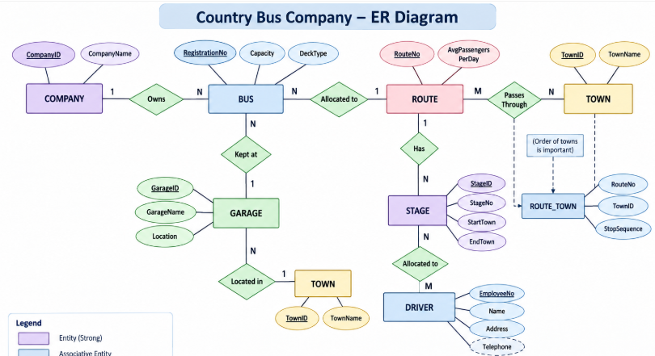
Entities: Bus, Route, Town, Driver, Stage, Garage and optionally Company.

Slide 63
Class Activity
Construct an E-R diagram for a car-insurance company whose customers own one or more cars each. Each car has associated with it zero to any number of recorded accidents.
Construct appropriate tables for the above ER Diagram ?

Slide 64
