Slide 1
Software Engineering
Weekly report “COALA”
Dorostkar Zahra
13.03.2019
Notes:
<number>

Slide 2
Project CHARTER
Project goals and vision
To create an application to organize
The implementation method is a Mobile application.
Project description
manages all the important aspects of classes, allowing to add classes, remove class, calculate your grades, and easily access information from any class, past or present.
<number>
Notes:
<number>

Slide 3
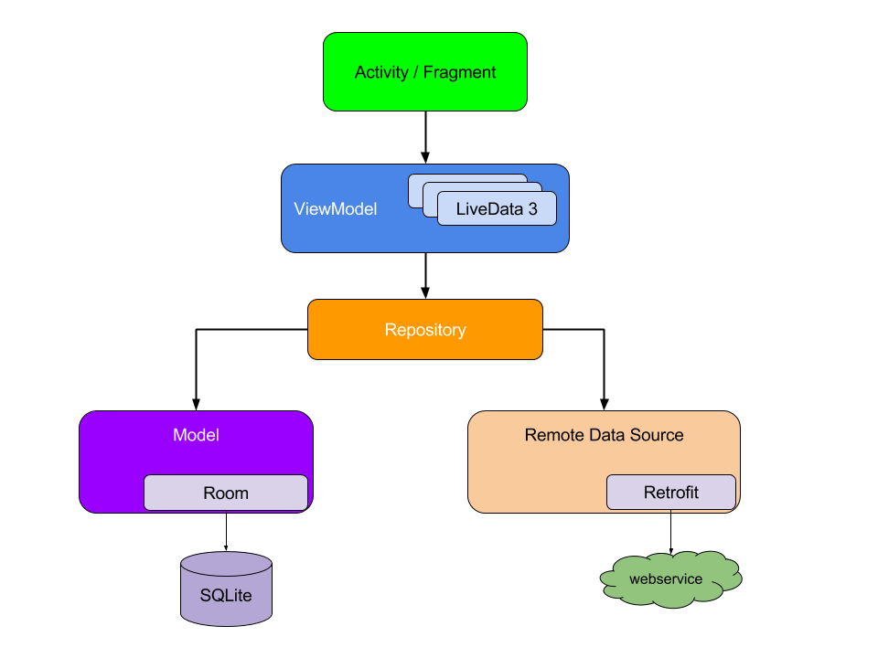
Architecture, high level design
<number>
Notes:
<number>

Slide 4
Архитектура, техническое решение / Architecture, high level design
Used technologies and development framework:
Java
CSS3 - basis for styles
Sqlite
<number>

Slide 5
Основные Достижения Отчетного Периода / Key Accomplishments For Reporting Period
Designing the Entity diagram
Designing the UML diagram
Writing the scenarios
Detailed requirements are described
Gantt chart
<number>

Slide 6
Schedule Accuracy
Past Accomplishments | Plan | Actual
Architecture planning | 29-02-2020 | 13-03-2020
Architecture designing | 13-03-2020 | 10-04-2020
Future Milestones | % | Plan | Forecast
Architecture development | 25% | 10-04-2020 | 16-04-2020
Basic UI development | 25% | 16-04-2020 | 24-04-2020
Merging, debugging, testing | 0% | 24-04-2020 | 03-05-2020
<number>
Notes:
Provide milestone tracking data in your own form used in project.
Use proposed table in case you have no special form for milestone tracking
<number>

Slide 7
Plans for future Reporting Period
Implementing of Architecture of application
Completing the design
<number>

Slide 8
Thanks for attention
<number>
Notes:
<number>

