Slide 1
Neural Network
Most material from Andrew NG’s Course at Coursera

Slide 2
Agenda
Logistic Regression
Neural Network
Multi-classification

Slide 3
Logistic Regression

Slide 4

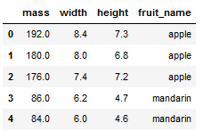
Binary Classification
1 (apple) vs 0 (non apple)

Slide 5
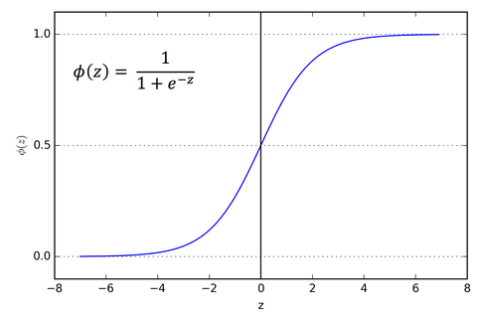







Logistic Regression Model
$$x_{1}$$
x
$$x_{2}$$
$$\hat{y}$$
w
$$z=w^{T}x+b$$
$$a=σ(z)$$
$$ℒ(a,y)$$
$$x_{3}$$
b

Slide 6
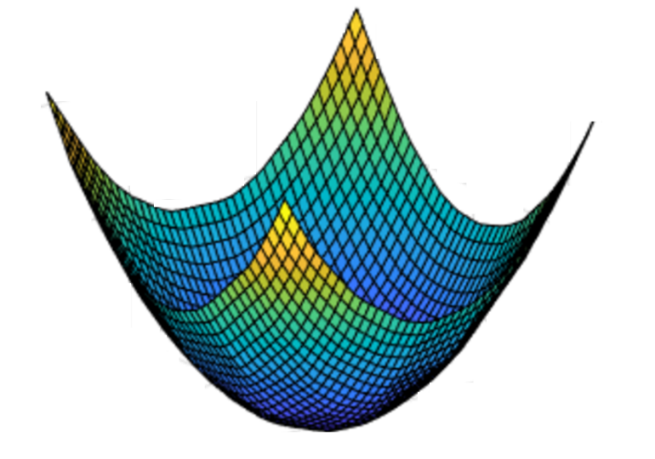
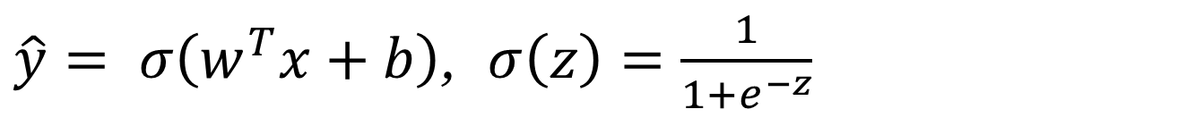

Gradient Descent
$\hat{y}= σ\left(w^{T}x+b\right)$, $σ\left(z\right)=\frac{1}{1+e^{−z}}$
$$\frac{1}{m}\sum_{i=1}^{m}{ }$$
$ℒ({\hat{y}}^{\left(i\right)},y^{(i)})$ $=$
$$−\frac{1}{m}\sum_{i=1}^{m}{ }$$
$$J\left(w,b\right)=$$
$y^{(i)}\log{{\hat{y}}^{\left(i\right)}}$+ $({1−y}^{(i)})\log{(1 −{\hat{y}}^{\left(i\right)})}$
Want to find $w,b$ that minimize $J\left(w,b\right)$
$$J\left(w,b\right)$$
$$b$$
$$w$$

Slide 7
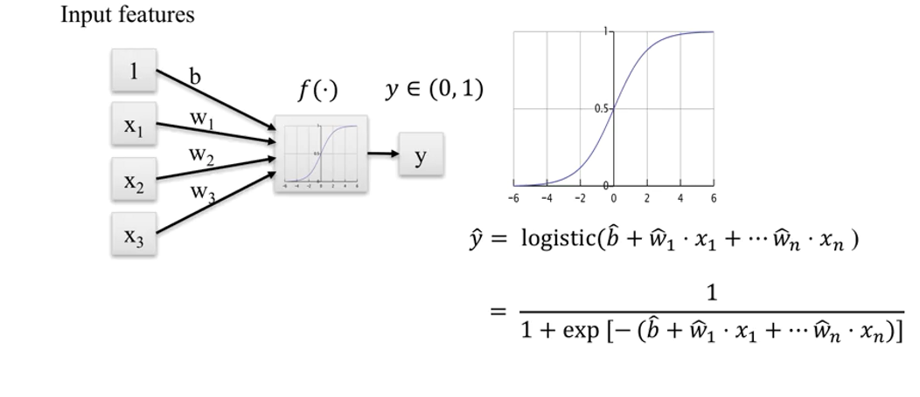
Summary

Slide 8
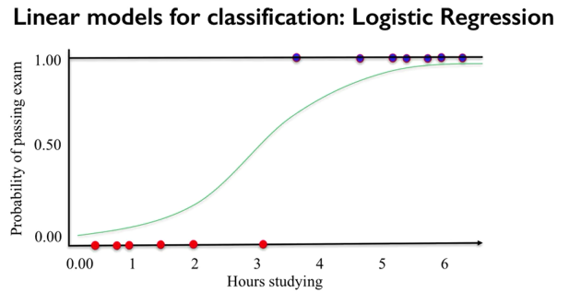
Example

Slide 9
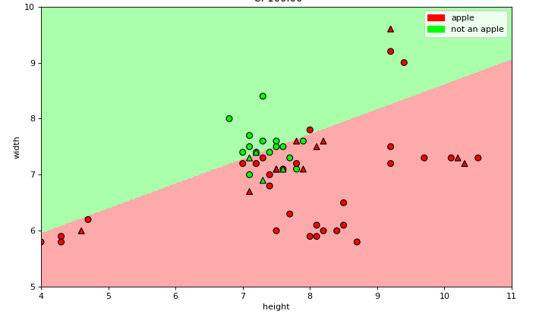
Example
Apple

Slide 10
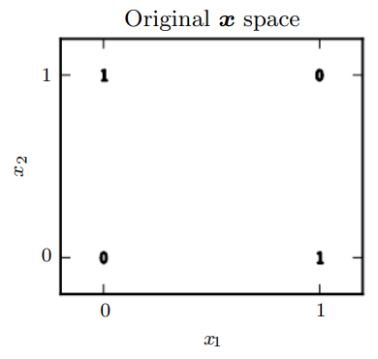
Limitation: XOR Example

Slide 11
Neural Network

Slide 12






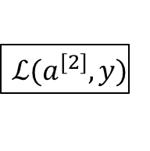






What is a Neural Network?
$$x_{1}$$
$$x_{2}$$
$$\hat{y}$$
$$x_{3}$$
x
w
$$z=w^{T}x+b$$
$$a=σ(z)$$
$$ℒ(a,y)$$
b
$$x_{1}$$
$$x_{2}$$
$$\hat{y}$$
$$x_{3}$$
x
$$W^{[1]}$$
$$z^{[1]}=W^{[1]}x+b^{[1]}$$
$$a^{[1]}=σ(z^{[1]})$$
$$z^{[2]}=W^{[2]}a_{ }^{[1]}+b^{[2]}$$
$$a^{[2]}=σ(z^{[2]})$$
$$ℒ(a^{[2]},y)$$
$$b^{[1]}$$
$$W^{[2]}$$
$$b^{[2]}$$

Slide 13




Neural Network Representation
$$x_{1}$$
$$x_{2}$$
$$\hat{y}$$
$$x_{3}$$

Slide 14
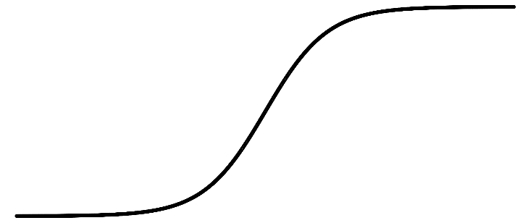
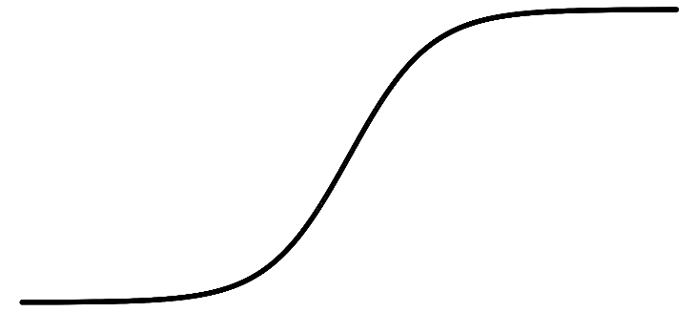

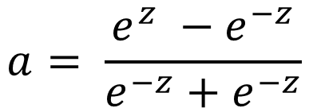

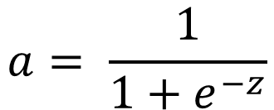
Activation functions
a
a
x
z
$$a= \frac{1}{1+e^{−z}}$$
sigmoid:
$$a= \frac{e^{z} −e^{−z}}{e^{−z}+e^{−z}}$$
tanh:
a
a
z
z
ReLU:
$$a=max⁡(0,z)$$
Leaky ReLU:
$$a=max⁡(kz,z)$$

Slide 15
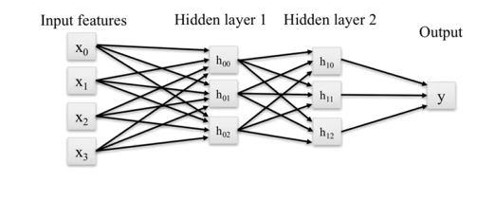
Multi-layer Perceptron

Slide 16
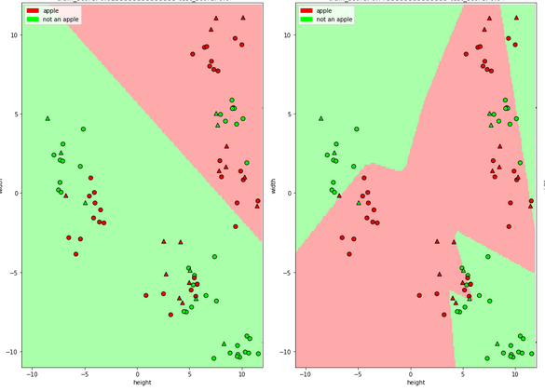
Difference between logistic and neural network
Logistic Regression
Neural network

Slide 17
Representation Learning
The representations are formed by composition of multiple non-linear transformations of the input data with the goal of yielding abstract and useful representations for tasks like classification, prediction etc.

Slide 18
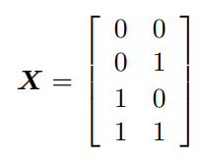








XOR Example
$$x_{1}$$
$$h1$$
$$y$$
$$Y=$$
$$x_{2}$$
$$h2$$

Slide 19
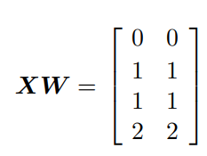
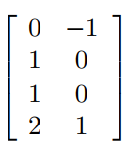
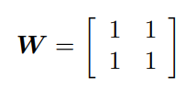

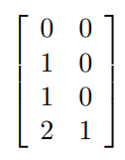


XOR Example
$$x_{1}$$
$$h1$$
$$y$$
$$x_{2}$$
$$h2$$
$$XW+c=$$
$$ReLU=\max\left(0, XW+c\right)=$$

Slide 20
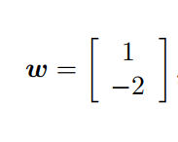
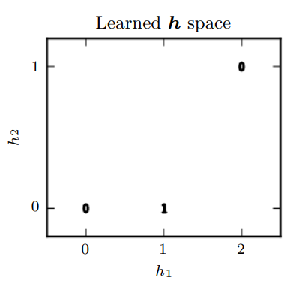

XOR Example
$$x_{1}$$
$$h1$$
b = 0
$$\max\left(0, XW+c\right)w+b=$$
$$y$$
$$x_{2}$$
$$h2$$
Hidden layer :

Slide 21
Multi-Classification

Slide 22
Binary Classification
Multi-Class Classification
Multi-label Classification

Slide 23
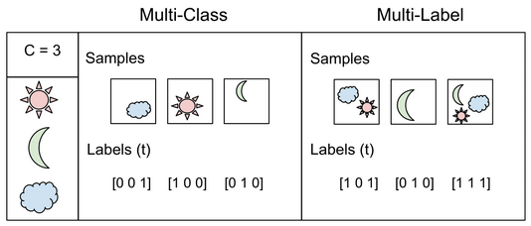

Slide 24

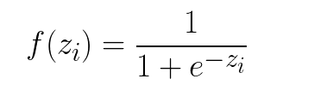
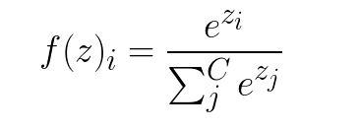
Sigmoid
Soft-max

Slide 25
One-hot Encoding
A one hot encoding is a representation of categorical variables as binary vectors.
This first requires that the categorical values be mapped to integer values.
Then, each integer value is represented as a binary vector that is all zero values except the index of the integer, which is marked with a 1.

Slide 26

Example
data: ['red', 'red', 'green‘]
Representation:

Slide 27
Why One-hot?
Many machine learning algorithms cannot work with categorical data directly.
We could use an integer encoding directly?
Ordinal relationships: labels for temperature ‘cold’, warm’, and ‘hot’.
non ordinal relationships: labels ‘dog’ and ‘cat’

