Slide 1
Hyper-Parameter Tuning

Slide 2
Datasets
Train
Test
Validation

Slide 3
Automatic-hyper parameter tuning
Evolutionary Algorithms
Reinforcement Learning
Gaussian Processing

Slide 4
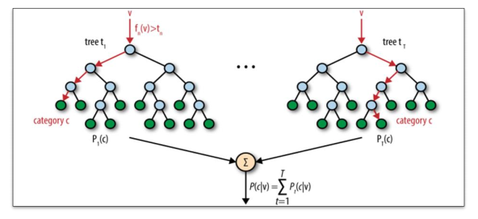
Setting Up a Baseline
Random Forest

Slide 5
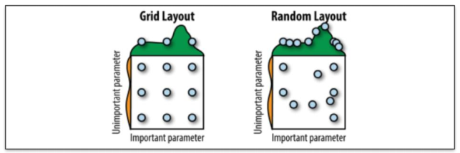
Grid Search & Random Search

