Slide 1
K-means Clustering

Slide 2
K-means Clustering
Strengths
Simple iterative method
User provides “K”
Weaknesses
Often too simple → bad results
Difficult to guess the correct “K”

Slide 3
K-means Clustering
Basic Algorithm:
Step 0: select K
Step 1: randomly select initial cluster seeds
Seed 1 650
Seed 2 200

Slide 4
K-means Clustering
An initial cluster seed represents the “mean value” of its cluster.
In the preceding figure:
Cluster seed 1 = 650
Cluster seed 2 = 200

Slide 5
K-means Clustering
Step 2: calculate distance from each object to each cluster seed.
What type of distance should we use?
Squared Euclidean distance
Step 3: Assign each object to the closest cluster

Slide 6
K-means Clustering
Seed 1
Seed 2

Slide 7
K-means Clustering
Step 4: Compute the new centroid for each cluster
Cluster Seed 1 708.9
Cluster Seed 2 214.2

Slide 8
K-means Clustering
Iterate:
Calculate distance from objects to cluster centroids.
Assign objects to closest cluster
Recalculate new centroids
Stop based on convergence criteria
No change in clusters
Max iterations

Slide 9
K-means Issues
Distance measure is squared Euclidean
Scale should be similar in all dimensions
Rescale data?
Approach tries to minimize the within-cluster sum of squares error (WCSS)
Implicit assumption that SSE is similar for each group

Slide 10
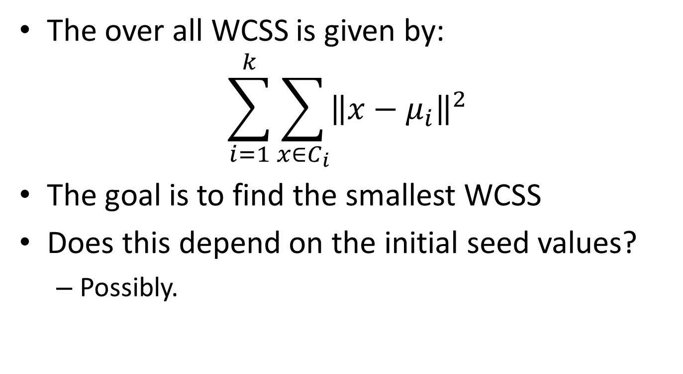
WCSS
The over all WCSS is given by:
$$\sum_{i=1}^{k}{\sum_{x∈C_{i}}{{\left\|x−μ_{i}\right\|}^{2}}}$$
The goal is to find the smallest WCSS
Does this depend on the initial seed values?
Possibly.

Slide 11
Bottom Line
K-means
Easy to use
Need to know K
May need to scale data
Good initial method
Local optima
No guarantee of optimal solution
Repeat with different starting values

