Slide 1

MongoDB
MongoDB is a cross-platform, document oriented (non-structured) database that provides, high performance, high availability, and easy scalability. MongoDB works on concept of collection and document.

Slide 2
Document Oriented
MongoDB is a document-oriented database. This means that it doesn’t use tables and rows to store its data, but instead collections of JSON-like documents. These documents support embedded fields, so related data can be stored within them.
MongoDB is also a schema-less database, so we don’t need to specify the number or type of columns before inserting our data.

Slide 3
Before we understand what MongoDB is we need to understand issues with traditional RDBMS.
Why MongoDB why not MySQL?

Slide 4

Scalability
Data stored in multiple tables (relationship) is difficult to scale.
Difficult to scale millions of data.

Slide 5

Flexibility
Fixed data structure therefore not easy to make modifications to data structure
You need to spend hours and hours on designing the database before development
In Agile projects database requires constant restructuring

Slide 6
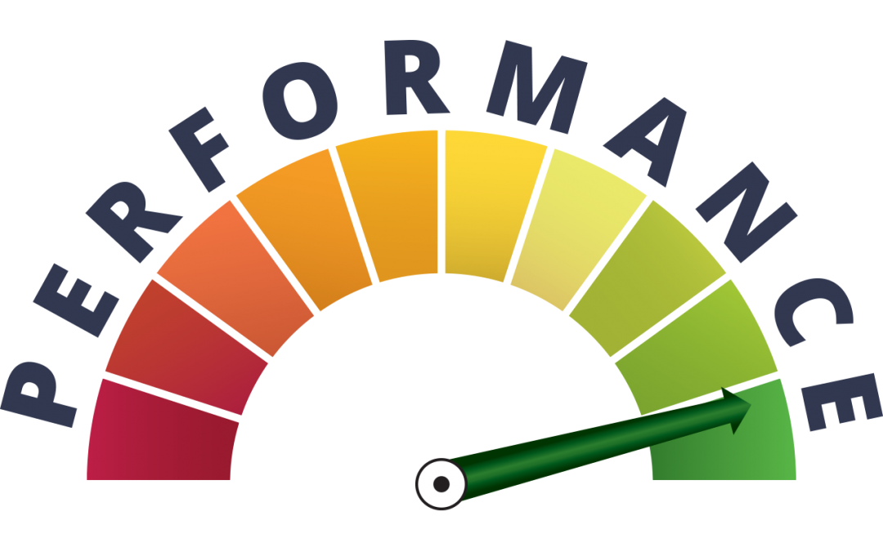
Performance
Data is generally stored across multiple tables. Joins have huge performance impact as it requires lot of CPU and resources
Need to install and configure complex caching mechanism to make it faster.

Slide 7
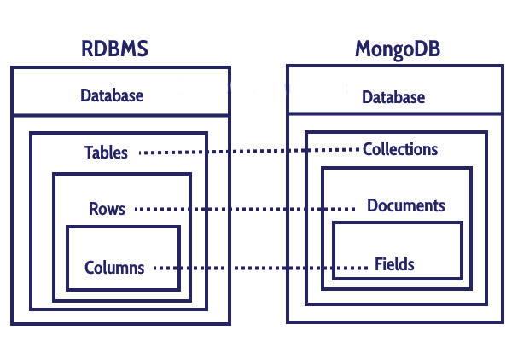

Slide 8
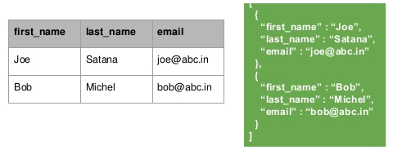
MongoDB look when compared to RDMS
Collection
// Document 1
// Document 2

Slide 9
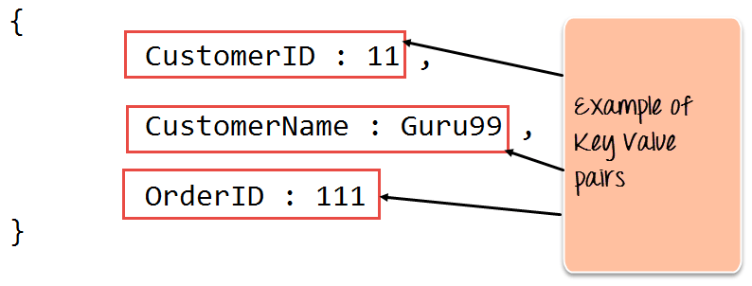

Slide 10
[
{
“first_name” : ”Joe”,
“last_name” : “Satana” ,
“date_of_birth” : “19-12-1998” ,
“email” : “ joe@abc.in”
} ,
{
“first_name” : ”Bob”,
“last_name” : “Micheal” ,
“email” : “ bob@abc.in”
}
]
Collection
// Document 1
Fields
Adding a new Field in MongoDB is easier
// Document 2

Slide 11
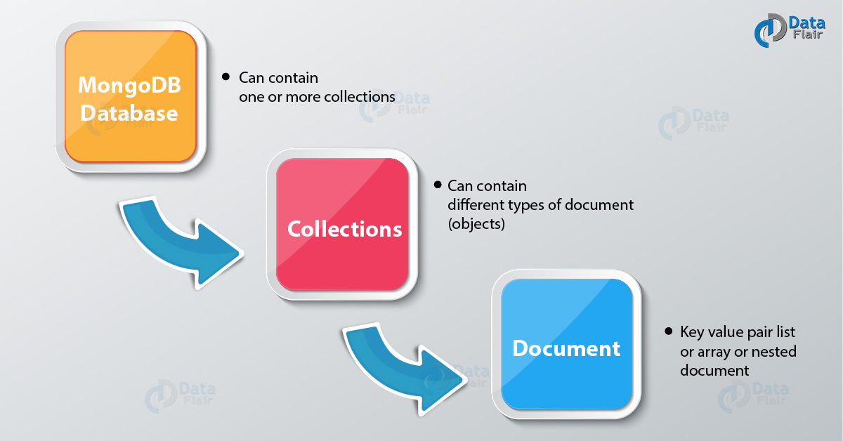

Slide 12
THANK
YOU

