Slide 1
Netflix Data Visualization and Storytelling
Name: Zahra Fathima I
Dataset: Netflix Movies & TV Shows

Slide 2


Project Objective
• Explore Netflix dataset • Clean data • Create visualizations • Tell a story with data

Slide 3
Dataset Overview
• Movies and TV Shows • Features: Title, Type, Country, Rating, Duration, Genre, Release Year

Slide 4
Data Preprocessing
• Filled missing values • Converted dates • Cleaned duration • Prepared genres and countries

Slide 5
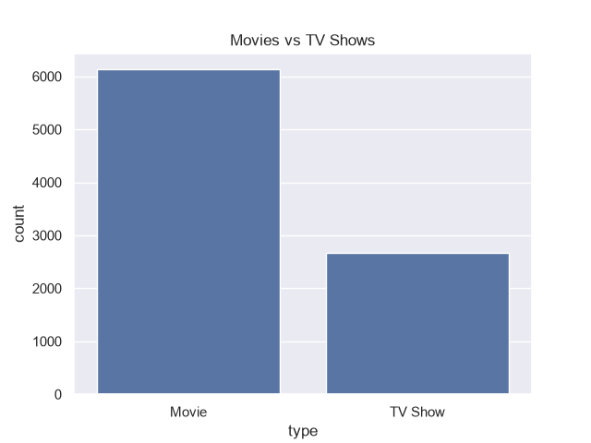
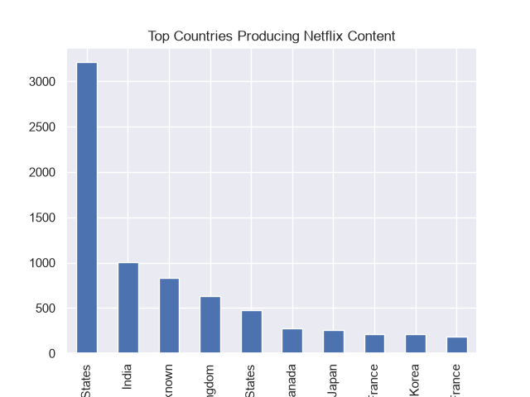
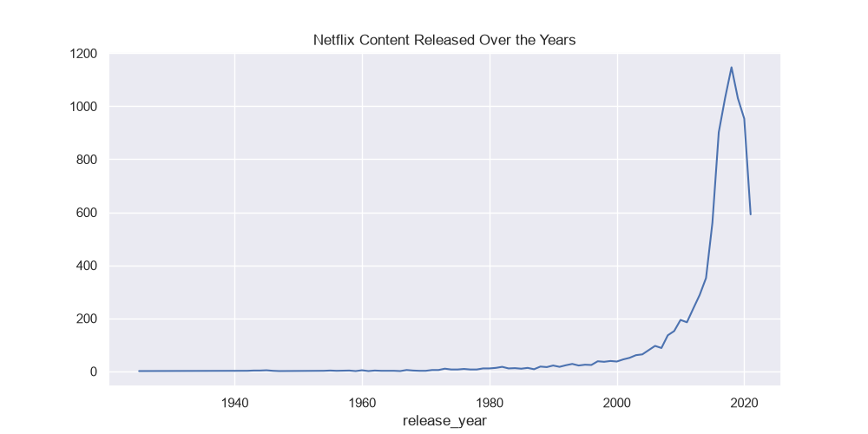
Visualizations
• Content Growth • Movies vs TV Shows • Top Countries

Slide 6
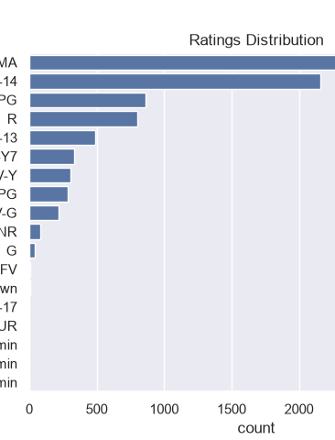
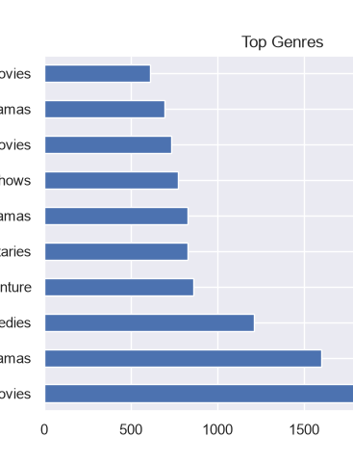
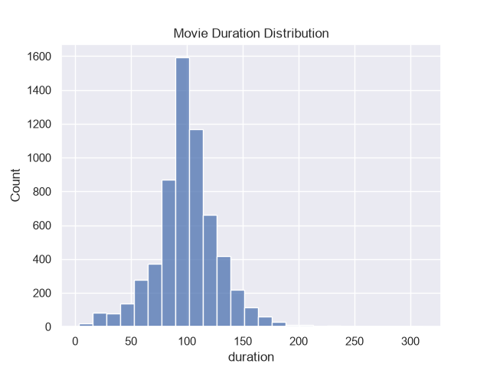

More Visualizations
• Ratings Distribution • Top Genres • Duration Distribution

Slide 7

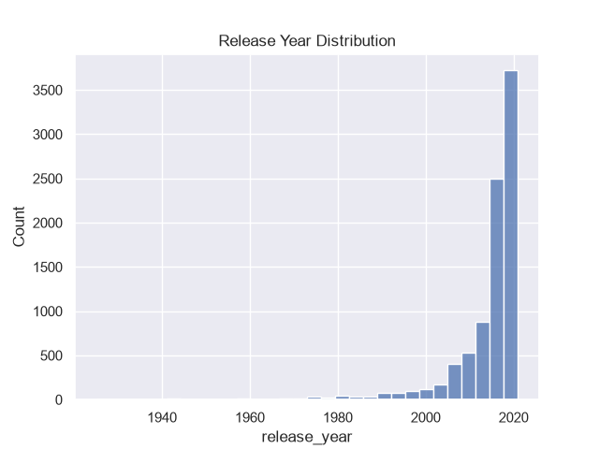
Final Visualizations
• Release Year Distribution • Description Word Cloud

Slide 8
Key Findings
• Rapid growth after 2015 • Movies dominate • USA leads content • Drama most common • Mature ratings common

Slide 9
Conclusion
Data visualization revealed meaningful insights and communicated patterns effectively.

